Slide 1

4th Grade
Text Talk
Unit 2

Slide 2
I can use words I learn from a text.
Notes:
Goal-
Students need to engage with the goal- read it, repeat it, write it, etc.

Slide 3
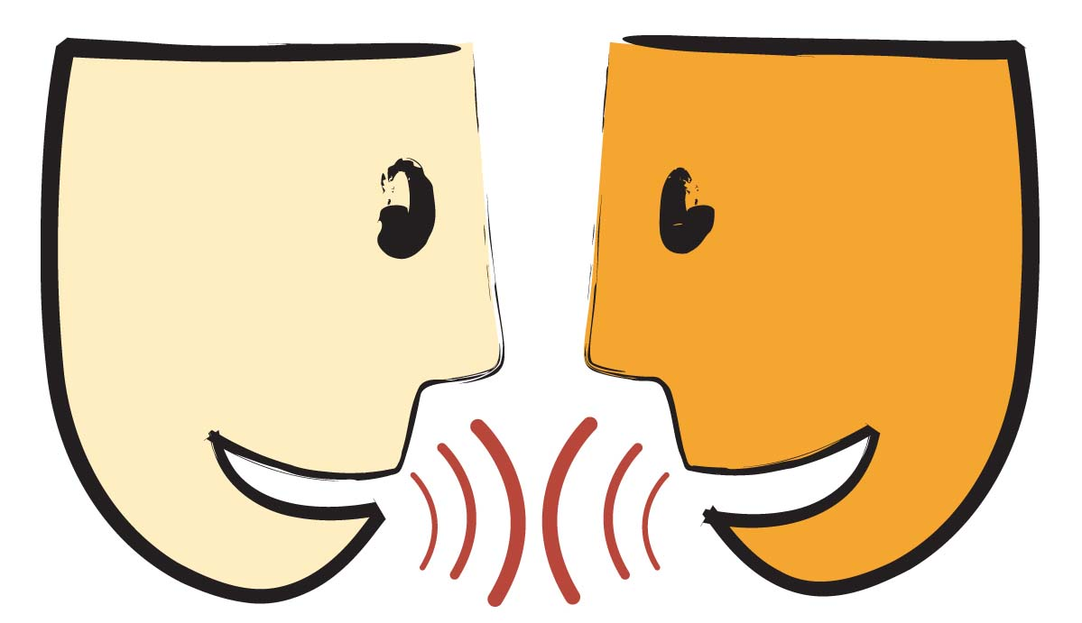
Tell your partner about a new word you learned last week.
Notes:
Access Prior Knowledge- (APK)
Turn and Talk

Slide 4
Notes:
New Information-
Read the book- provide a brief explanation of any words that may be new or unfamiliar to the students.

Slide 5
scorpion
Notes:
Contextualize the word- Find it in the text
Say the word together

Slide 6
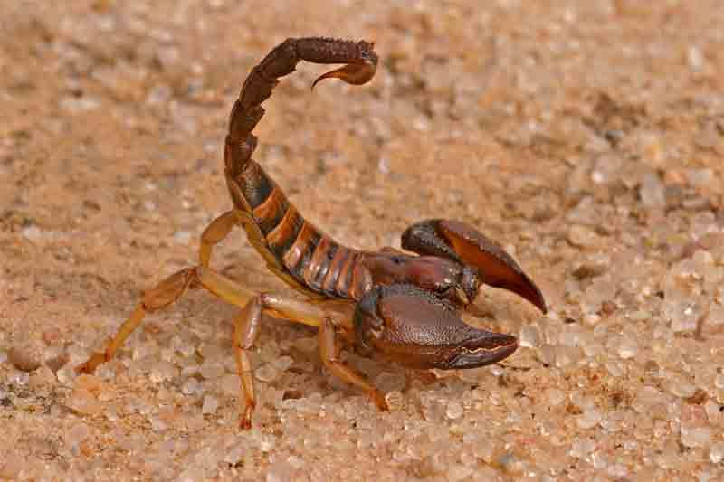
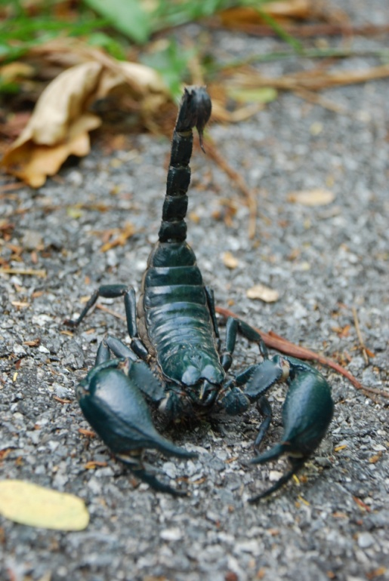
scorpion
A type of spider with poison in its long tail
Notes:
Give student friendly definition
Use the word in other contexts

Slide 7

Thumbs up, Thumbs down
Which of these has poison like a scorpion?
shark
black widow spider
dog
cobra snake
brown recluse spider
jellyfish
Notes:
Engage the students with the word

Slide 8
waded
Notes:
Contextualize the word- Find it in the text
Say the word together

Slide 9
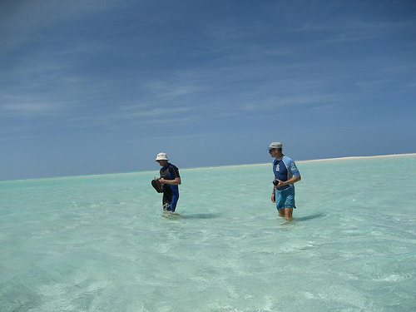
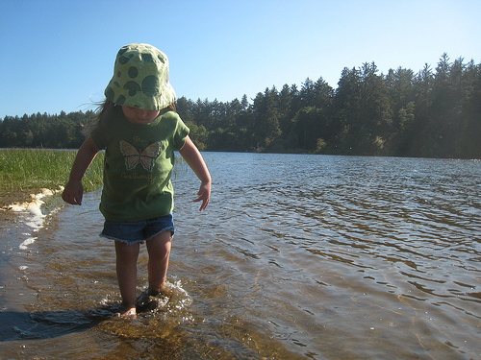
wade (waded)
to walk into the water
Notes:
Give student friendly definition
Use the word in other contexts

Slide 10
Describe a time you had to wade through water?
Notes:
Engage the students with the word

Slide 11
thrashed
Notes:
Contextualize the word- Find it in the text
Say the word together

Slide 12
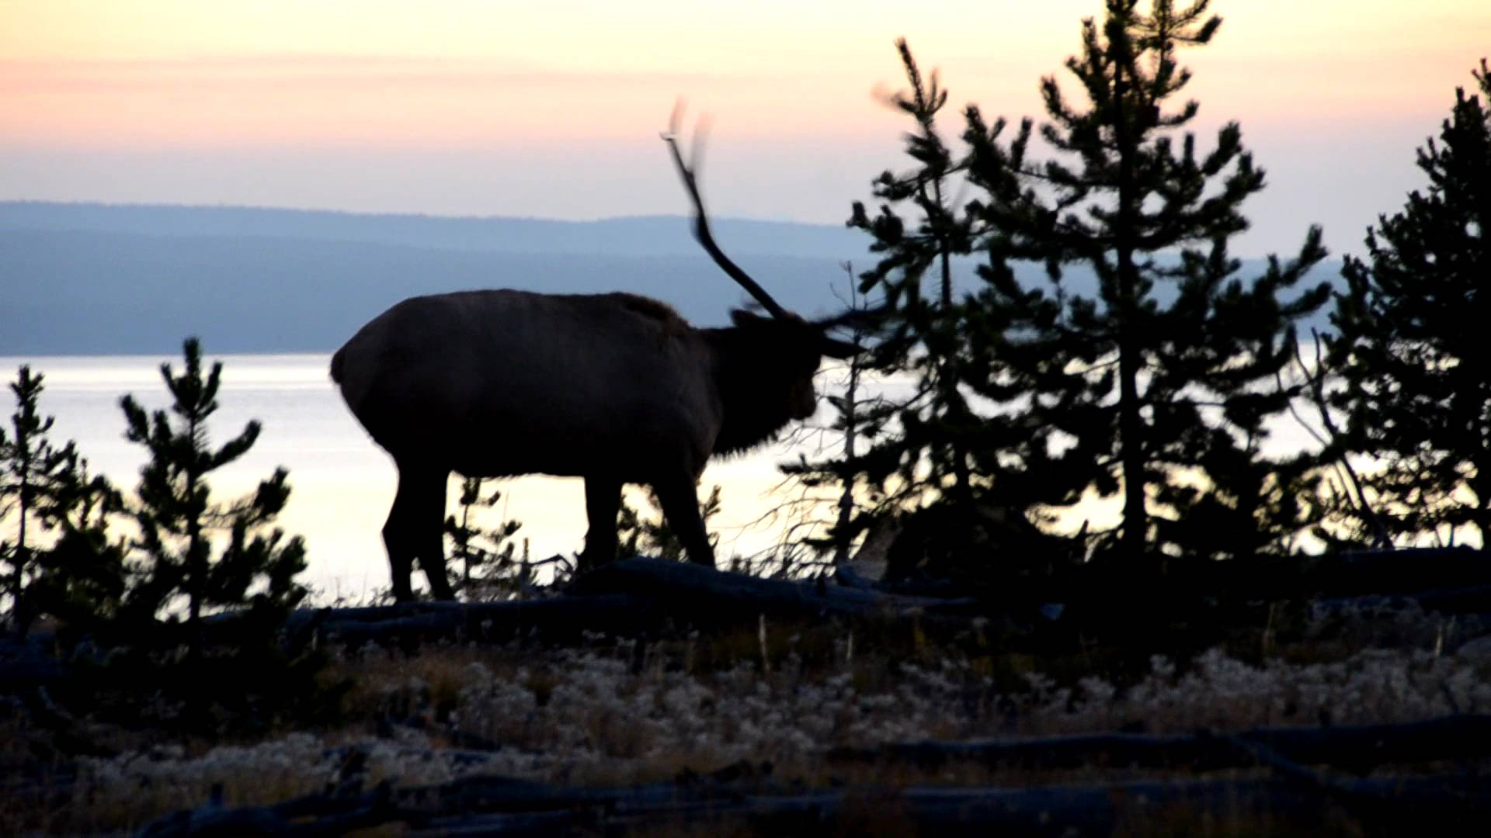
thrash(thrashed)
to move about wildly
Click on the picture to view a YouTube video of an Elk thrashing a tree.
Notes:
Contextualize the word- Find it in the text
Say the word together

Slide 13
Have you ever seen an animal or a person thrash around? Why were they thrashing around?
Notes:
Engage the students with the word

Slide 14
Who can use all 3 words in a sentence?
scorpion
waded
thrashed
Notes:
Read all three words and see if you can use them in one sentence.

Slide 15


Draw a picture for each word to show what they mean.
scorpion
waded
thrashed
Notes:
Application-
Students need an opportunity to use the words they just learned from the text.

Slide 16
I can use words I learn from a text.
Notes:
Goal-
Revisit the Goal

