Slide 1
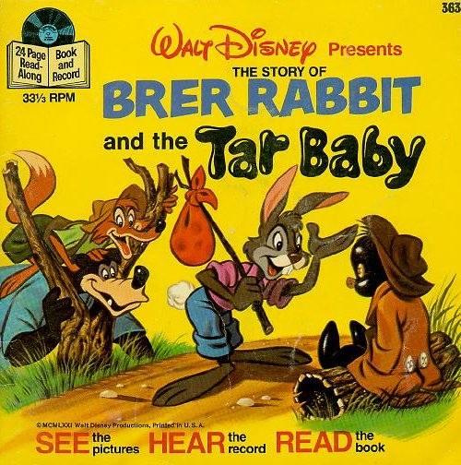
Brer Rabbit
4th grade Unit 1

Slide 2
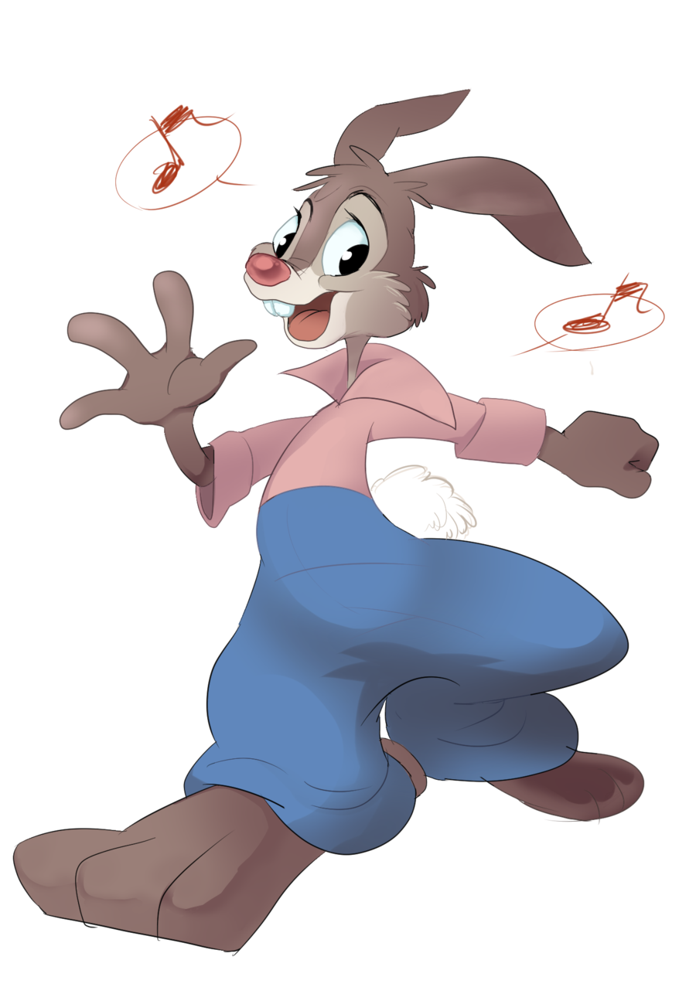
Brer Rabbit
Do you think Brer Rabbit is a trickster?
Explain your answer to your partner.

Slide 3
Describe a Character
As you listen to the story-
Take notes to help you describe
Brer Rabbit
http://wn.com/brer_bear
Notes:
Tell the students that his is a video recording of the 33 1/2 record. When records got a scratch it affected the recording, often causing it to skip and repeat. They will hear a skip/repeat in this recording.

