Slide 1
Fifth grade

Slide 2
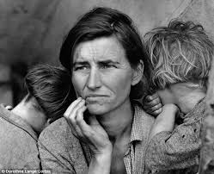
Dorothea lang’s migrant mother

Slide 3
What do you notice about the mother?
List 3-4 words that describe the mother in this picture.

Slide 4
What do you notice about the children?
List 3-4 words that describe the children in this picture.

Slide 5
What is the story behind this picture?
Where did they come from?
Where are they going?
Are they alone, or with someone else?
What happened yesterday?
What is happening now?
What might happen tomorrow?

