Slide 1
Coming of Age
5th Grade Unit 6
Notes:
Students need to have notebook paper ready for a future slide. This presentation is to prep kids for the upcoming unit (provide excitement and understanding)

Slide 2

How do dramatic events influence the people we will become?
Score yourself on what it means to have a dramatic event that influences your life. What do you know about this?

Slide 3
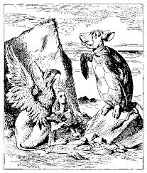
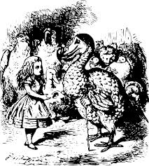
We just finished Alice in Wonderland. What kind of challenge did Allice have?
Notes:
Guide students to how her character trait changed from the beginning of the story to the end of the story with the animals, Her challenge was keeping her mouth shut in offending the animals, and she learned how to do that by the end. We are going to move into a direction of real life experiences that change a person.

Slide 4
We are going to watch 3 different videos that demonstrate how certain individuals handled challenges in their lives.
On your notebook paper…..
Video | Challenge | Overcoming the Challenge
Notes:
Have students share with each other what it means to have a dramatic event happen in your life. Before students share, talk about the phrase, “dramatic events” and the possible meaning.
After each video, work with the students to fill in their chart.

Slide 5
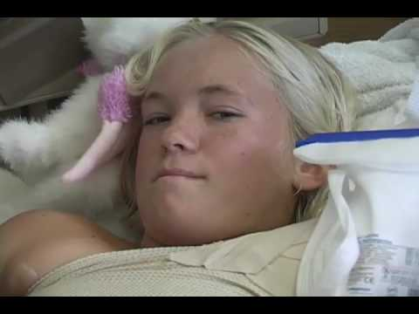
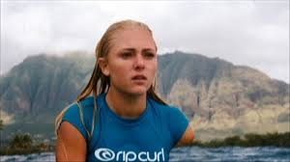
Bethany Hamilton
Soul surfer

Slide 6
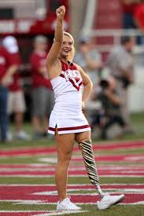
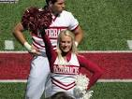
Patience Beard

Slide 7
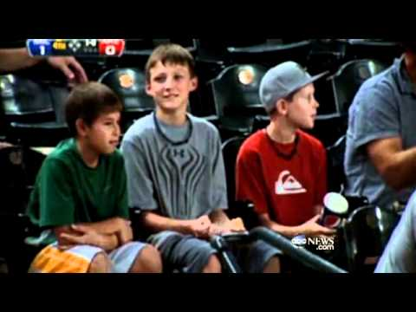
2CMNU
What choice would you make?

Slide 8
You have taken notes on the videos, so let’s talk about what you have seen….
Video | Challenge | Overcoming the Challenge
How are the challenges of the 2 girls the same?
How are their challenges different from the boy?
Notes:
Have students do some sort of pair/share to discuss the questions.
Possible discussions:
Ian had a split second to make a decision;
Bethany’s challeng came from a quick instance in the ocean;
Patience decided throughout her life to overcome her challenge by working hard and not making excuses.

Slide 9
Unit 6….Your last unit in 5th grade….
The Essential Questions for this unit:
How do dramatic events influence the people we will become?
2. How do life experiences shape our journey from childhood into adolescence?

Slide 10
How do dramatic events influence the people we will become?
Score yourself on what it means to have a dramatic event that influences your life.
How do you score yourself now that you have seen these videos?
Notes:
Depending upon time, possibly go to the next slide to introduce the different books we will be using during the unit.

Slide 11

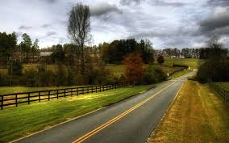
How are we going to answer the essential questions and reach our destination with our standards?

Slide 12




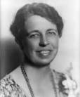

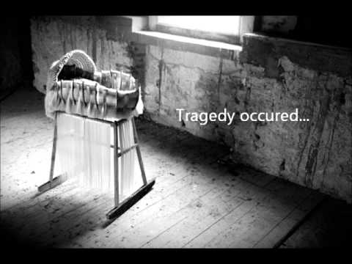
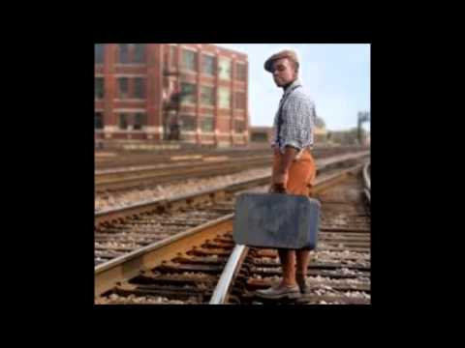
We are going to learn from both fiction and informational text about challenging times in the life of children and young adults.
Notes:
Take students to the ppt on the TCR page that has book trailers for other books that could be read by a small group or individually.

