Slide 1

Literary Conflict

Slide 2
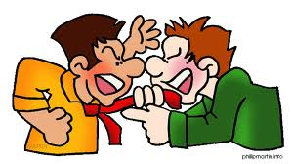
Conflict
In a story, conflict is the struggle between opposing forces.

Slide 3
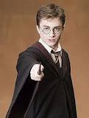
Protagonist
The main character

Slide 4
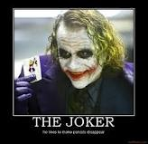
Antagonist
The character in conflict with the main character

Slide 5
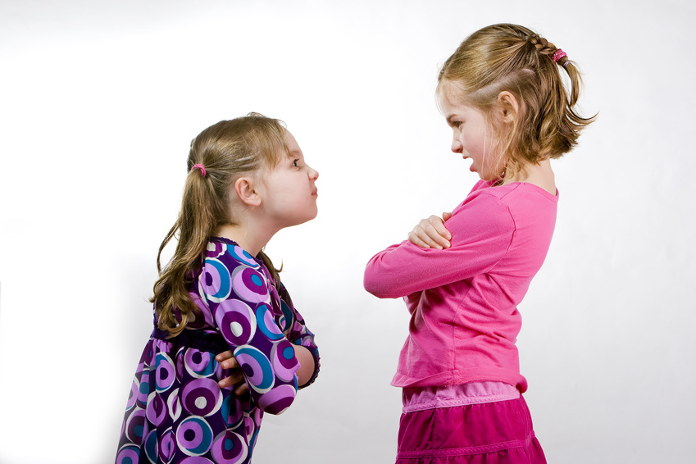
External
External Conflict takes place outside of the body

Slide 6
External
There are three types of external conflict

Slide 7
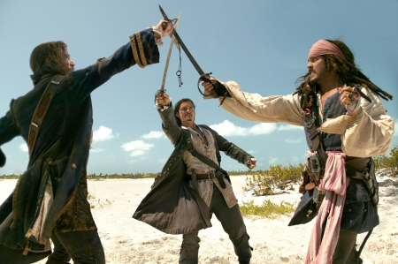
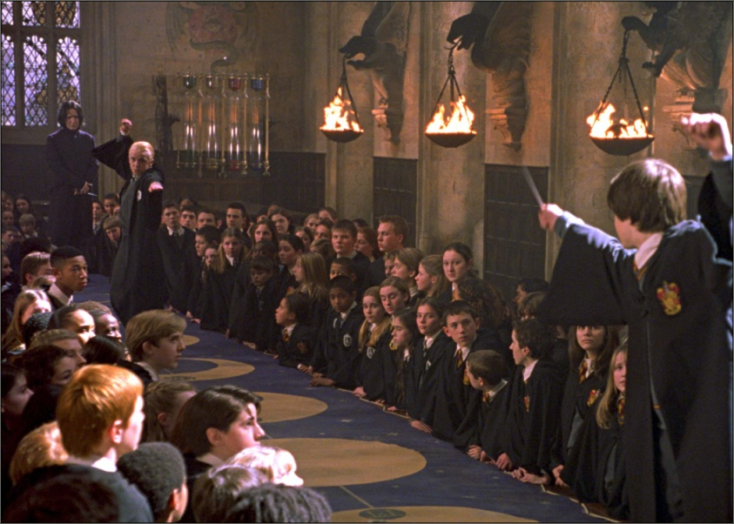
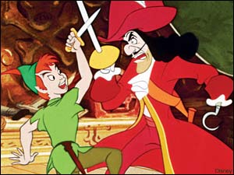
Man vs. Man
The struggle is between two or more characters in the story.

Slide 8
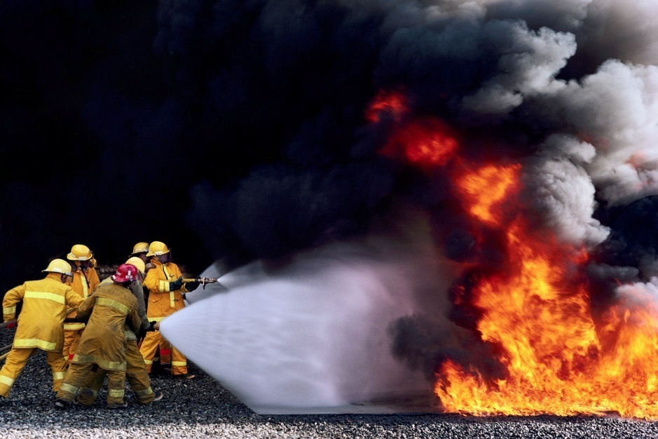
External
Man vs. Nature
This type of conflict pits a story's main character or characters against a natural force such as a flood, predatory animal, or disease epidemic.

Slide 9

External
Man Against Society
In many stories, the protagonist battles against element of government or culture.

Slide 10

Internal
Internal Conflict takes place inside of the body/mind.

Slide 11
Internal
There is one type of internal conflict.

Slide 12
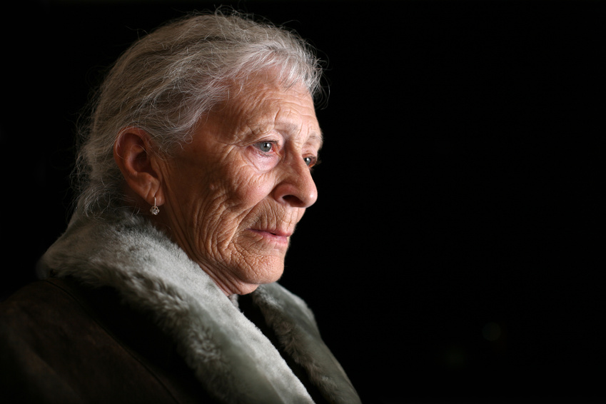

Man vs. Self
The struggle or opposition is within one character--making a tough decision, for example. A character struggling to overcome fear, addiction, emotional damage or other crippling personal issue.

Slide 13
Internal
Man vs. Self
Some literary conflicts take the form of a character struggling to overcome fear, addiction, emotional damage or other crippling personal issue.

Slide 14
Practice
Decide what type of conflict is being illustrated in the following pictures

Slide 15
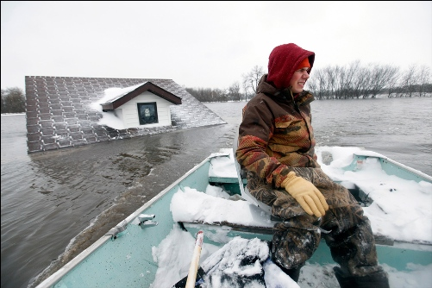
1. Man vs. ?

Slide 16

2. Man vs. ?

Slide 17
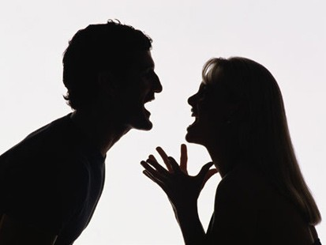
3. Man vs. ?

Slide 18
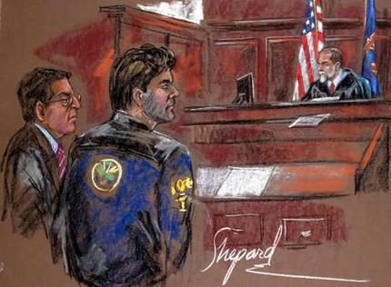
4. Man vs.

Slide 19
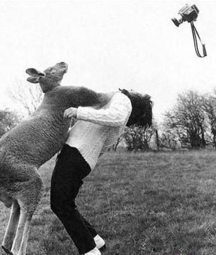
5. Man vs. ?

Slide 20
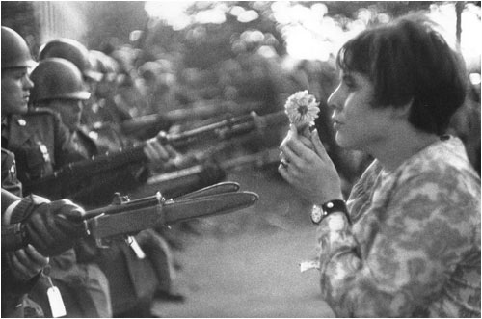
6. Man vs. ?

Slide 21
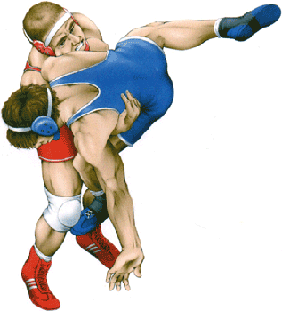
7. Man vs. ?

Slide 22
Practice
Now that you have mastered pictures, let’s try some text!

Slide 23
8. Man vs. ?
“If she had only proceeded more slowly.
If she had only taken the Southerly route, avoiding the icebergs. If only the watch had had a pair of binoculars.”
(news story about the Titanic)

Slide 24
9. Man vs. ?
Charles decided to break all the rules the day he decided to steal that car. He was immediately arrested and sent to jail to await his trial. He should have known better than to mess with the “rules.”

Slide 25
10. Man vs. ?
“I don’t care who you talk to!” screamed Sarah to West. “I just wish I had never met you!”

Slide 26
11. Man vs. ?
After the light in the cave was completely gone Tom began to stumble through the cave blindly cutting his hands on what appeared to be sharp rocks.

Slide 27
12. Man vs. ?
Tom found a dry spot to sit down in the dark and began to feel guilty over an argument he had had earlier in the day with his mother in which he had said, “I hope I never see you again!”

Slide 28
13. Man vs. ?
Tom’s mother was upset that he wanted to skip going to college in order to go exploring in all of the world’s greatest caves before he turned thirty. Tom didn’t understand what the big deal was and wanted to run his own life.

