Slide 1
Clues to a Culture
Fifth Grade
Unit 3 – Art and Media

Slide 2
Art and Photographs
Apache Life

Slide 3
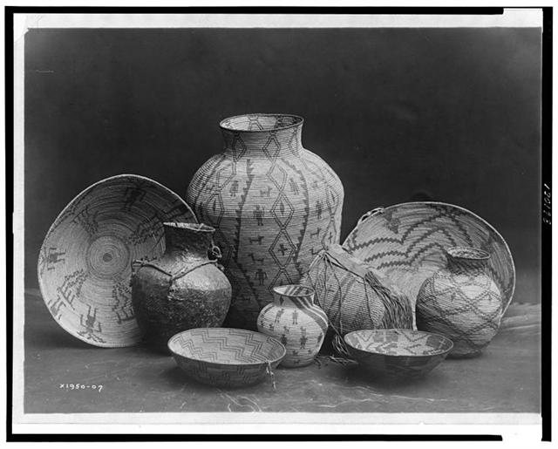
Apache Still Life
Edward S. Curtis - 1907

Slide 4
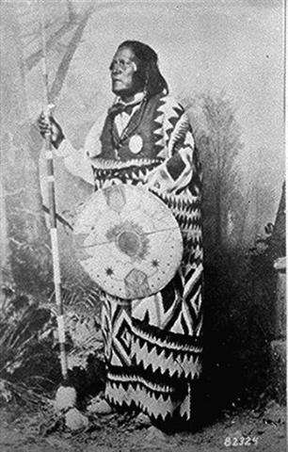
San Juan, A Mescalero Apache Chief

Slide 5
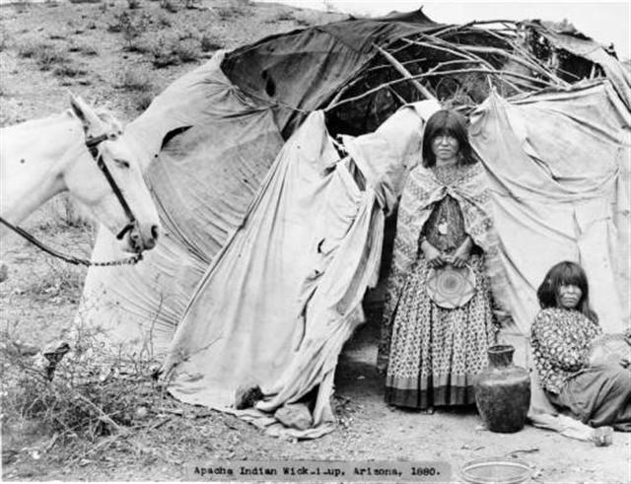
View of two Native American Apache women outside their cloth-covered wickiups in a camp in Arizona
Noah H. Rose - 1880

Slide 6
Art and Photographs
Hopi Life

Slide 7
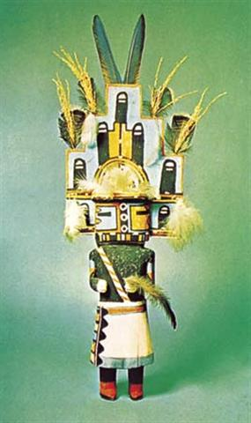
Wooden Hopi Kachina Doll - 1925

Slide 8

Hopi Girl With Jar
Notes:
Right click on image and choose “Open Hyperlink.”

Slide 9
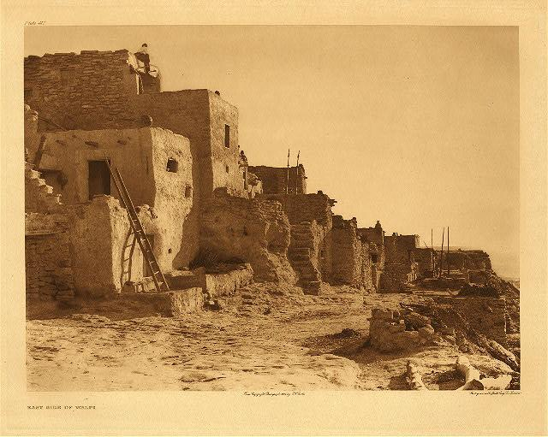
East Side of Walpi
Edward Curtis - 1921

Slide 10
Art and Photographs
Haida Life

Slide 11
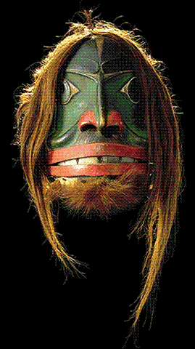
Haida mask - 1879

Slide 12
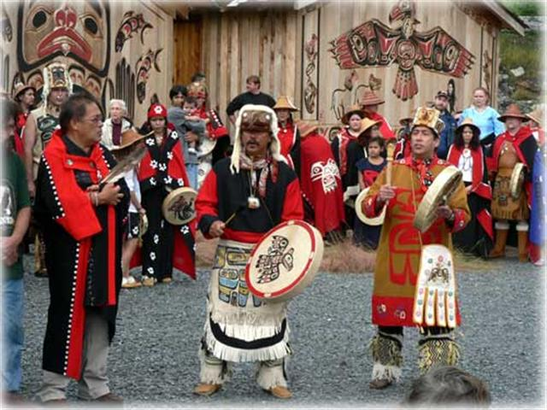
Dedication Potlach: The Honoring of Ancient Traditions
Bill Hupe - 2006

Slide 13
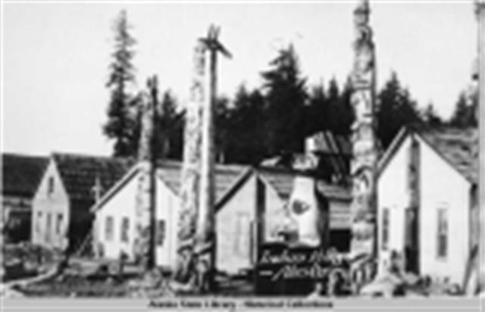
Indian Village, Alaska - 1897

Slide 14

Ojibway Music from Minnesota

Slide 15
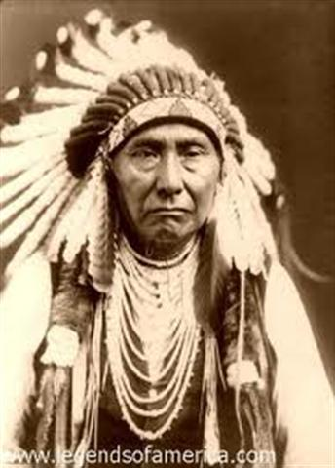
I Will Fight No More Forever
Chief Joseph

