Slide 1
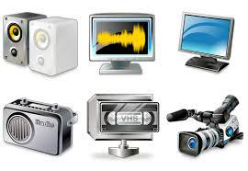
Multimedia Elements and Their Effects on Stories
5th Grade RL.5.7

Slide 2
Watch this short video clip.
Write down how this video makes you feel.
Discuss with a partner.
http://www.youtube.com/watch?v=2m-42ek85G4
*Teacher- only show the first minute of the video.

Slide 3
I can analyze multimedia elements and determine what they add to a story.
Score yourself
3 2 1

Slide 4
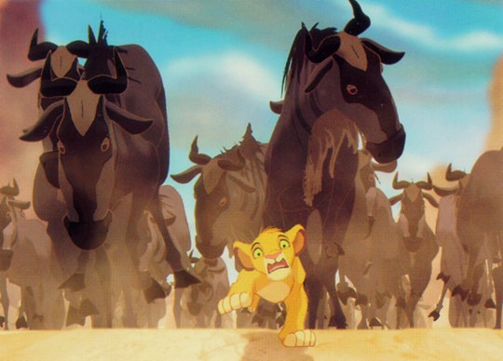
Notes:
Teacher notes:
When I watched this scene in the Lion King, I noticed my heart was racing and my palms got sweaty.
I was wondering why I was having such a reaction to a fictional movie. Why was I so deeply scared? I realized it was the visuals in the video that where making me scared. Simba’s face and the hundreds of animals running toward him influenced the meaning of the story for me.

Slide 5

Notes
Multimedia
Many different kinds of communication.
Could be audio, video, text, animation, touch screen.
Notes:
I thought it would be interesting to dig a little deeper and look at the ways multimedia influence the meaning and tone for us. Let’s review 3 key concepts.

Slide 6
2. Meaning
Meaning is the significance or the message

Slide 7
3. Tone
The feeling, attitude or mood of the story. It could be funny, sad, serious, playful.

Slide 8
The Crow and the Pitcher
A Crow, half-dead with thirst, came upon a Pitcher which had once been full of water; but when the Crow put its beak into the mouth of the Pitcher he found that only very little water was left in it, and that he could not reach far enough down to get at it. He tried, and he tried, but at last had to give up in despair. Then a thought came to him, and he took a pebble and dropped it into the Pitcher.

Slide 9
Then he took another pebble and dropped that into the Pitcher. Then he took another pebble and dropped that into the Pitcher. Then he took another pebble and dropped that into the Pitcher. At last, at last, he saw the water mount up near him, and after casting in a few more pebbles he was able to quench his thirst and save his life.

Slide 10
Moral of this story is that thoughtfulness and persistence will succeed.
Notes:
Discuss Tone- The tone is serious. The bird is going through a tough problem and could die if he doesn’t find water. At the same time the play is kind of playful. The bird is almost acting like he is human.

Slide 11
Now let’s look at a video clip of the same story. While you are watching think about the tone and see if it is the same.
http://www.youtube.com/watch?v=XtnG37texEI
Notes:
What do you think? The meaning has stayed similar. The bird is still trying to work through a hard problem. The tone is different. Let’s look through some of the multimedia elements that are contributing to the tone. The visuals with the cartoon animation and the audio sound effects are making the story seem funny and silly.

Slide 12
Visuals - cartoon animations
Audio- Funny sound effects

Slide 13
Written version:
Established the meaning and tone
Video:
Cartoon and sound effects influenced the tone
Notes:
To summarize

Slide 14

Read: Raven Steals the Light
In your notebook, write about the meaning and tone of this story.
Meaning-
Tone -
Notes:
Now you can try it. Pass out one copy of Raven steals the Light from the Unit 3 Tricksters Book(pg 109).

Slide 15
Now watch this video. Notice if the multimedia elements in the video change the tone and meaning of the story.
http://www.youtube.com/watch?v=yhXZv1tJ2Ak

Slide 16

In your notebook, write any changes you noticed in the meaning and tone. Make note of how the multimedia elements contributed to the changes.
Notes:
After walking around and providing feedback to students, have a discussion with the group about their work.

Slide 17
Next time you are reading a book, watching a video, or playing on an app think about the way the multimedia elements are effecting the story.

Slide 18
Revisit the Goal:
I can analyze multimedia elements and determine what they add to a story.
Score yourself
3 2 1

