Slide 1
Informational Text Structure
Notes:
This lesson is intended to help students understand what “text structures” mean so that they can then apply this knowledge in order to compare information between 2 texts.
RI 5.6

Slide 2
Goal
I can recognize the text structure of informational text
Score yourself on your knowledge of text structures
Notes:
Goal for the lesson:
This is intended to help students have a better understanding of the text structure of informational text. The standard for 5th grade states: RI5:”Compare and contrast the overall structure (eg chronology, comparison, cause/effect, problem/solution) of events, ideas, concepts, or information in two or more texts.”

Slide 3

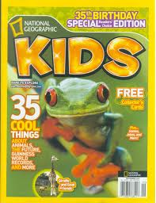



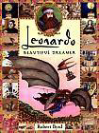

What do you know about all these texts?
Notes:
APK: Have students share with their partner or table; what do we know about all these texts? They give us information; non-fiction; articles, biographies, etc.

Slide 4

Guess What?
Research says that if students (that’s you) know the text patterns and understand how to ask questions, they will improve their comprehension of text.
Hmm…..What does this mean?
Notes:
New Information:
Read the slide with the information; let students process this; talk about what some of these words mean, pattern, comprehension, improve. Ask the students what they think it means to “ask questions”/ when? What kind of questions? How will asking questions help you remember the information?
We are going to learn how to start looking for the text patterns, or structures, of our informational books. By doing this, it will help you remember the information

Slide 5
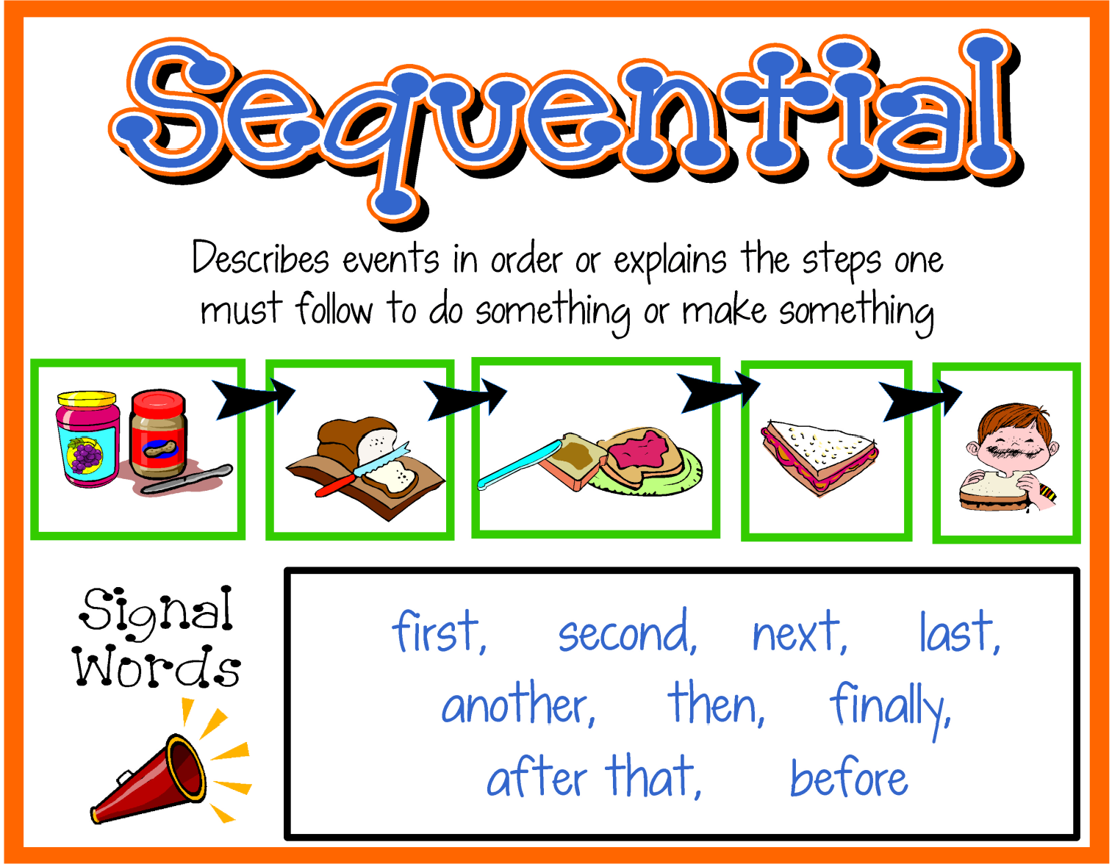
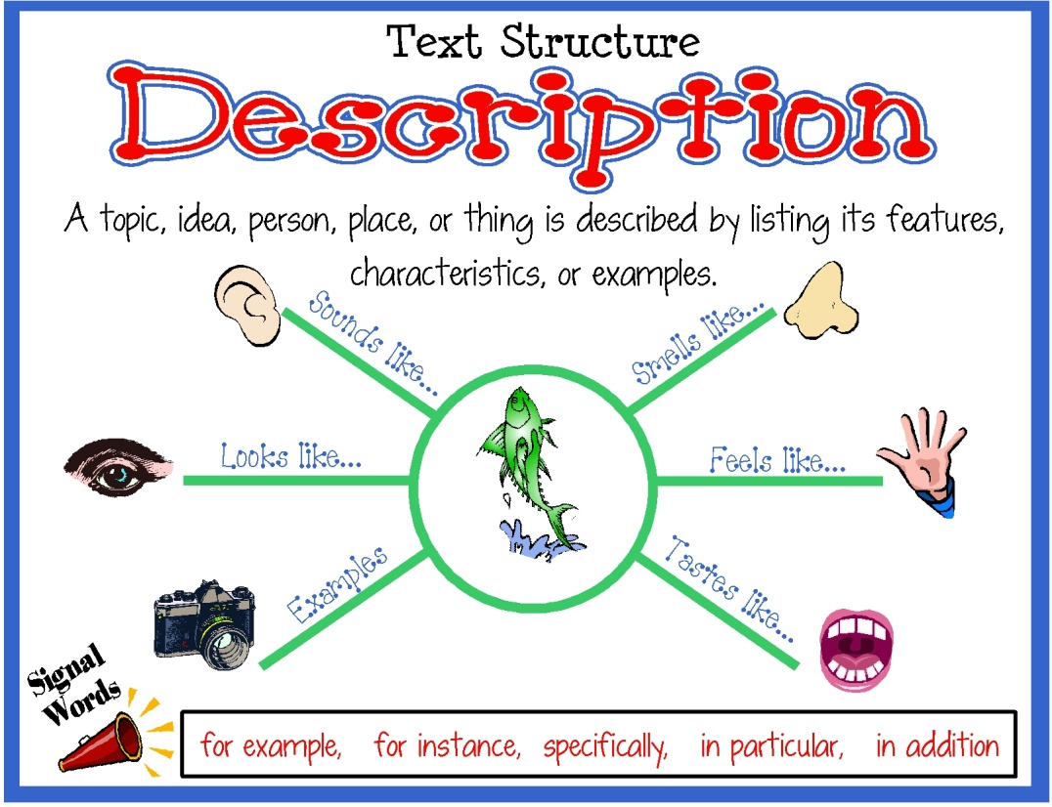

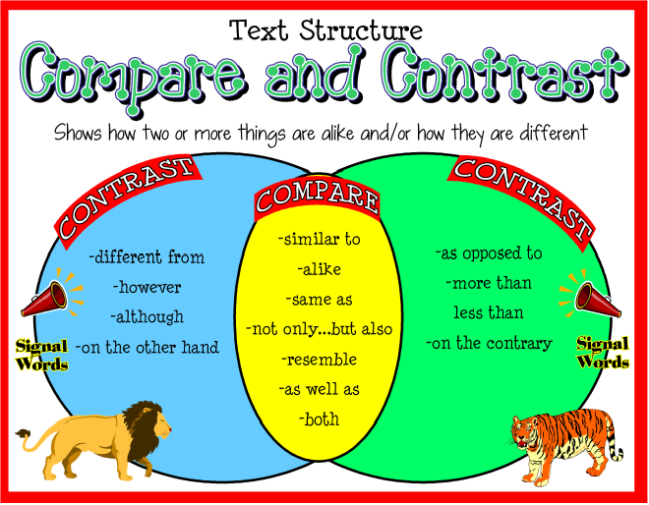
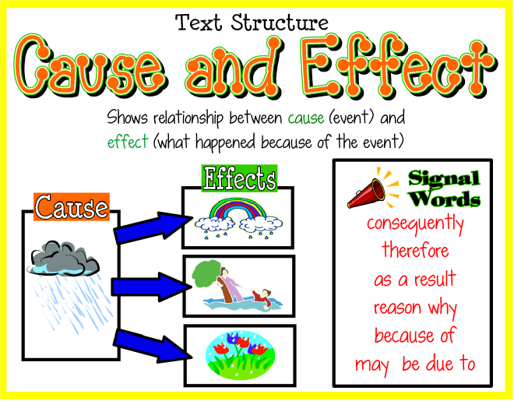
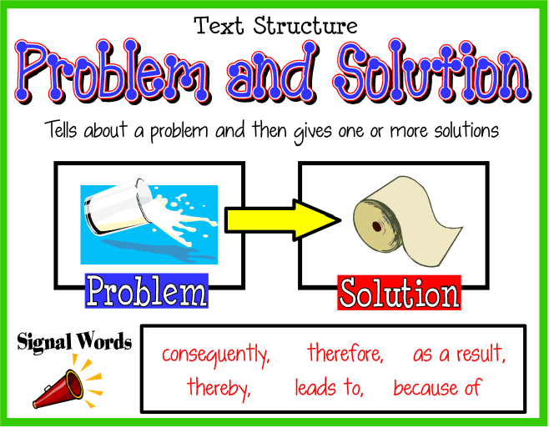
Notes:
New Information:
Teacher Note: On the “sequential” page (all by Beth Newingham), she does not include the word, “chronological”.
When an author writes an informational piece, there are 5 different ways an author presents the information. There is a pattern to the text, and you, as the student can understand what you are reading, if you are able to recognize HOW the text is laid out. Briefly go through the signs on the text.
1.Description
2.Sequence
3. Comparison/contrast
4. Cause/Effect
5. Problem/Solution

Slide 6
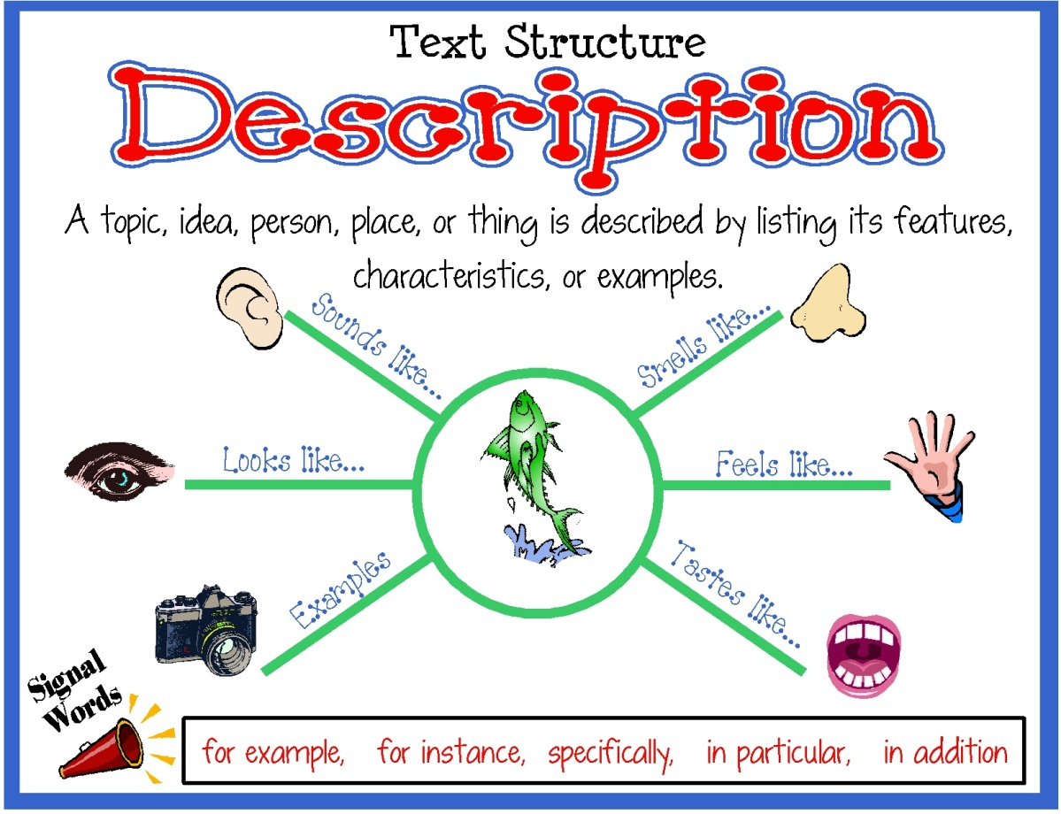

Notes:
A lot of the texts that we have read so far this year, have fallen into these 2 main categories: Description and Sequential. Look at each slide; remembering to use the word, chronological, with the sequential sign.
Let’s look at some examples of texts we have already used this year.

Slide 7


We are going to look at different texts to determine if they are descriptive or sequential.
Use the sign language for ‘d’ if you think the text is descriptive
Use the sign language for ‘s’ if you think the text is sequential

Slide 8
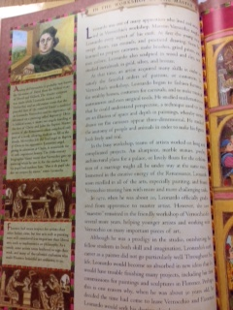
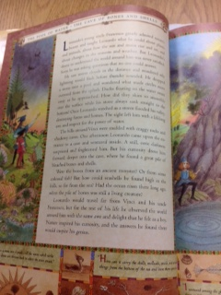
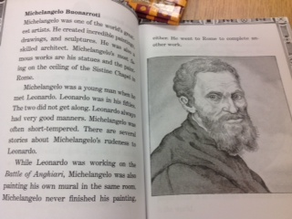
or
Notes:
New Information:
Looking back at some of the texts that you used in the past unit, how did you use these texts? Who were you researching? How did you know what information to look for? (most of the questions were on the research guide). As a reader, you need to start asking your own questions about what you are researching. Depending upon the information you are seeking, may depend upon the kind of informational text you choose to read.
These books give us information about da Vinci. In just looking at the text, what kind of text structure did the author use?
Does it look like a story? (yes, it is descriptive).
These texts also go in chronological order of da Vinci’s lifetime. If the text is going in a specific order, what is the pattern of the text? (sequential)

Slide 9
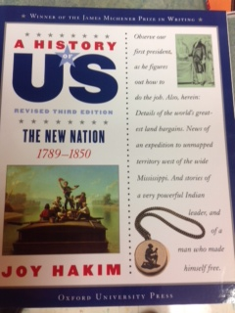
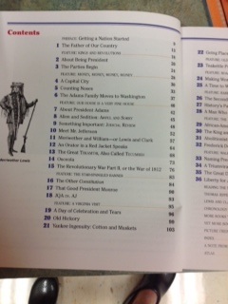
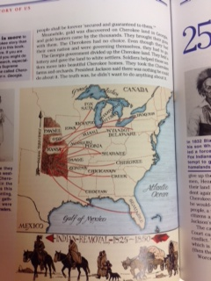
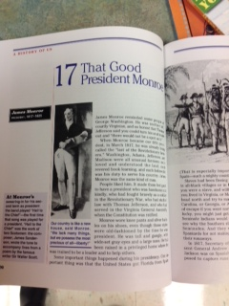
or
Notes:
What do we notice right off with this book? Look at the title and where the arrow is pointing. How is this book organized? It is sequential, or chronological? It goes in order of the dates given on the front of the book. Within the book, you would be able to find information on events and people based upon the time in which it happened.

Slide 10
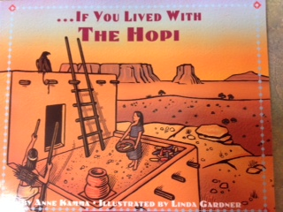
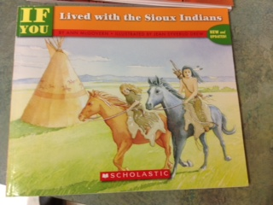
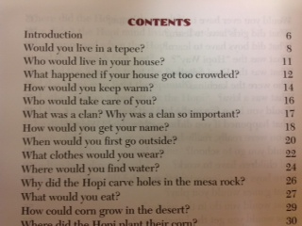
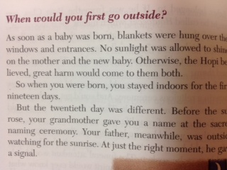
or
Notes:
Application:
These are a few books you will use to research a native American tribe to learn more about their culture. What is the text structure of this book? What kinds of questions will you want answered about your tribe? Orally talk about questions students may want answered, and how going into the text with those questions, and using the structure of the text; will your question get answered?

Slide 11
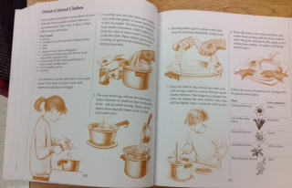
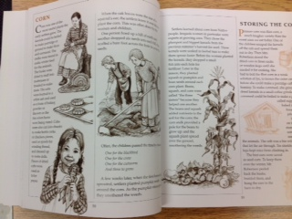
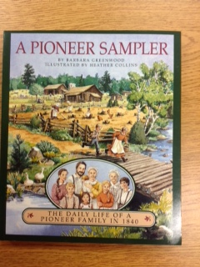
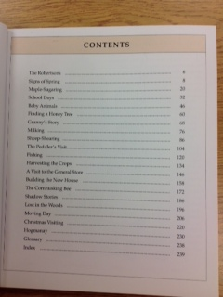
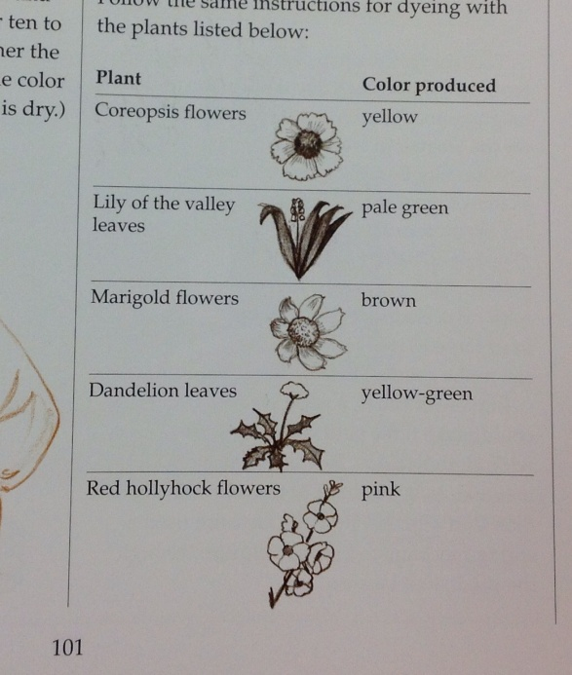
or
Notes:
This text gives you information about the life of a pioneer. By looking at the pictures, what kind of text structure did the author use?
Maybe both sequential and descriptive?

Slide 12

Goal
I can recognize the text structure of informational text
Oh! Now I got it!
Notes:
Revisit the goal of the lesson:
Remind students the purpose of knowing the different text structures.

