Slide 1
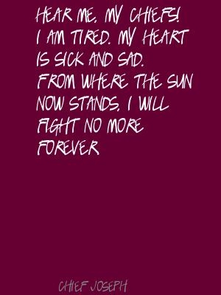
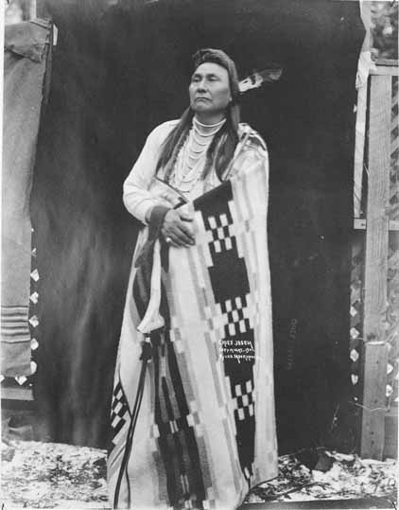
1877

Slide 2
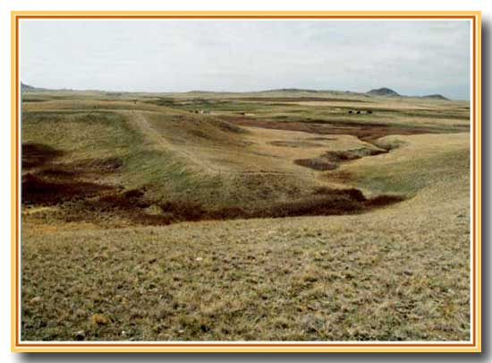
What does the text say? General Understanding
Who is delivering the speech?
What happened?
Notes:
Canyon Creek Battlefield, Bear Paw Mountains, Montana: site of Chief Joseph’s speech.
Background info: In 1863, some Nez Perce chiefs signed a treaty with the US agreeing to surrender their ancestral lands and be moved instead to a reservation in Idaho. Chief Joseph the Elder (Chief Joseph’s father), Chief Looking Glass and Chief Toohulhulsote, as well as others, refused to do so. This lead to an uneasy standoff for 14 years, during which time the non-treaty Nez Perce were allowed to remain. In 1877, the US Army decided to take action to end the standoff. The Nez Perce War was the name given to the U.S. Army's pursuit of the over 800 Nez Perce and an allied band of the Palouse tribe who had fled toward freedom. Initially they had hoped to take refuge with the Crow nation in the Montana Territory, but when the Crow refused to grant them aid, the Nez Perce went north in an attempt to reach asylum with Sioux Chief Sitting Bull and his followers who had fled to Canada in 1876.
For over three months, the Nez Perce outmaneuvered and battled their pursuers traveling 1,170 miles across Oregon, Washington, Idaho, Wyoming, and Montana.
General Howard, leading the opposing cavalry, was impressed with the skill with which the Nez Perce fought, using advance and rear guards, skirmish lines, and field fortifications. Finally, after a devastating five-day battle during freezing weather conditions with no food or blankets, with the major war leaders dead, Joseph formally surrendered to General on October 5, 1877 in the Bear Paw Mountains of the Montana Territory, less than 40 miles south of Canada. (Source: Wikipedia)
The battle is remembered in popular history by the words attributed to Chief Joseph at the formal surrender.

Slide 3
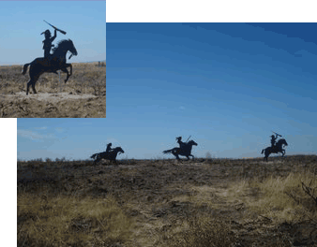
What does the text say? General Understanding
Without yet knowing who Looking Glass and Toohulhulsote are, what can we say about their roles in this decision?
Notes:
Pronunciation: Too hool hool zo the

Slide 4
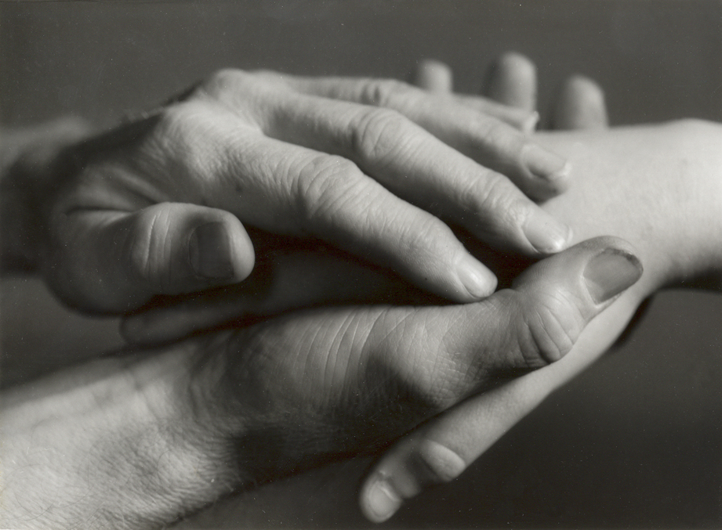
What does the text say? Key Details
What concerns does Chief Joseph have about the health and welfare of his people? How do you know?

Slide 5
Select some one in your group to read the speech aloud.
Add pauses, inflections, intonations, and emphasis (prosody) to the text.

Slide 6
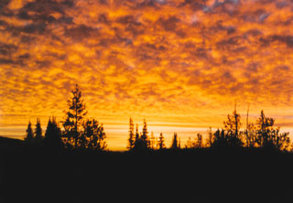
How does the text work? Vocabulary
What does Chief Joseph mean when he says, “From where the sun now stands?”

Slide 7
How does the text work? Vocabulary
What is the tone of this speech? What words and phrases support your claim?

Slide 8
How does the text work? Structure
How does the text structure convey Chief Joseph’s mood?

Slide 9
How does the text work? Structure
What is it about the use of the word forever in the last line, “I will fight no more forever” that makes this statement so memorable?

Slide 10
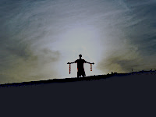
What does the text mean? Inferences
Who is Chief Joseph referring to when he says, “I want to have time to look for my children”? What other parts of the speech support your claim?

Slide 11
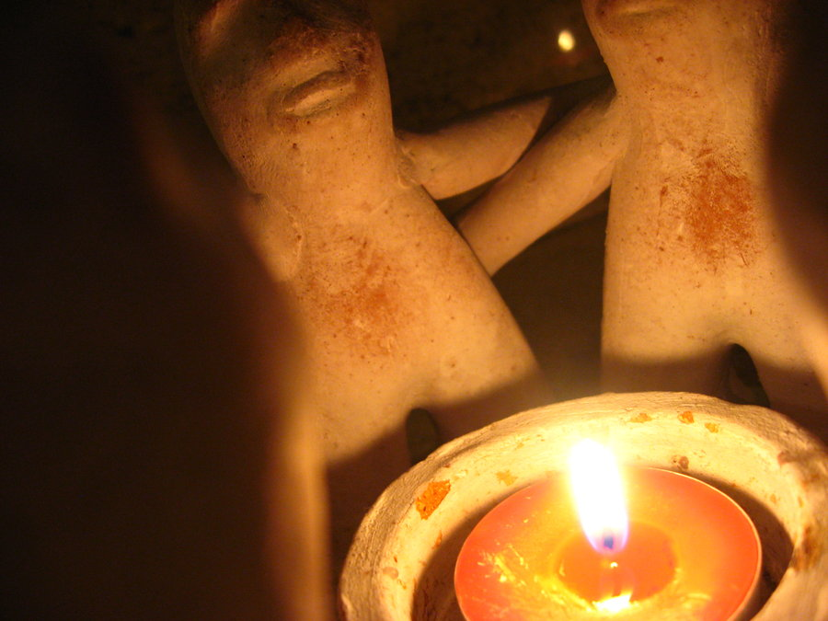
What does the text mean? Intertextual connections
Chief Joseph succeeded his father as leader of the Wallowa band in 1871. Before his death, the father said to his son:

Slide 12
“My son, my body is returning to my mother earth, and my spirit is going very soon to see the Great Spirit Chief. When I am gone, think of your country. You are the chief of these people. They look to you to guide them. Always remember that your father never sold his country. You must stop your ears whenever you are asked to sign a treaty selling your home. A few years more and white men will be all around you. They have their eyes on this land. My son, never forget my dying words. This country holds your father's body. Never sell the bones of your father and your mother.”
Joseph commented "I clasped my father's hand and promised to do as he asked. A man who would not defend his father's grave is worse than a wild beast."

Slide 13
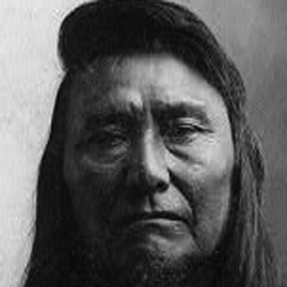
What does the text mean? Intertextual connections
How does this second passage help you to understand the speech?
What inner conflict would Chief Joseph have experienced?
Where do you see evidence of this conflict in the speech?

Slide 14
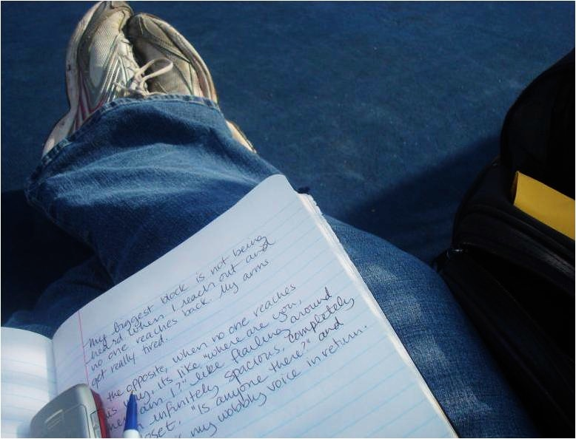
Writing From Sources
What is the role of courage in surrender? After reading and discussing Chief Joseph’s speech “I Will Fight No More Forever,” write an essay that defines courage and explains the courageousness of Chief Joseph’s decision. Support your discussion with evidence from the text. What conclusions can you draw?
Constructed using Task Template 12: www.literacydesigncollaborative.org

