Slide 1
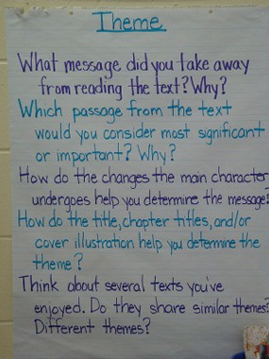

Slide 2
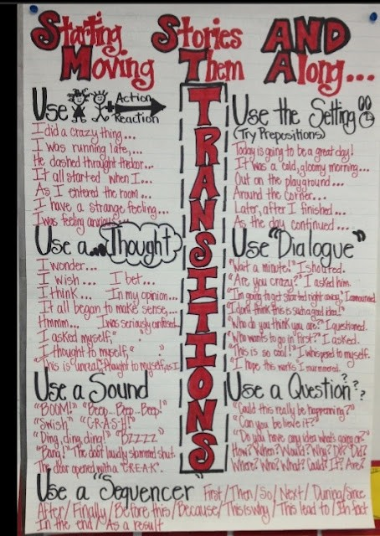

Slide 3
Notes:
Linked to the article

Slide 4
