Slide 1

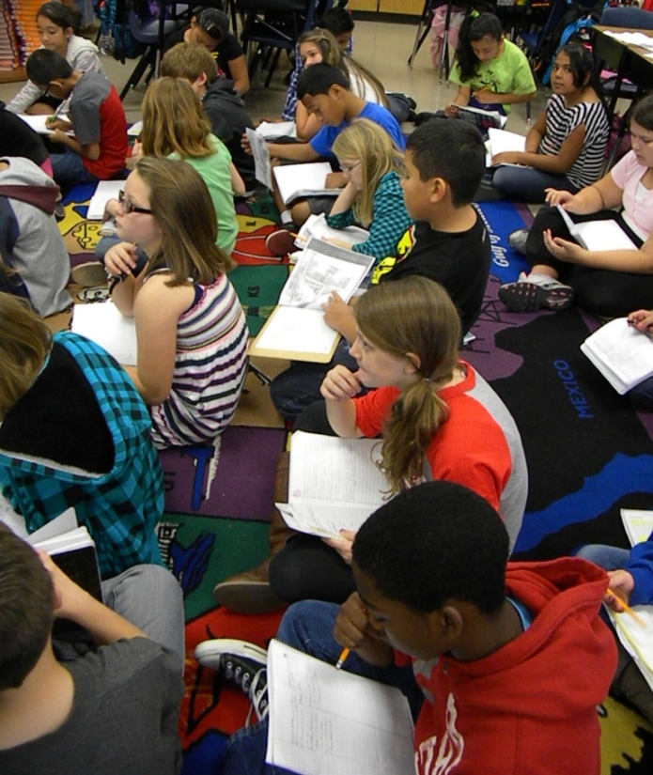
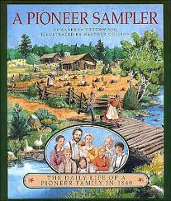
Pioneer Schools
5th Grade CCCM Unit 3
Mrs. Harp’s Class
Lowell Elementary, Rogers AR
November 9, 2012

Slide 2

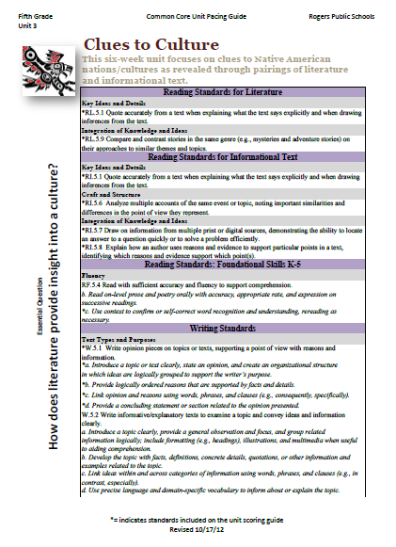

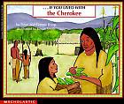



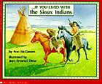
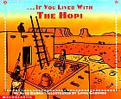
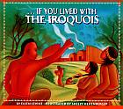
Unit Preparation
Prior to beginning Unit 3, Mrs. Harp did the following:
Identified the standards to be taught- (she looked at the unit 3 pacing guide)
She asked herself-
  “What will my students know and be able to do better at the end of this unit?”
3. She gathered and studied the resources in order to prepare the daily lessons.

Slide 3

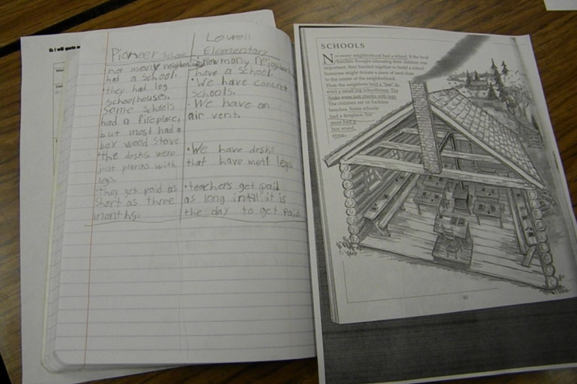
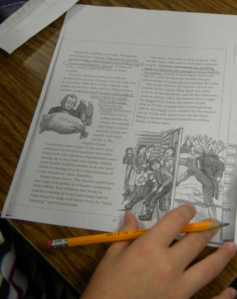
Plan Daily Lessons:
Once Mrs. Harp had the big picture for the unit, she began planning daily lessons.
The standards she based this lesson’s goal on are:
RI. 5.1 Quote accurately from a text when explaining what the text says explicitly and when drawing inferences from the text.
RI.5.9 Integrate information from several texts on the same topic in order to write or speak about the subject knowledgably
The resources she selected for the lesson are:
  Excerpt from Pioneer Sampler
  Interactive Notebook

Slide 4

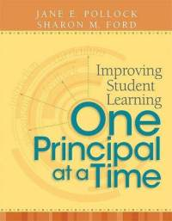

GANAG is a daily lesson structure that allows teachers to plan for student use of research based instructional strategies.
G= goal
A= access prior knowledge
N= new information
A= application
G= generalize the goal

Slide 5

GANAG provides students the opportunity to actively use the nine high-yield strategies:
(2) Identifying Similarities and Differences
(7) Cooperative Learning
(8) Setting Objectives and Providing Feedback
(3) Summarizing and Note Taking
(4) Reinforcing Effort and Providing Recognition
(9) Generating and Testing Hypotheses
(5) Homework and Practice
(10) Cues, Questions and Advance Organizers
(6) Nonlinguistic Representations

Slide 6

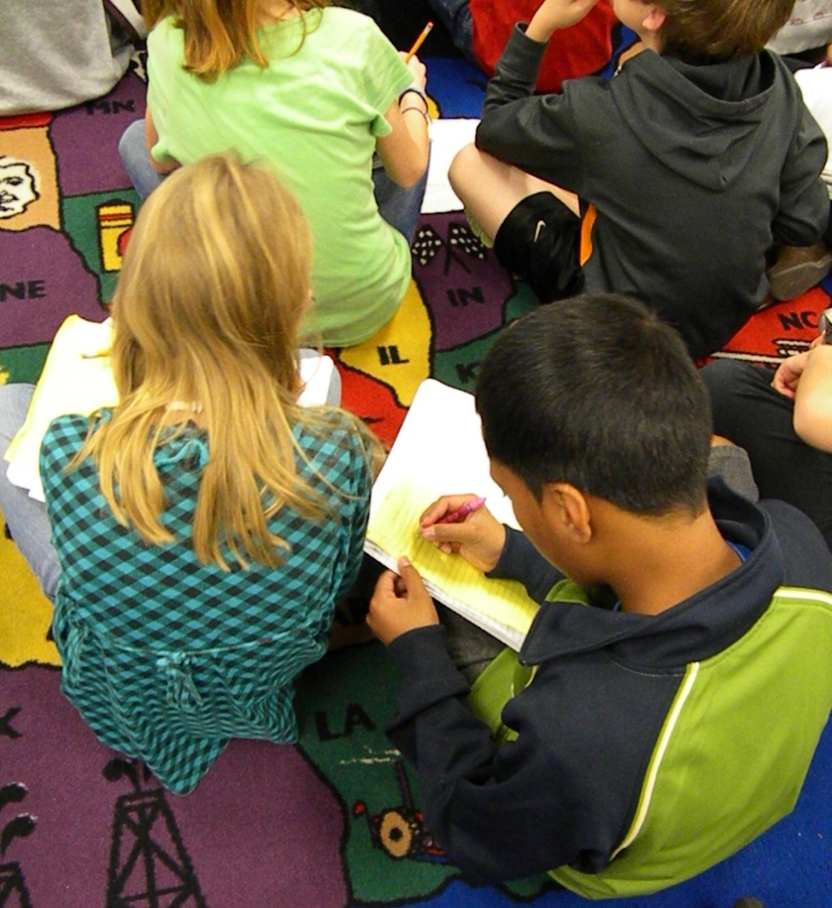
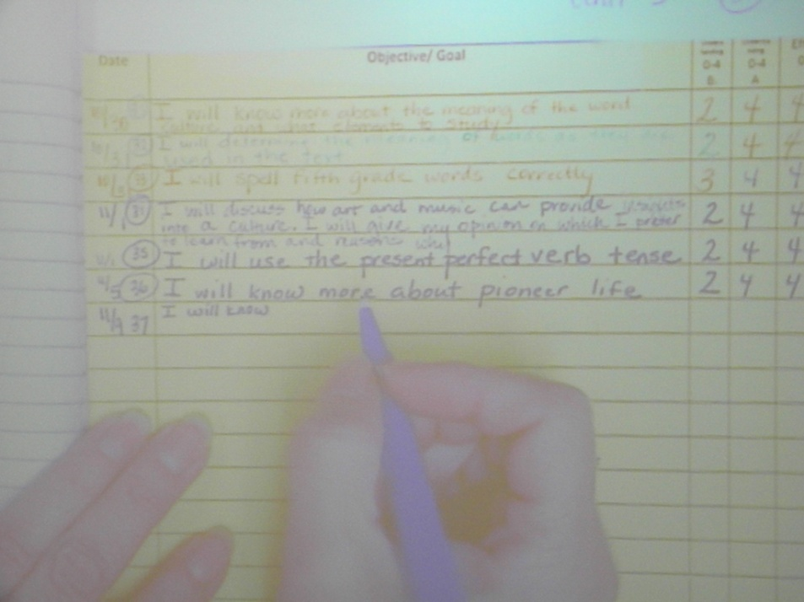
GOAL
I will know about pioneer life- compare and contrast schools
Students recorded the goal in their notebooks.

Slide 7
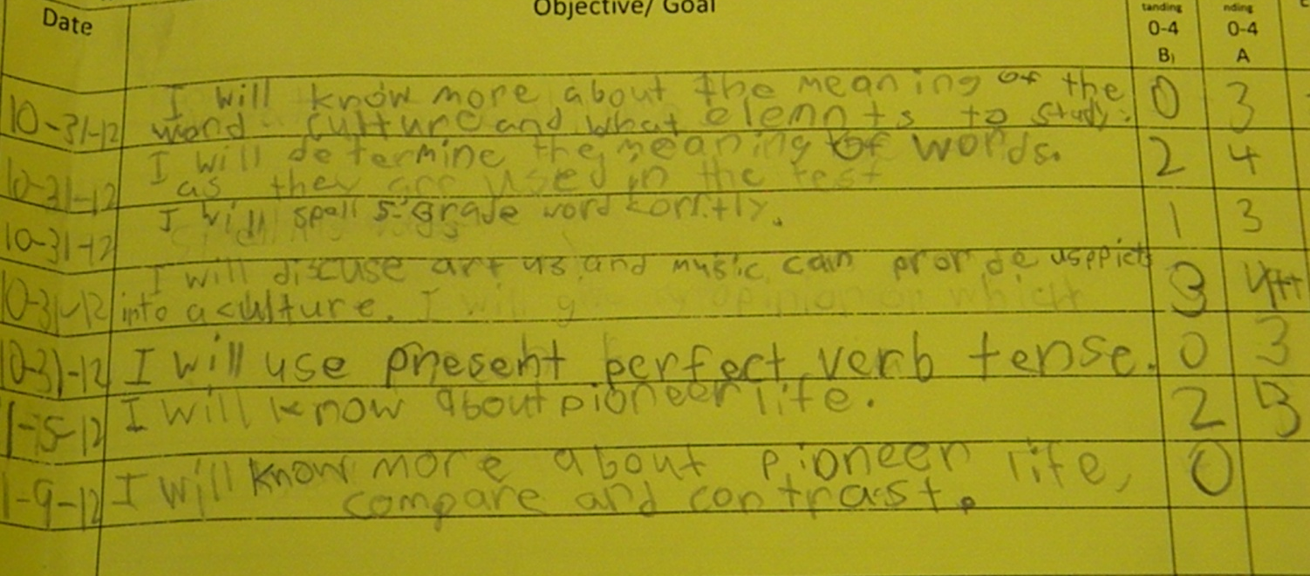
Students scored their knowledge of the goal before the lesson.
(8) Setting Objectives and Providing Feedback

Slide 8
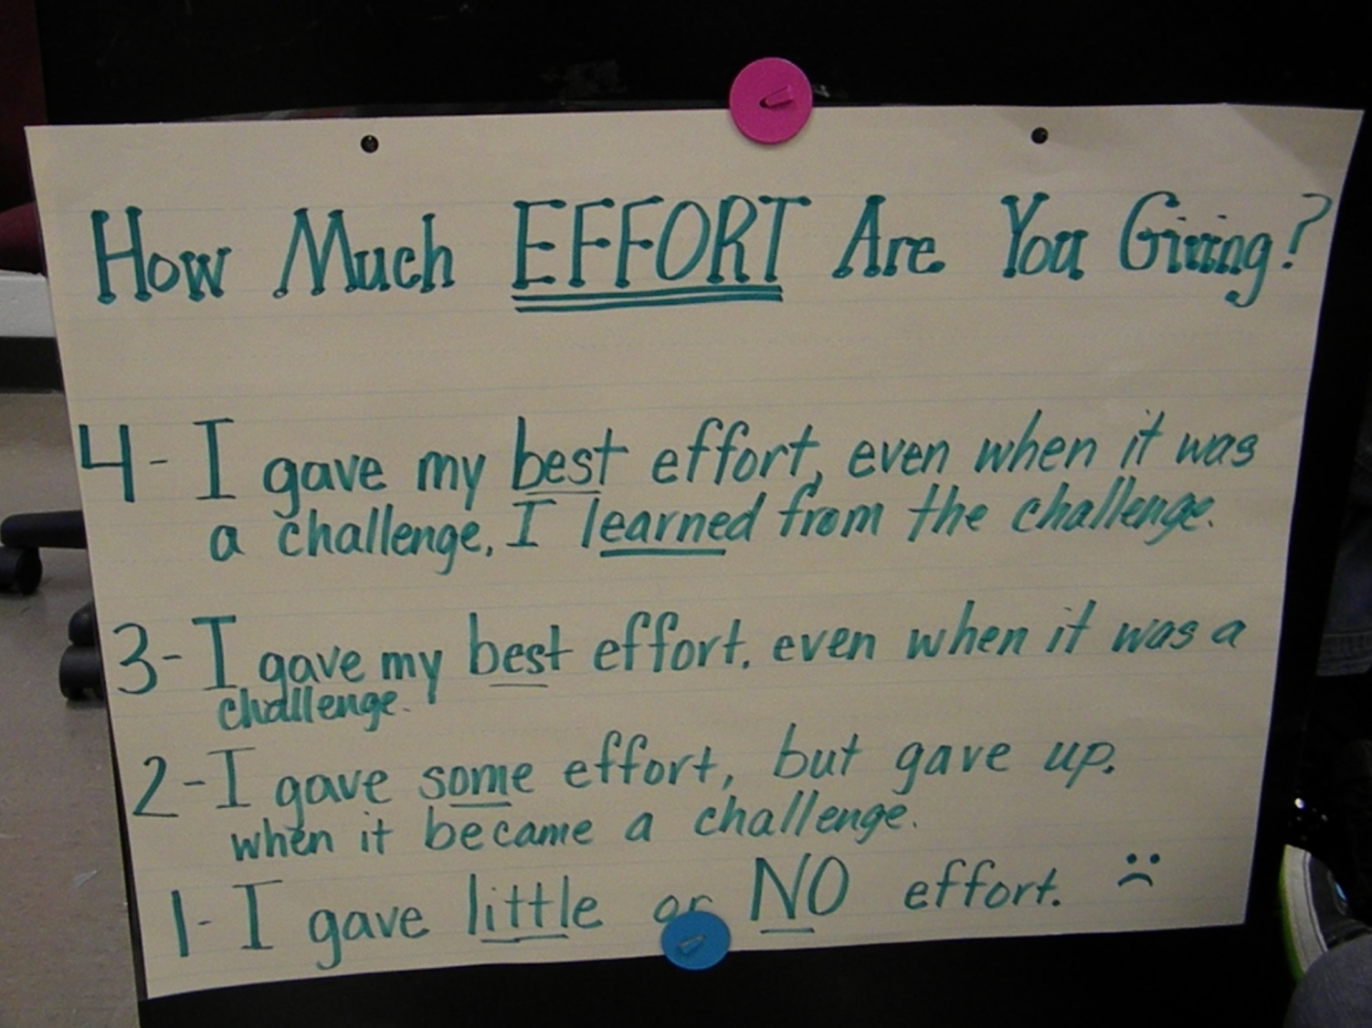
They used an effort rubric to score the effort they would
put into the lesson.
(4) Reinforcing Effort and Providing Recognition

Slide 9
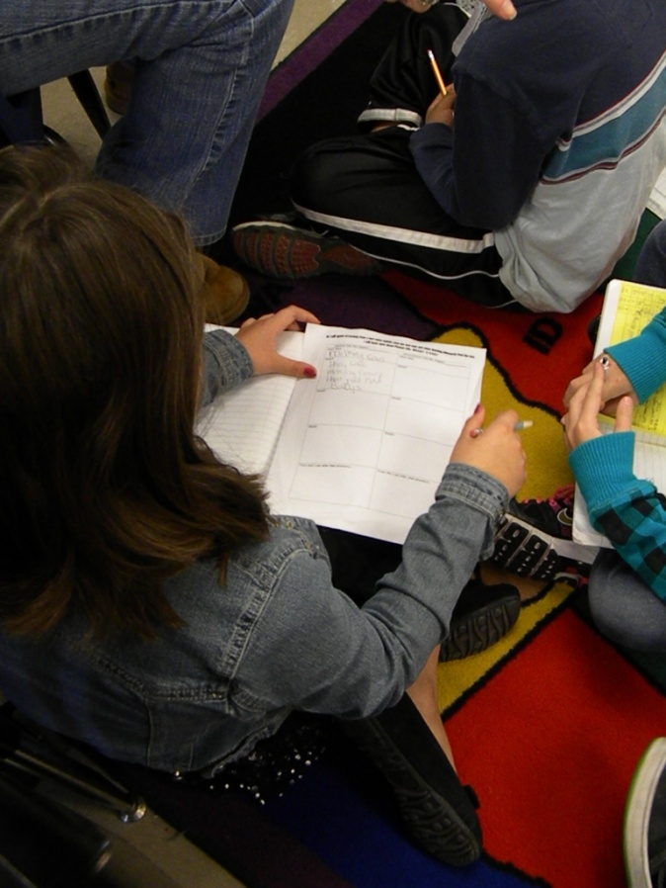
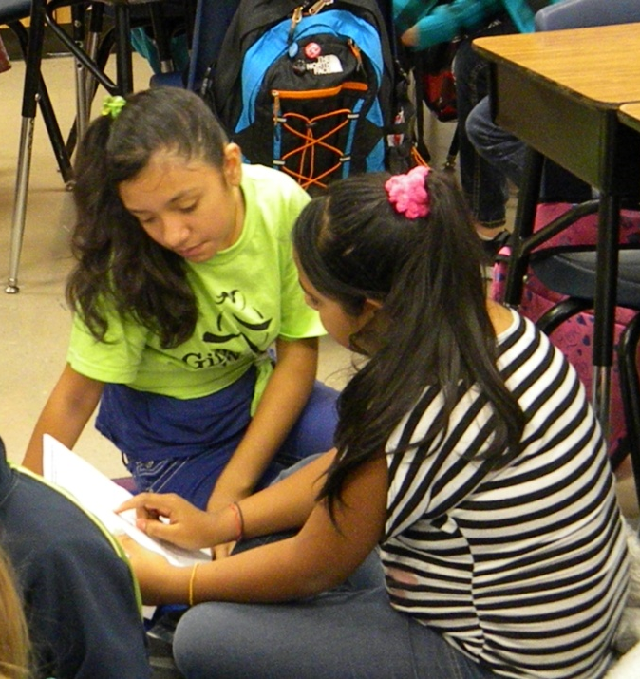
Access Prior Knowledge
“Look back through your notes and find three things you have learned about pioneers. Share with your shoulder partner.”
(7) Cooperative Learning

Slide 10
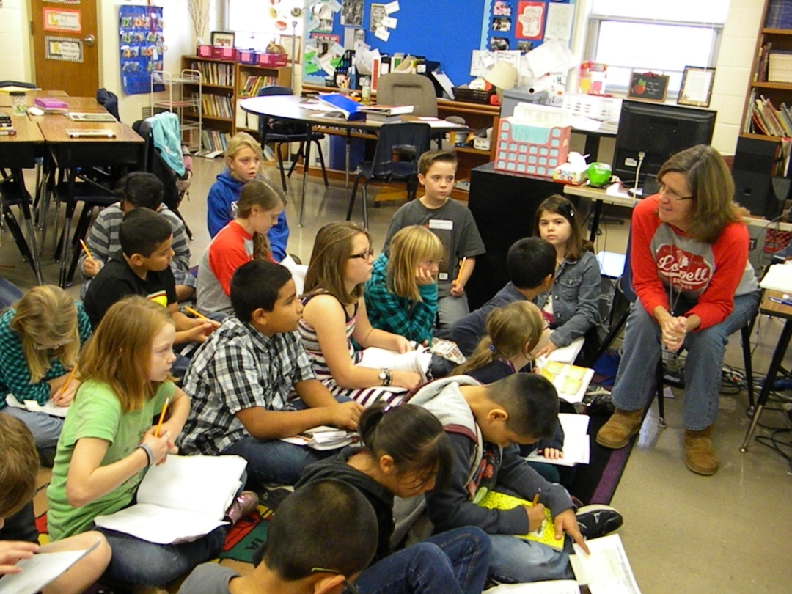
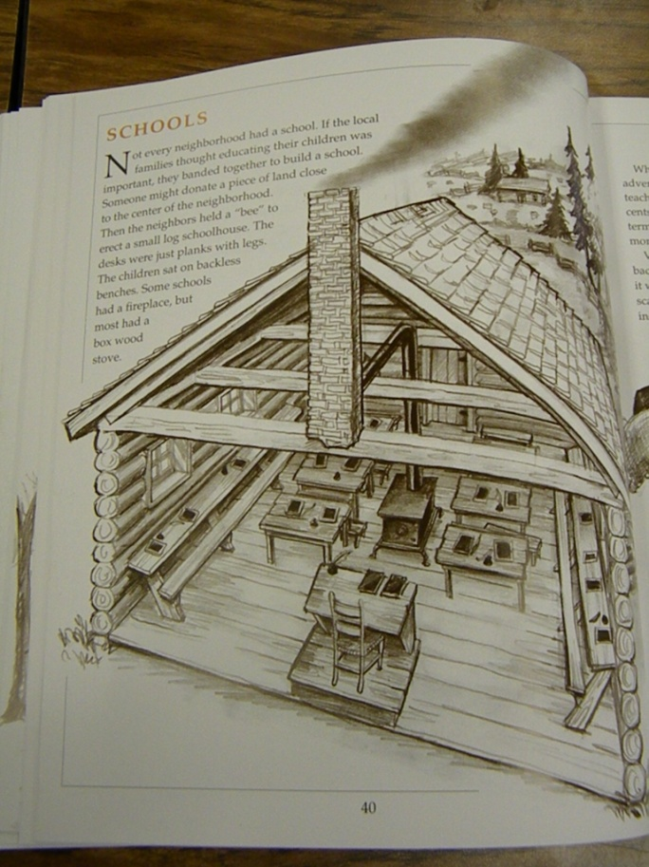
New Information
Mrs. Harp explained that the students would read an excerpt from Pioneer Sampler that addressed schools. She wanted them to take notes as they read. They would use their notes to compare and contrast pioneer schools to their school.

Slide 11

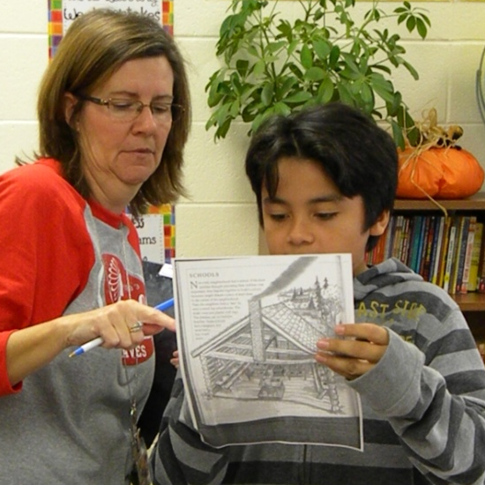
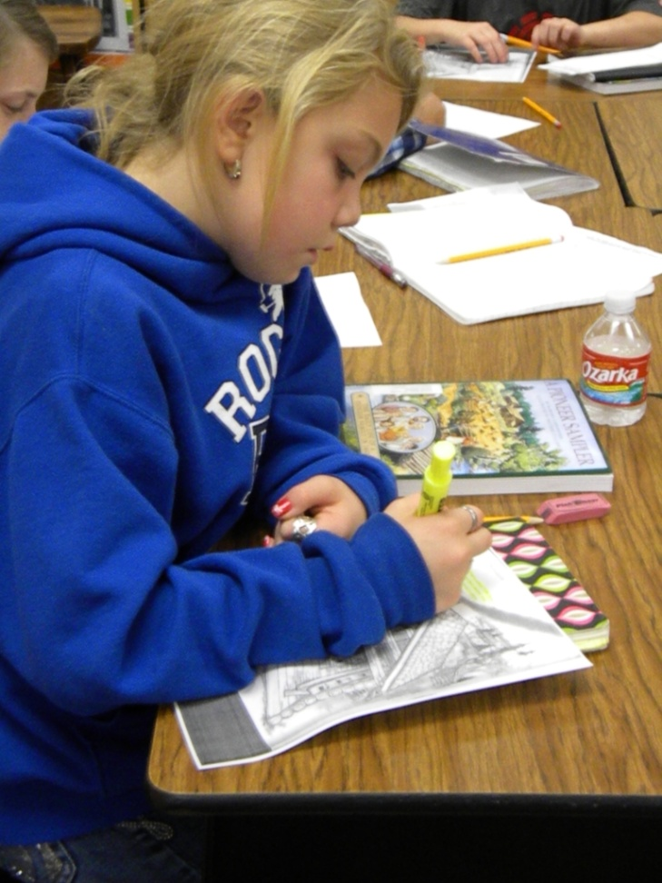
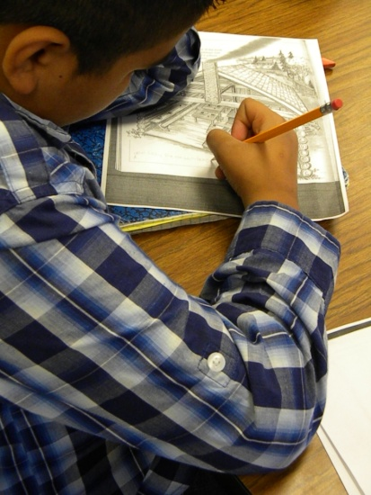
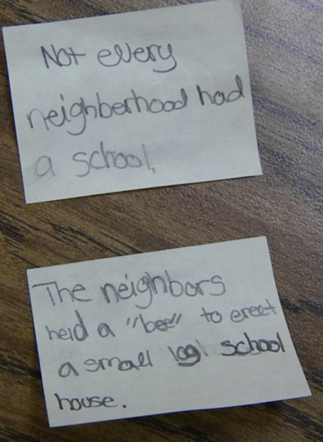
Students read and took notes.
(3) Summarizing and Note Taking

Slide 12
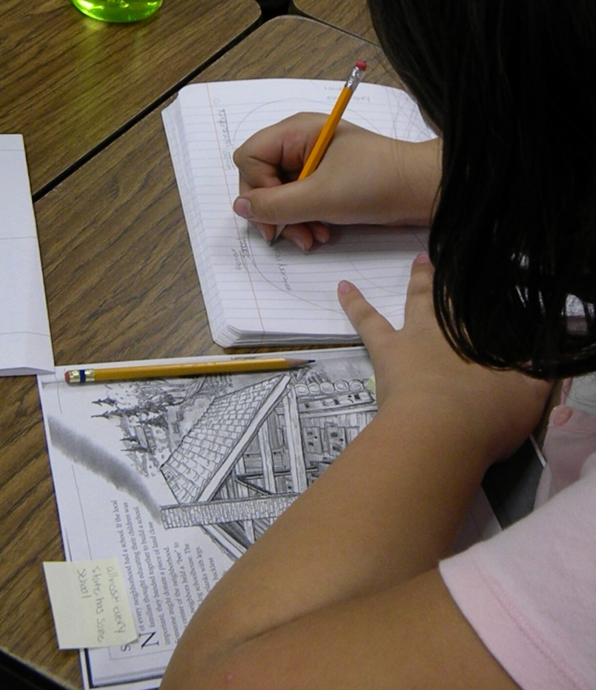
Application
The students used the information from their notes to compare pioneer schools to their own school.
Comparing: describing how things are the same and different
I find the items to compare
I choose features to compare the items
I tell how the items are the same or different
(2) Identifying Similarities and Differences

Slide 13
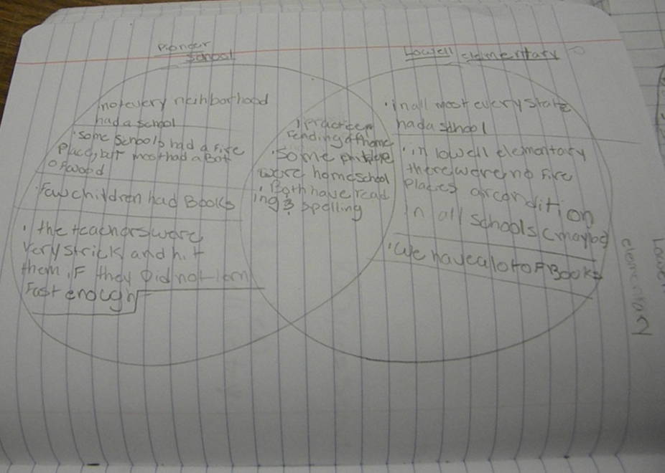
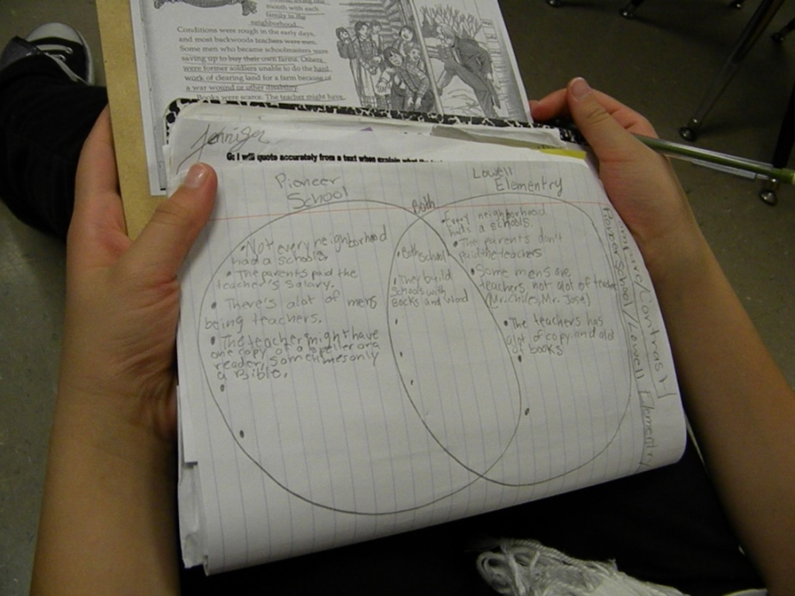
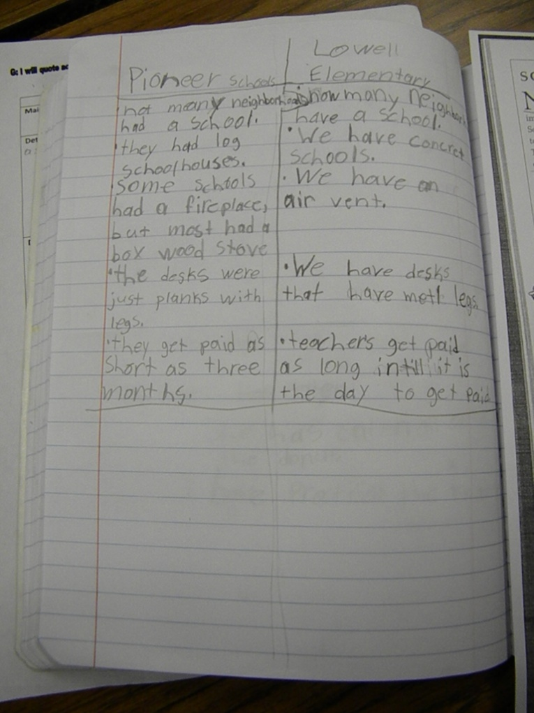
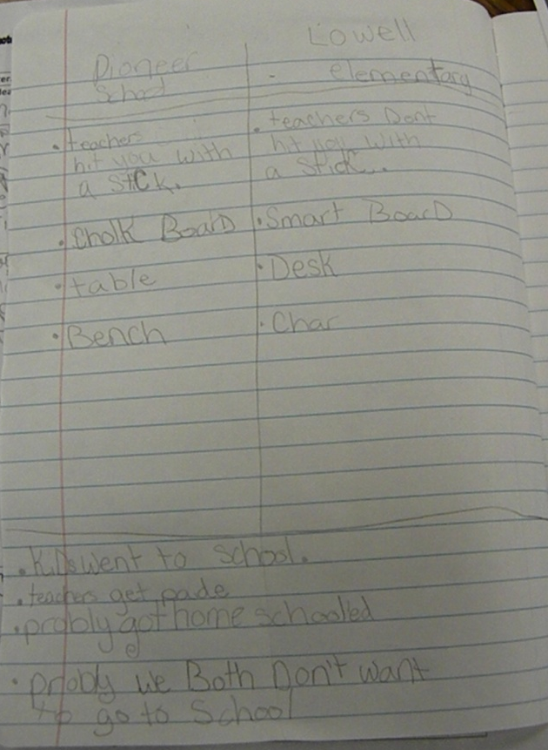
Mrs. Harp let the students select the features to compare and the format they wanted to use.
Comparing: describing how things are the same and different
I find the items to compare
I choose features to compare the items
I tell how the items are the same or different

Slide 14
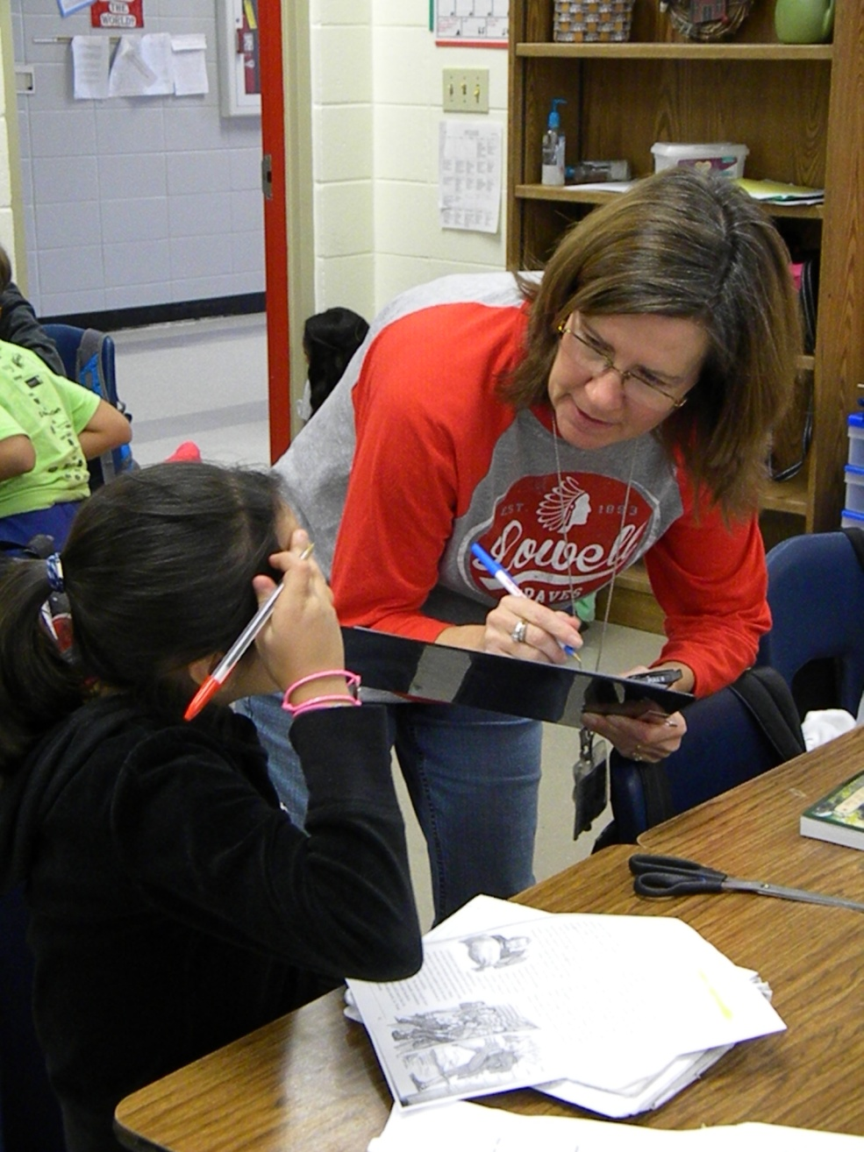
Mrs. Harp scored students performance of the standards while they worked.

Slide 15
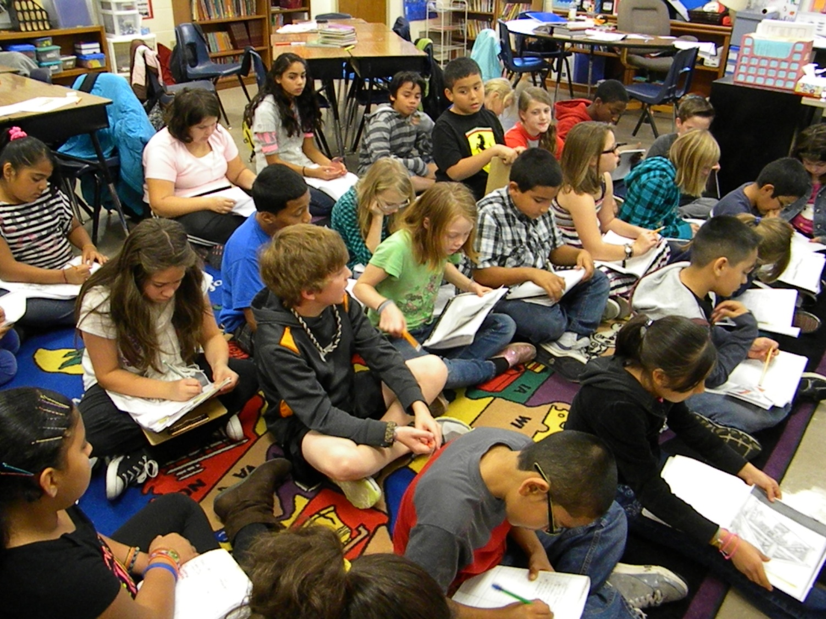
The students returned to the carpet and shared some of the similarities and differences they discovered.
Comparing: describing how things are the same and different
I find the items to compare
I choose features to compare the items
I tell how the items are the same or different

Slide 16
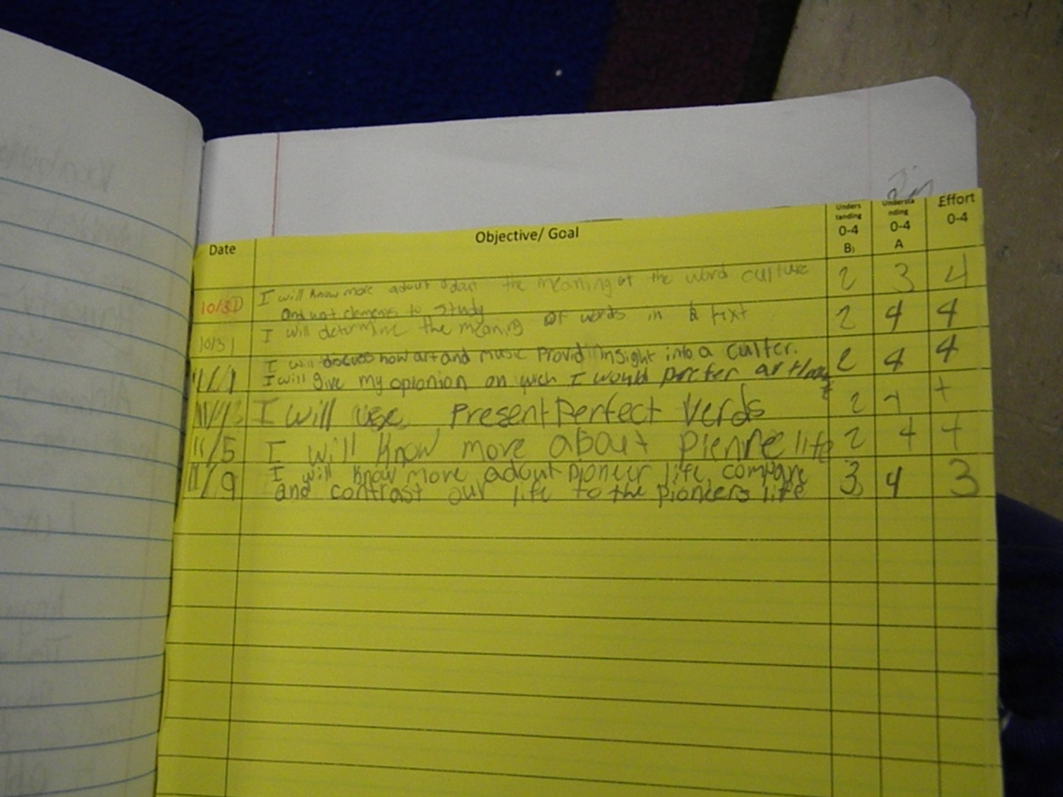
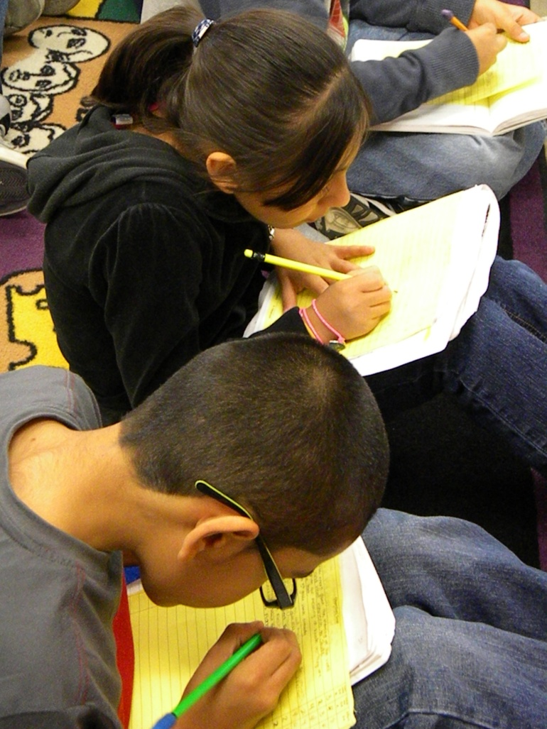
Revisiting the Goal
Mrs. Harp asked the students to score their knowledge of the goal once again.
(8) Setting Objectives and Providing Feedback

Slide 17
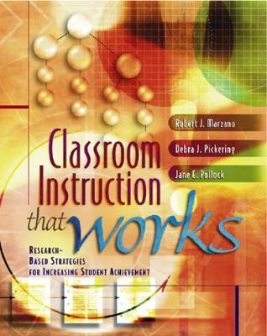
Marzano, R. J., Pickering, D. J., & Pollock, J. E. (2001). Classroom instruction that works: Research-based strategies for increasing student achievement. Alexandria, VA: Association for Supervision and Curriculum Development.
Pollock, J. E. (2007). Improving student learning one teacher at a time. Alexandria, VA: Association for Supervision and Curriculum Development.
Pollock, J. E., & Ford, Sharon M. (2009). Improving student learning one principal at a time. Alexandria, VA: Association for Supervision and Curriculum Development.
Pollock, J. E., Ford, Sharon M., & Black, Margaret M. (2012). Minding the Achievement Gap. Alexandria, VA: Association for Supervision and Curriculum Development.

