Slide 1
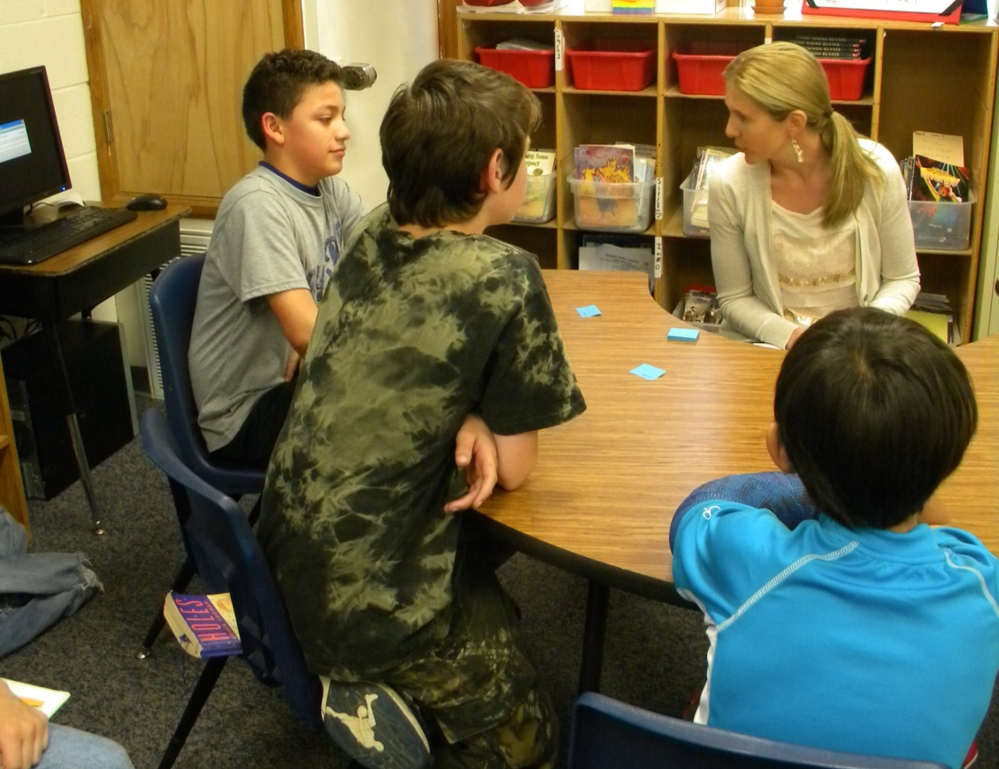
Fifth Grade
Small Group Instruction
with Gretchen Childs
Garfield Elementary
Rogers Public Schools
April 27, 2011
S. Hensley

Slide 2
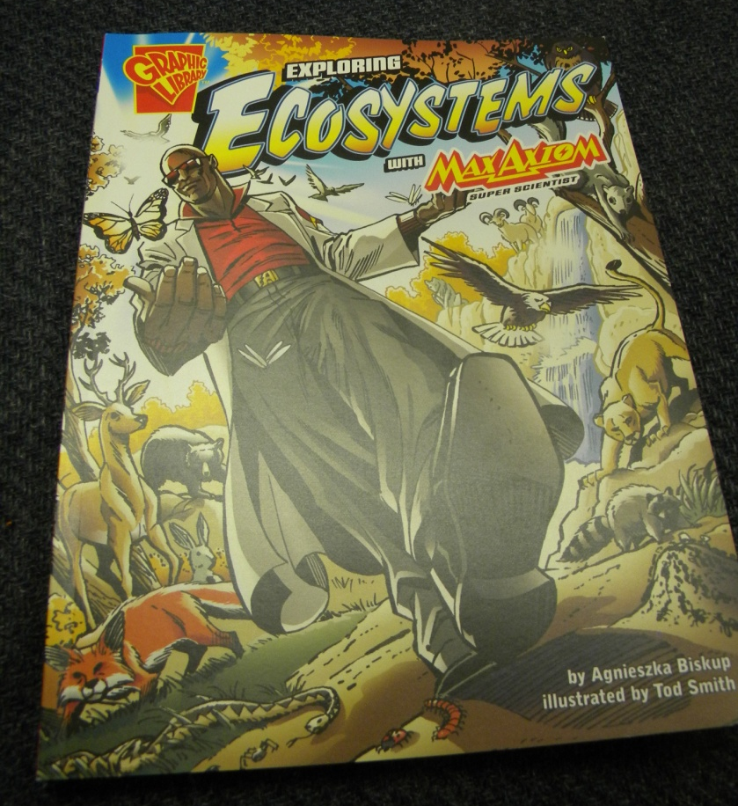
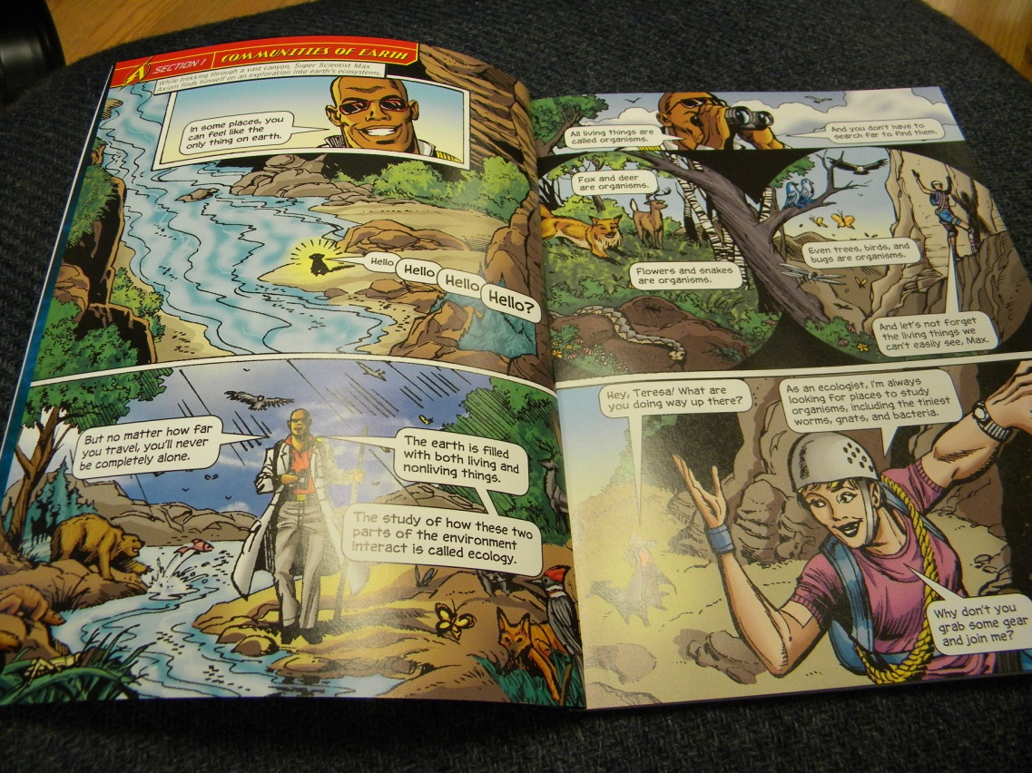
Group: Fifth Grade (Garfield Elementary)
Focus/Goal: Adjusting Pace for Comprehension
Title: Exploring Ecosystems by Agnieszka Biskup
Level: 4.0

Slide 3
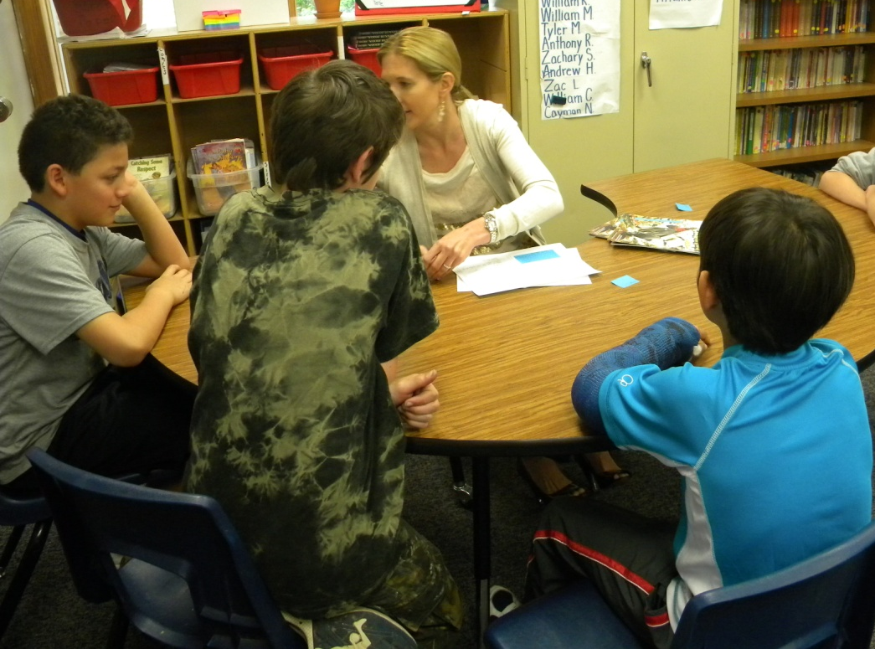
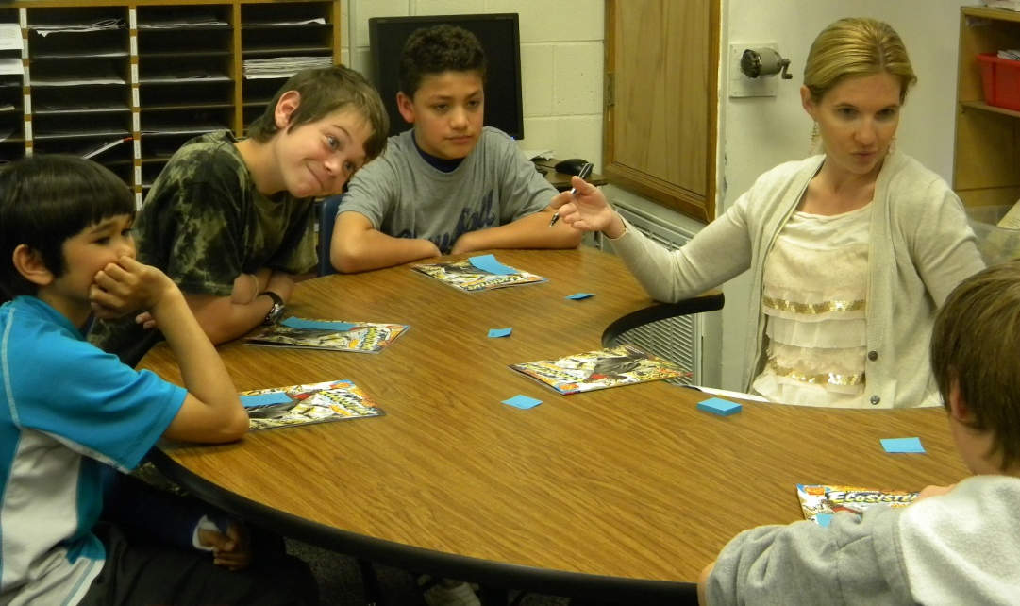
Before Reading
Access Prior Knowledge:
“Have you ever read a book quickly and then not known what you read?”
The guys all grinned and said, “YES!”

Slide 4
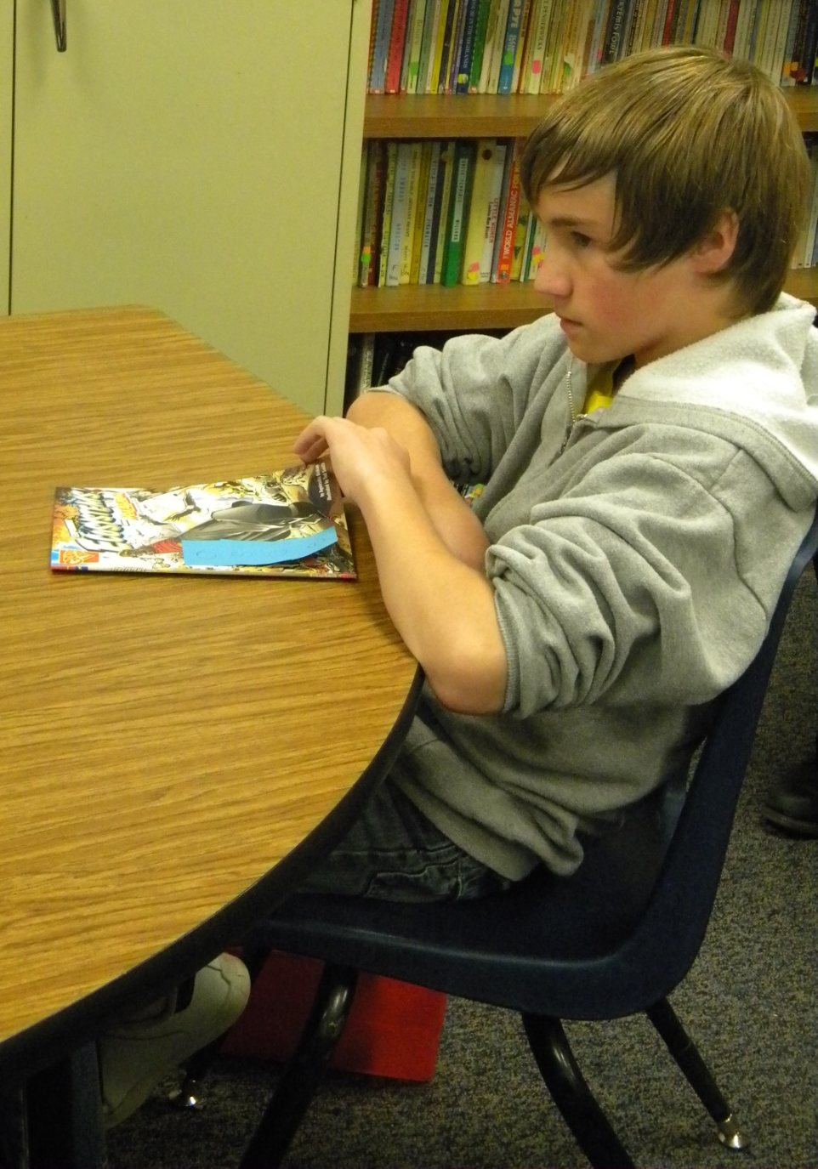
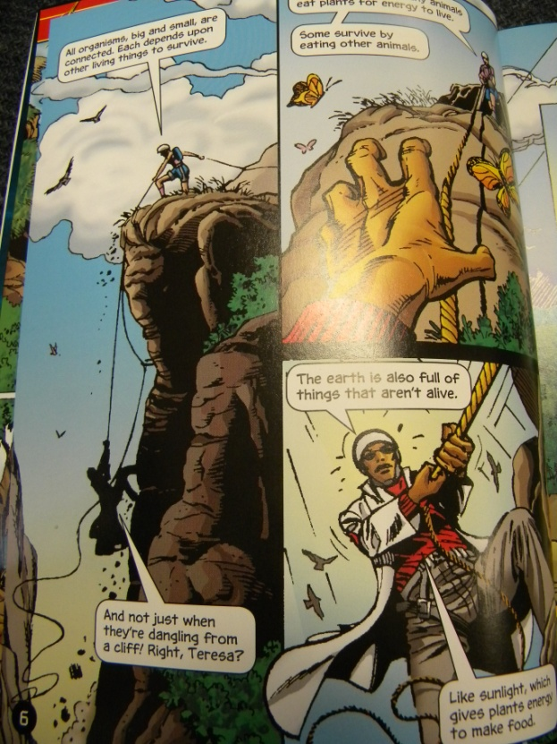
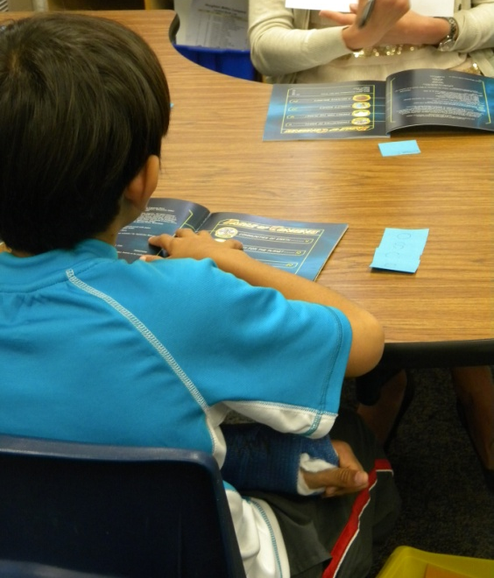
Before Reading
Review the format of the book:
“I know you have used books in this series before. Do you remember how they are set up?”

Slide 5
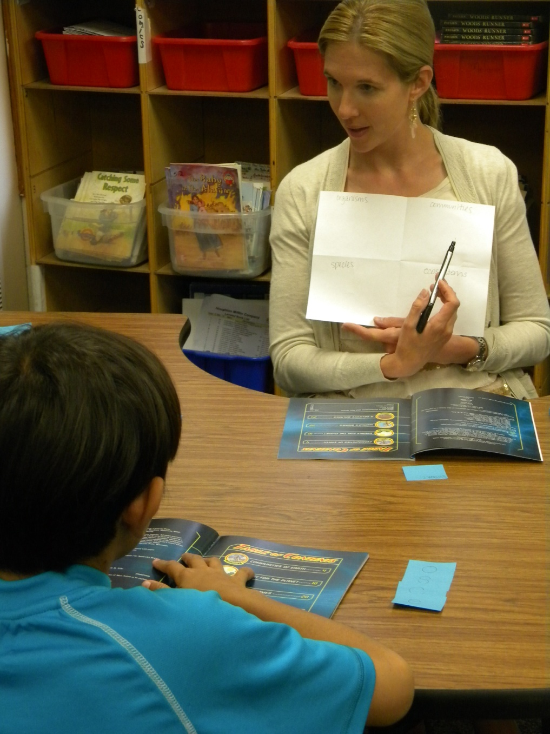
Before Reading
O
organisms | communities
species | ecosystems
C
S
E
Goals:
Read to learn new information about ecosystems
What is an organism, species, community and ecosystem? Use sticky notes to mark the information in the text.

Slide 6
Before Reading
New Information:
“When you are reading for information, sometimes you have to adjust your rate to help you understand. If you find yourself not understanding, slow down.
Goals:
Read to learn new information about ecosystems.
What is an organism, species, community and ecosystem? Use sticky notes to mark the information in the text.
Adjust your rate to help you understand.

Slide 7
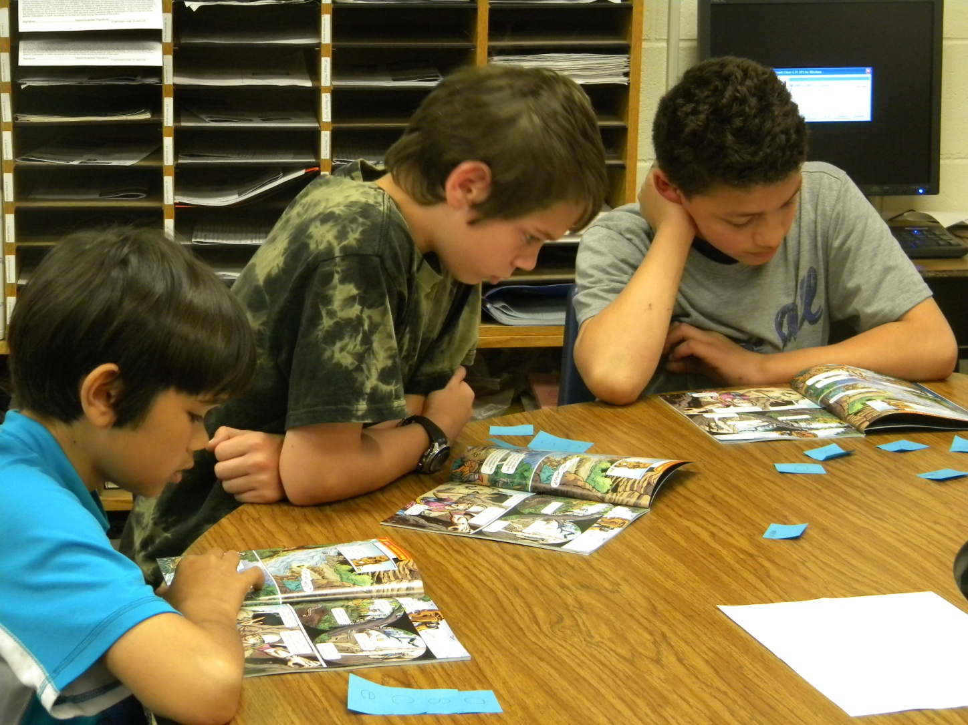
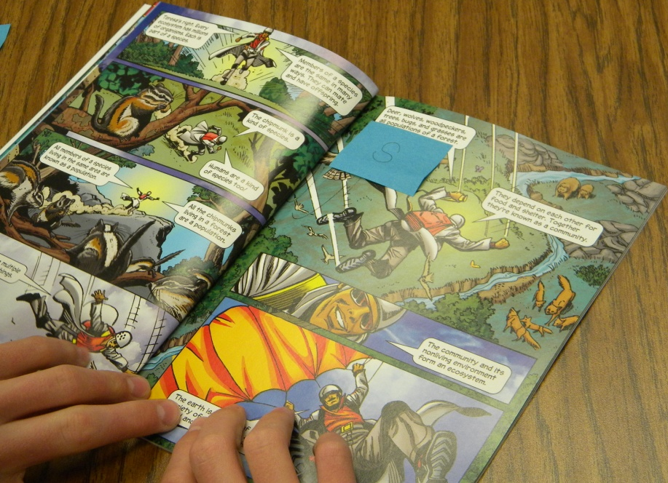
During Reading
The students:
read silently
used sticky notes to mark new information

Slide 8
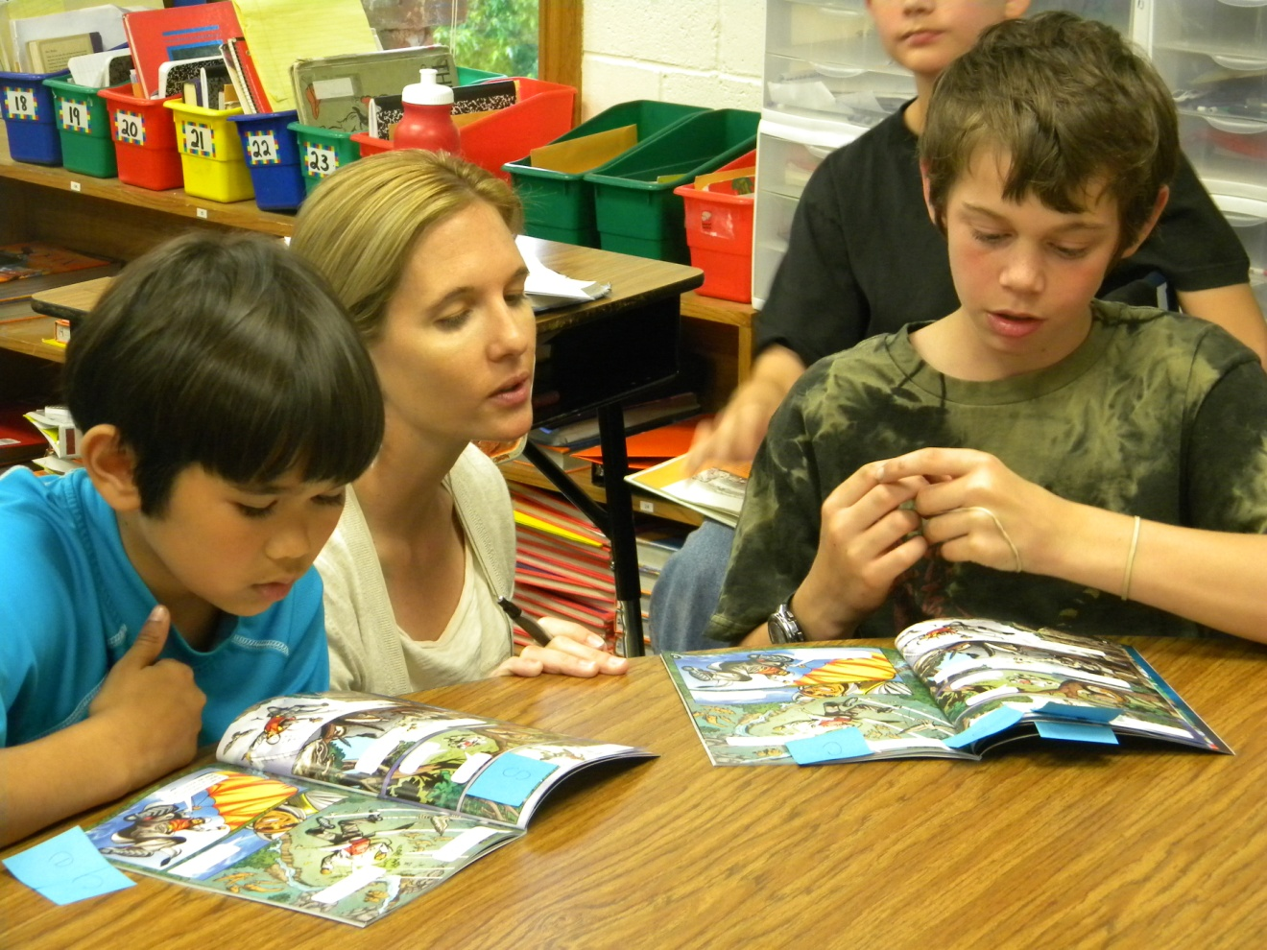
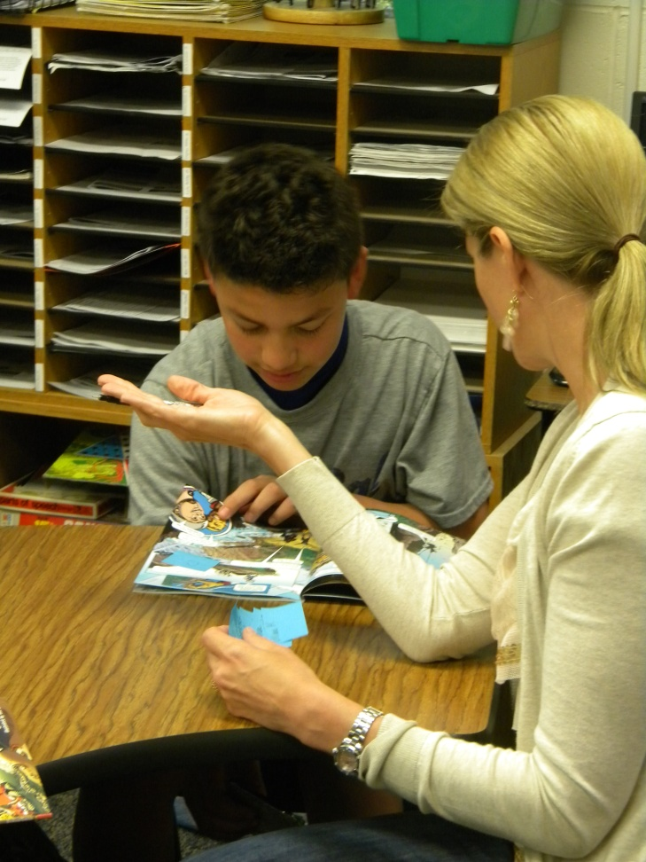
During Reading
Gretchen (the teacher):
listened to students read a portion of the text
prompted to the goals when necessary
jotted anecdotal notes about the students

Slide 9
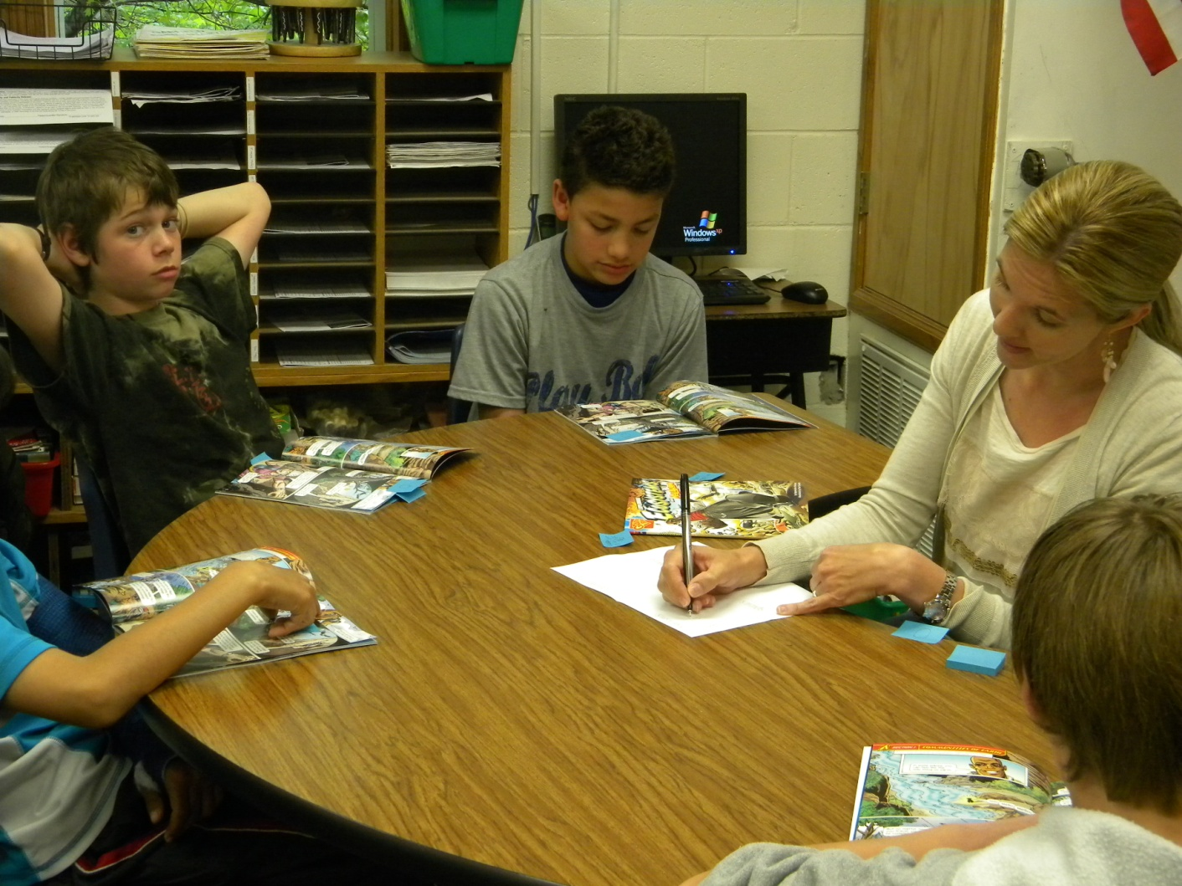
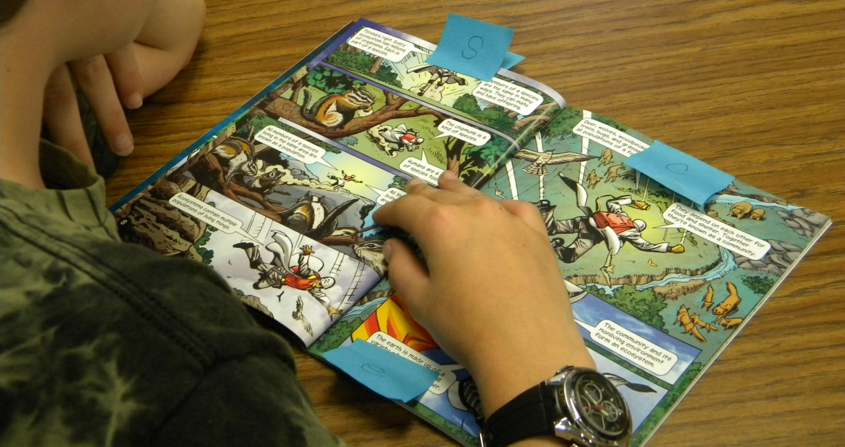
After Reading
Revisit the Goal:
The boys helped Gretchen complete the graphic organizer with information from the text.

Slide 10
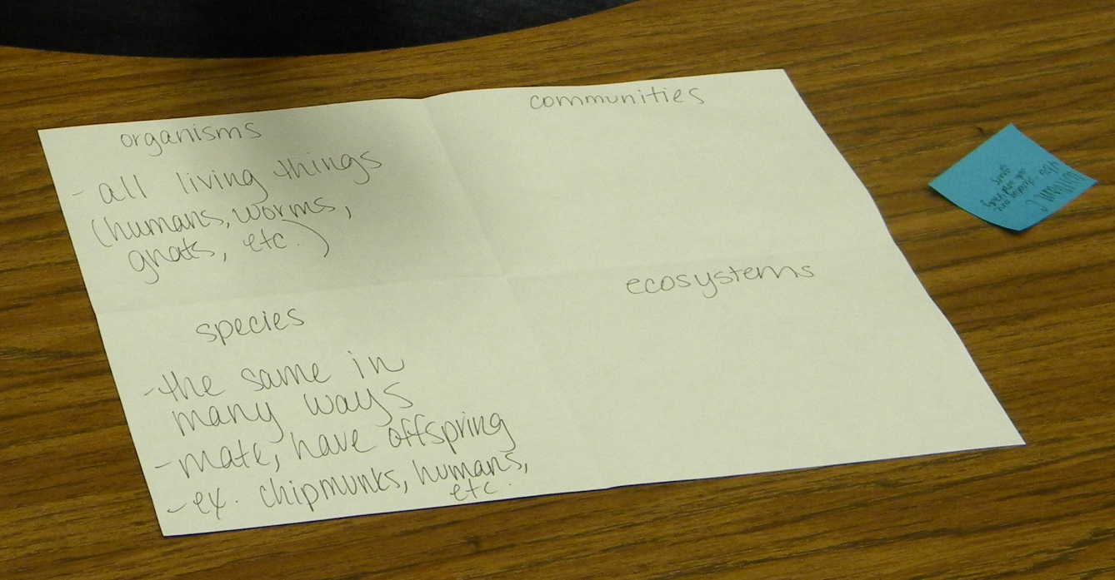
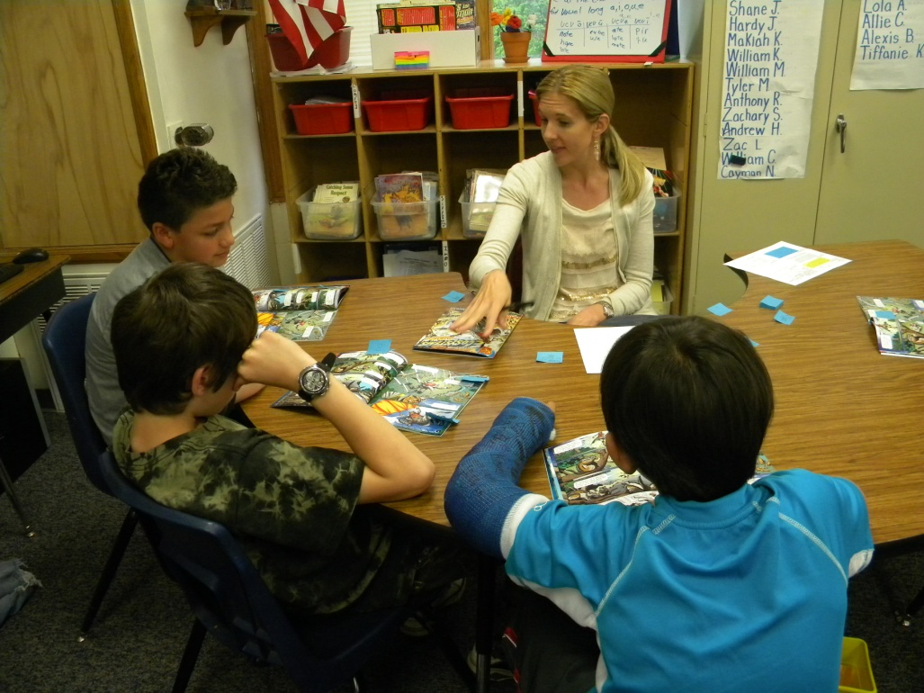
After Reading
Revisit the Goals:
They discussed where in the text they had to adjust their pace to help them understand what they were reading.

Slide 11
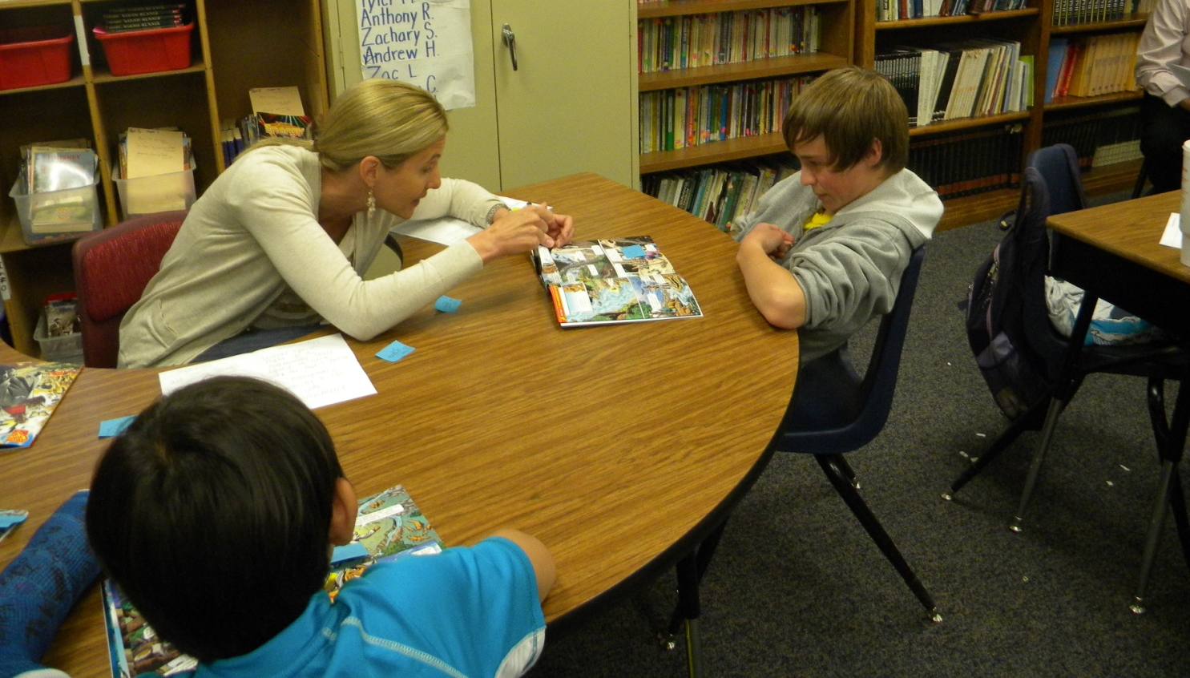
After Reading
Feedback from the students:
Gretchen asked the group, “How did you do stopping and thinking about how you could help yourself? Was it easy, tricky or hard?”

Slide 12
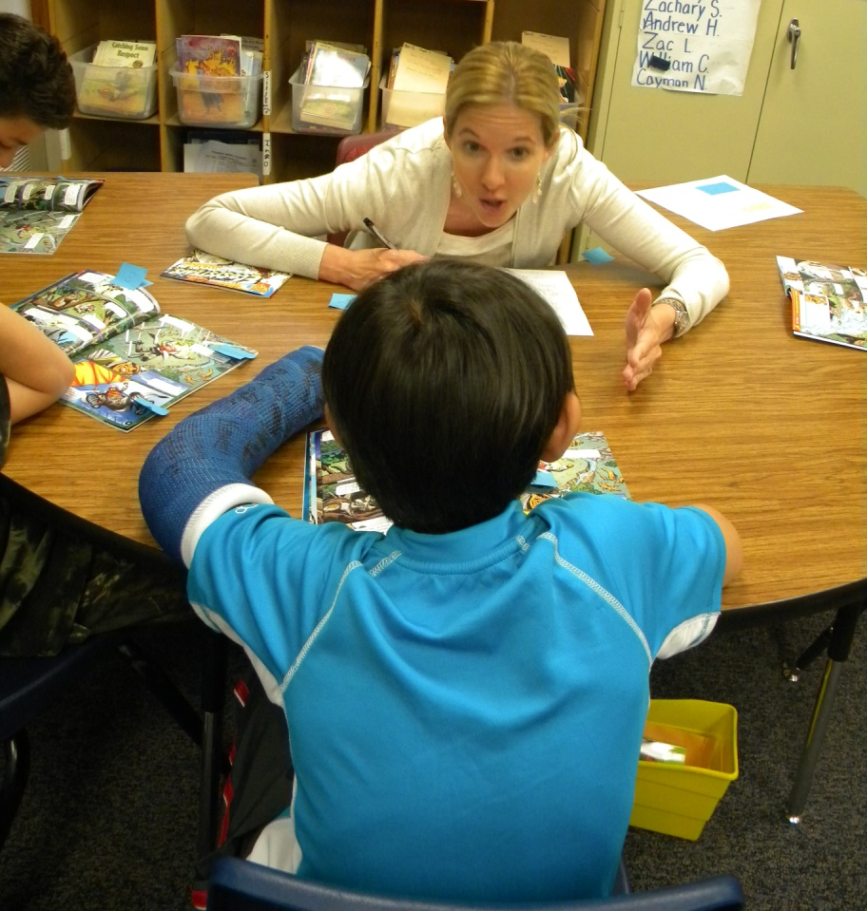
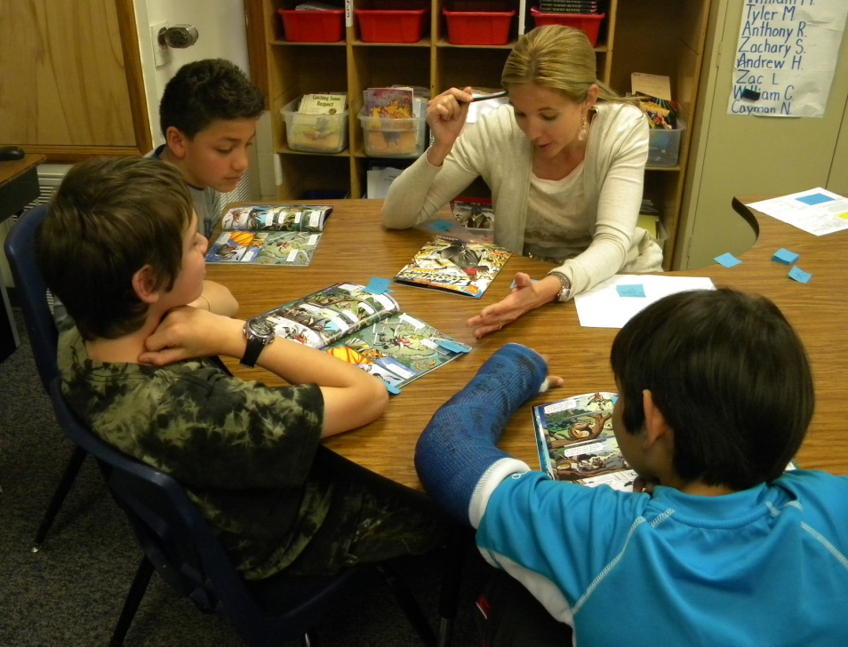
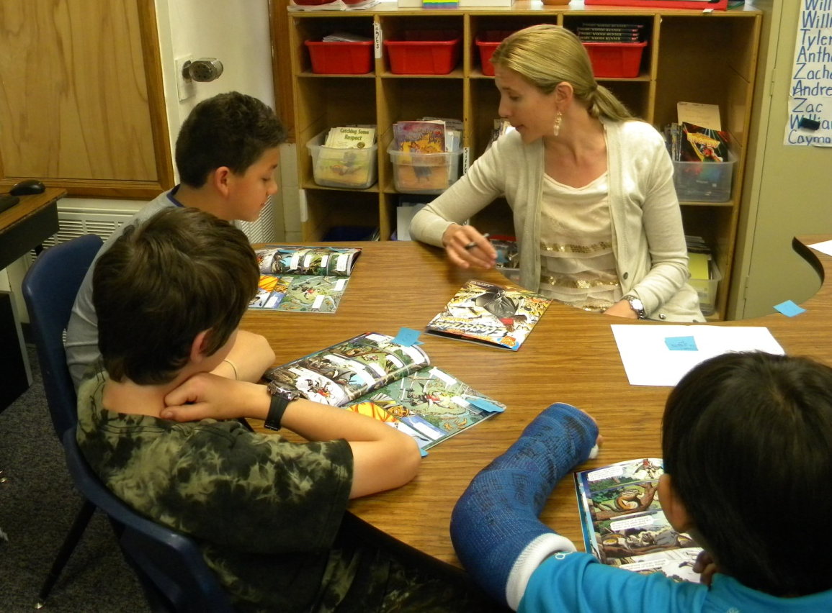
After Reading
Individual Feedback:
Gretchen gave each student individual feedback that was specific to the goals of the lesson.

Slide 13
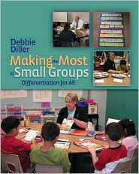
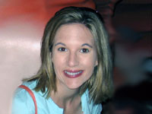
Diller, Debbie (2007). Making the Most of Small Groups; Differentiation for All. Portland, Maine: Stenhouse Publishers.
Gretchen Childs has been an educator for over 15 years. She has taught kindergarten and 2nd grade, as well as Special Education in Pre-K, 5th and 6th grades. She has been a District Literacy Coach, District Math Coach, and Reading Specialist. Gretchen has presented numerous workshops on literacy topics, and has traveled the country as a consultant for Debbie Diller & Associates since 2005.
Gretchen earned her degree from Southwest Texas State University, with specializations in both Special Education and Reading. She also carries an Early Childhood Education endorsement.
She resides in Pearland, Texas with her husband, Michael, and their three daughters.

