Slide 1
Ba Da Bing Sentences
Creating Strong Leads
Ms. Roller’s
5th Grade Class
Renee Simpson Literacy Facilitator
Northside Elementary
Rogers, AR
February 25, 2011

Slide 2
Purpose of the GANAG Structure
To give students the opportunity to actively use the nine high-yield strategies:
(2) Identifying Similarities and Differences
(7) Cooperative Learning
(8) Setting Objectives and Providing Feedback
(3) Summarizing and Note Taking
(4) Reinforcing Effort and Providing Recognition
(9) Generating and Testing Hypotheses
(5) Homework and Practice
(10) Cues, Questions and Advance Organizers
(6) Nonlinguistic Representations

Slide 3
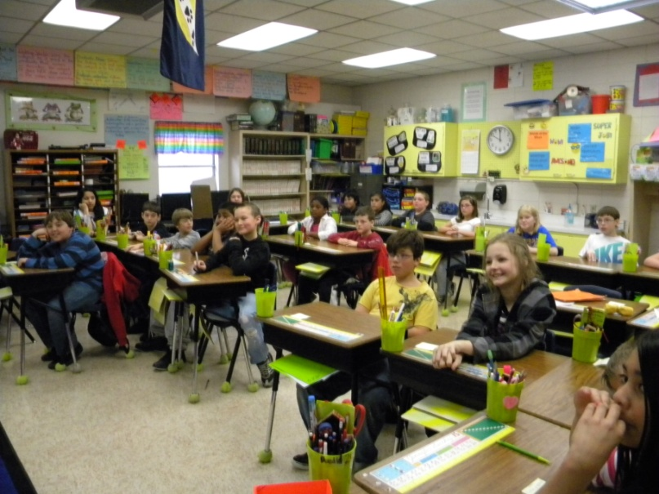
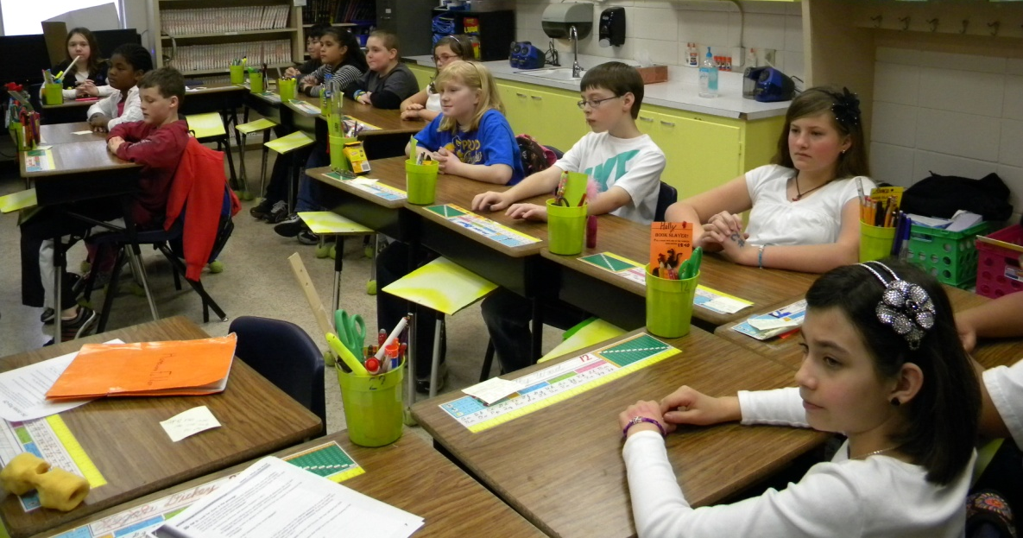
3.
A= Access Prior Knowledge
Ms. Simpson began:
“Hello.”
“Working on making sentences.”
“Fun to do.”
“Waiting for homework.”
“Wonder homework.”
“Ideas?”
“Begin now.”
“PROBLEM?”
The students looked amused and confused.
Students-“You are not talking in sentences.”

Slide 4
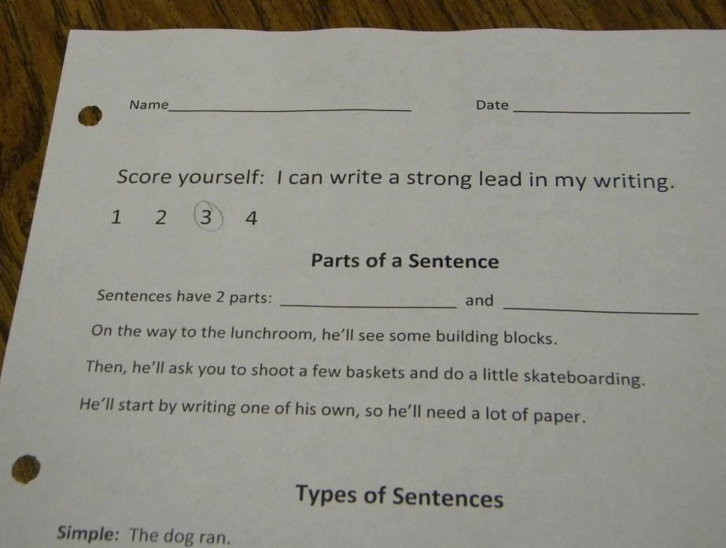
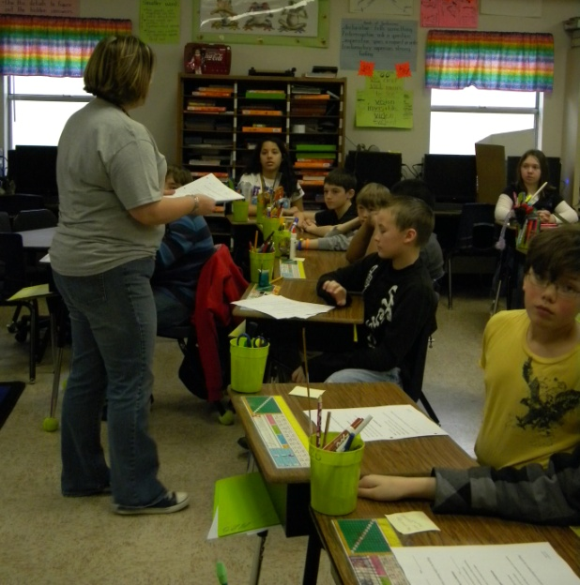
4.
G= Goal
I can create a strong lead in my writing.
W.4.5.7
Create an effective lead sentence for each paragraph by using such features as questions or exclamations
W.7.5.5
Create a strong lead and conclusion
Students were asked to score themselves .

Slide 5
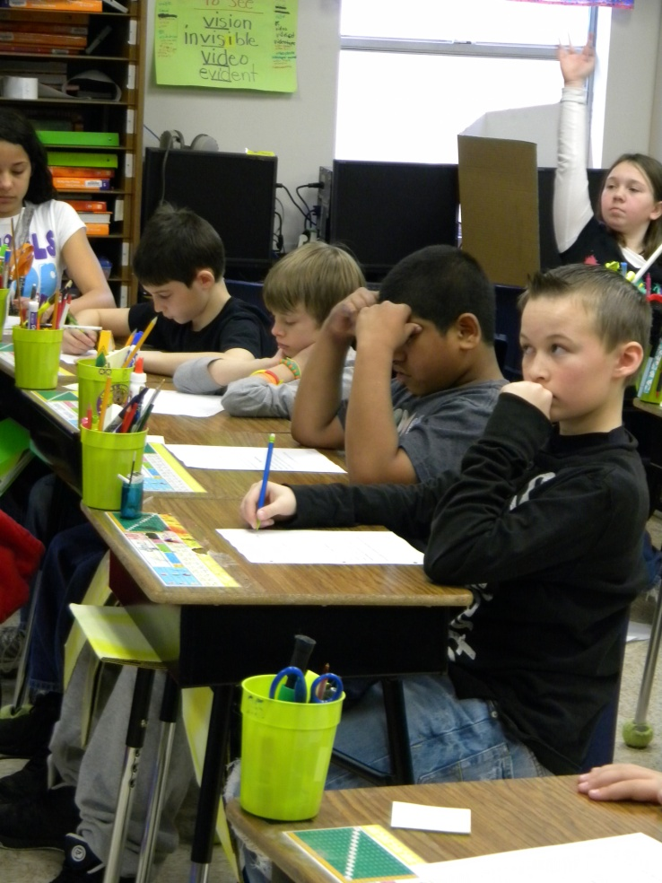
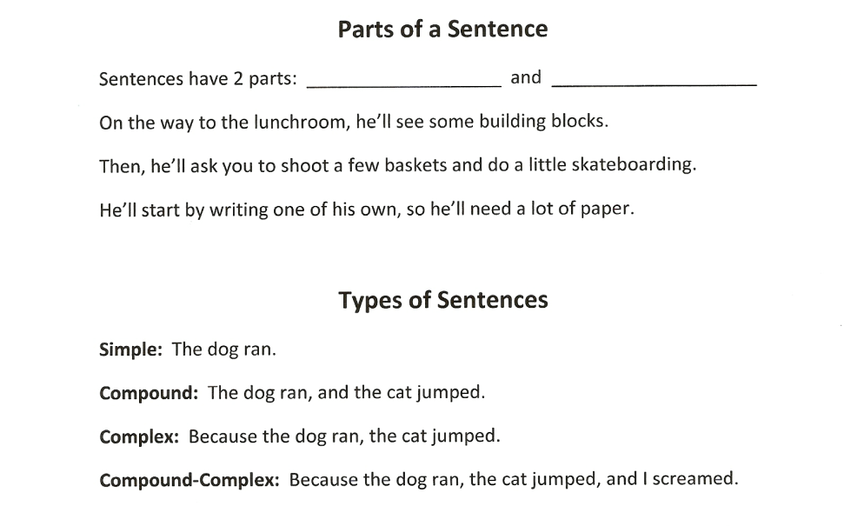

N= New Information
5.
“What is a lead?”
“What are the features of a good lead?”
“We are going to need to use what we know about complete sentences to help us write strong leads.”
The class used text from a previous lesson to review parts and types of sentences.

Slide 6
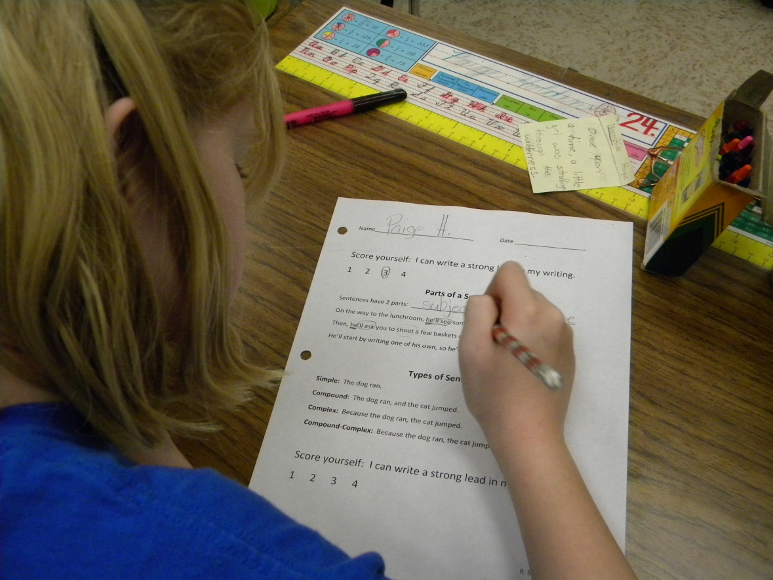
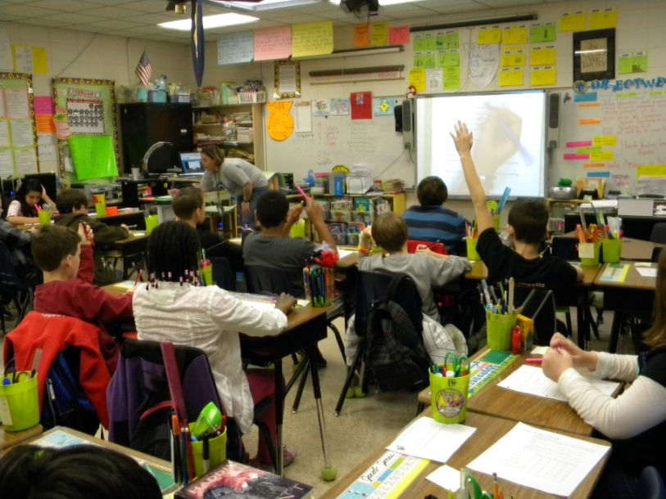
N= New Information
6.
Students, circled, underlined and highlighted.

Slide 7
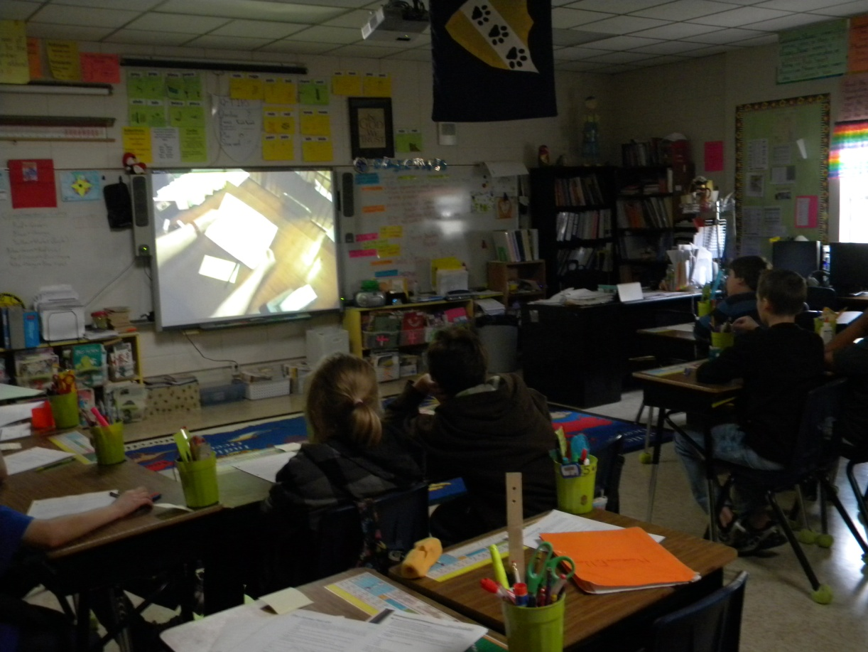
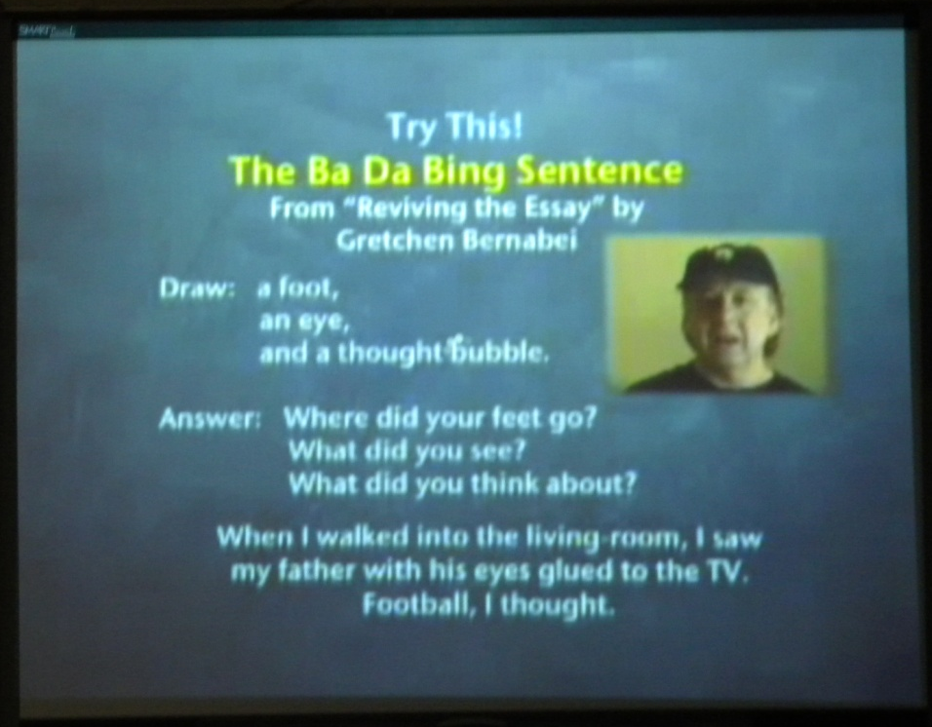
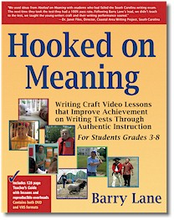
N= New Information
7.
Ba Da Bing Sentences
The students viewed Barry Lane video clip #3: Create Unique Sentences
Hooked on Meaning by Barry Lane

Slide 8
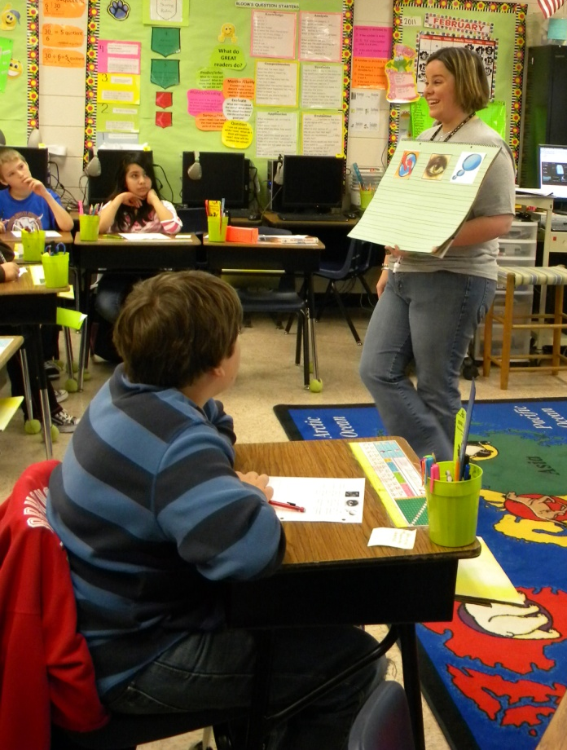
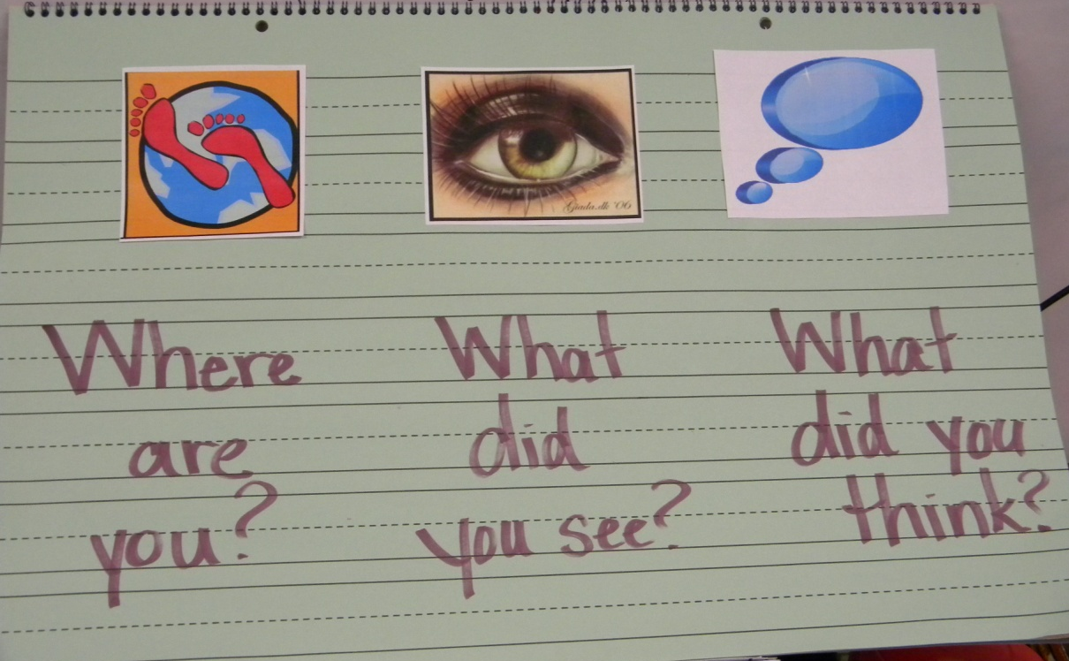
N= New Information
8.
An anchor chart was created with the students.

Slide 9
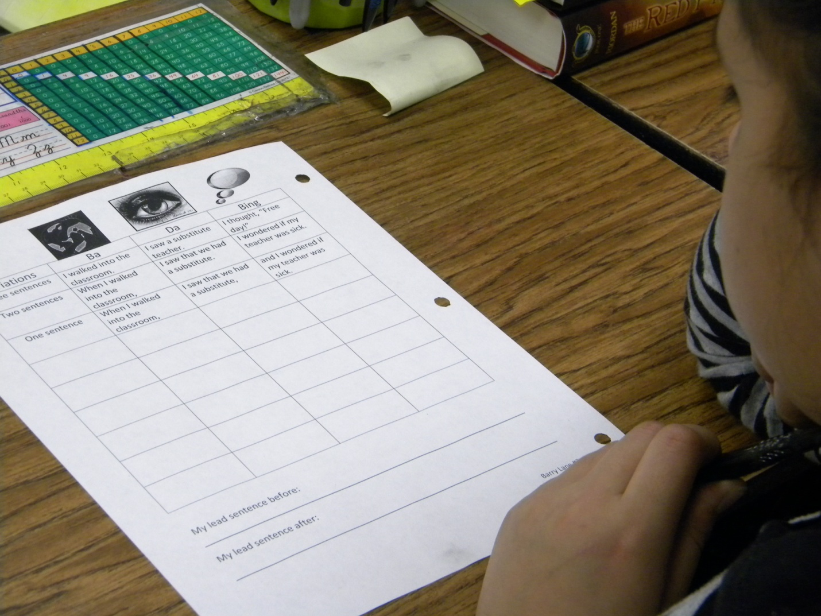
N= New Information
9.
The class practiced writing Ba Da Bing Lead Sentences using three variations (three sentences, two sentences, and one sentence).

Slide 10
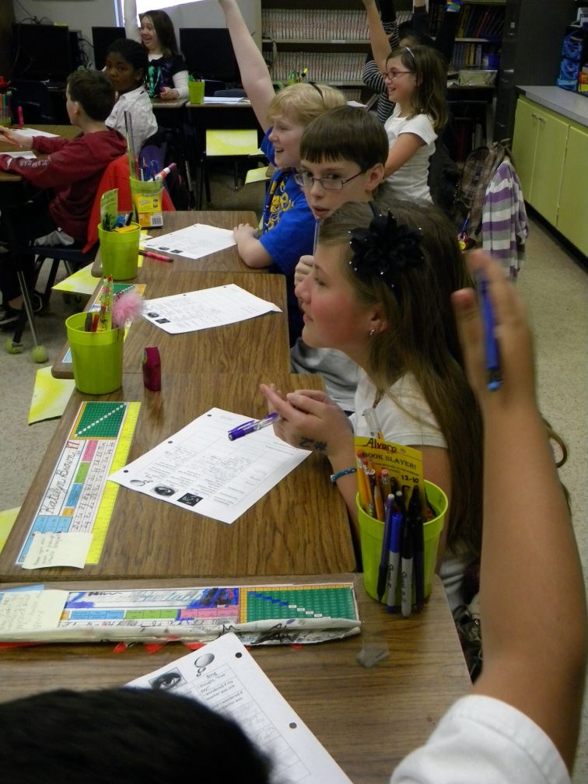
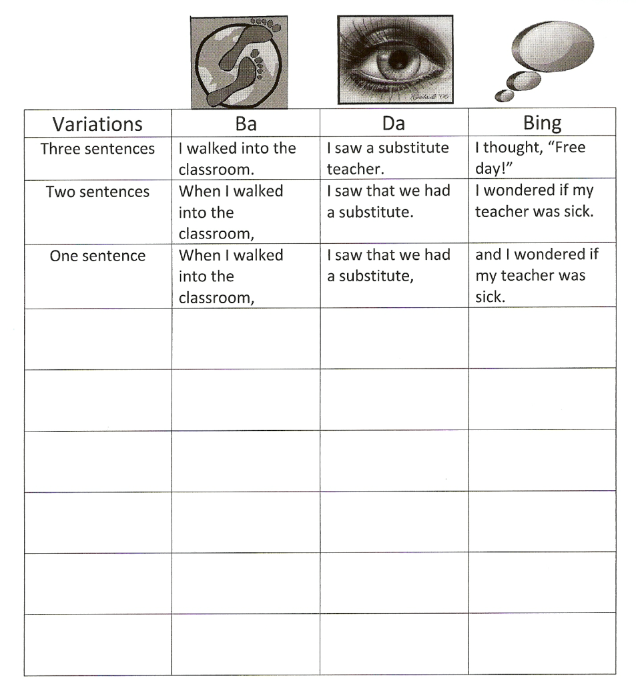
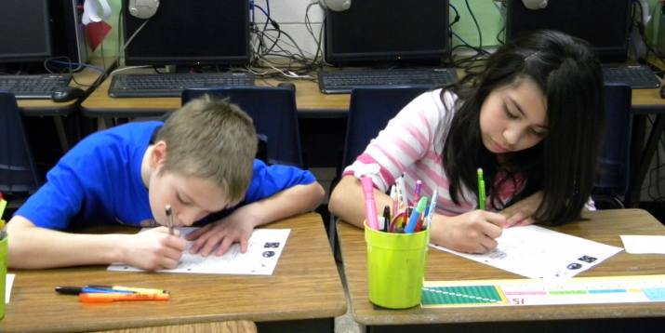
N= New Information
10.
Student’s collaborated with the whole group to create Ba Da Bing sentences.

Slide 11
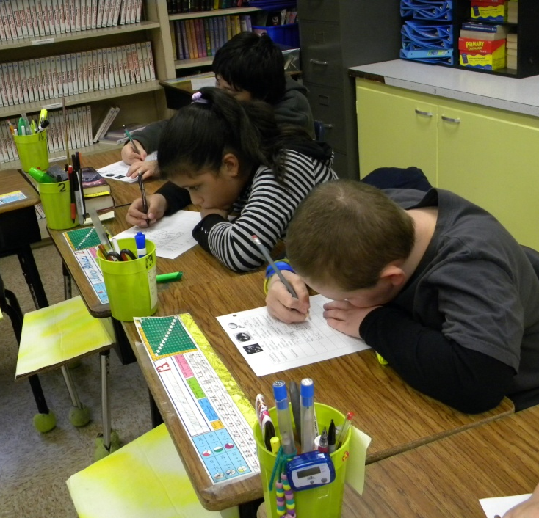
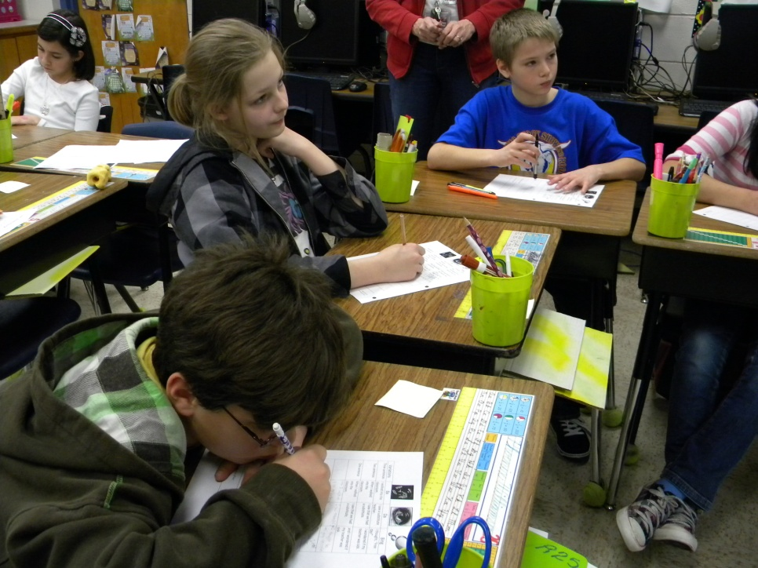
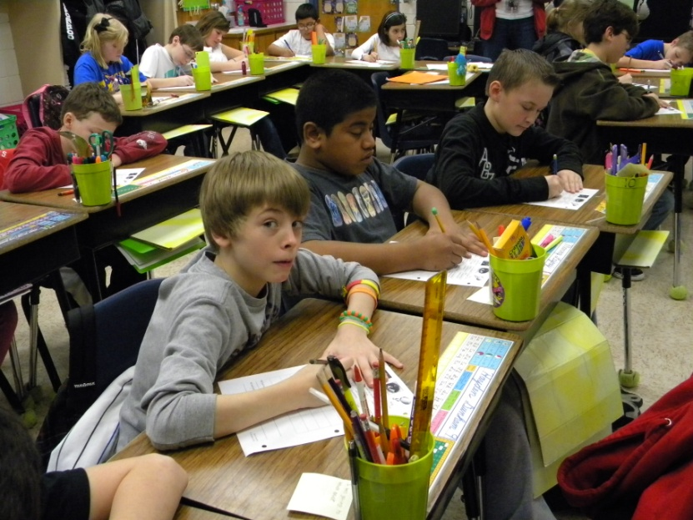
N= New Information
11.

Slide 12
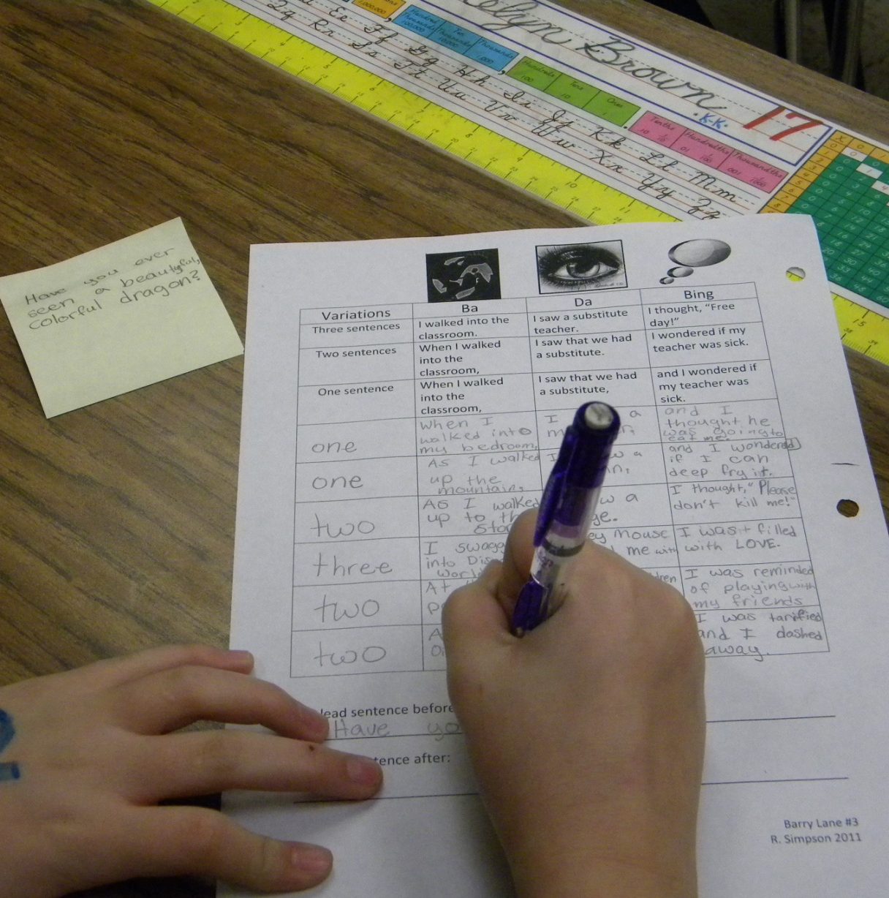
A= Apply Knowledge
12.
(Prior to the lesson, the students were asked to write a lead sentence on a post-it note.)
“Copy your lead sentence on the before line.”
“Use what you have learned today to rewrite your lead sentence on the after line.”

Slide 13
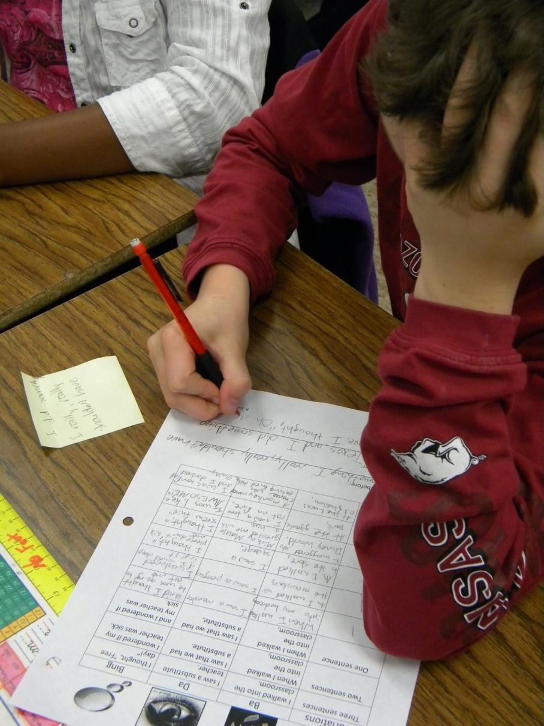
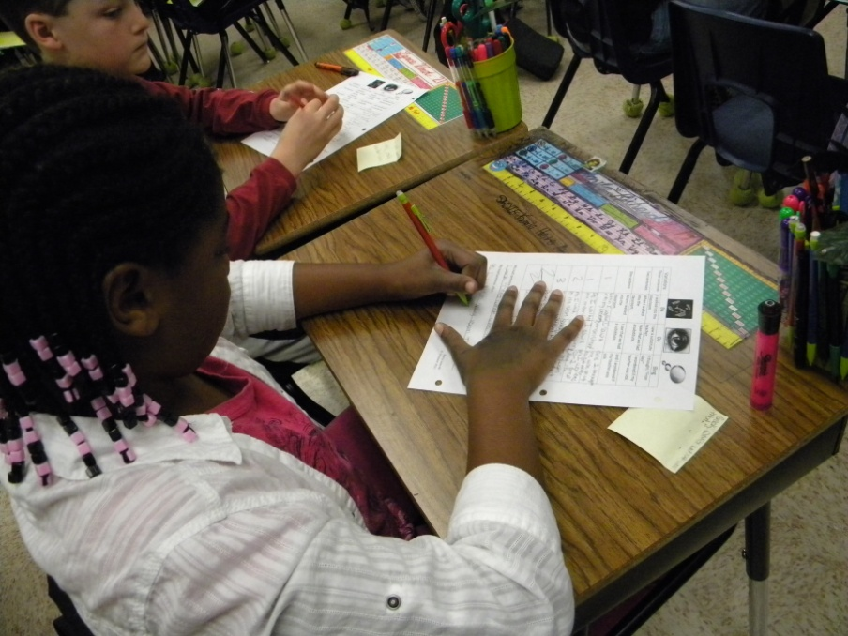
A= Apply Knowledge
13.

Slide 14
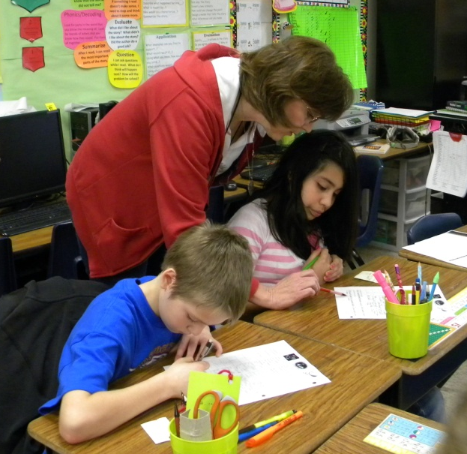
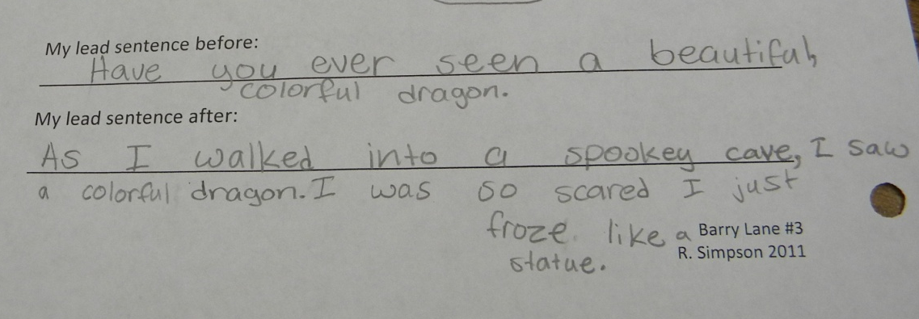
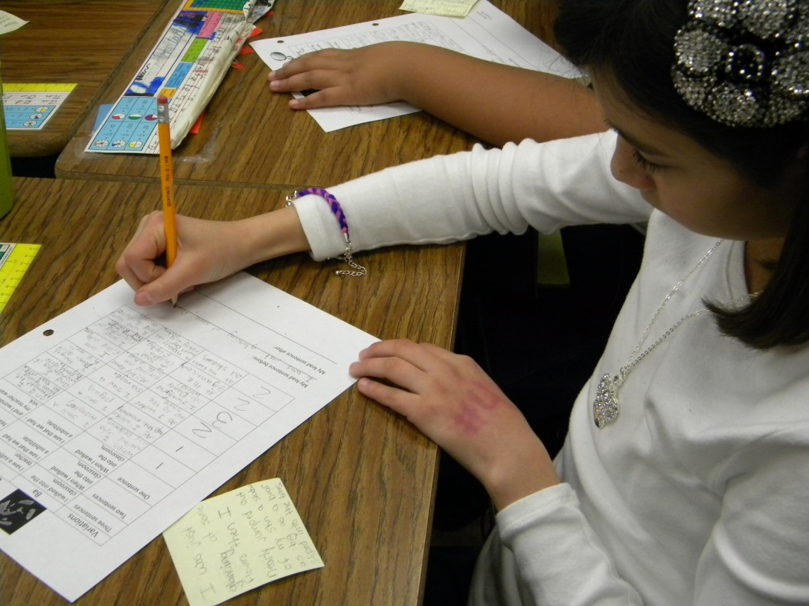
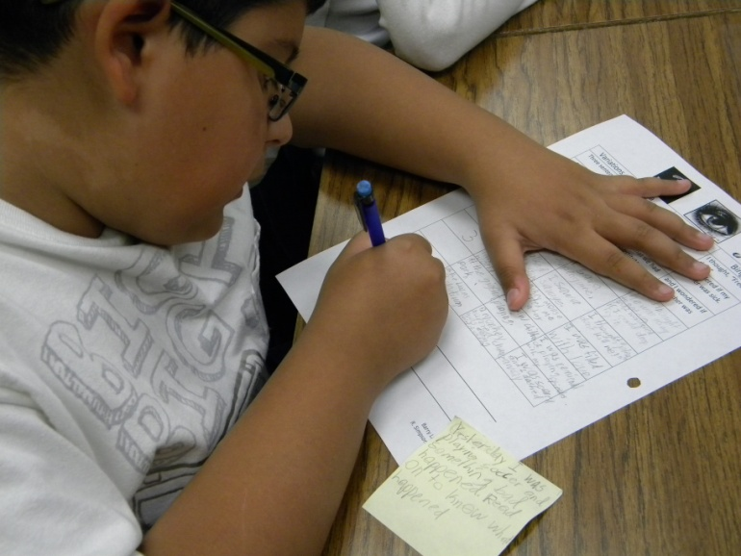
A= Apply Knowledge
14.

Slide 15
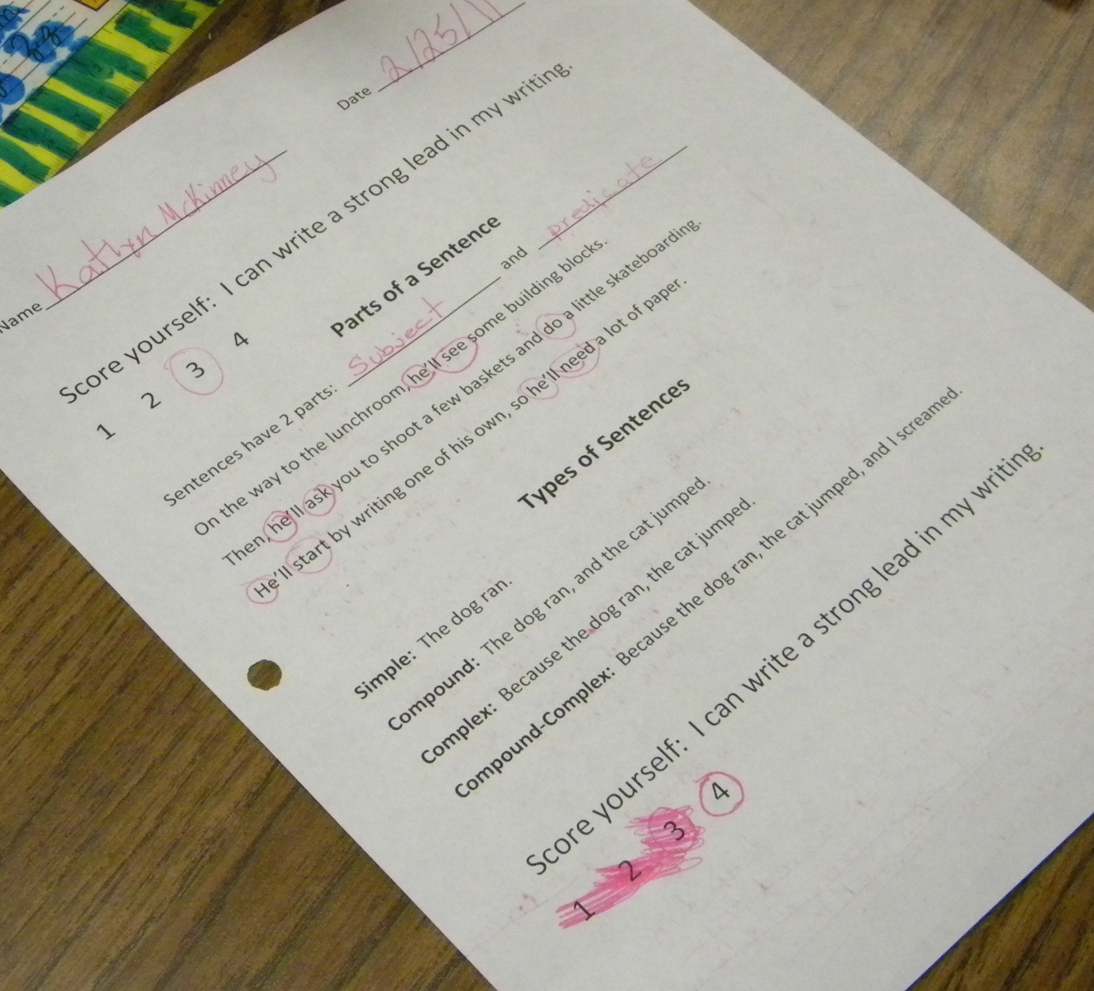
G= Generalize the Goal
15.
Students revisited the goal and then scored themselves again.

Slide 16
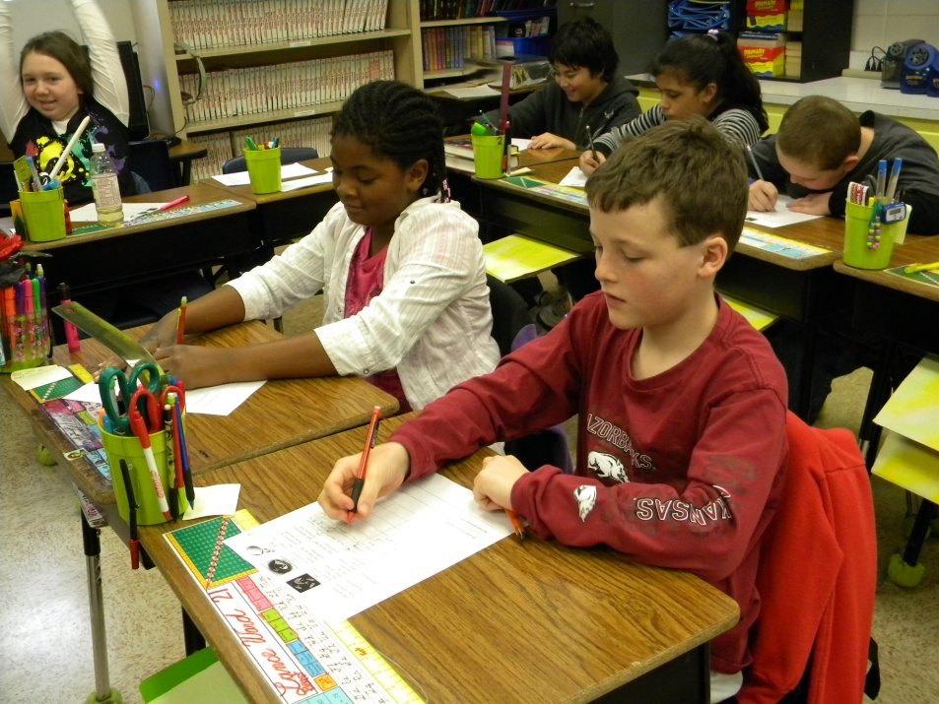
G
A
N
A
G
Student Use of the High Yield Strategies

Slide 17
Ms. Simpson’s Reflections
(3) Summarizing and Note Taking
Slide 5, 6, 9-11
(4) Reinforcing Effort and Providing Recognition
Slide 10
(5) Homework and Practice
Slide 10- 14

Slide 18
(6) Nonlinguistic Representations
Slide 8
(8) Setting Objectives and Providing Feedback
Slide 4, 15
(10) Cues, Questions and Advance Organizers
Slide 3,5,6, 9-11

Slide 19
Ms. Simpson felt the students did not actively use these strategies.
(2) Identifying Similarities and Differences
(7) Cooperative Learning
(9) Generating and Testing Hypotheses

Slide 20
Ms. Simpson’s reflections on how to incorporate student use of these strategies next time.
(2) Identifying Similarities and Differences
Ask the students to compare their before and after sentence.
(7) Cooperative Learning
Let students work with partners to complete part of the table.
(9) Generating and Testing Hypotheses
Ask the students, “What would happen if we switched the order of the Ba Da Bing parts?”

Slide 21
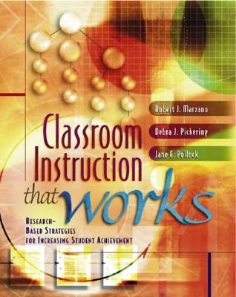


Marzano, R. J., Pickering, D. J., & Pollock, J. E. (2001). Classroom instruction that works: Research-based strategies for increasing student achievement. Alexandria, VA: Association for Supervision and Curriculum Development.
Pollock, J. E. (2007). Improving student learning one teacher at a time. Alexandria, VA: Association for Supervision and Curriculum Development.
Pollock, J. E., & Ford, Sharon M. (2009). Improving student learning one principal at a time. Alexandria, VA: Association for Supervision and Curriculum Development.

