Slide 1
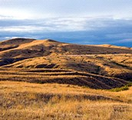
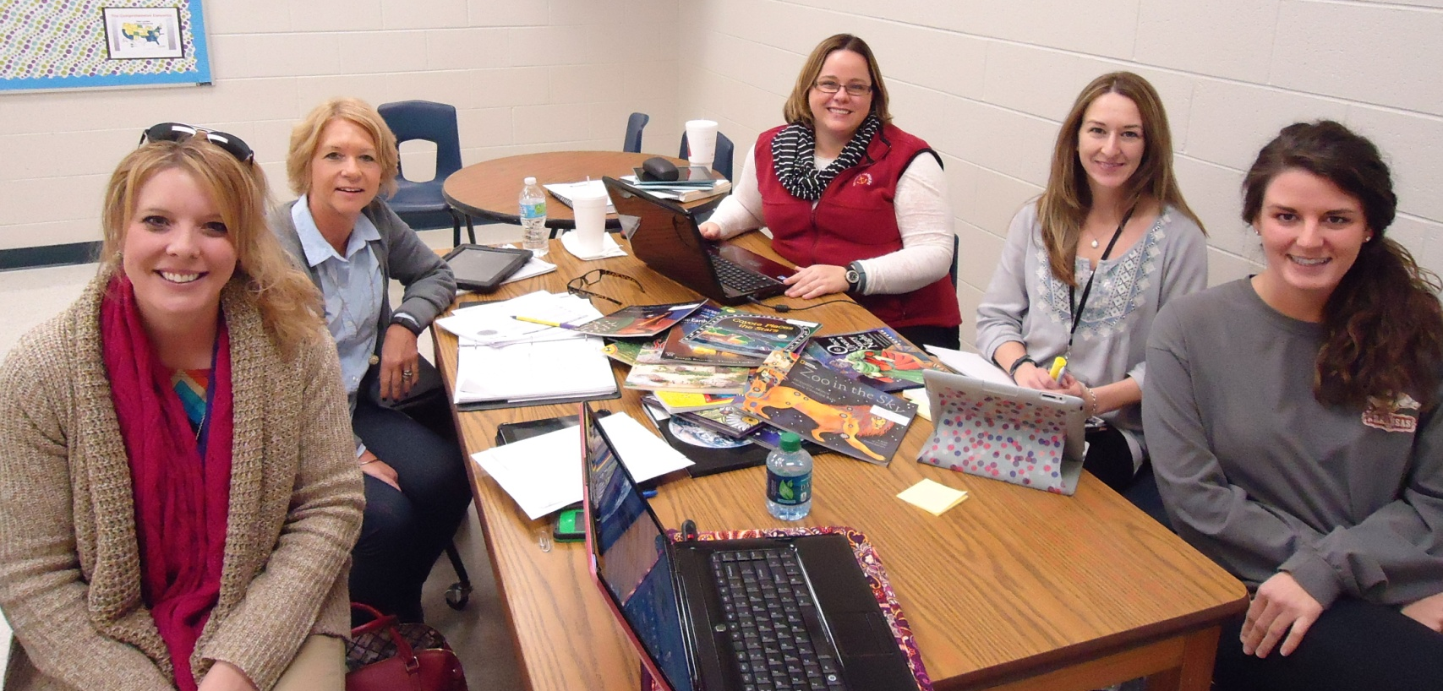

Stories of Earth & Sky
Fourth Grade Unit 5
Planning Team: Kristy Brown (GF), Liz Begnoche (FT), Renee Simpson (JM), Angela Black (ES), Kelly Wilkinson (BG)

Slide 2
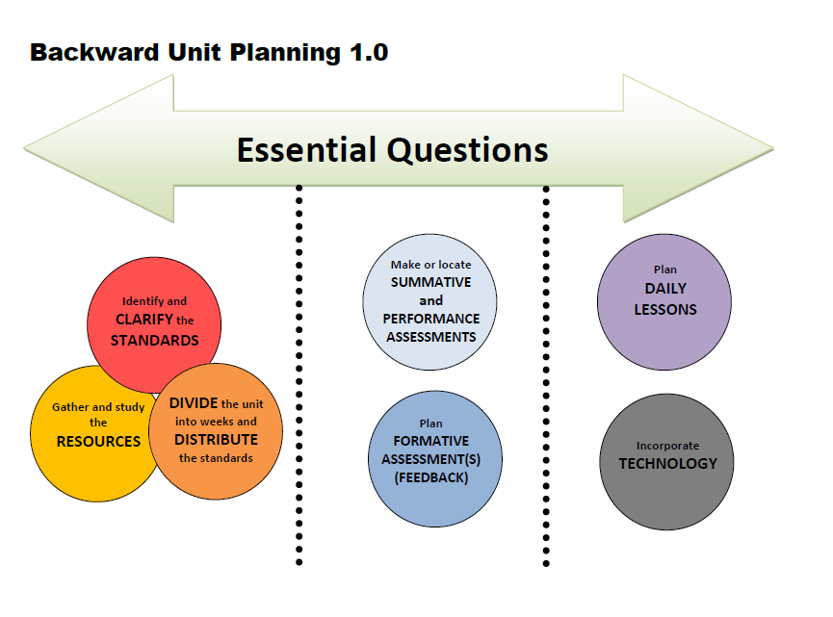

Slide 3
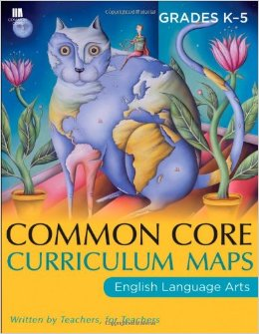
Stories of Earth & Sky
Essential Question
How do the unknown origins of the earth and sky inspire readers, writers, and inventors?
Why are reasons and evidence essential?

Slide 4
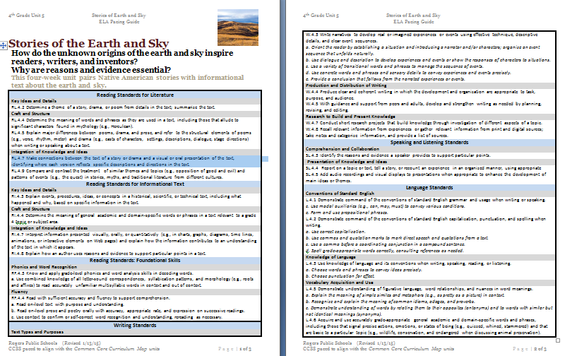
Unit Pacing Guide

Slide 5
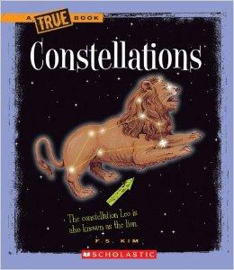
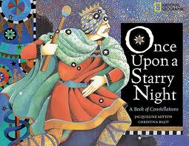
New Texts
28 copies
27 additional copies

Slide 6
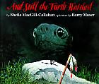
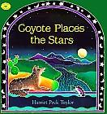


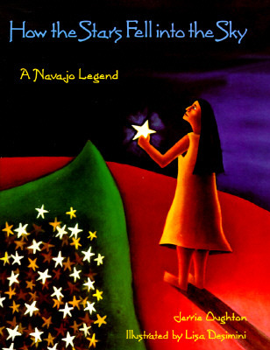
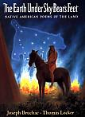

4th Grade
Print Resources
Unit 5
Literature
Poems
Poems
For Earth Day

Slide 7
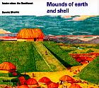
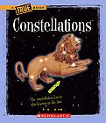

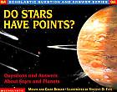
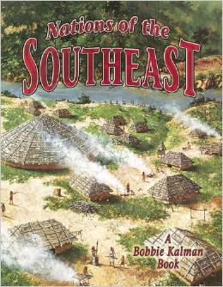
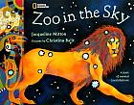
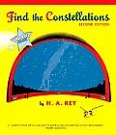
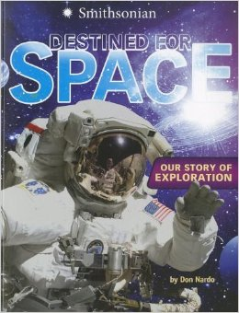

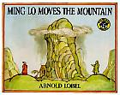
Informational Text
Native Americans
Earth, Sun, Moon, and Stars
Space
Grammar

Slide 8
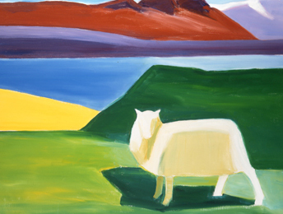
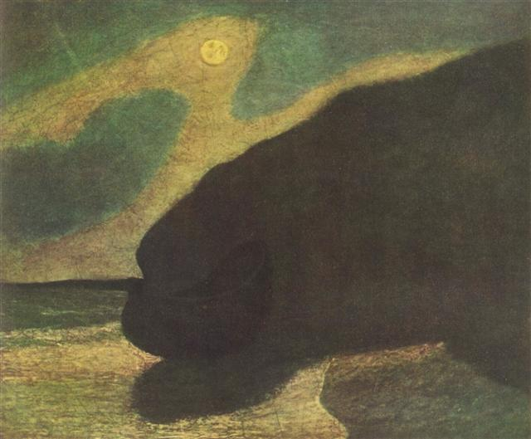
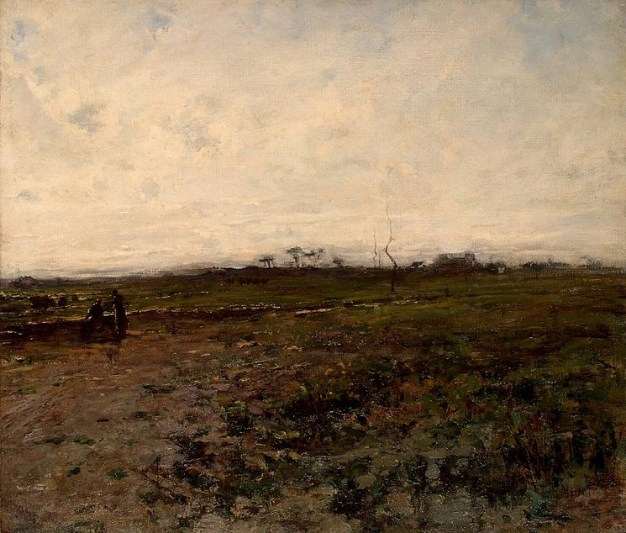
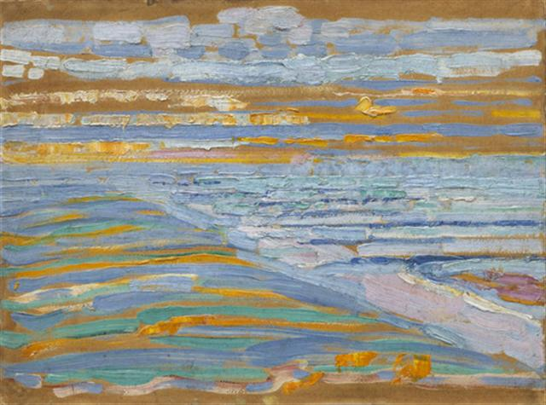
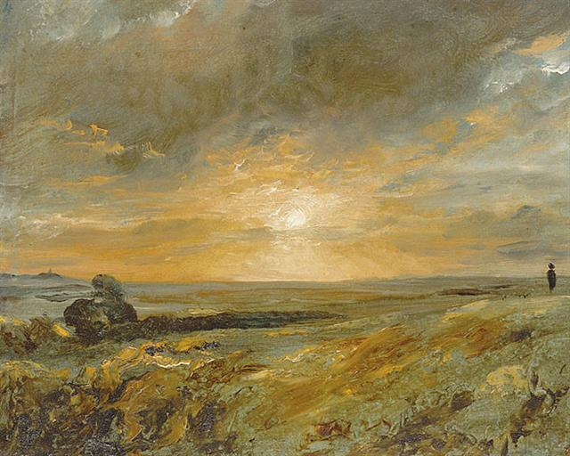
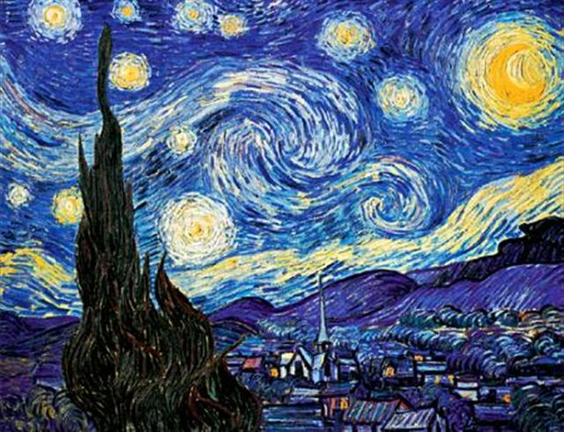
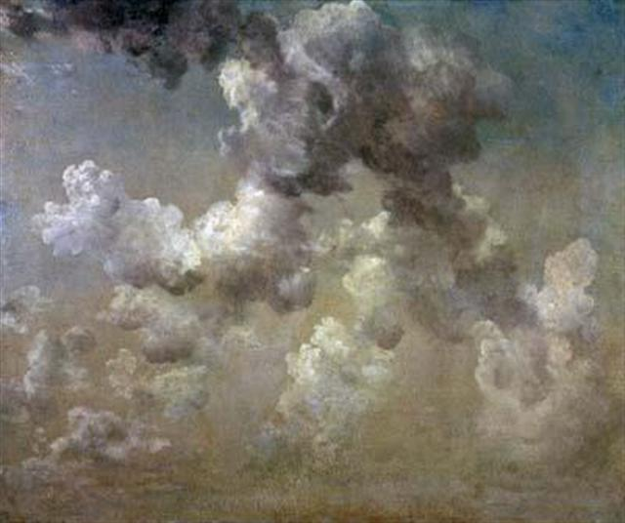
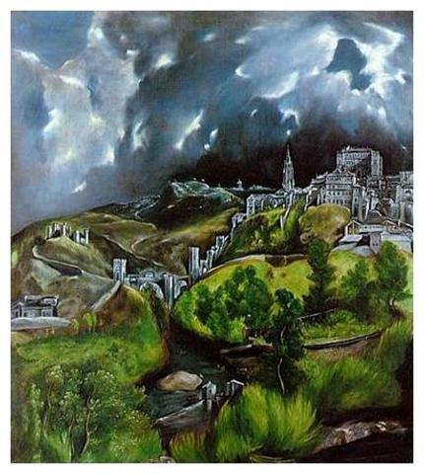
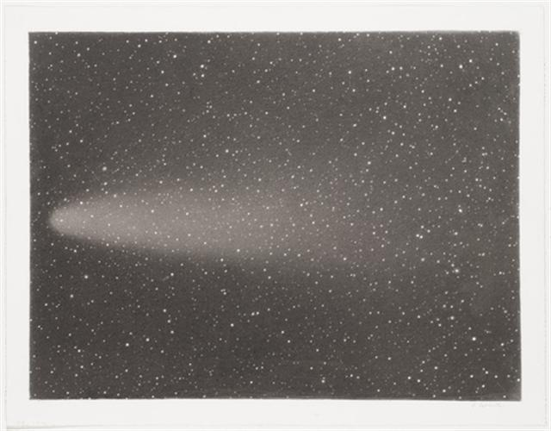
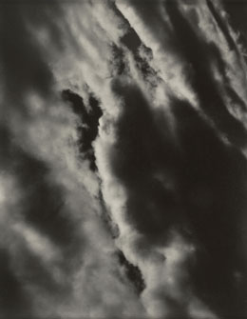
Art
Earth Images
Sky Images

Slide 9
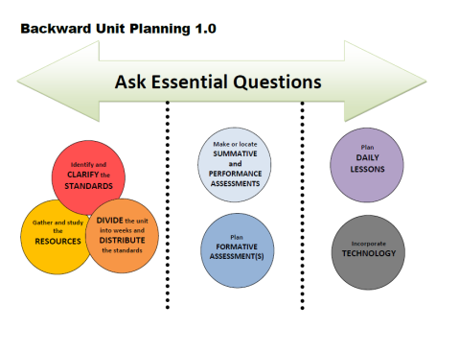
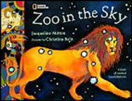


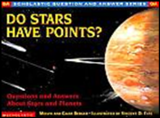

Week | Standards | Texts
1 | RI.4.3 Explain events, procedures, ideas, or concepts in a historical, scientific, or technical text, including what happened and why, based on specific information in the text. RI.4.4 Determine the meaning of general academic and domain-specific words or phrases in a text relevant to a grade 4 topic or subject area. RL.4.4 Determine the meaning of words and phrases as they are used in a text, including those that allude to significant characters found in mythology (e.g., Herculean). L.4.2b. Use commas and quotation marks to mark direct speech and quotations from a text. L.4.2c. Use a comma before a coordinating conjunction in a compound sentence. | Videos discussing constellations BrainPop: Constellations
DIVIDE the unit into weeks and DISTRIBUTE the standards
Notes:
Story kit tutorial
https://www.youtube.com/watch?v=RSWQkUS4kXk

Slide 10

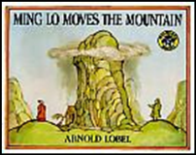
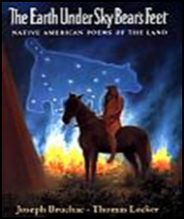





Weeks | Standards | Texts
2 & 3 | RL.4.2 Determine a theme of a story, drama, or poem from details in the text; summarize the text. RL.4.4 Determine the meaning of words and phrases as they are used in a text, including those that allude to significant characters found in mythology (e.g., Herculean). RL.4.5 Explain major differences between poems, drama, and prose, and refer to the structural elements of poems (e.g., verse, rhythm, meter) and drama (e.g., casts of characters, settings, descriptions, dialogue, stage directions) when writing or speaking about a text. RL.4.7 Make connections between the text of a story or drama and a visual or oral presentation of the text, identifying where each version reflects specific descriptions and directions in the text. RL.4.9 Compare and contrast the treatment of similar themes and topics (e.g., opposition of good and evil) and patterns of events (e.g., the quest) in stories, myths, and traditional literature from different cultures. L.4.1c. Use modal auxiliaries (e.g., can, may, must) to convey various conditions. L.4.1e. Form and use prepositional phrases. | Text version of Coyote Places the Stars found on Teacher Created Resources
DIVIDE the unit into weeks and DISTRIBUTE the standards
Notes:
Story kit tutorial
https://www.youtube.com/watch?v=RSWQkUS4kXk

Slide 11

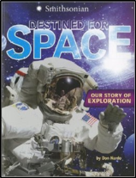
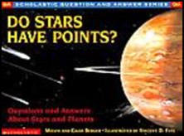



Week | Standards | Texts
4 | RI.4.3 Explain events, procedures, ideas, or concepts in a historical, scientific, or technical text, including what happened and why, based on specific information in the text. RI.4.4 Determine the meaning of general academic and domain-specific words or phrases in a text relevant to a grade 4 topic or subject area. RI.4.8 Explain how an author uses reasons and evidence to support particular points in a text W.4.3 Write narratives to develop real or imagined experiences or events using effective technique, descriptive details, and clear event sequences. W.4.8 Recall relevant information from experiences or gather relevant information from print and digital sources; take notes and categorize information, and provide a list of sources. L.4.2a. Use correct capitalization. L.4.3a. Choose words and phrases to convey ideas precisely. L.4.3b. Choose punctuation for effect. | Timekids.org *Student Work Samples for Summative Projects are on Teacher Created Resources under the assessments section.
DIVIDE the unit into weeks and DISTRIBUTE the standards
Notes:
Story kit tutorial
https://www.youtube.com/watch?v=RSWQkUS4kXk

Slide 12
Week | Standards | Essential Questions
1
2
3
4 |  | How do the unknown origins of the earth and sky inspire readers, writers, and inventors? Why are reasons and evidence essential?

Slide 13
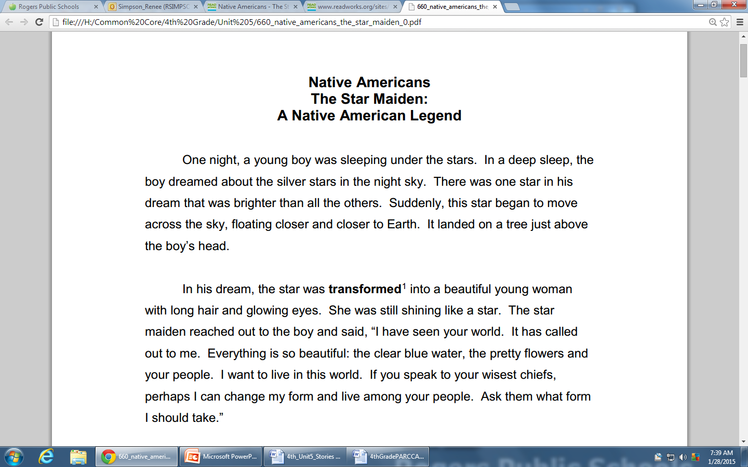
Assessments
The full assessment will be linked to Teacher Created Resources. Students will be asked to closely read two pieces, answer comprehension questions, and write an essay integrating information from both sources.

Slide 14



RESOURCES
Susan Hensley
Elementary Curriculum Specialist
shensley@rps.k12.ar.us

