Slide 1
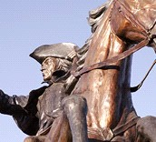
Revolutionaries from the Past
4th Grade Unit 4
Planning Team:
Karen Maloney, Adria Trombley, Jenifer Pastore, Kelly Wilkinson,
Debbie Moore, Megan Fawley
Notes:
This is the 4th grade unit 4 planning team. This is the 8 week unit, Revolutionaries from the Past.

Slide 2
Notes:
This is how we went about planning the unit.

Slide 3
Revolutionaries
from the Past
Essential Question
How does our understanding of events influence our opinions?
Notes:
We discussed the essential question many times during our planning. By the end of the day this is the essential question we decided on. “How does our understanding of events influence our opinions? We felt it crossed over into all areas of academics and life.

Slide 4
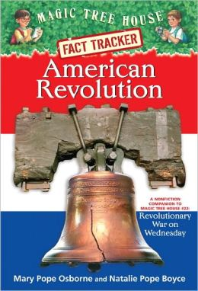
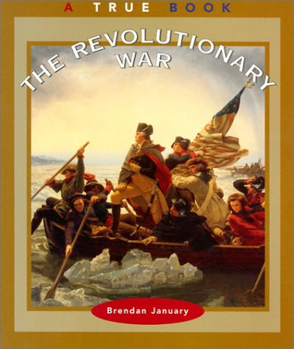
New and Additional Texts
28 Copies
28 Copies
Notes:
After identifying and clarifying our standards we realized we needed some additional nonfiction text that was not written in a narrative form. You will be getting 28 additional copies of The Revolutionary War, A True Book to use plus the Magic Tree House, Fact Tracker, American Revolution.

Slide 5
Week | ELA Standards | S.S Standards | Resources and Suggested Instruction
1 | (RI 4.4) Determine the meaning of general domain-specific words . (RI 4.5) Describe the overall structure, chronological. (L4.4) b. Use common Greek and Latin affixes and roots as clues to the meaning of a word. (L4.6) Acquire and use domain-specific words. (RI. 4.3) Explain events in a historical text including what happened and why. (RF.4.4)a. Read on-level text with purpose and understanding. (W.4.1a) Introduce a topic or text clearly, state an opinion and create an organizational structure in which related ideas are grouped to support the writer’s purpose. | (H6.4.4) Name the major causes of the American Revolutionary War: taxation, distance, lack of Communication. (H6.4.5) Identify George Washington as the lead general in the Revolutionary War. (H6 4.8) Discuss how differences between people lead to conflict. | *Anticipation Guide. Analyze and define the word Revolution. Begin a domain-specific word wall. (Wall the of Revolution) Day 1 Revolution word analysis. TCR School House Rock TCR *Point out chorological order. Begin timeline. This will carry out through the whole unit. Interactive Timeline http://www.readwritethink.org/classroom-resources/student-interactives/timeline-30007.htm
29 copies
Notes:
The first thing the teachers wanted to do was make sure your social studies standards were paced along with the ELA standards since the line up perfectly with the unit. You will notice each week we have the ELA standards on the left, the social standards that match in the middle, then resources and suggestions for instruction on the far right. It looks like there are a lot of standards each week and lots of resources and suggestions, but we wanted to make sure you had options and had your language and writing standards in each week. To kick off the unit the team is suggesting using an anticipation guide to see what the students already know about the Revolutionary War. There is a sample of what this looks like on the teacher created resource page. The team also planned the unit around the language standard 4, using common Greek and Latin affixes and roots as clues to the meaning of a word. The word, Revolution is the starting word. Lessons that go with this are found on the TCR page. The teachers came up with the idea of a word wall called, The Wall of Revolution that you could keep throughout the unit. If you notice the Reading standards paced for this week you are working on kicking off the unit with the two new texts and they are written in chronological order. This would lead to starting a timeline that could carry through the entire unit. There is a link here on how to make an interactive timeline. The social studies standards focus in on what information you are reading for each week.

Slide 6
Week | ELA Standards | S.S Standards | Resources and Suggested Instruction
2 | (RI. 4.3) Explain events in a historical text including what happened and why. (RI 4.5) Describe the overall structure, chronological. (S.S. text cause/effect) (RI.4.7) Interpret information presented visually and orally. (RF.4.4)a. Read on-level text with purpose and understanding. (L4.4) b. Use common Greek and Latin affixes and roots as clues to the meaning of a word. (L4.6) Acquire and use domain-specific words. (W.4.1a) Introduce a topic or text clearly, state an opinion and create an organizational structure in which related ideas are grouped to support the writer’s purpose. (W.4.1b)Provide reasons that are supported by facts and details. | (H6.4.4) Name the major causes of the American Revolutionary War: taxation, distance, lack of Communication. (H6.4.5) Identify George Washington as the lead general in the Revolutionary War. (C.5.4.2) Identify and explain the purpose of the founding documents: Declaration of Independence, Articles of Confederation, United States Constitution. | Brain Pop American Revolution *Practicing how to take notes from a video. Learn 360-Road to Revolution Continue Timeline. Pull excerpts from 5th grade social studies text. Chapters 8&9. (Cause/effect structure)
29 copies
Notes:
Week two goes into a cause/effect structure if you pull excerpts from the 5th grade social studies text book. You will continue to use the same books from the first week. We want to focus on taking notes from videos this week. There are videos on Brain Pop and Learn 360. If you look at the social studies standards this week they focus on the major causes, George Washington, and the founding documents.

Slide 7
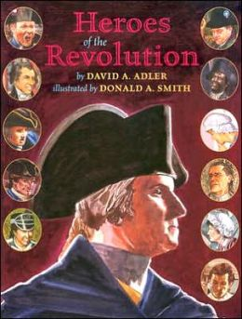
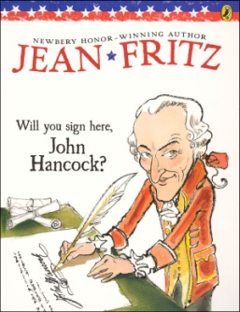
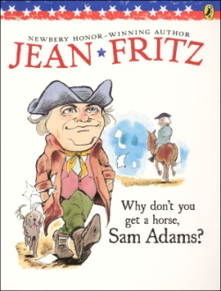
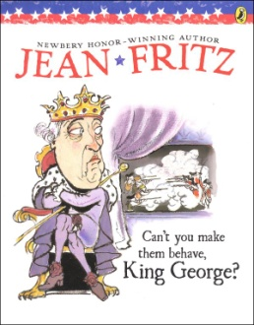
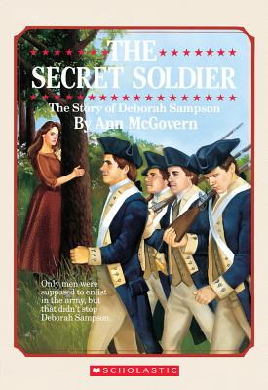
Week | ELA Standards | S.S Standards | Resources and Suggested Instruction
3 | (RI.4.8) Explain how an author uses reasons and evidence to supports points in a text. (RI.4.9) Integrate information from two texts on the same topic. (RI.4.6) Compare and Contrast a firsthand and secondhand account. (RF.4.4a) Read on-level text with purpose and understanding. (RF.4.4c) Use context to confirm or self-correct word recognition and understanding, rereading as necessary. (RF.4.4b.) Read on-level prose or poetry with accuracy, appropriate rate, and expression. (L.4.2.b) Use commas and quotation marks to mark direct speech and quotations from a text. (W.4.7) Conduct short research projects that build knowledge through investigation. (W.4.8) Gather relevant information from print and digital sources; take notes and categorize information, and provide a list of sources. With Timeline Project (Ongoing) (L.4.3c)Differentiate between contexts that call for formal English. (SL.4.2) Paraphrase portions of a text read aloud or information presented in diverse formats. (SL.4.3) Identify the reasons and evidence a speaker provides to support particular points. (SL.4.4) Report on a topic in an organized manner, using appropriate facts and relevant, descriptive details to support the main idea; speak clearly at an understandable pace. (SL.4.5) Add audio recordings and visual displays to presentations. (SL.4.6) Differentiate between contexts that call for formal English and situations where informal discourse is appropriate; use formal English when appropriate to task and situation. | (C.5.4.1) Identify and explain the role of the Founding Fathers in writing the founding documents: Benjamin Franklin, John Hancock, Thomas Jefferson, James Madison, George Washington. (C.5.4.2) Identify and explain the purpose of the founding documents: Declaration of Independence, Articles of Confederation, United States Constitution. | Pull excerpts from 5th grade social studies text. Chapters 8&9 on the documents. 1st and 2nd hand account link: http://www.historycentral.com/Revolt/ Fluency Practice Links: Fluency for American Revolution American Revolution Script http://www.rosalindflynn.com/pdf%20files/AmRevolution.pdf Songs of the Revolution http://www.ushistory.org/carpentershall/edu/songs.htm Paul Revere’s Ride http://www.teachercreatedmaterials.com/curriculum_files/free/activities/apr2008/10032.pdf Declaration of Independence http://www.americanheritage.org/AHEF_National_Elementary_Extraction_08_4_DeclarationofIndependence.pdf (scroll down to script)
2 copies
6 copies
29 copies
Notes:
This week looks like a lot of things, but we have included all the standards that can be scored if you do the interactice timeline and have the students discussing their parts with each other. This week we will introduce the first and secondhand accounts of events. There are links to website for this on this slide and the next. We are also focusing on the important people. Fluency is a focus for this week and passages are linked that could be used to practice and score your reading foundational standards.

Slide 8
Week | ELA Standards | S.S Standards | Resources and Suggested Instruction
4 | (RI.4.8) Explain how an author uses reasons and evidence to supports points in a text. (RI.4.9) Integrate information from two texts on the same topic. (RI.4.6) Compare and Contrast a firsthand and secondhand account. (RF.4.4a) Read on-level text with purpose and understanding. (RF.4.4c) Use context to confirm or self-correct word recognition and understanding, rereading as necessary. (RF.4.4) Read on-level prose or poetry with accuracy, appropriate rate, and expression. (L.4.2.b) Use commas and quotation marks to mark direct speech and quotations from a text. (W.4.7) Conduct short research projects that build knowledge through investigation. (W.4.8) Gather relevant information from print and digital sources; take notes and categorize information, and provide a list of sources. With Timeline Project (Ongoing) (L.4.3c)Differentiate between contexts that call for formal English. (SL.4.2) Paraphrase portions of a text read aloud or information presented in diverse formats. (SL.4.3) Identify the reasons and evidence a speaker provides to support particular points. (SL.4.4) Report on a topic in an organized manner, using appropriate facts and relevant, descriptive details to support the main idea; speak clearly at an understandable pace. (SL.4.5) Add audio recordings and visual displays to presentations. (SL.4.6) Differentiate between contexts that call for formal English and situations where informal discourse is appropriate; use formal English when appropriate to task and situation. | (C.5.4.1) Identify and explain the role of the Founding Fathers in writing the founding documents: Benjamin Franklin, John Hancock, Thomas Jefferson, James Madison, George Washington. (C.5.4.2) Identify and explain the purpose of the founding documents: Declaration of Independence, Articles of Confederation, United States Constitution. (H.6.4.13) Understand the transition of the thirteen colonies into thirteen separate states. | *Also in 5th grade social studies text book Unit 3 chapters 5-7. 1st and 2nd hand account link: http://www.historycentral.com/Revolt/ 13 colonies- unite or die file:///C:/Users/jpastore/Downloads/UniteorDie_ReadersTheater.pdf
2 copies
6 copies
29 copies
Notes:
In week 4 you will continue your work from week 3 on the important people and all the RI standards that are listed here. Continue to add to your timeline each week. Again, the 5th grade social studies book can be included as a source.

Slide 9
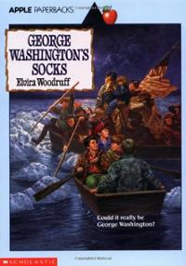
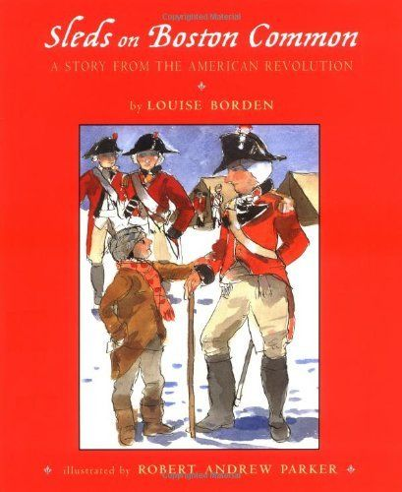
Week | ELA Standards | S.S Standards | Resources and Suggested Instruction
5 | (RL. 4.3) Describe in depth a character, setting, or event in a story or drama, drawing on specific details in the text. (RL.4.6) Compare and contrast the point of view from which different stories are narrated. (L.4.1e) Form and use prepositional phrases. (L.4.1f)Produce complete sentences, recognizing and correcting inappropriate fragments and run-ons. (L.4.1g) Correctly use frequently confused words. (W.4.1a) Introduce a topic or text clearly, state an opinion and create an organizational structure in which related ideas are grouped to support the writer’s purpose. (W.4.1b)Provide reasons that are supported by facts and details. (W.4.1c) Link opinions and reasons using words and phrases.
29 copies
3rd person
1st person
Notes:
Week 5 switches to the literature standards using your class set of George Washington’s Socks, and Sleds on Boston Commons. Standard 6 is addressed through both of these texts. We have paced the language standards here that we felt were easlity addressed with these texts.

Slide 10
Week | ELA Standards | S.S Standards | Resources and Suggested Instruction
6
(RL. 4.3) Describe in depth a character, setting, or event in a story or drama, drawing on specific details in the text.
(RL.4.6) Compare and contrast the point of view from which different stories are narrated.
(W.4.1a) Introduce a topic or text clearly, state an opinion and create an organizational structure in which related ideas are grouped to support the writer’s purpose.
(W.4.1b)Provide reasons that are supported by facts and details.
(W.4.1c) Link opinions and reasons using words and phrases.
(W.4.1d)Provide a concluding statement or section related to the opinion presented.
29 copies
3rd person
1st person
Notes:
Week 6 is continuing with the literary texts really making sure our students are proficient on standards 3 and 6. By this week in writing they should be able to do all of W4.1, a, b, c, & d

Slide 11
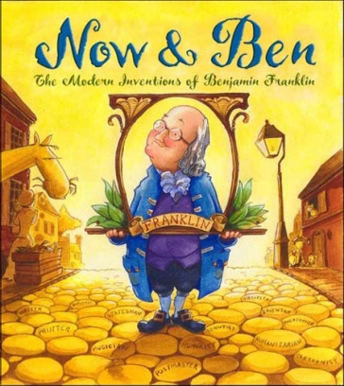
Week | ELA Standards | Science Standards | Resources and Suggested Instruction
7 | (RI.4.3) Explain events in a historical text, including what happened and why. (RI.4.5)Describe the overall structure. (Problem/Solution) (RI.4.7) Interpret information presented visually and orally. (Brain Pop) (RI.4.9) Integrate information from two texts on the same topic. W.4.1 Write opinion pieces on topics or texts, supporting a point of view with reasons. State and opinion Provide reasons that are supported by facts Link opinion and reasons using words and phrases Provide a concluding statement or section related to the opinion presented. | *If you have not taught the 2nd quarter standards on electricity, this would be a great place to do that. (PS.7.4.2) Classify electrical conductors and electrical insulators. (PS.7.4.3) Construct simple circuits from circuit diagrams. | Brain Pop http://www.brainpop.com/science/energy/benjaminfranklin/preview.weml http://www.readworks.org/passages/benjamin-franklin-ultimate-solution-creator There is a STEM project that goes along with this book. Writing Prompt What makes a person revolutionary?
Notes:
Week 7 is going back to informational standards. We have included the texts and some extra resources on Benjamin Franklin. We have also put in a formative writing assessment, What makes a person revolutionary? This will help them with the summative writing assessment we have included in week 8. Also a reminder that the text, Now & Ben has a STEM project that goes along with the book. If you have not taught the science standards on electricity you could include them this week.

Slide 12
Week | ELA Standards | S.S Standards | Resources and Suggested Instruction
8 | W.4.1 Write opinion pieces on topics or texts, supporting a point of view with reasons. State and opinion Provide reasons that are supported by facts Link opinion and reasons using words and phrases Provide a concluding statement or section related to the opinion presented. With Timeline Project Make sure it is complete and scored. (L.4.3c)Differentiate between contexts that call for formal English. (SL.4.2) Paraphrase portions of a text read aloud or information presented in diverse formats. (SL.4.3) Identify the reasons and evidence a speaker provides to support particular points. (SL.4.4) Report on a topic in an organized manner, using appropriate facts and relevant, descriptive details to support the main idea; speak clearly at an understandable pace. (SL.4.5) Add audio recordings and visual displays to presentations. (SL.4.6) Differentiate between contexts that call for formal English and situations where informal discourse is appropriate; use formal English when appropriate to task and situation. |  | Summative Writing: Write an opinion piece supporting your point of view with reasons on who you think is the most revolutionary person you have studied? You would be scoring for all the writing standards. Emphasize the essential question and use the writing from the previous week.
Notes:
Week 8 concludes with a summative writing piece. At this time you would also want your interactive timeline complete and ready for the students to present to each other or another audience.

Slide 13
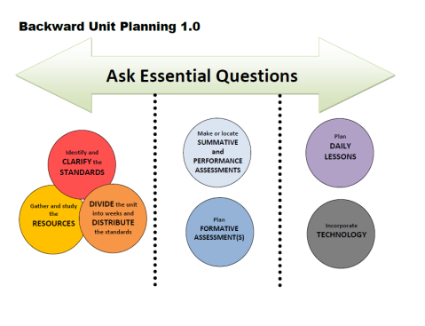
Week | Standards | Essential Question
1 |  | How does our understanding of events influence our opinions?
2
3
4
5
6 |  | How does our understanding of events influence our opinions?
Notes:
The essential question should be talked about each week and discussion about how their understanding of what happened might be changing their opinion of events. By week 8 it should be seen through their summative writing assessment.

Slide 14
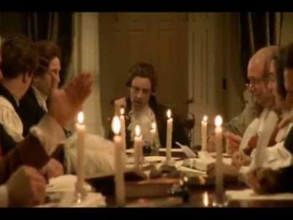
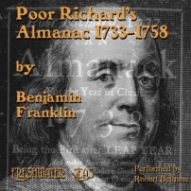
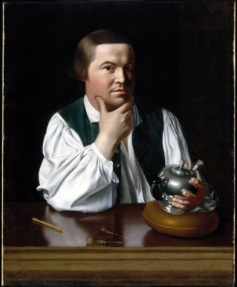
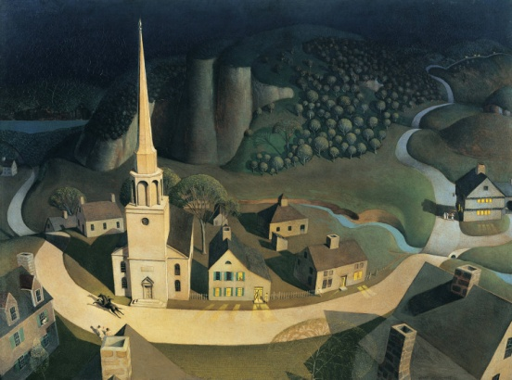
Additional Resources
Media
Poems
“Concord Hymn”
“George Washington”
“A Tragic Story”
“A Nation’s Strength”
“The Flag”
https://archive.org/details/poorrichardsalm01frangoog
“Too Late to Apologize”
Art
*See additional resources in Teacher Created Resources.
Notes:
These are additional resources that can be used in the unit wherever you see fit. There are also things already made on TCR.

Slide 15
Extra Resources
Revolutionary War Passages
Lexile Levels 710 – 830 (4-5 Grade Band is 770 – 980)
http://www.readworks.org/passages/colonization-revolutionary-war-background-colonies
http://www.readworks.org/passages/colonization-revolutionary-war-introduction-revolutionary-war
http://www.readworks.org/passages/colonization-revolutionary-war-jamestown
http://www.readworks.org/passages/colonization-revolutionary-war-paul-reveres-ride
http://www.readworks.org/passages/colonization-revolutionary-war-roanoke-lost-colony
http://www.readworks.org/passages/colonization-revolutionary-war-declaration-independence
http://www.readworks.org/passages/colonization-revolutionary-war-valley-forge
http://www.readworks.org/passages/us-presidents-george-washington
Notes:
Here are some links to passages with questions on the Revolutionary War that are in the grade band.

Slide 16
Sample Assessments Here
Under Construction
These will be added and available in paper and electronic format to use as not only an end of unit assessment, but also a PARCC like practice.
Notes:
We are working on a summative reading assessment that will be on paper and electronically made. Since this unit runs right up to a PARCC we wanted to make a practice that could be used to assess this unit and give the students exposure to the types of things they will see on PARCC. Please keep checking the website for the finished product. Please send any resources you have or make to your facilitator or Susan Hensley. Thank you!

