Slide 1



4th Grade Whole Novel Studies

Slide 2
Your Goal…
Compare and contrast the treatment of similar themes and topics.
Compare and contrast the point of view from which different stories are narrated.
Determine the meaning of words and phrases as they are used in a text.

Slide 3

How will you do this?
Choose your book
Keep up with your reading by following your calendar
Make notes of your thinking
When you are finished, you will have options on how to show your learning.

Slide 4
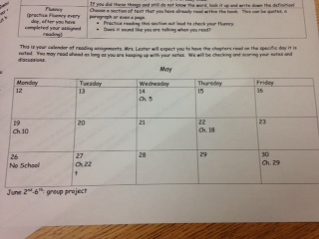
Calendar?? What Calendar?
Each book has a calendar to help you keep track of your reading. You can read ahead as much as you want, just be prepared!

Slide 5
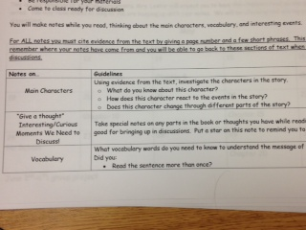

What am I writing on sticky notes?
Vocabulary
Thoughts
Predictions
Key Points

Slide 6
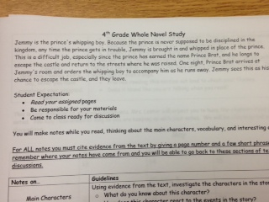
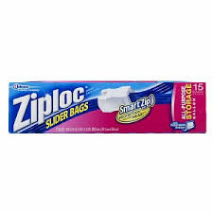
How do I keep up with my stuff?

Slide 7
Now What?

Slide 8


