Slide 1
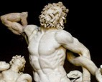
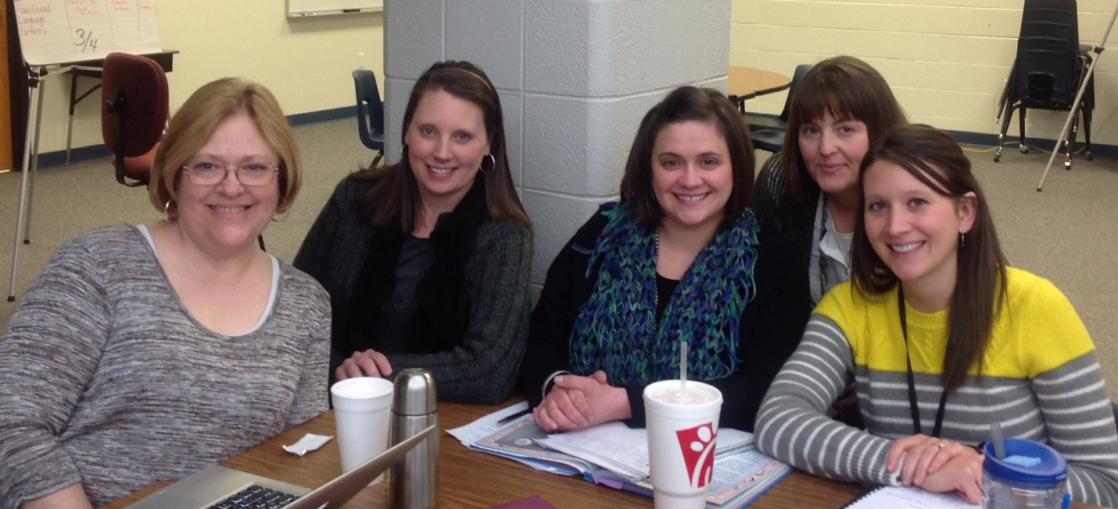

Fantastic Adventures with Dragons, Gods and Giants
Third Grade Unit 6
Planning Team
Deborah Goff, Renee Weidman, Kendree Kilsch, Kerri Wells, Halley Parsons

Slide 2
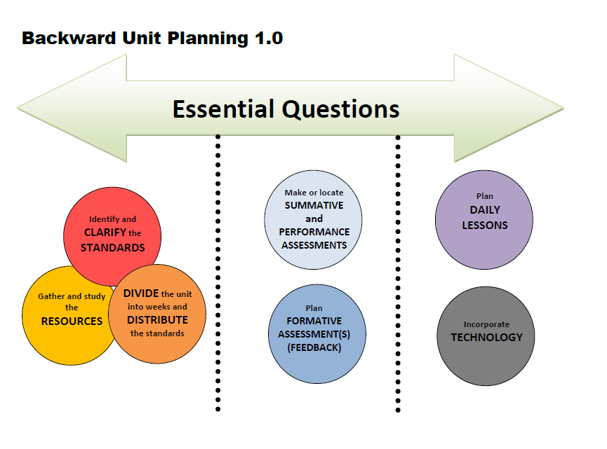

Slide 3
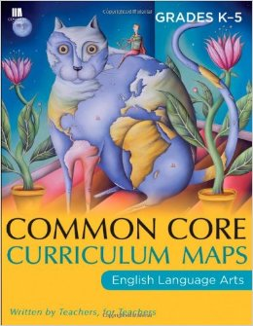
Fantastic Adventures with Dragons, Gods and Giants
Essential Question
How does mythology connect with our lives today?

Slide 4
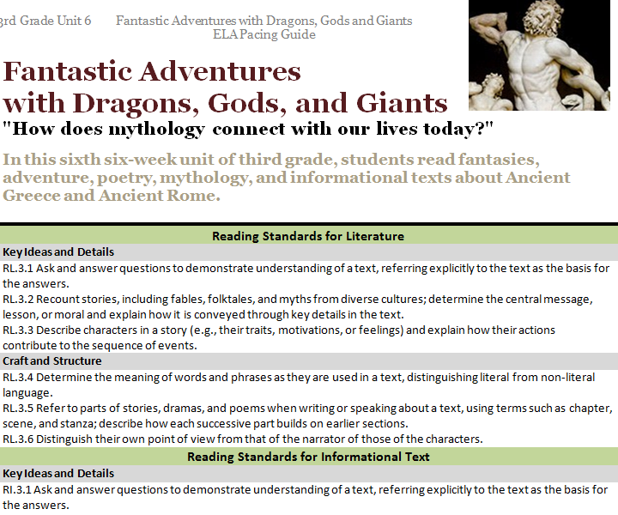

Slide 5
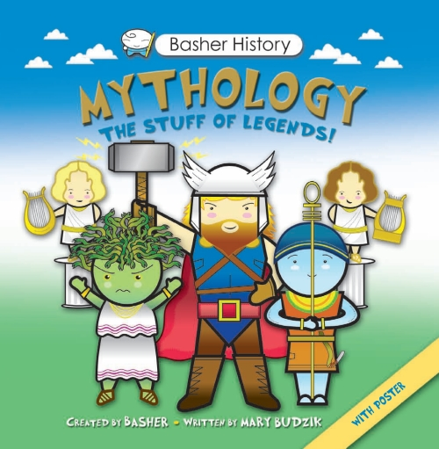
New Text
1 copy each

Slide 6

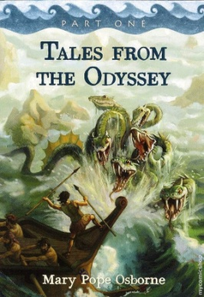
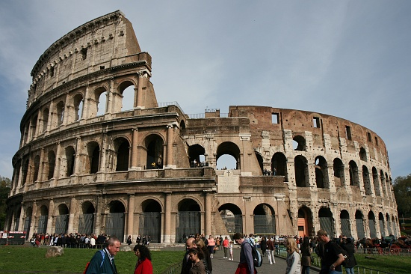
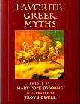
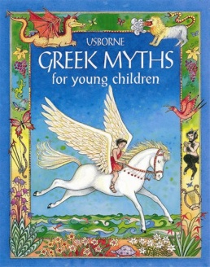
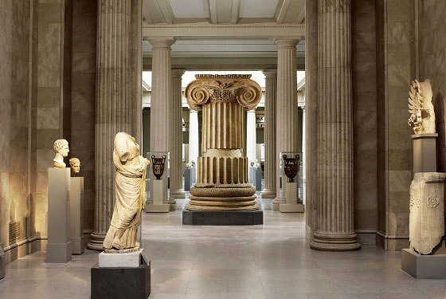
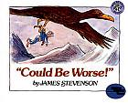
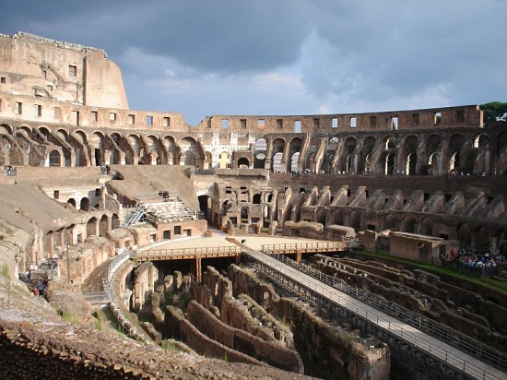
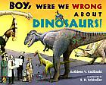

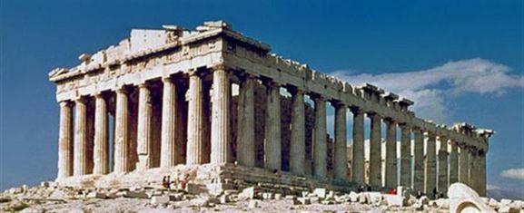
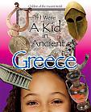
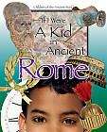

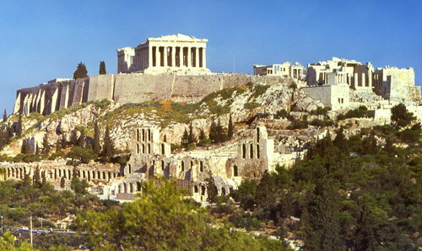
3rd Grade
Print Resources
Unit 6
Literature
Stories
“Adventures of Isabel”
“A Dragon’s Lament”
“The Dragons are Singing Tonight”
“Life Doesn’t Frighten Me At All”
Poem
(READ ALOUD)
“The Tale of Custard the Dragon”
26 copies
Read Aloud
Art
Informational Text
13 copies
Notes:
“We do not have any informational standards for this unit, but you can see on your handout that we have these informational texts by Ruth Heller that can be used to help teach language standards through writing. Has anyone used these texts in other ways effectively in their classroom?” Discuss
“We were not sure where to put the tooth book, has anyone used this text in an effective way?” Discuss
“What ways are you using the artwork effectively?” Discuss

Slide 7
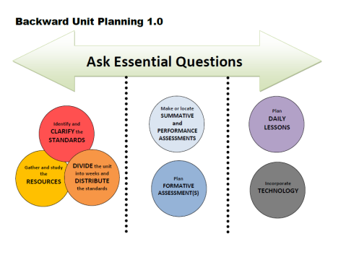
Week | Standards | Texts
1 | RL.3.1 Ask and answer questions to demonstrate understanding of a text, referring explicitly to the text as the basis for the answers. RL.3.2 Recount stories, including fables, folktales, and myths from diverse cultures; determine the central message, lesson, or moral and explain how it is conveyed through key details in the text. RL.3.5 Refer to parts of stories, dramas, and poems when writing or speaking about a text, using terms such as chapter, scene, and stanza; describe how each successive part builds on earlier sections. RL.3.6 Distinguish their own point of view from that of the narrator or those of the characters. | Use intro Power Point available on the Teacher Created Resources for Unit 6. My Father’s Dragon Knapsack comprehension Use Mini Book Notebook - Writing and recounting
DIVIDE the unit into weeks and DISTRIBUTE the standards
Notes:
Story kit tutorial
https://www.youtube.com/watch?v=RSWQkUS4kXk
Week 1. We started with My Father’s Dragon because of the accessibility of the text for students. Starting with this book puts students in the frame of mind to connect with the fantasy/mythology focus of the unit.
Week one and 2: Use a power point that introduces mythology. This should be a two day event as students take notes on the various gods presented in the Power Point
Students will use the My Father’s Dragon Notebook from the Teacher Created Resources section of the Rogers Website to take notes
Student will ask and answer questions to demonstrate understanding of the text, (RL.3.1) through notes and discussion of the Intro power point, and completion of the Notebook for My Father’s Dragon. As students complete the My Father’s Dragon Notebook, they will be recounting the story and connecting the different chapters and events (RL3.2 &3.5)
Writing prompt will address RL.3.6

Slide 8
Week | Standards | Texts
2 | RL.3.1 Ask and answer questions to demonstrate understanding of a text, referring explicitly to the text as the basis for the answers. RL.3.2 Recount stories, including fables, folktales, and myths from diverse cultures; determine the central message, lesson, or moral and explain how it is conveyed through key details in the text. RL.3.5 Refer to parts of stories, dramas, and poems when writing or speaking about a text, using terms such as chapter, scene, and stanza; describe how each successive part builds on earlier sections. RL.3.6 Distinguish their own point of view from that of the narrator or those of the characters. W.3.3 Write narratives to develop real or imagined experiences or events using effective technique, descriptive details, and clear event sequences. W.3.6 With guidance and support from adults, use technology to produce and publish writing (using keyboarding skills) as well as to interact and collaborate with others. | My Father’s Dragon “Create a creature” Power point and notes pages Write this and publish electronically. Mini Book notebook from website Writing Prompt: Would you have reacted the same way to the animals as the boy did in My Father’s Dragon? (quick journal entry)

Slide 9
Week | Standards | Texts
3 | RI.3.1 Ask and answer questions to demonstrate understanding of a text, referring explicitly to the text as the basis for the answers. RI.3.3 Describe the relationship between a series of historical events, scientific ideas or concepts, or steps in technical procedures in a text, using language that pertains to time, sequence, and cause/effect. RI.3.4 Determine the meaning of general academic and domain-specific words and phrases in a text relevant to a grade 3 topic or subject area. RI.3.5 Use text features and search tools (e.g., key words, sidebars, hyperlinks) to locate information relevant to a given topic efficiently. RI.3.7 Use information gained from illustrations (e.g., maps, photographs) and the words in a text to demonstrate understanding of the text (e.g., where, when, why, and how key events occur). SL.3.2 Determine the main ideas and supporting details of a text read aloud or information presented in diverse media and formats, including visually, quantitatively, and orally. W.3.7 Conduct short research projects that build knowledge about a topic. W.3.2 Write informative/explanatory texts to examine a topic and convey ideas and information clearly. W.3.5 | If I were a Kid in Ancient Greece /Ancient Rome (read aloud) Mary Pope Osborne books - use Fact Tracker for notes. Hour of the Olympics Writing: Compare the Olympics then and Now using online research and the matrix form the District Website. http://www.olympic.org/ancient-olympic-games https://www.engageny.org/resource/grade-2-english-language-arts https://www.engageny.org/resource/grade-2-ela-domain-4-greek-myths (Caution to teachers to print out the sections of these resources that are appropriate for students.)
Notes:
Week 3 – Using the texts from Mary Pope Osborne and the book “if I were a Kid in Ancient Greece/Ancient Rome” as a read aloud, connecting to the Mary Pope Osborne books that will be used during this week.
As you employ these read alouds, facilitate discussions about the lifestyle and comparisons to present day. Discuss the reasons for the numerous Greek and Roman gods, and the
Students will use the Fact Tracker Notes pages from the District Website to keep track of the origins of the Olympics and the connection to the Greek gods. Links are included to online resources for research.

Slide 10
Week | Standards | Texts
4 | RL.3.1 Ask and answer questions to demonstrate understanding of a text, referring explicitly to the text as the basis for the answers. RL.3.2 Recount stories, including fables, folktales, and myths from diverse cultures; determine the central message, lesson, or moral and explain how it is conveyed through key details in the text. RL.3.3 Describe characters in a story (e.g., their traits, motivations, or feelings) and explain how their actions contribute to the sequence of events. | Begin the week with a Power Point introducing the Greek Gods, Brain pop on Greek Myths (Linked on the district website) Usborne Greek Myths Greek Myths: Pandora’s box p. 9, The Midas Touch p. 73 , The Gift of Fire p. 6, Cyclops the One-Eyed Giant p. 93 Model using the matrix, especially the final “lesson learned”. TDQ available on the website for Pandora’s Box & The Gift of Fire. You may choose other myths from the Usborne books and the book Favorite Greek Myths by Mary Pope Osborne Teachers Pay Teachers Link: https://www.teacherspayteachers.com/Product/Greek-Mythology-Stories-and-Activities-aligned-with-CCSS-646574
Notes:
Week 4;
Begin this week with a Power Point introducing the Greek gods. The Power point also has fill in the blank notes pages and “trading cards” for the Greek gods to facilitate active listening and learning.
Using five of the Usborne book on Greek Myths, students will compare each of the myths using a matrix and Text Dependent Questions. Students will be able to recount the stories, describe the characters, and ask and answer questions to demonstrate their understanding of these myths. The specific myths suggested were chosen for their utility as to future relevance to the students. A Teachers Pay Teachers Link is included for a Notebook featuring Greek myths.
Other texts in the unit could be used for read alouds.
A link to a Teachers Pay Teachers set of materials is included.
A possible
Matrix directions:
Model Day 1 and 2
Students fill in the matrix with a partner on day 3.
Students fill in the matrix independently on day 4.
This will be used as a foundation for the summative assessment in week 6.

Slide 11
Week | Standards | Texts
5 | RL.3.2 Recount stories, including fables, folktales, and myths from diverse cultures; determine the central message, lesson, or moral and explain how it is conveyed through key details in the text. RL.3.5 Refer to parts of stories, dramas, and poems when writing or speaking about a text, using terms such as chapter, scene, and stanza; describe how each successive part builds on earlier sections. W.3.1 Write opinion pieces on topics or texts, supporting a point of view with reasons. b. Provide reasons that support the opinion. W.3.4 With guidance and support from adults, produce writing in which the development and organization are appropriate to task and purpose. | Choose the most notable Greek god or goddess and write an opinion essay explaining your choice and giving reasons to support your opinion. Brain Pop on Homer Tales from the Odyssey by Mary Pope Osborne Resources: Teachers pay Teachers https://www.teacherspayteachers.com/Product/Tales-from-the-Odyssey-Part-1-Common-Core-Aligned-532537 https://www.teacherspayteachers.com/Product/Tales-from-the-Odyssey-Part-2-by-Mary-Pope-Osborne-657225
Notes:
Weeks 5 and 6 are devoted to Tales from the Odyssey. This two week period begins with a Brain Pop video on Homer.
During the reading, students could make posters for each chapter, or for certain characters in the book. Use your imagination to assist students in comprehending and understanding the text.
Use Odyssey Fact Questions from the district website as a further resource.
Links to a set of materials for this text on Teachers Pay Teachers are included.

Slide 12
Week | Standards | Texts
6 | RL.3.2 Recount stories, including fables, folktales, and myths from diverse cultures; determine the central message, lesson, or moral and explain how it is conveyed through key details in the text. RL.3.5 Refer to parts of stories, dramas, and poems when writing or speaking about a text, using terms such as chapter, scene, and stanza; describe how each successive part builds on earlier sections. W.3.4 With guidance and support from adults, produce writing in which the development and organization are appropriate to task and purpose. W.3.5 With guidance and support from peers and adults, develop and strengthen writing as needed by planning, revising, and editing. | Tales from the Odyssey by Mary Pope Osborne Could be Worse Write a Grandfather fantasy story of your own. Can be done in partners or individually. Continue to publication. Summative Assessment: The Wooden Horse
Notes:
In week six, students will be concluding the unit as they finish reading Tales from the Odyssey.
After Reading aloud the book Could be Worse students will write a Grandfather fantasy story of their own and bring this writing to publication.

Slide 13
Week | Standards | Essential Questions
1 |  | How does mythology connect with our lives today? (Discussion)
2
3
4 |  | How does mythology connect with our lives today?
5
6 |  | How does mythology connect with our lives today?
Notes:
The essential question will be addressed through discussion especially in week 4 as teacher and student work together to complete matrix on various Greek myths.

Slide 14
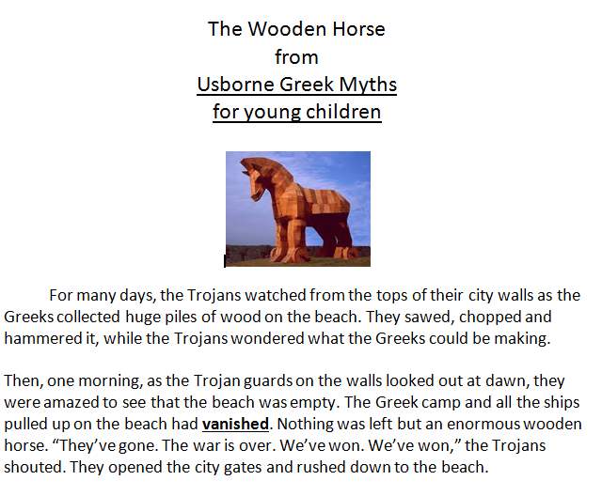
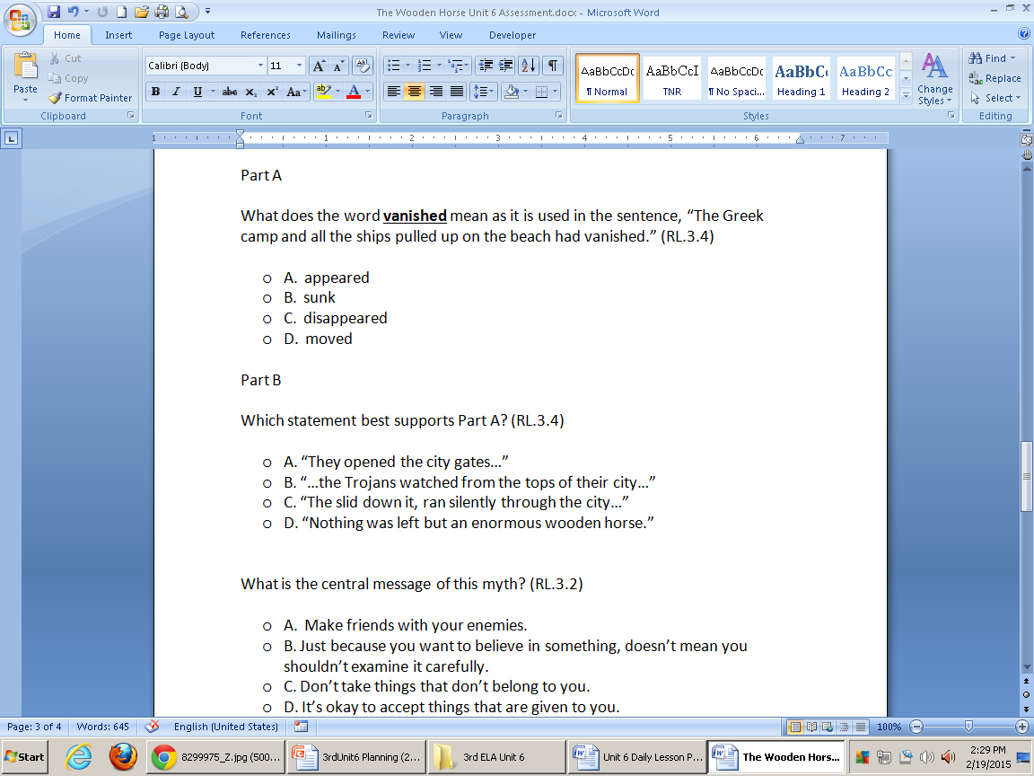
Summative Assessment

Slide 15
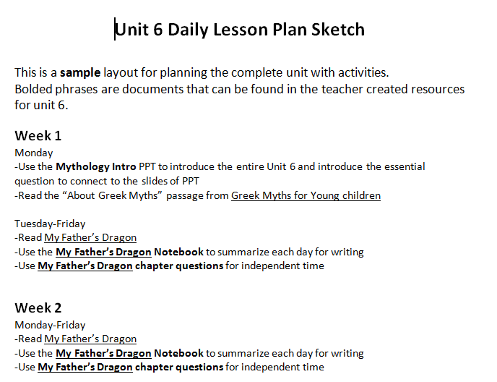
Notes:
You can find a daily lesson plan sketch under teacher created resources that gives a little more detail about the thinking that went into the weekly plans.

Slide 16

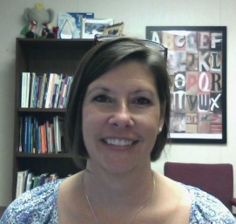

RESOURCES
Susan Hensley
Elementary Curriculum Specialist
shensley@rps.k12.ar.us

