Slide 1
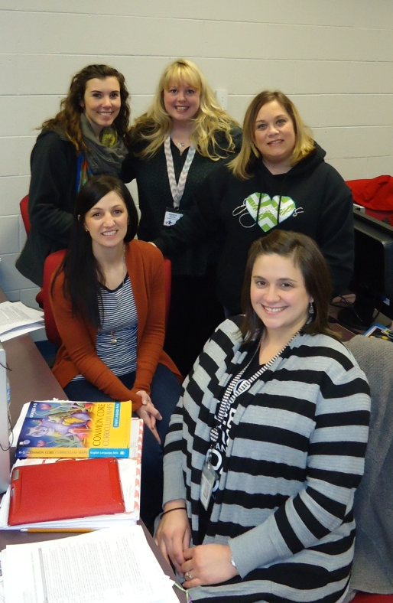
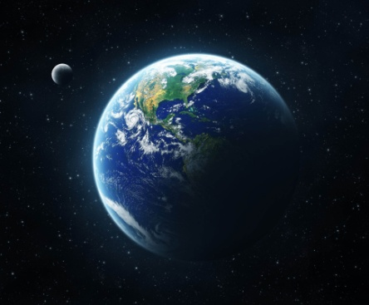

Investigation on a
Planet Called Earth
and Beyond
3rd Grade Unit 5
Planning Team:
Sarah Henry, Alexandra Duran, Kendree Kilsch, Krista Roth, and Adria Trombley.

Slide 2
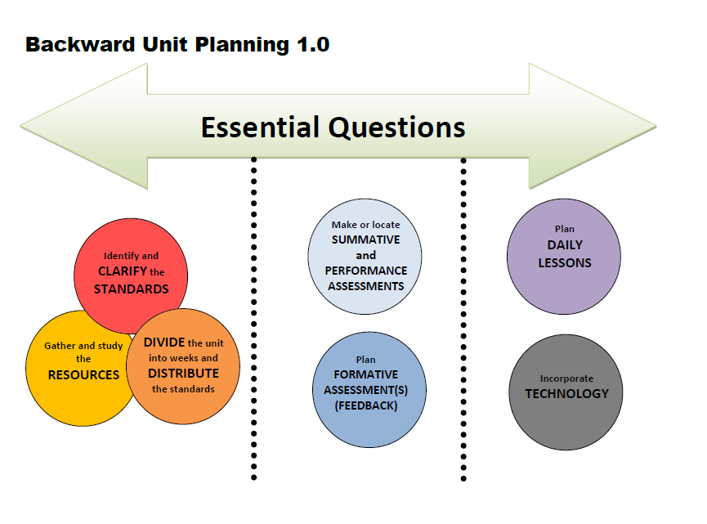
Notes:
This is how we went about planning the unit.

Slide 3
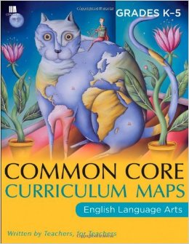
Investigation on a Planet Called Earth and Beyond
Essential Question
How do I prove what I know?

Slide 4






3rd Grade
Print Resources
Unit 5
Literature
Stories
Books About Idioms
Read Aloud
25 Copies
Poems
“Eating While Reading” Gary Soto
“Catch a Little Rhyme” Eve Merriam
“Barefoot Days” Rachel Field
“The City” Langston Hughes
“Skyscrapers” Rachel Field
Poems
(READ ALOUD)
“I Wandered Lonely as a Cloud” William Wordsworth
“The Grass” Emily Dickinson
“Spring Grass” Carl Sandburg
“The Grass on the Mountain” Paiute American Indian
Notes:
“We do not have any informational standards for this unit, but you can see on your handout that we have these informational texts by Ruth Heller that can be used to help teach language standards through writing. Has anyone used these texts in other ways effectively in their classroom?” Discuss
“We were not sure where to put the tooth book, has anyone used this text in an effective way?” Discuss
“What ways are you using the artwork effectively?” Discuss

Slide 5


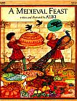
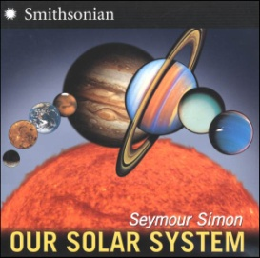

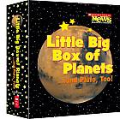

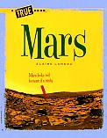
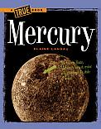

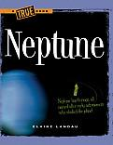
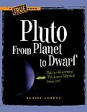



Informational Text
Read Aloud
OR set of Blastoff! Readers (Earth, Jupiter, Mars, Mercury, Neptune, Saturn, The Sun, Uranus and Venus)
2 copies of each title
1 copy
Notes:
“We do not have any informational standards for this unit, but you can see on your handout that we have these informational texts by Ruth Heller that can be used to help teach language standards through writing. Has anyone used these texts in other ways effectively in their classroom?” Discuss
“We were not sure where to put the tooth book, has anyone used this text in an effective way?” Discuss
“What ways are you using the artwork effectively?” Discuss

Slide 6

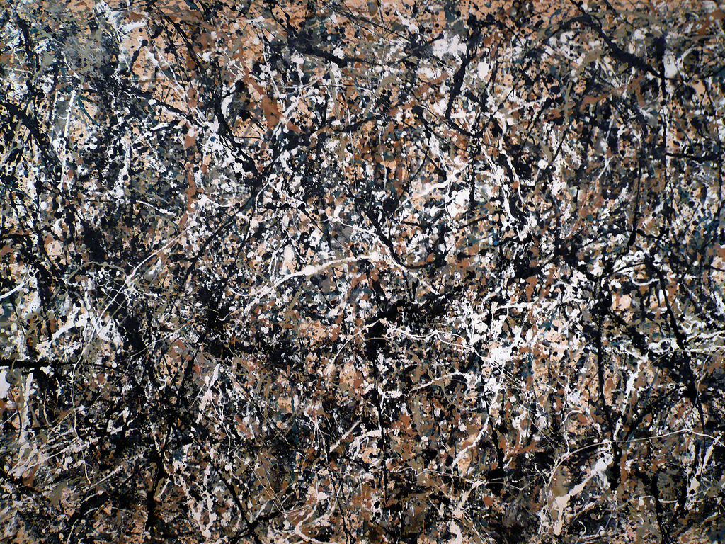

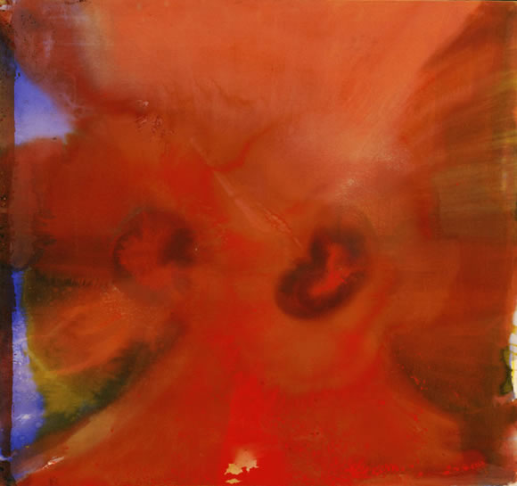
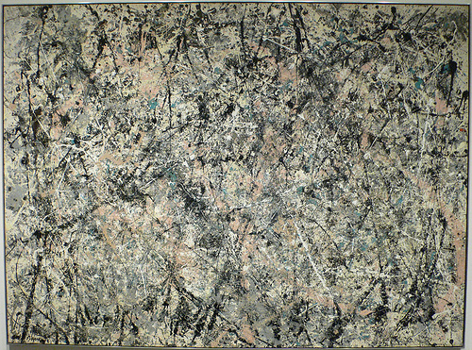
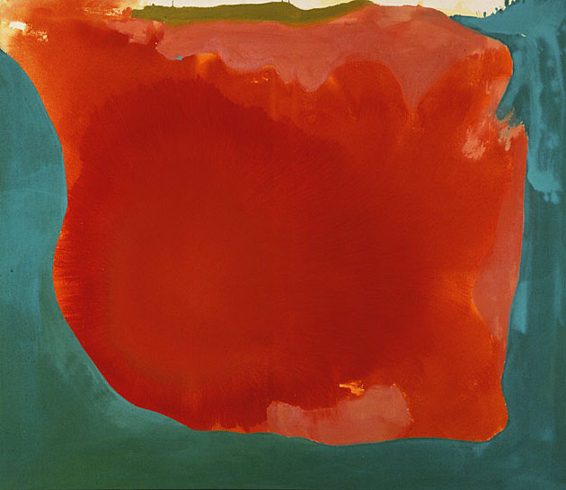
Art

Slide 7
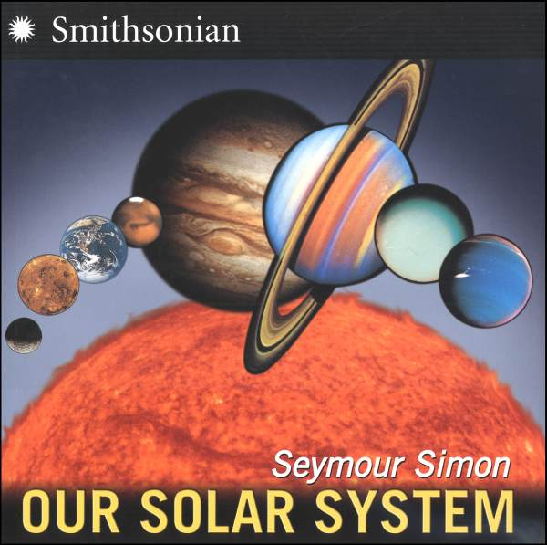
New Texts
1 copy of each title

Slide 8

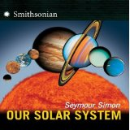

Week | ELA Standards | Science Standards | Resources and Suggested Instruction
1 | RI 3.1 Ask and answer questions to demonstrate understanding of a text, referring explicitly to the text as the basis for the answers. RI 3.2 Determine the main idea of a text; recount the key details and explain how they support the main idea. RI 3.4 Determine the meaning of general academic and domain-specific words and phrases in a text relevant to a grade 3 topic or subject area. RI 3.5 Use text features and search tools to locate information relevant to a given topic efficiently. SL 3.2 Determine the main ideas and supporting details of a text read aloud or information presented in diverse media and formats, including visually, quantitatively, and orally. W.3.7 Conduct short research projects that build knowledge about a topic. W.3.8 Recall information from experiences or gather information from print and digital sources; take brief notes on sources and sort evidence into provided categories. | ESS.8.3.6 Describe the layers of Earth. Crust Mantle Inner core Outer Core | Day 1-Brain Pop Solar System, students take notes in their notebook. (Overview) Days 2-5 Focus on Earth. Teacher will use Earth as a model to take notes, use text-features, and teach the science standards over Earth. This will set the kids up to work on their own planets the next two weeks. – Brain Pop on Earth that goes over layers. Super Teacher packet on Earth’s layers. (Have to pay for packet)
New books- 1 copy of each per teacher

Slide 9
Week | ELA Standards | Science Standards | Resources and Suggested Instruction
2 | RI 3.1 Ask and answer questions to demonstrate understanding of a text, referring explicitly to the text as the basis for the answers. RI 3.2 Determine the main idea of a text; recount the key details and explain how they support the main idea. RI 3.4 Determine the meaning of general academic and domain-specific words and phrases in a text relevant to a grade 3 topic or subject area. RI 3.5 Use text features and search tools to locate information relevant to a given topic efficiently. SL 3.2 Determine the main ideas and supporting details of a text read aloud or information presented in diverse media and formats, including visually, quantitatively, and orally. SL 3.3 Ask and answer questions about information from a speaker, offering appropriate elaboration and detail. SL 3.4 Report on a topic or text, tell a story, or recount an experience with appropriate facts and relevant, descriptive details, speaking clearly at an understandable pace SL 3.6 Speak in complete sentences when appropriate to task and situation in order to provide requested detail or clarification. W.3.2: Introduce a topic and group related information together; include illustrations when useful to aiding comprehension. Develop the topic with facts, definitions, and details. Use linking words and phrases to connect ideas within categories of information. Provide a concluding statement or section. L 3.1g Form and use comparative and superlative adjectives and adverbs, and choose between them depending on what is to be modified. | ESS.10.3.1 Demonstrate how the planets orbit the sun. ESS.10.3.2 Demonstrate the orbit of Earth and its moon around the sun. ESS.10.3.3 Relate Earth’s rotation to the day/night cycle. | Choose a different planet each day. You can choose to do the inner planets first and the outer planets next week or vice versa. Focus on taking notes, using the text features. You could also run it with students divided in groups and doing their own planet research. Formative Assessment: A True Book: Mars TCR Earthbound Astronaut Rubric TCR Brain Pop has lessons/videos on each planet you can use. Super Teacher packet on every planet. Mercury is free. (Have to pay for the rest of the planets. *These passages also build background for the Greek Gods in Unit 6)
2 copies of each book.

Slide 10
Week | ELA Standards | Science Standards | Resources and Suggested Instruction
3 | RI 3.1 Ask and answer questions to demonstrate understanding of a text, referring explicitly to the text as the basis for the answers. RI 3.2 Determine the main idea of a text; recount the key details and explain how they support the main idea. RI 3.4 Determine the meaning of general academic and domain-specific words and phrases in a text relevant to a grade 3 topic or subject area. RI 3.5 Use text features and search tools to locate information relevant to a given topic efficiently. RI 3.8 Describe the logical connection between particular sentences and paragraphs in a text (e.g., comparison, cause/effect, first/second/third in a sequence). RI 3.9 Compare and contrast the most important points and key details presented in two texts on the same topic. W.3.3 Narratives Establish a situation and introduce a narrator and/or characters; organize an event sequence that unfolds naturally. Use dialogue and descriptions of actions, thoughts, and feelings to develop experiences and events or show the response of characters to situations. Use temporal words and phrases to signal event order. Provide a sense of closure. L 3.1h. Use coordinating and subordinating conjunctions. L 3.1i. Produce simple, compound, and complex sentences. L 3.2c. Use commas and quotation marks in dialogue. SL 3.2 Determine the main ideas and supporting details of a text read aloud or information presented in diverse media and formats, including visually, quantitatively, and orally. SL 3.3 Ask and answer questions about information from a speaker, offering appropriate elaboration and detail. SL 3.4 Report on a topic or text, tell a story, or recount an experience with appropriate facts and relevant, descriptive details, speaking clearly at an understandable pace SL 3.6 Speak in complete sentences when appropriate to task and situation in order to provide requested detail or clarification. | ESS.10.3.1 Demonstrate how the planets orbit the sun. ESS.10.3.2 Demonstrate the orbit of Earth and its moon around the sun. ESS.10.3.3 Relate Earth’s rotation to the day/night cycle. | Continue work from week 2. Students can continue to work on their research, or move to another planet so each student has two planets to compare. By the end of this week students should be prepared to share their research with each other. Formative Assessment: A True Book: Mars TCR Earthbound Astronaut Rubric TCR Brain Pop has lessons/videos on each planet you can use.
2 copies of each book.

Slide 11
Week | ELA Standards | Resources and Suggested Instruction
4 | RL.3.1 Ask and answer questions to demonstrate understanding of a text, referring explicitly to the text as the basis for the answers. RL 3.4 Determine the meaning of words and phrases as they are used in a text, distinguishing from non-literal language. W.3.3 Narratives Establish a situation and introduce a narrator and/or characters; organize an event sequence that unfolds naturally. c. Use temporal words and phrases to signal event order. L 3.5a. Distinguish the literal and nonliteral meanings of words and phrases in context (e.g., take steps). | Intro to Frindle PP-Goes to You Tube book trailer Smart Notebook Introduction to Frindle. (RL 3.5) Vocabulary Power points for each chapter on TCR *The Amelia Bedelia books can be used in small group to address language and reading standards, or in whole group. We are placing them in this week, but you may use them any time it works during the 3 weeks of literature.

Slide 12
Week | ELA Standards | Resources and Suggested Instruction
5 | RL 3.3 Describe characters in a story and explain how their actions contribute to the sequence of events. RL 3.4 Determine the meaning of words and phrases as they are used in a text, distinguishing from non-literal language. RL 3.5 Refer to parts of stories, dramas, and poems when writing or speaking about a text, using terms such as chapter, scene, and stanza; describe how each successive part builds on earlier sections W.3.3 Narratives b. Use dialogue and descriptions of actions, thoughts, and feelings to develop experiences and events or show the response of characters to situations. d. Provide a sense of closure. L 3.5a Distinguish the literal and nonliteral meanings of words and phrases in context (e.g., take steps). | Vocabulary Power points for each chapter of Frindle on TCR. The focus this week moves into describing the characters. In describing the characters they use the evidence from the text and quote the dialogue from the characters. These books can be used to address figurative language with a focus on idioms.

Slide 13
Week | ELA Standards | Resources and Suggested Instruction
6 | RL 3.2 Recount stories, including fables, folktales, and myths from diverse cultures; determine the central message, lesson, or moral and explain how it is conveyed through key details in the text. RL 3.4 Determine the meaning of words and phrases as they are used in a text, distinguishing from non-literal language. RL 3.5 Refer to parts of stories, dramas, and poems when writing or speaking about a text, using terms such as chapter, scene, and stanza; describe how each successive part builds on earlier sections. W.3.3 Narratives Establish a situation and introduce a narrator and/or characters; organize an event sequence that unfolds naturally. Use dialogue and descriptions of actions, thoughts, and feelings to develop experiences and events or show the response of characters to situations. Use temporal words and phrases to signal event order. Provide a sense of closure. L 3.5a Distinguish the literal and nonliteral meanings of words and phrases in context (e.g., take steps). | Vocabulary Power points for each chapter of Frindle on TCR. Frindle Vocab Smart Notebook…overall vocabulary. TCR

Slide 14
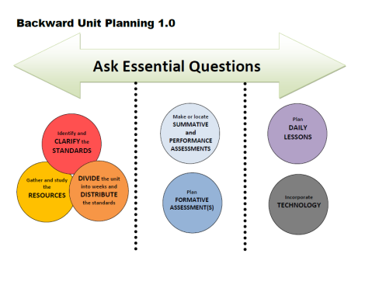
Week | Standards | Essential Question
1 |  | How do we prove what we know?
2
3 |  | How do we prove what we know? (Informational Text)
4
5
6 |  | How do we prove what we know? (Literature)

Slide 15
Additional Resources
Poems
(READ ALOUD)
“I Wandered Lonely as a Cloud” William Wordsworth
“The Grass” Emily Dickinson
“Spring Grass” Carl Sandburg
“The Grass on the Mountain” Paiute American Indian
Poems
“Eating While Reading” Gary Soto
“Catch a Little Rhyme” Eve Merriam
“Barefoot Days” Rachel Field
“The City” Langston Hughes
“Skyscrapers” Rachel Field
Art
*See additional resources in Teacher Created Resources.
Notes:
These are additional resources that can be used in the unit wherever you see fit. There are also things already made on TCR.

Slide 16
Extra Resources
http://www.readworks.org/passages/final-journey
http://www.readworks.org/passages/explore-our-solar-system
http://www.readworks.org/passages/whats-space
Notes:
Here are some links to passages with questions on the Revolutionary War that are in the grade band.

