Slide 1
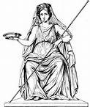



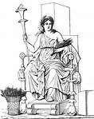
Why is it Important to Know Mythology?

Slide 2
Goal
I can explain why mythology is important.
I can identify some important characters from myths.
Score yourself:
  4: I can teach this
  3: I can do this all by myself
  2: I might need help
  1: I think this is new

Slide 3
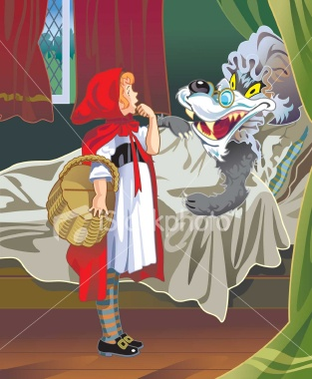
Think about this story…
Once upon a time there was a little girl who everyone called “Little Red Riding Hood” because of the red cloak she wore. One day, her grandmother was very sick, and her mother asked Red to take a basket of food and medicine to her. Before she left, her mother said, “Stay on the path that goes straight to grandmother’s house. Do not go through the woods.”
What happened next? Work with a partner to tell the rest of the story.

Slide 4
Why would parents and teachers tell children stories that aren’t true?
What could children learn from the story of Little Red Riding Hood?

Slide 5
What is a myth? http://www.kidsinco.com/myth/
A myth is a story that tries to teach how people should act. Many years ago, myths also explained natural events that people didn’t understand.
Myths gave human attributes to the supernatural heroes of their stories. These gods and goddesses helped or harmed people as they wanted.
Myths and their lessons are used in many ways today.

Slide 6
Why is it important to know mythology?
Planets and constellations were named after characters in myths.
The names of mythical creatures, gods and goddesses are used in advertising – the attributes of the god or creature are important to the message the business wants to send.
Their names are also used to indentify the purpose of a group or place.

Slide 7
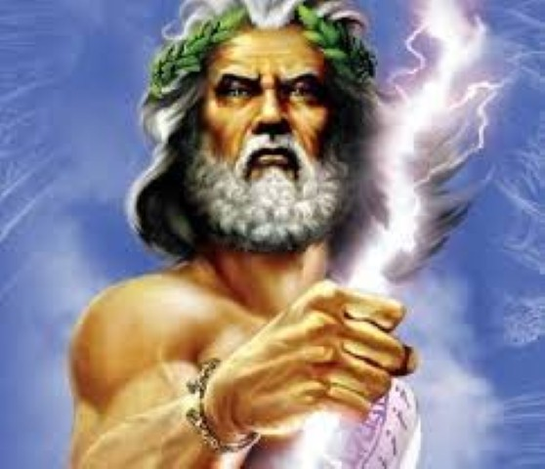
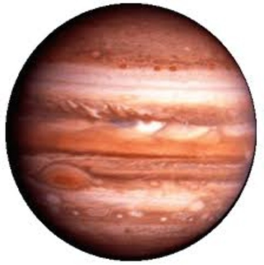
Meet the King of the Gods
Zeus was not patient and he would often get angry at people and the other gods.
Even though Zeus was married, he was not loyal to his wife. When his wife would find out about new girlfriends, she would often punish the women and sometimes their children.
Roman name: Jupiter
Greek name: Zeus
  (Click picture for hyperlink)
Jupiter

Slide 8
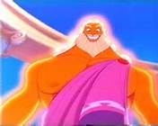


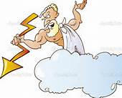
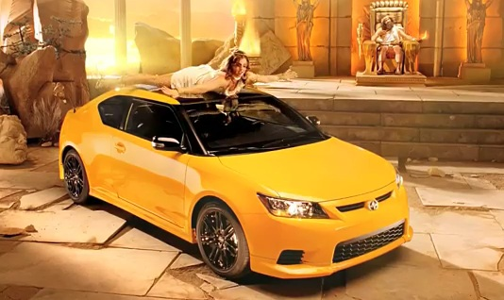
We also see Zeus in businesses, commercials, and even cartoons!

Slide 9
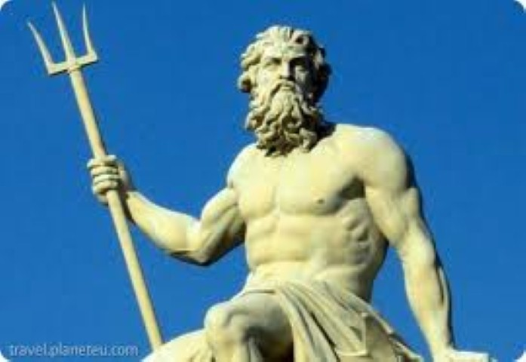
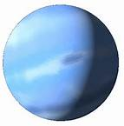
Brother of Zeus
Poseidon was more patient than Zeus as long as he was left alone.
Poseidon was jealous of Zeus and his power, so he created his own kingdom under the oceans. When Zeus or his followers bothered him, he would cause storms.
Roman name: Neptune
Greek name: Poseidon
  (Click picture for hyperlink)
Neptune

Slide 10
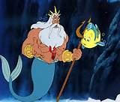

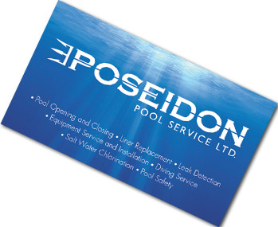
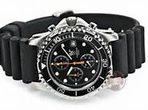
Other Poseidon Sightings
Poseidon Diver’s Watch

Slide 11
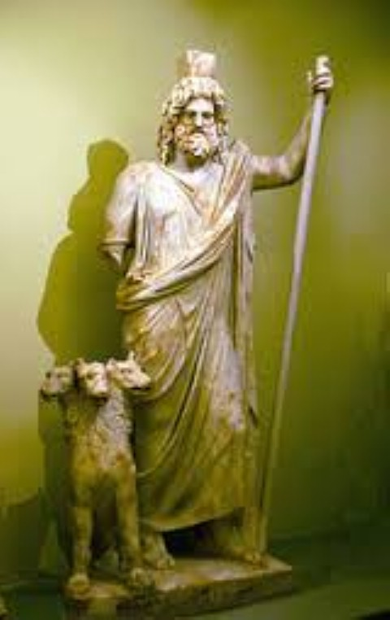
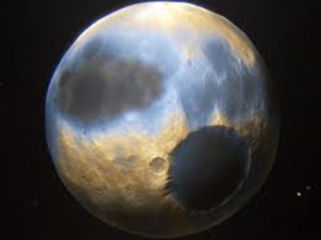
The third brother
Hades was the ruler of the underworld. For a long time he was very lonely.
Hades was also the god of riches because the people thought that whatever you did during life you took with you when you died.
Roman name: Pluto
Greek name: Hades
  (Click picture for hyperlink)
Pluto

Slide 12
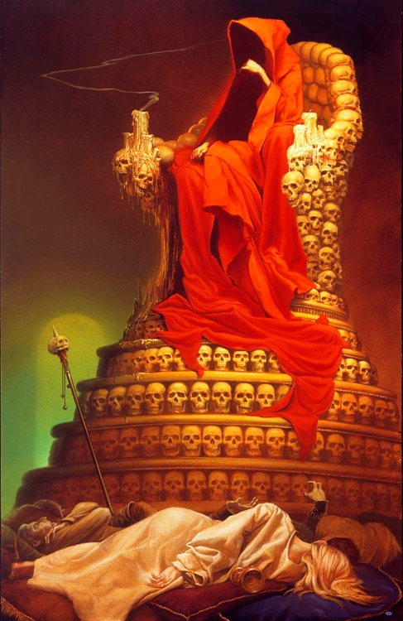
Pluto/Hades
Hades isn’t used very much in business or commercials.
Talk with your partner about why Hades would not be good for advertising.

Slide 13
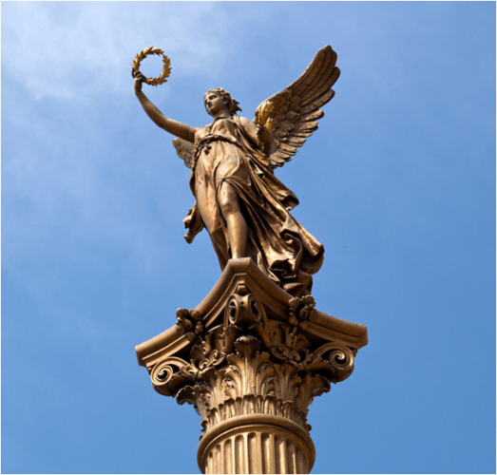
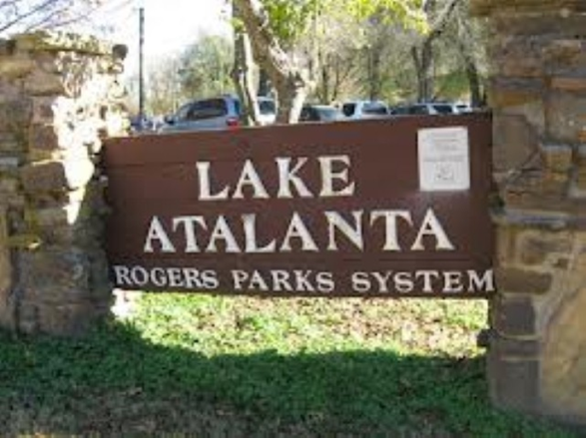

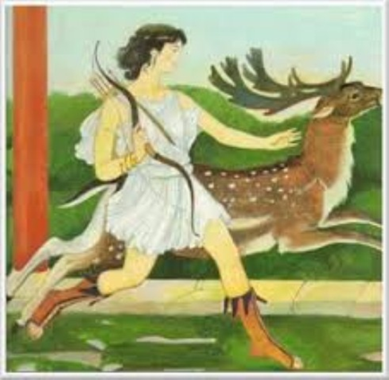
Other mythical characters whose names you know
Greek: artemis
Roman: nike
Greek and roman name: Atalanta
Goddess of Victory
Hunter, athlete, and runner

Slide 14
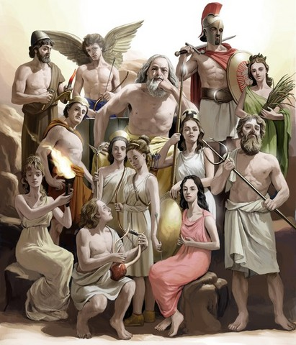
Talk to your partner
Summarize: What is a myth?
Why is it important to know myths?

Slide 15
Goal
I can explain why mythology is important.
I can identify some important characters from myths.
Score yourself:
  4: I can teach this
  3: I can do this all by myself
  2: I might need help
  1: I think this is new

