Slide 1

Frindle
Day 8
Chapters 15
Notes:
Day 2

Slide 2
Goal
I can use words I learn from a text
Notes:
Day 2

Slide 3

Tell your partner about a new word you learned yesterday.

Slide 4
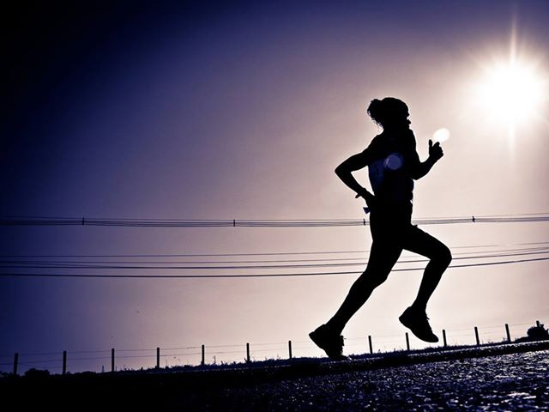
endures
Definition- last a long time .
Notes:
Contextualize the word- Find it in the text
Say the word together

Slide 5

oblong
Definition- longer in one direction than the other.
Notes:
Contextualize the word- Find it in the text
Say the word together

Slide 6


Write a sentence to show you know what each of these words mean.
The girl can endure because she…
The __________ was in an oblong shape.
Notes:
Application-
Students need an opportunity to use the words they just learned from the text.

Slide 7
Goal
I can use words I learn from a text

