Slide 1

Frindle
Day 7
Chapters 13 & 14
Notes:
Day 2

Slide 2
Goal
I can use words I learn from a text
Notes:
Day 2

Slide 3

Tell your partner about a new word you learned last week.

Slide 4

forbidden
Definition- not to be done or used .
Notes:
Contextualize the word- Find it in the text
Say the word together

Slide 5
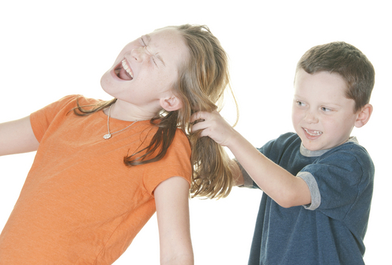
rascal
Definition- a mean or dishonest person.
Notes:
Contextualize the word- Find it in the text
Say the word together

Slide 6


Write a sentence to show you know what each of these words mean.
The girl was forbidden to…
The little girl was being a rascal because she…
Notes:
Application-
Students need an opportunity to use the words they just learned from the text.

Slide 7
Goal
I can use words I learn from a text

