Slide 1

Frindle
Day 6
Chapters 11 & 12
Notes:
Day 2

Slide 2
Goal
I can use words I learn from a text
Notes:
Day 2

Slide 3
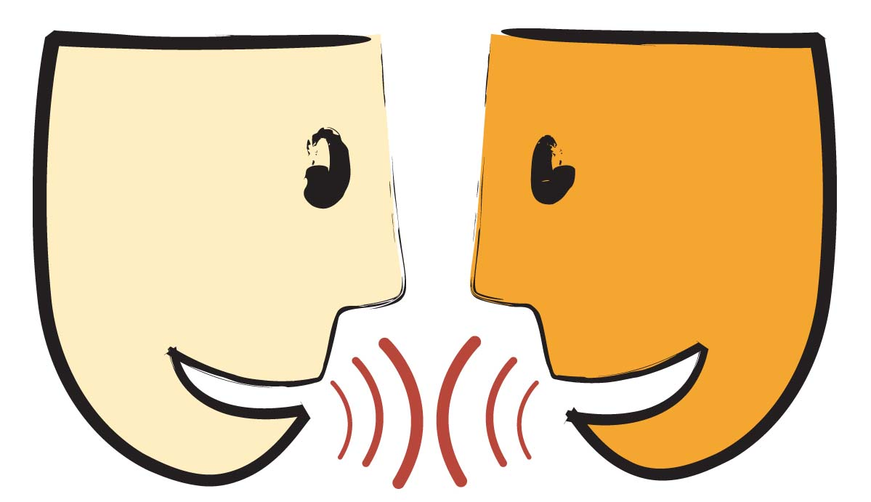
Tell your partner about a new word you learned yesterday.

Slide 4
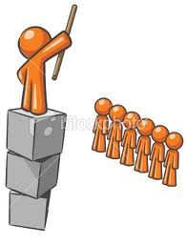
authority
Definition- right to give commands.
Notes:
Contextualize the word- Find it in the text
Say the word together

Slide 5
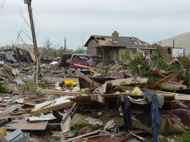
disaster
Definition- something that happens suddenly and causes much loss.
Notes:
Contextualize the word- Find it in the text
Say the word together

Slide 6


Write a sentence to show you know what each of these words mean.
The man showed authority by…
The tornado was a disaster because…
Notes:
Application-
Students need an opportunity to use the words they just learned from the text.

Slide 7
Goal
I can use words I learn from a text

