Slide 1

Frindle
Day 5
Chapters 9 & 10
Notes:
Day 2

Slide 2
Goal
I can use words I learn from a text
Notes:
Day 2

Slide 3

Tell your partner about a new word you learned yesterday.

Slide 4
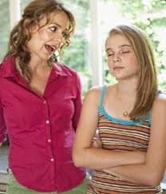
rebellion
Definition- refusal to obey rules or accept normal standards of behavior, dress, etc.
Notes:
Contextualize the word- Find it in the text
Say the word together

Slide 5
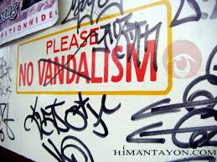
vandalism
Definition- the act of deliberately destroying or damaging property
Notes:
Contextualize the word- Find it in the text
Say the word together

Slide 6


Write a sentence to show you know what each of these words mean.
The boys perform vandalism when they…
The girl acted with rebellion when she…
Notes:
Application-
Students need an opportunity to use the words they just learned from the text.

Slide 7
Goal
I can use words I learn from a text

