Slide 1

Frindle
Day 4
Chapters 7 & 8
Notes:
Day 2

Slide 2
Goal
I can use words I learn from a text
Notes:
Day 2

Slide 3

Tell your partner about a new word you learned yesterday.

Slide 4
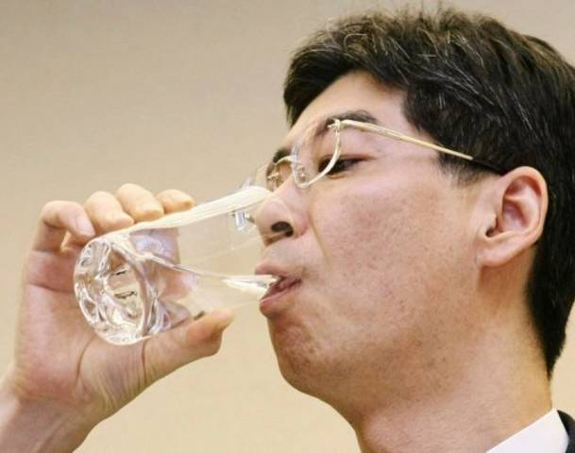
gulped
Definition- to eat or swallow quickly, take in air quickly.
Notes:
Contextualize the word- Find it in the text
Say the word together

Slide 5
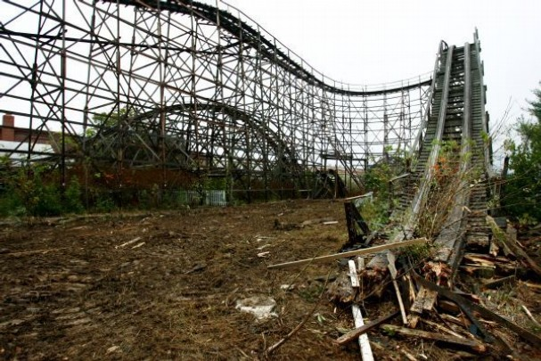
abruptly
Definition- very sudden and not expected.
Notes:
Contextualize the word- Find it in the text
Say the word together

Slide 6


Write a sentence to show you know what each of these words mean.
The boy gulped…
The girl abruptly…
Notes:
Application-
Students need an opportunity to use the words they just learned from the text.

Slide 7
Goal
I can use words I learn from a text
Notes:
Day 2

