Slide 1

Frindle
Day 2
Chapters 3 & 4
Notes:
Day 2

Slide 2
Goal
I can use words I learn from a text
Notes:
Day 2

Slide 3
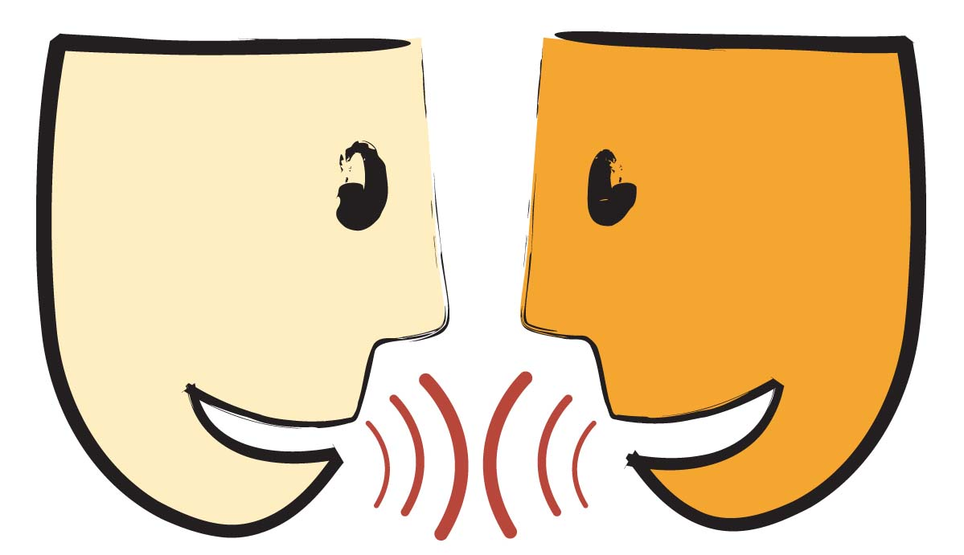
Tell your partner about a new word you learned yesterday.

Slide 4
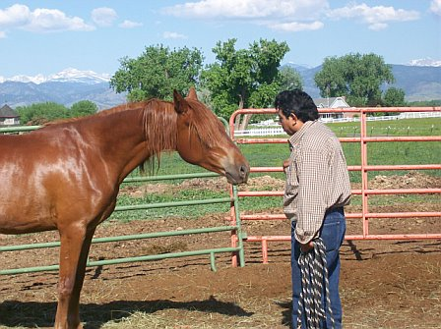
acquainted
Definition- to know someone or become familiar with.
Notes:
Contextualize the word- Find it in the text
Say the word together

Slide 5
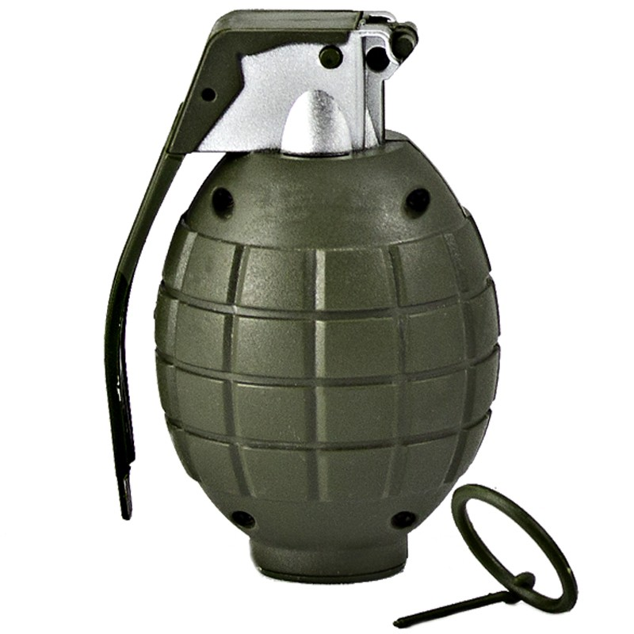
grenade
Definition- a small bomb that is designed to be thrown by someone or shot from a rifle

Slide 6


Write a sentence to show you know what each of these words mean.
The friends became acquainted when…
The grenade was dangerous because…
Notes:
Application-
Students need an opportunity to use the words they just learned from the text.

Slide 7
Goal
I can use words I learn from a text
Notes:
Day 2

