Slide 1

Frindle
Day 1
Chapters 1 & 2

Slide 2
Goal
I can use words I learn from a text.

Slide 3

Tell your partner about a new word you learned last week.
Notes:
APK- Share words from last week

Slide 4

Crimson
Definition- deep purplish red
Synonyms- red, blush
Notes:
Contextualize the word- Find it in the text
Say the word together

Slide 5
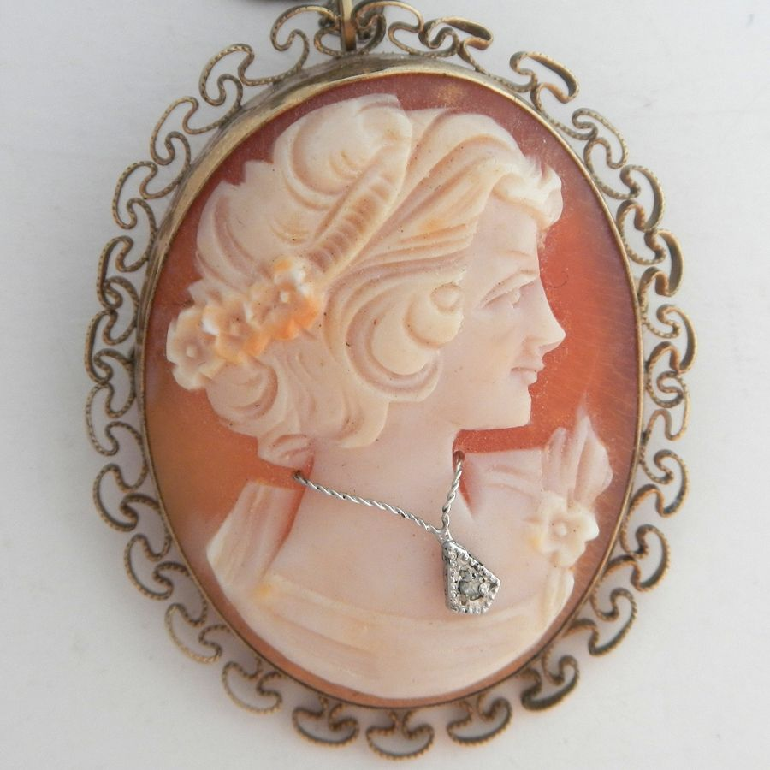
cameo
Definition- a piece of jewelry.
Notes:
Contextualize the word- Find it in the text
Say the word together

Slide 6
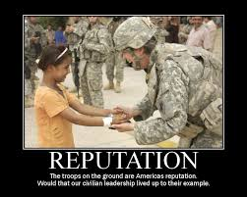
reputation
Definition- the way in which people think about someone or something.
Notes:
Contextualize the word- Find it in the text
Say the word together

Slide 7


Write a sentence to show you know what each of these words mean.
The fans wore crimson red to the ballgame because…
The woman wore a cameo on her…
The boy had a good reputation because he always…..
Notes:
Application-
Students need an opportunity to use the words they just learned from the text.

Slide 8
Goal
I can use words I learn from a text
Notes:
Revisit the goal- Continue on with reading the book and stop at the end of page 9.

