Slide 1
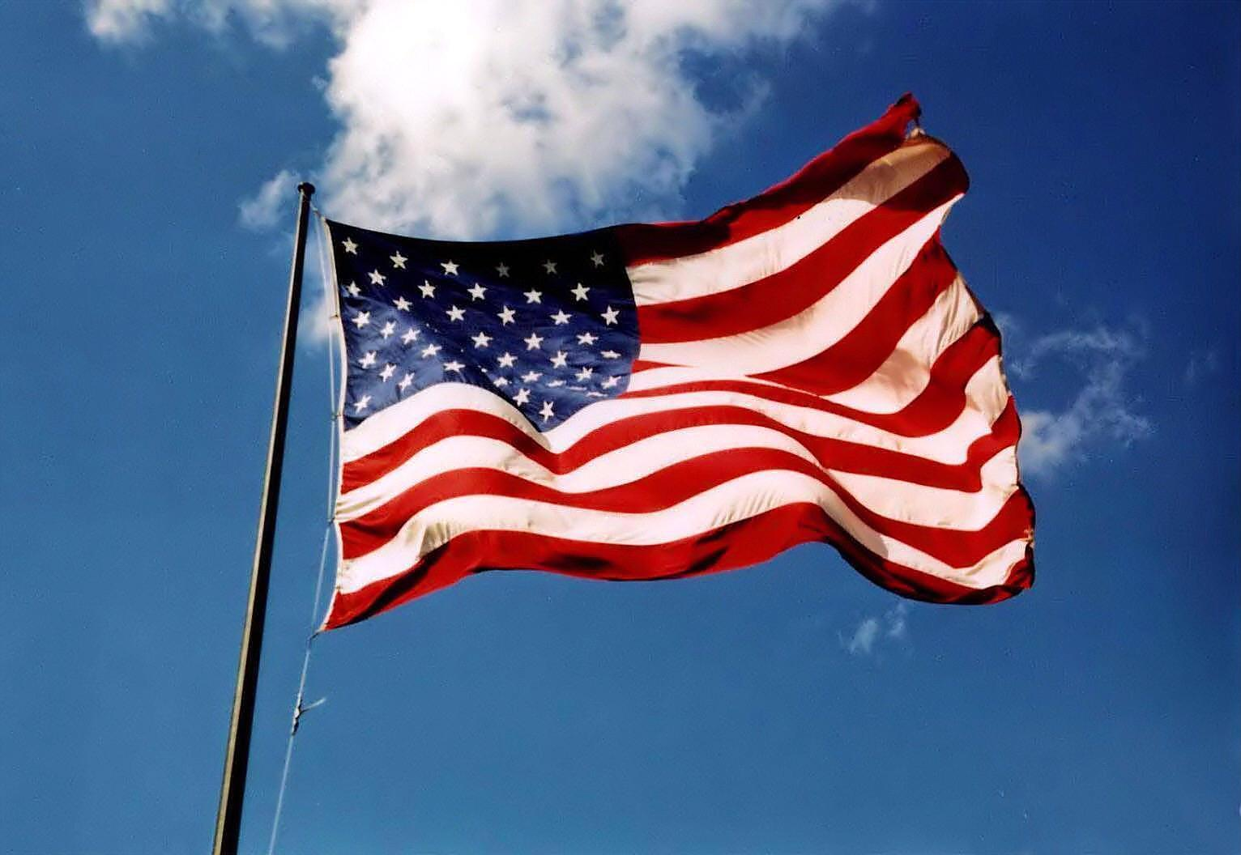
3rd Grade
Text Talk
Unit 4
“The Flag Goes By”

Slide 2
I can use words I learn from a text.
Notes:
Goal-
Students need to engage with the goal- read it, repeat it, write it, etc.

Slide 3

Tell your partner about a new word you learned last week.
Notes:
Access Prior Knowledge- (APK)
Turn and Talk

Slide 4
“The Flag Goes By”
By Henry Holcomb Bennett
Notes:
New Information-
Read the book- provide a brief explanation of any words that may be new or unfamiliar to the students.

Slide 5
foreign
21 To ward her people from foreign wrong
Notes:
Contextualize the word- Find it in the text
Say the word together

Slide 6

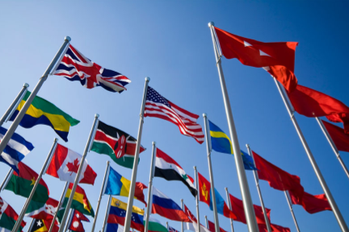
foreign
in or from another country
Synonym: unfamiliar, from abroad
Notes:
Give student friendly definition
Use the word in other contexts

Slide 7
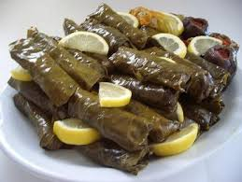
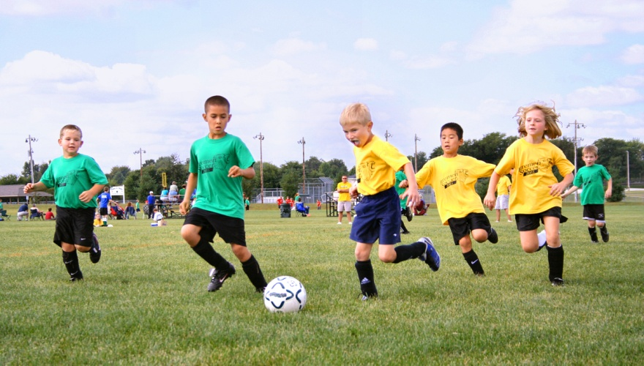
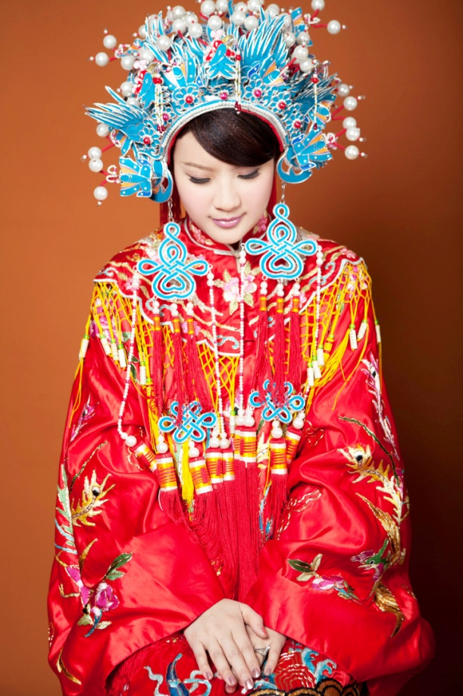
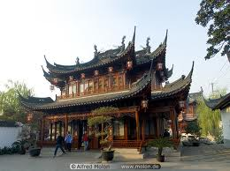
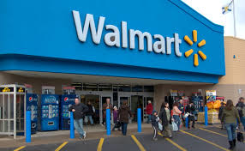
Which of these things are
foreign?
Notes:
Engage the students with the word

Slide 8
loyal
27 And loyal hearts are beating high
Notes:
Contextualize the word- Find it in the text
Say the word together

Slide 9
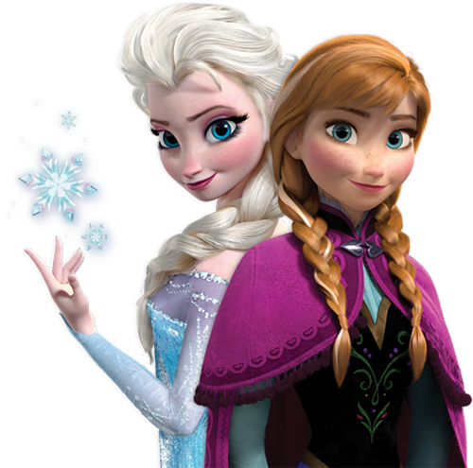
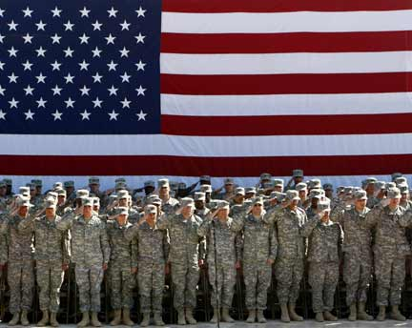
loyal
Giving constant support to a person or country
Synonyms: faithful, devoted
Notes:
Give student friendly definition
Use the word in other contexts

Slide 10
Idea Substitution
Try to change each sentence to use the word loyal.
The dog never left his owner’s side.
The woman had given constant support to her husband for 30 years.
The soldier was faithful to defend his country.
Jessica and Laura are devoted friends who always stand up for each other.
Notes:
Engage the students with the word

Slide 11
reverent
Stately honor and reverent awe…
Notes:
Contextualize the word- Find it in the text
Say the word together

Slide 12
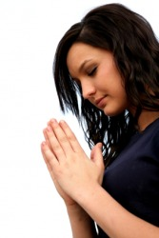
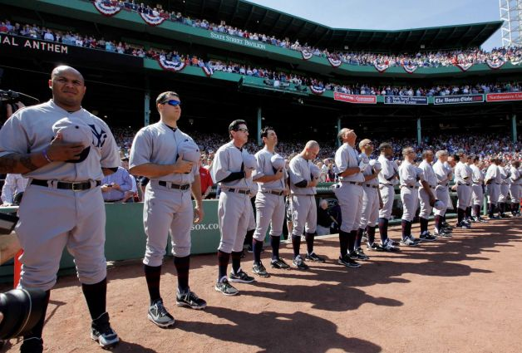
reverent
feeling or showing deep respect
Synonym: admiring, respectful
Notes:
Contextualize the word- Find it in the text
Say the word together

Slide 13
At which of these places would someone be reverent?
A place of worship (like a church or temple)
The playground
During the Pledge of Allegiance
A birthday party
At a performance like a play
Notes:
Engage the students with the word

Slide 14
Who can use all 3 words in a sentence?
reverent
foreign
loyal
Notes:
Read all three words and see if you can use them in one sentence.

Slide 15


Write a sentence to show you know what each of these words mean.
The man was reverent because…
The food was foreign because…
She was a loyal friend because…
Notes:
Application-
Students need an opportunity to use the words they just learned from the text.

Slide 16
I can use words I learn from a text.
Notes:
Goal-
Revisit the Goal

