Slide 1
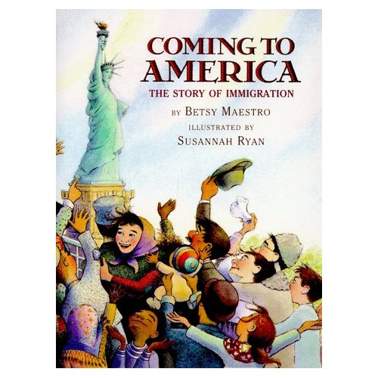
3rd Grade
Text Talk
Unit 4

Slide 2
I can use words I learn from a text.
Score yourself
Notes:
Goal-
Students need to engage with the goal- read it, repeat it, write it, etc.

Slide 3

Tell your partner about a new word you learned last week.
Notes:
Access Prior Knowledge- (APK)
Turn and Talk

Slide 4
Notes:
New Information-
Read the book- provide a brief explanation of any words that may be new or unfamiliar to the students.

Slide 5
immigrant
Notes:
Contextualize the word- Find it in the text
Say the word together

Slide 6
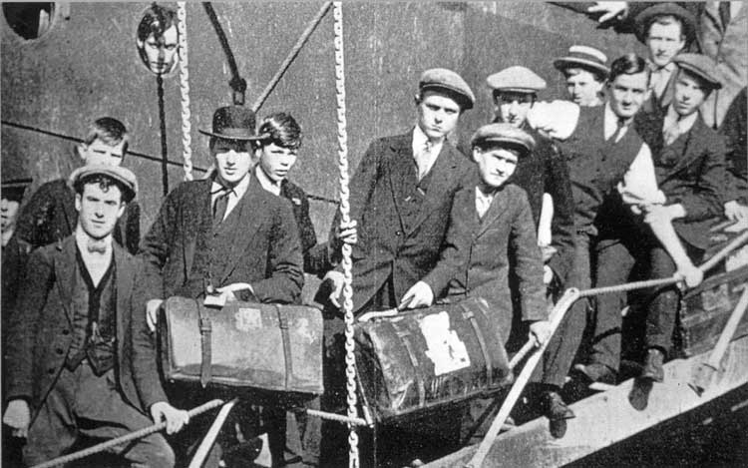
immigrant
a person who comes to live permanently in a foreign country.
Notes:
Give student friendly definition
Use the word in other contexts

Slide 7

Thumbs up, Thumbs down
Which of these would be an immigrant?
A man moving from Russia to America in 1835 because he could make more money in America.
A boy switching schools because his Dad got a new job.
A young girl and her family moving to America from Germany because they wanted religious freedom.
Notes:
Engage the students with the word

Slide 8
native
Notes:
Contextualize the word- Find it in the text
Say the word together

Slide 9
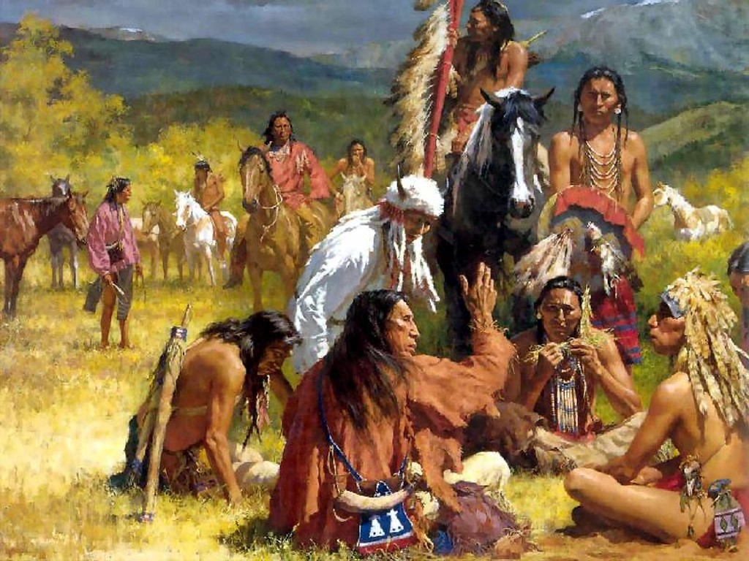
native
Being a member of the original people who lived in a particular place.
Notes:
Give student friendly definition
Use the word in other contexts

Slide 10
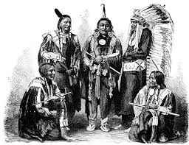
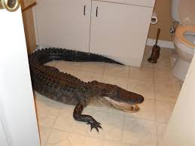
Which is native to their environment?
Are these people native to America?
Is an alligator native to a house?
Notes:
Engage the students with the word

Slide 11
persecution
Notes:
Contextualize the word- Find it in the text
Say the word together

Slide 12
persecution
Treating someone poorly because of their race, religious beliefs, or other characteristics.
Notes:
Contextualize the word- Find it in the text
Say the word together

Slide 13
refugee
Notes:
Contextualize the word- Find it in the text
Say the word together

Slide 14
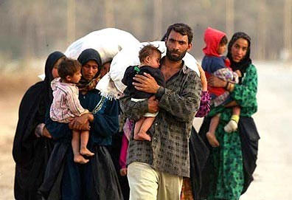
refugee
Someone who has been forced to leave their country in order to escape war, persecution, or natural disaster.
Notes:
Contextualize the word- Find it in the text
Say the word together

Slide 15
Would these people be a refugee ?
A family leaving their home country after a major hurricane destroyed their village.
A family moving to another country to find religious freedom.
Notes:
Engage the students with the word

Slide 16
Who can use all 4 words in a sentence?
immigrant
native
persecution
refugee
Notes:
Read all three words and see if you can use them in one sentence.

Slide 17


Write a sentence to show you know what each of these words mean.
immigrant
native
Persecution
refugee
Notes:
Application-
Students need an opportunity to use the words they just learned from the text.

Slide 18
I can use words I learn from a text.
Score yourself.
Notes:
Goal-
Revisit the Goal

