Slide 1
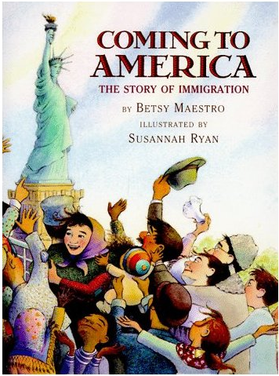
Coming to America:
The Story of Immigration
Context Clues
3rd Grade
Unit 4

Slide 2
I can use the context in a sentence as a clue to the meaning of a word or phrase.

Slide 3
duck
Turn and talk: What does this word mean?
Notes:
Turn and talk: What does this word mean

Slide 4
The duck quacked and waddled into the pond.
Notes:
Turn and talk: What does duck mean in this sentence?

Slide 5
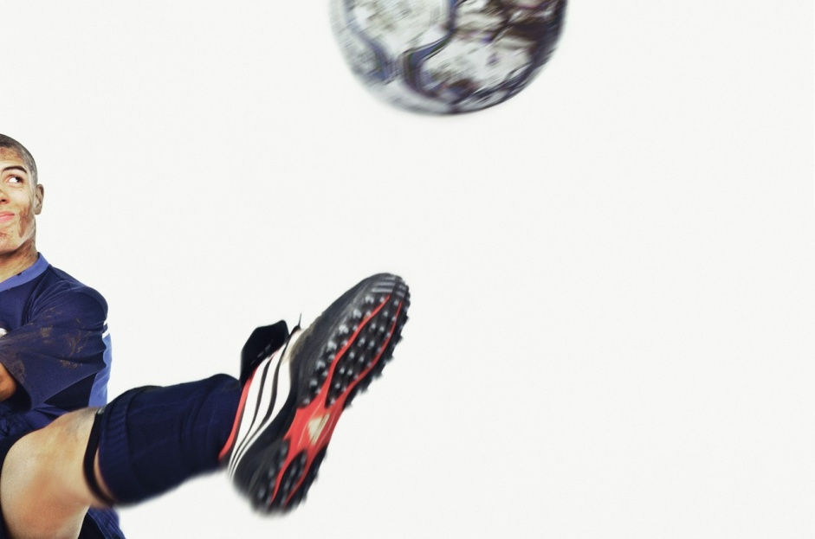
“Duck!” Connor shouted as the soccer ball flew through the air toward Ben’s head.
Notes:
Turn and talk: What duck mean in this sentence?

Slide 6

What are context clues?
Context is the part of a text that surrounds a word or phrase and contribute to its full meaning.
Context clues are information that appears near a word or phrase and offers suggestions about its meaning.

Slide 7
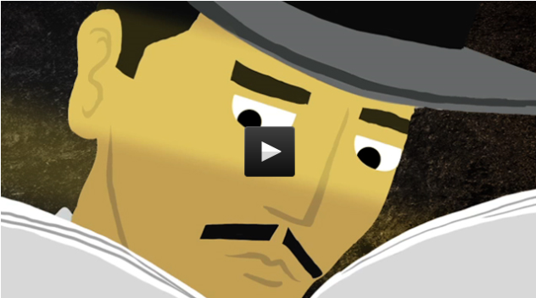
What types of context clues can help me determine the meaning of a new word?

Slide 8
Types of Context Clues
Synonyms
Antonyms
Explanation
Examples

Slide 9
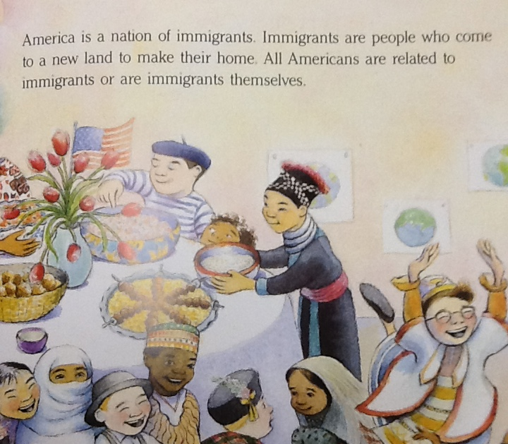
immigrants

Slide 10
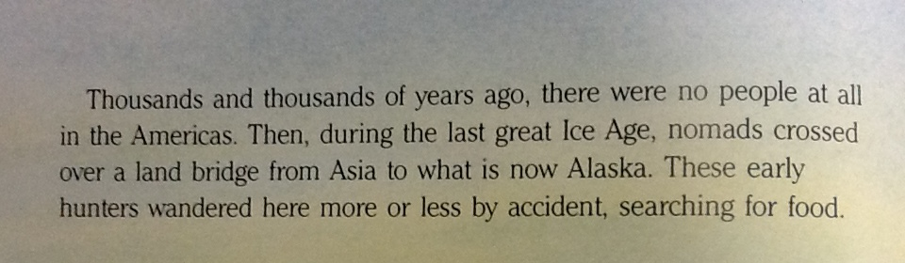
nomads

Slide 11
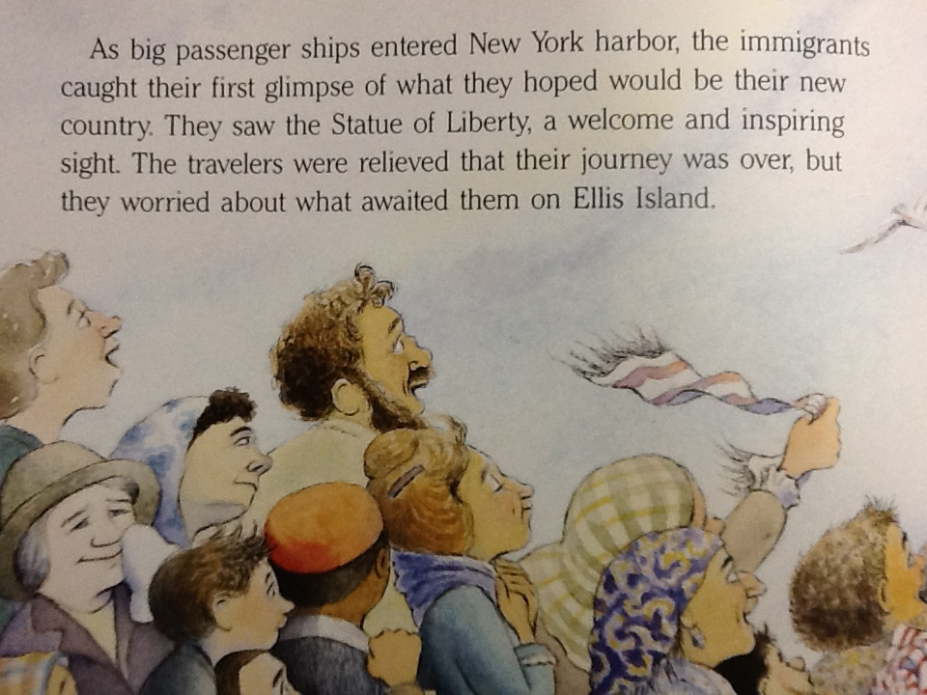
relieved

Slide 12
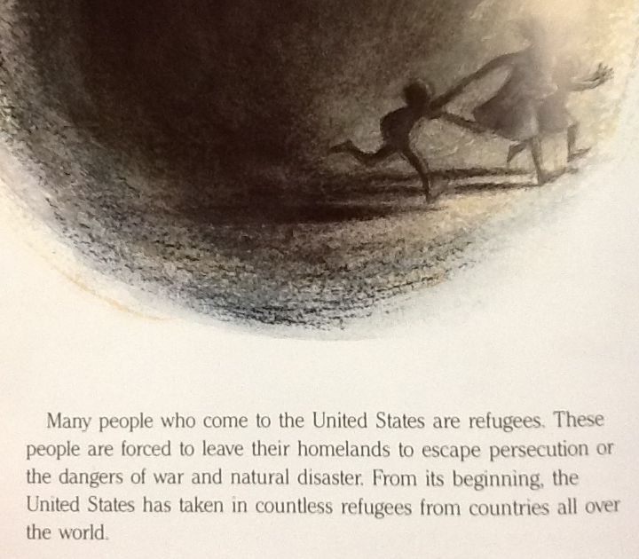
refugees

Slide 13
I can use the context in a sentence as a clue to the meaning of a word or phrase.

