Slide 1
What is Immigration?
3rd Grade Unit 4
Notes:
Our goal is to learn about immigration. Do you know what it is?

Slide 2
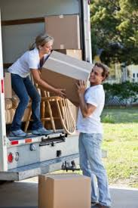
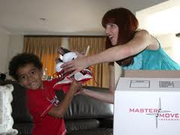
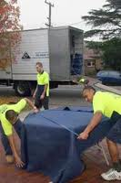
What are these people doing?
Notes:
APK
What do you notice all these people doing?
Moving…why do people move?

Slide 3
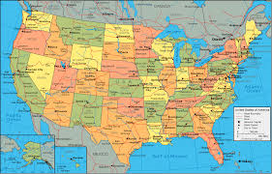
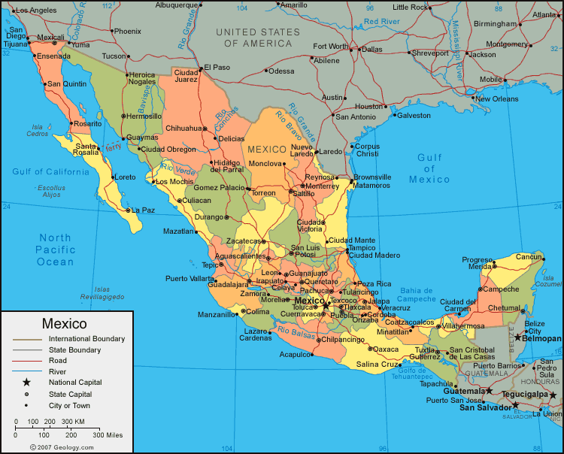
Immigration
When a person moves from one country to a another country.
Notes:
New Knowledge:
Definition of immigration:
Person moving from one country to another country
Its not just people that move to the U.S.; immigrants can be people that move from France to Germany, or Mexico to Peurto Rico.
We are going to be reading different books about immigration and reading about current immigrants.

Slide 4
Why did people want to leave their country?
There are several reasons people wanted to leave their country:
War
Religious persecution
Famine
Over population
People wanted better opportunities
Notes:
We are going to learn about when people first started immigrating to our country…. In the late 1800’s. We still have immigration today, but we are talking about when it first started.

Slide 5
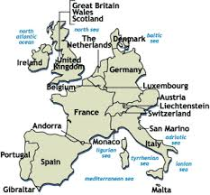
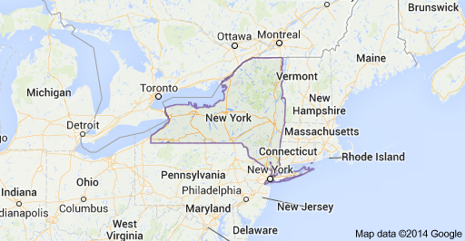
Where did they come from?
Western Europe
Notes:
This is showing where immigrants came from back in the early 1900’s. Today, we have immigrants from all over the country.

Slide 6
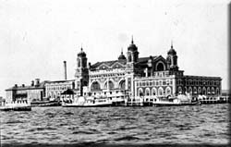
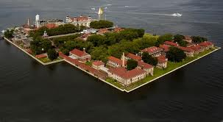
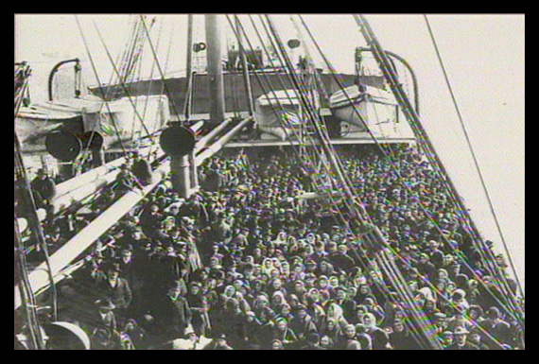
Where did they go once they got to the United States?
Ellis Island
(off the coast of New York)
Traveled by boat
Notes:
Traveled by Boat
very crowded, little food, stinky!
Took up to 2 weeks to travel
Some people used all their money to get a chance to travel to the US
No showers, no dining rooms
Ellis Island
There had to be a place for the immigrants to go once they got off the boat. Ellis Island was made so that each person could go through different stations to make sure they could stay in the United States. If anyone was sick or carrying a disease, they were sent back to their country. Families were separated during this time of being checked out by doctors. Ellis Island is still in NY and is a museum. There were about 13 million people that came through Ellis Island. Ellis Island was open from 1892-1954.

Slide 7

Imagine…
What do you think life was like for someone coming to America and going to Ellis Island?
Watch this video, listen to your teacher read the words on the screen.
Notes:
The video is 5:29. You will want to read the words that come on the screen.
After the video, get students share what they learned from the video, orally.

Slide 8

In your notebooks…
In your notebooks,
  What did you learn about immigration?
  What are you still wondering about immigration?
Notes:
Let students respond to the questions about immigration…students can share their responses.

Slide 9
What is Immigration?
3rd Grade Unit 4
Notes:
Our goal is to

