Slide 1
Current Day Immigrants

Slide 2
Goal
I can listen to information presented through video, and determine the main ideas.

Slide 3
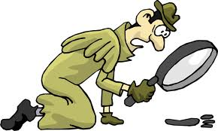
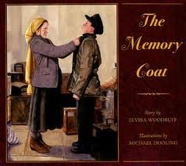
Normally when you are asked to find the main idea, you are reading a piece of text.
Notes:
APK: you have heard your teacher say many times, “What is the main idea of this book?” or, “What is the main idea of this passage, text?”
Today, we are wanting to find the main idea, but it will be with something we are HEARING through video. What do you think you will need to do in order to hear the main idea?
pay attention
Listen to the speaker
Take notes on the sheet in front of me

Slide 4

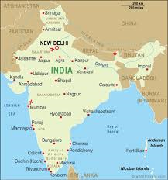
Sadana age 11
Notes:
Students can take notes on the word document that has the chart with different questions to listen for; each video is about 3-5 minutes long.

Slide 5

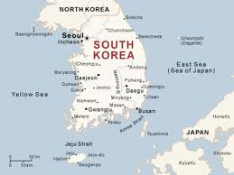
Taylor age 11

Slide 6


Gabrielle age 13

Slide 7
Goal
I can listen to information presented through video, and determine the main ideas.
Notes:
How did you do in listening for the main idea? Do you think it is harder to listen for the main idea, or reading something and then determining the main idea?
What important information did we learn today about present day immigrants?

