Slide 1
Your Goal…
Explain how illustrations help you understand the story.
Notes:
RL.3.7 Explain how specific aspects of a text’s illustrations contribute to what is conveyed by the words in a story (e.g. create mood, emphasize aspects of a character or setting).

Slide 2
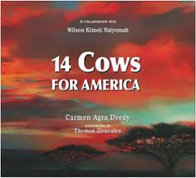

What do you remember from the story?
What was the main idea?
What did you like best about this book?
Notes:
Let students share the answers to the questions from the story.
APK:
What was the main idea of our story from yesterday, 14 Cows?
What did you like best about this book?
Let students share why they enjoyed this book…
Maybe share how the illustrations are so vibrant, it gave almost a real picture of this tribe.

Slide 3

When reading a literary text:
THINK:
What can I learn from the illustrations?
What do the illustrations tell me about the story elements?(characters, setting, events)
How does the text and illustrations support each other?
Notes:
New Information:
As readers, we need to take time to look at the pictures and think about how the illustrations help us to understand the story.
Read the “think questions” together.
We are going to use 14 cows to see how we can use the illustrations to help us understand the story.
Teacher Note:
When focusing on the illustrations in the text, we need to help students see how the text and pictures intertwine; sometimes we get information from the illustrations that is not written in the text.
We have this as an informational standard as well, but it focuses on charts, graphs, maps, photographs

Slide 4
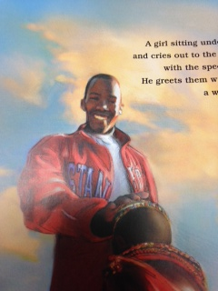
“The children run to him with the speed and grace of cheetahs. He greets them with a gentle touch on the head, a warrior’s blessing.”
Notes:
New Information:
Let’s look at this picture from the book and read the text that is on the same page:
This is the first time we see Kimeli. What can you learn about Kimeli from the illustration?
(Have the class read the text with you on the slides)
How do the words on this page help us know what kind of person Kimeli is? (Teacher Note:this is looking at how the illustration and text work together to show us his character.)
How does the illustration show that Kimeli is gentle and kind?
Another possible question: How can the reader know that Kimeli has been in the United States (based off the picture)

Slide 5
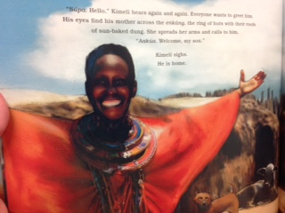
“Everyone wants to greet him. His eyes find his mother… She spreads her arms and calls to him”
Notes:
Let’t try again…
How does the illustration support the text?
(this is a right-there question)
In looking at his mother, what do you think she is feeling? How do you know she feels this way?
(happy, excited, joyful…because of the big smile on her face.)
What do you think the mood of the story is at this point? What kind of feeling do you get in reading the text and looking at the picture?

Slide 6
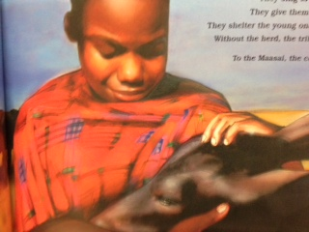
“They treat their cows as kindly as they do their children.
They sing to them. They give them names. They shelter the young ones in their homes. Without the herd, the tribe might starve.
To the Maasai, the cow is life.”
Notes:
What information do we learn about the Masaai and their cows from both the text and the illustration?

Slide 7
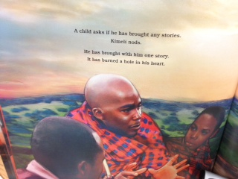
“He has brought with him one story. It has burned a hole in his heart.”
Notes:
How does this illustration change the mood of the story? Does it still feel happy and joyous?
What do you notice?
-face is serious; you can tell he is talking about something with the way he is holding his eyes, the little boy listening looks solemn.
Read the text:
Has the story really burned a hole in his heart? How has the text help support the mood from the illustration?

Slide 8
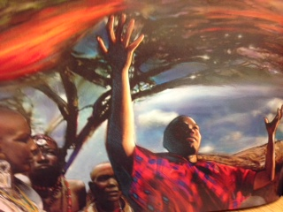
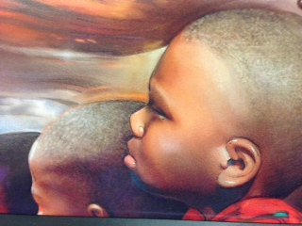
Later, in a tradition as old as the Maasai, the rest of the tribe gathers under an acacia tree to her the story.
There is a terrible stillness in the air as the tale unfolds. With growing disbelief, men, women, and children listen.
Buildings so tall they can touch the sky?
Fires so hot they can melt iron?
Smoke and dust so thick they can block out the sun?
Notes:
Application:
We have practiced looking more carefully at the illustrations and text, so let’s try to do some on our own.
Teacher Note: If you think you class needs more practice, you can work this slide together and do the next one on their own.
The pictures will be on the slides and you will answer the questions in your notebooks.
How do the illustrations support the text in these pictures?
In working together, how do the text and illustrations create the mood on this page?

Slide 9
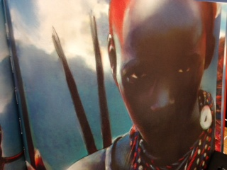
“The story ends. More than three thousand souls are lost. A great silence falls over the Maasi.
Kimeli waits.
He knows his people.
They are fierce when provoked, but easily moved to kindness when they hear of suffering or injustice.”
Notes:
When reading the text with this slide, focus on the last sentence. It is POWERFUL!!!
In your notebook…
How does the quote, “they are fierce when provoked, but easily moved to kindness when they hear of suffering or injustice.”,
support the Illustration?
Orally ask:
What did the Massai people do to show their kindness at this point in the story?

Slide 10
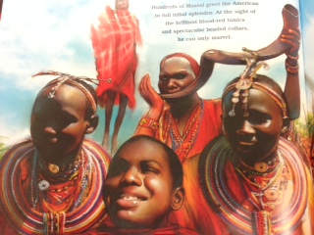
“Hundreds of Maasai greet the American in full tribal splendor. At the sight of the brilliant blood-red tunics and spectacular beaded collars, he can only marvel. “
Notes:
In this illustration, the tribe is having their celebration for the giving the cows to the American diplomat.
How does the author use the illustration and text to help the reader understand the ceremony of giving the 14 cows to America?

Slide 11
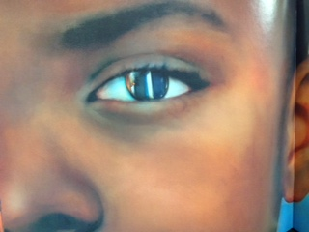
“Because there is no nation so powerful it cannot be wounded, nor a people so small they cannot offer mighty comfort.”
Notes:
This slide is on a handout if you prefer to use it as an assessment. It brings all the elements together of the text and illustrations.
How does the illustration within the eye support the text, “no nation so powerful it cannot be wounded”? What nation is the author talking about? How was our nation wounded?
2. Read the second part of the sentence, “nor a people so small they cannot offer mighty comfort”.
Who is the author talking about and what comfort did they bring?
3. In working together, how do the text and illustration create the main idea of this story?
Possible Question to review RL3.3
How do Kimeli’s actions contribute to the sequences of events?

Slide 12
When reading a literary text:
THINK:
What can I learn from the illustrations?
What do the illustrations tell me about the story elements?(characters, setting, events)
How does the text and illustrations support each other?
Notes:
Quick review of how we use these questions to think about the illustrations in text…

Slide 13
Your Goal…
Explain how illustrations help you understand the story.
Notes:
RL.3.7 Explain how specific aspects of a text’s illustrations contribute to what is conveyed by the words in a story (e.g. create mood, emphasize aspects of a character or setting).

