Slide 1

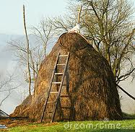
Day 1 – Narrative Writing
Goal: We will create a story mountain using the “haystack scene” from Sarah, Plain and Tall.

Slide 2
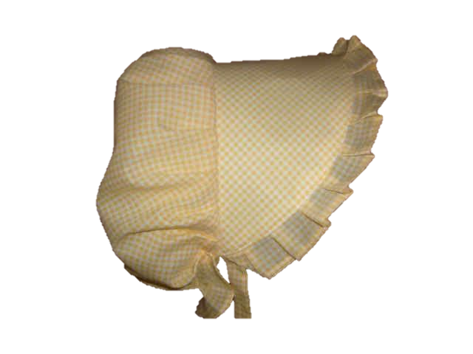
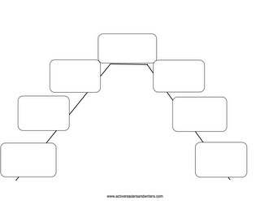
We are going to fill in a story mountain together about this scene.
You will each get a copy of the “haystack scene” and we will read it together.

Slide 3
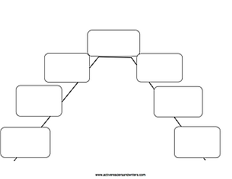

As we create our story mountains, we are also going to use our copies of the “haystack scene” to box off the text for each event that we use to make our story mountains.
We will number the boxes we draw on our papers to match the number on our story mountain to help organize our thinking.
1.
“We have no dunes here,” he said. Papa stood up. “Yes we do,” he said. He took the lantern and went out the door to the barn. “We do?” Caleb called after him.
Caleb didn’t think there were any dunes on the Prairie.
1.

Slide 4
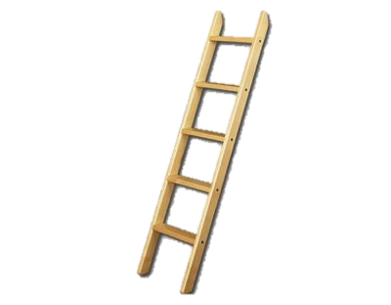
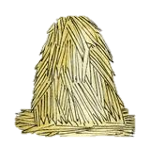
Haystack Scene
“We have no dunes here,” he said. Papa stood up. “Yes we do,” he said. He took the lantern and went out the door to the barn. “We do?” Caleb called after him. He ran ahead, Sarah and I following, the dogs close behind.
Next to the barn was Papa’s mound of hay for bedding, nearly as tall as the barn, covered with canvas to keep the rain from rotting it. Papa carried the wooden ladder from the barn and leaned it against the hay.
“There.” He smiled at Sarah. “Our dune.” Sarah was very quiet. The dogs looked up at her, waiting. Seal brushed against her legs, her tail in the air. Caleb reached over and took her hand. “It looks high up,” he said. “Are you scared, Sarah?” “Scared? Scared!” exclaimed Sarah. “You bet I’m not scared.”
She climbed the ladder, and Nick began to bark. She climbed to the very top of the hay and sat, looking down at us. Above, the stars were coming out. Papa piled a bed of loose hay below with his pitchfork. The light of the lantern made his eyes shine when he smiled up at Sarah.
“Fine?” called Papa. “Fine,” said Sara. She lifted her arms over her head and slid down, down, into the soft hay. She lay, laughing, as the dogs rolled beside her. “Was it a good dune?” called Caleb. “Yes,” said Sara. “It is a fine dune.”
Caleb and I climbed up and slid down. And Sarah did it three more times. At last Papa slid down, too, as the sky grew darker and the stars blinked like fireflies.
Notes:
With students, you should box off the events in the scene and plotting them on the story mountain.

Slide 5
Day 1 – Narrative Writing
Goal: We will create a story mountain using the “haystack scene” from Sarah, Plain and Tall.
Rate Yourself 1 2 3 4

Slide 6
Day 2 – Narrative Writing
Goal: We will identify the 3 main characteristics of good writing from the haystack scene.
Description
Dialogue
Action

Slide 7
There should be an equal balance of all 3 characteristics.

Slide 8
We are going to look at our story mountain we created from the haystack scene and color-code the 3 main characteristics of good writing.
Actions will be GREEN.
Dialogue will be RED.
Descriptions will be BLUE.

Slide 9
We will do an example together.
“We have no dunes here,” he said. Papa stood up. “Yes we do,” he said. He took the lantern and went out the door to the barn. “We do?” Caleb called after him. He ran ahead, Sarah and I following, the dogs close behind.
Next to the barn was Papa’s mound of hay for bedding, nearly as tall as the barn, covered with canvas to keep the rain from rotting it.

Slide 10
It’s your turn!
You get to color code the rest of the “haystack scene” with a partner. You both need to color code your papers with the 3 characteristics of a good writer.
Descriptions are BLUE.
Dialogue is RED.
Actions are GREEN.

Slide 11
Day 2 – Narrative Writing
Goal: We will identify the 3 main characteristics of good writing from the haystack scene.
Description
Dialogue
Action
Rate Yourself 1 2 3 4

Slide 12
Day 3 – Narrative Writing
Goal: We will plan our own personal narrative with a balance of action, dialogue, and description.
Rate Yourself 1 2 3 4

Slide 13
Now it is your turn to write your own “scene” for “Sarah Plain & Tall”
Pretend you were Patricia McLaughlin and you were going to add another scene to the story. What would you write about? Plan a scene for Sarah Plain & Tall using the characters, setting, and other story elements you’ve already encountered in the book. Be sure to include an introduction and a conclusion to your scene.

Slide 14
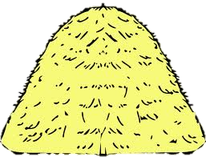
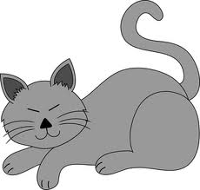
I will model my new scene for Sarah Plain & Tall.
Make sure to notice all of the descriptions, actions, dialogue, and details I add in my own scene.
I want you to be thinking of all of these elements that you want to add in your story.

Slide 15
Now it’s YOUR TURN!!!
You get to fill out your own story mountain about a new scene for Sarah Plain & Tall.
Make sure to include all 3 characteristics of a good writer.
Action
Dialogue
Description

Slide 16
Day 4 – Narrative Writing
Goal: We will write a personal narrative using the story mountain we created.
Rate Yourself 1 2 3 4

Slide 17
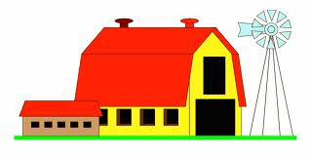
I will model writing my new scene from the story mountain I created yesterday.
Notice all of the descriptions, actions, dialogue, and details I add in my own story as I write it.
I want you to be thinking of all of these elements that you want to add in your story.

Slide 18
Now it’s YOUR TURN!!!
You get to write your scene from the story mountain you created yesterday.
Make sure to add a balance of all 3 characteristics of a good writer.
Action
Dialogue
Description

Slide 19
Day 4 – Narrative Writing
Goal: We will write a personal narrative using the story mountain we created.
Rate Yourself 1 2 3 4

Slide 20
Day 5 – Narrative Writing
Goal: We will edit our personal narratives for dialogue, descriptions, and actions.
Rate Yourself 1 2 3 4

Slide 21
Go back and color code the three characteristics of a good writer in your scene and see if there is an equal balance. If not, go back and add these elements in your story.
Actions will be GREEN.
Dialogue will be RED.
Descriptions will be BLUE.

Slide 22
When you are finished editing your paper for content, you can begin publishing your personal narrative.
Be sure to use correct capitalization.
Make sure you are spelling words correctly.
Write using your best handwriting.

Slide 23
Day 5 – Narrative Writing
Goal: We will edit our personal narratives for dialogue, descriptions, and actions.
Rate Yourself 1 2 3 4

