Slide 1
I can describe a character’s feelings and how they change in a story.
Rate yourself
1-2-3-4

Slide 2
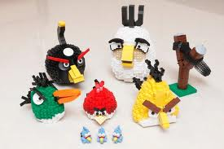
How would you feel if you built this out of Legos?
Notes:
APK

Slide 3
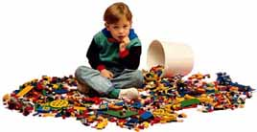
How would you feel if your little brother came by and did this to your creation?
Notes:
Feelings change because of things that happen or don’t happen. This is also true in stories. Characters feelings change throughout a story.

Slide 4
Character’s Feelings
We can use
  the author’s description of a character’s feelings
  how the character acts when events happen
  what the character says when events happen
  what other character’s say about how a character acts when events happen
Notes:
New Information

Slide 5
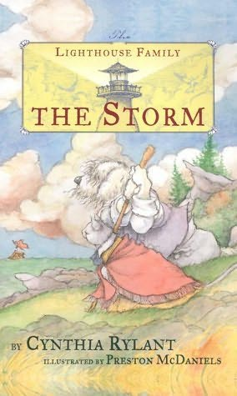
The Storm by Cynthia Rylant
Chapter 2: Seabold
Notes:
Give students a copy of Chapter 2. Ask the following questions after reading:
How does Seabold feel about the sea?
Why was this day different for Seabold?
What was the “magnificent light”?
Why did Seabold name his boat “Adventure”?
Why do you think the author chose the name “Seabold” for the character?
What does the author mean when she says “…the sea turned against him”?

Slide 6
Application
How do Seabold’s feelings about the sea change in this chapter? Why do they change? Use text evidence to support your answer.
Notes:
Application

Slide 7
I can describe a character’s feelings and how they change in a story.
Rate yourself
1-2-3-4

