Slide 1
Inspired by the Sea
Day 1
Watch these two videos about the sea. Make a
T-chart in your reading response notebook. Jot down notes about each video of the sea.
The Beach
Ship at Sea
Video one – calm sea | Video two – storm at sea
Notes:
Your new unit is introducing you to writers and information that is inspired by the sea. Let’s look at these two videos to give you an idea about the sea

Slide 2

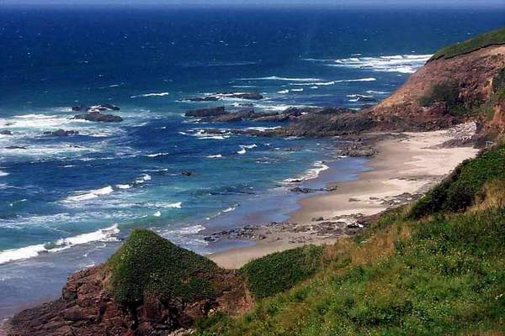
Essential Question
Why does the sea inspire writers?
Notes:
In your response journal, write about how the sea could inspire writers.

Slide 3
Literature
Day 1
G I will use information from the text to describe characters and their actions in the story.
Rate yourself
1 – 2 – 3 - 4
A Think back to The Stories Julian Tells. We used character traits to describe Julian. Turn and tell a partner what some of those character traits were.

Slide 4

We are going to listen to this story and learn about how the characters impact the outcome.
Notes:
N Some stories have many characters and some may only have a few.
To better understand a character in a story, the reader must be “read between the lines”. This means the reader must see what a character says, thinks, or does and then draw conclusions.

Slide 5

A While I am reading the first part Amos & Boris today, I want you to think about Amos. Use the character sketch sheet to record some things you learn about Amos. We can add to the character sketch tomorrow.

Slide 6
While I am reading the first part Amos & Boris today, I want you to think about Amos. Use the character sheet to record some things you learn about Amos. We can add to the character sketch tomorrow.
Notes from listening to the story | Notes from listening to the story
What kind of character traits does Amos have? | What kind of character traits does Boris have?
Choose a trait of Amos. What happens in the story because of this trait? | Choose a trait of Boris. What happens in the story because of this trait?

Slide 7
G
I will use information from the text to describe characters and their actions in the story.
Rate yourself
1 – 2 – 3 - 4
Rate your effort today
1-2-3-4

Slide 8
Literature
Day 2
G I will use information from the text to describe characters and their actions in the story.
Rate yourself
1 – 2 – 3 - 4
A Turn and tell your partner why it is important to understand the characters and their actions in a story.

Slide 9
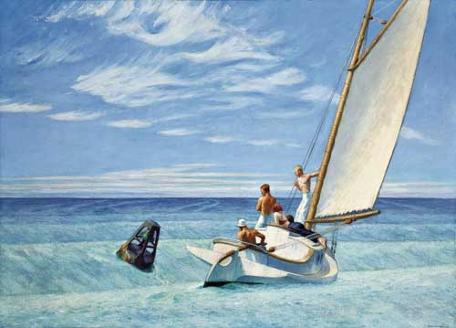
Ground Swell
Edward Hopper (1939)
Notes:
Edward Hopper, Ground Swell (1939)
Prominent American realist painter and printmaker.

Slide 10
We are going to use our sheet from yesterday to take notes on Boris. We know that characters are important in stories. They keep the action moving and they keep the reader interested.
Notes from listening to the story | Notes from listening to the story
What kind of character traits does Amos have? | What kind of character traits does Boris have?
Choose a trait of Amos. What happens in the story because of this trait? | Choose a trait of Boris. What happens in the story because of this trait?
Notes:
N Characters are important in stories. They keep the action moving and they keep the reader interested.
Most stories have two kinds of characters: major and minor
Major Characters
- Characters in the story most often.
- They are very important to the plot.
- Their names are often in the title.
Minor Characters
- They are not as important to the plot.
-They don’t appear in the story as much.
-You don’t learn as much about a minor character as you do a major character.

Slide 11
G
I will use information from the text to describe characters and their actions in the story.
Rate yourself
1 – 2 – 3 - 4
Rate your effort today
1-2-3-4

Slide 12

Day 3

Slide 13
I can use words I learn from a text.
Notes:
Goal-
Students need to engage with the goal- read it, repeat it, write it, etc.

Slide 14

Tell your partner about a new word you learned last week.
Notes:
Access Prior Knowledge- (APK)
Turn and Talk

Slide 15
Notes:
New Information-
Read the book- provide a brief explanation of any words that may be new or unfamiliar to the students.

Slide 16
miserable
Notes:
Contextualize the word- Find it in the text
Say the word together

Slide 17
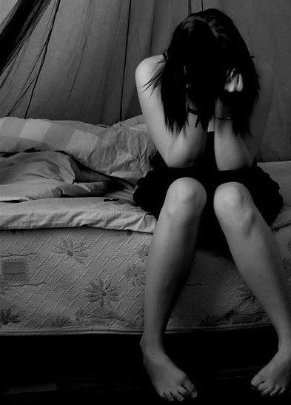
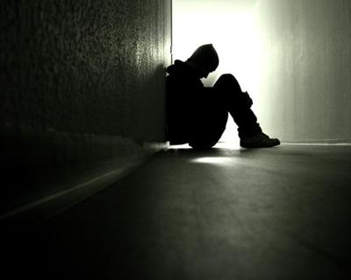
miserable
very unhappy, uncomfortable
Notes:
Give student friendly definition
Use the word in other contexts

Slide 18

Thumbs up, Thumbs down
Which of these would make you miserable?
Your gaming system broke.
Your teacher gave you extra recess.
You lost your favorite toy.
A tornado flattened your home.
Your best friend moved away.
Notes:
Engage the students with the word

Slide 19
ambitious
Notes:
Contextualize the word- Find it in the text
Say the word together

Slide 20
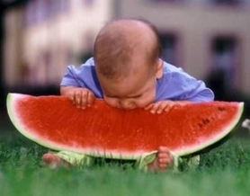
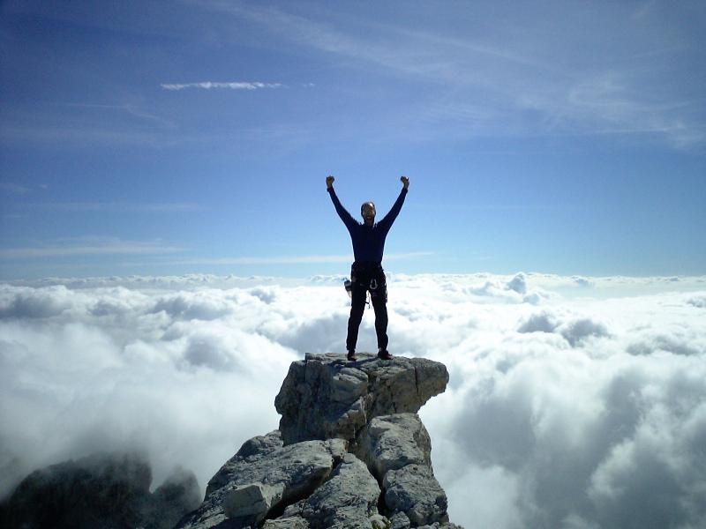

ambitious
a strong desire to do something
Notes:
Give student friendly definition
Use the word in other contexts

Slide 21
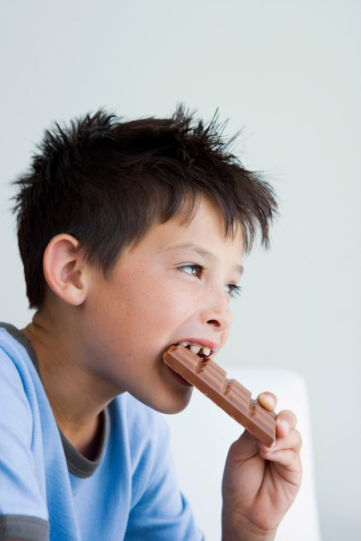
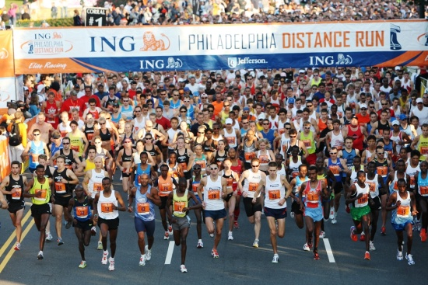
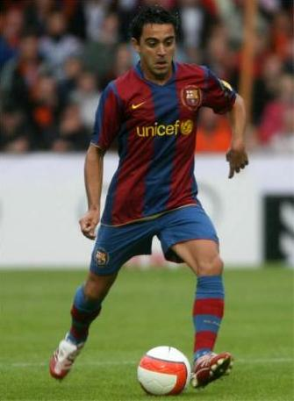

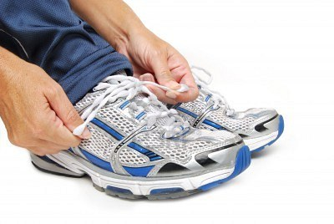
Which tasks would you need to be
ambitious to accomplish?
eat a chocolate bar
run a marathon
tie your shoe
read the whole series
become a professional
soccer player
Notes:
Engage the students with the word

Slide 22
leisurely
Notes:
Contextualize the word- Find it in the text
Say the word together

Slide 23
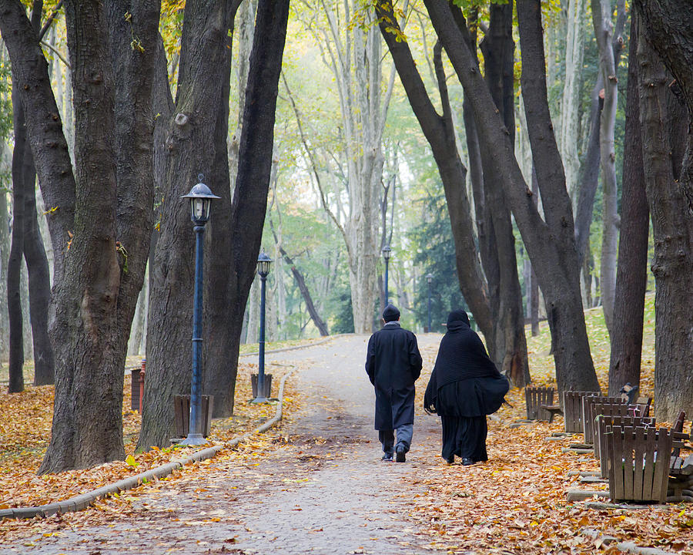

leisurely
unhurried, slow
Notes:
Contextualize the word- Find it in the text
Say the word together

Slide 24
Which of these things could you do leisurely ?
walk your dog
eat a hamburger
run a race
clean your room
take a timed test
Notes:
Engage the students with the word

Slide 25
Who can use all 3 words in a sentence?
miserable
ambitious
leisurely
Notes:
Read all three words and see if you can use them in one sentence.

Slide 26


Write a sentence to show you know what each of these words mean.
miserable
ambitious
leisurely
Notes:
Application-
Students need an opportunity to use the words they just learned from the text.

Slide 27
I can use words I learn from a text.
Notes:
Goal-
Revisit the Goal

