Slide 1
Learning Goal
I can determine point of view
Score yourself on our learning goal.
Notes:
Our learning goal is for you to know the point of view that an author has when telling/writing a story. To help us understand this, we are going to look at some different pictures.

Slide 2
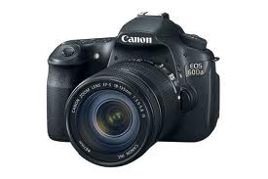
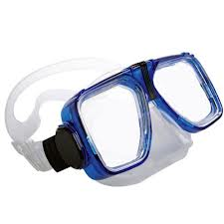
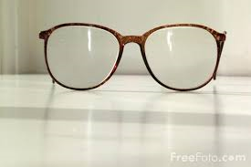

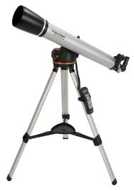
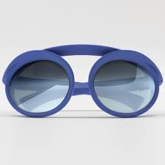
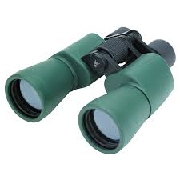
What do all these things have in common?
Notes:
APK: This is an AGNAG lesson What happens when you use a pair of glasses, or look through a camera? It changes the way you see something;

Slide 3
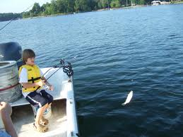
What do you see?
Notes:
Ask students what they see in this picture. Where is this child? (on a lake)

Slide 4
Do you know what you would see if you put this mask on and went into that same water?

Slide 5
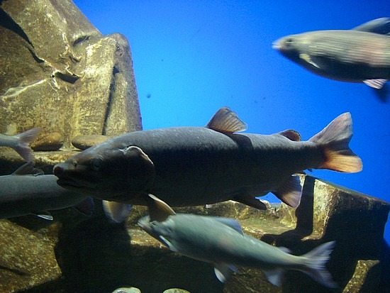
Why would you be able to see the fish IN the water?
Notes:
You can see the fish in the water because of the mask.

Slide 6
Both of these pictures are of the lake, so what changed to see it differently?
Notes:
It is the same lake, but because of the mask, and going into the water, you see it from a different perspective.

Slide 7
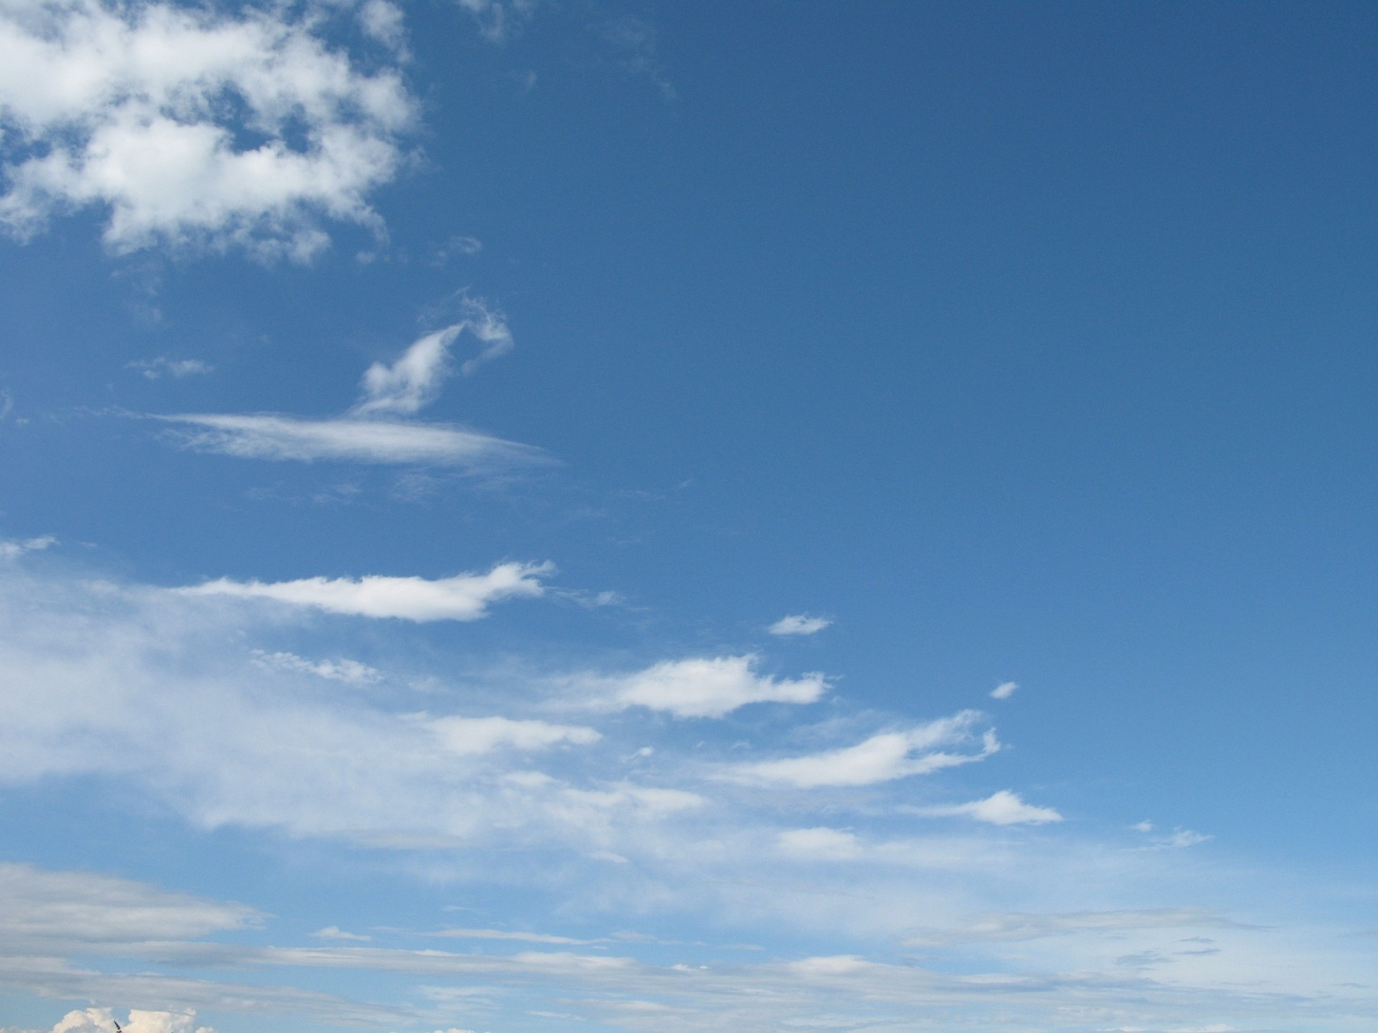
What do you see?

Slide 8

If you look at this same sky with a telescope, will you see the same thing?

Slide 9
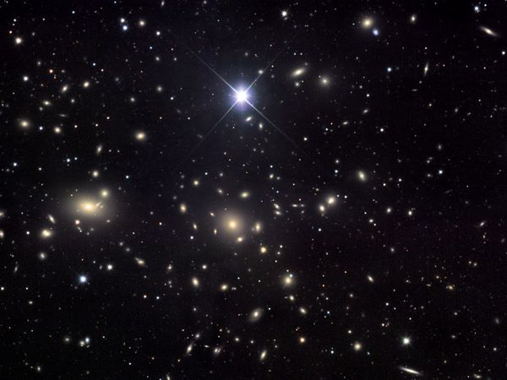
How has the view changed? What made it change?
Notes:
Once again, because of the telescope, you would have a different perspective of the sky.

Slide 10

Both of these pictures are of the sky during the daytime. Can you see the sky with the stars if you DO NOT have a telescope?
Notes:
If there were two of you standing outside, looking at the sky; one with a telescope and one without; are you BOTH looking at the same sky? But one of you will have a different experience because of looking through the telescope. If I were to ask you, “what did you see when you looked at the sky with that telescope?” you would have a different reaction from your friend. (use children’s names from the classroom to make more personal).

Slide 11
Point of View in literature
How someone sees something…their side of the story
Point of View: the perspective from which the story is told.
How the speaker sees the story play out
The narrator is the person telling the story

Slide 12
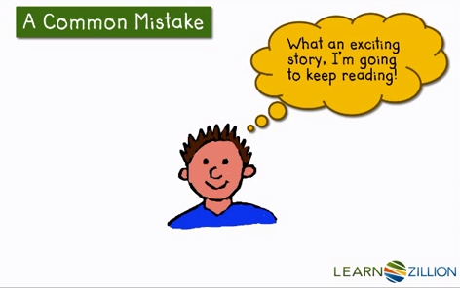
Notes:
When we read, we sometimes get so caught up in the story that we forget to stop and think about some things. Stopping to figure out the point of view…who is telling the story…can help us to more deeply understand our characters. It can help us figure out why they do some of the things they do. It also helps us figure out why authors do some of the things they do. Let’s practice looking at our book, The Raft.

Slide 13
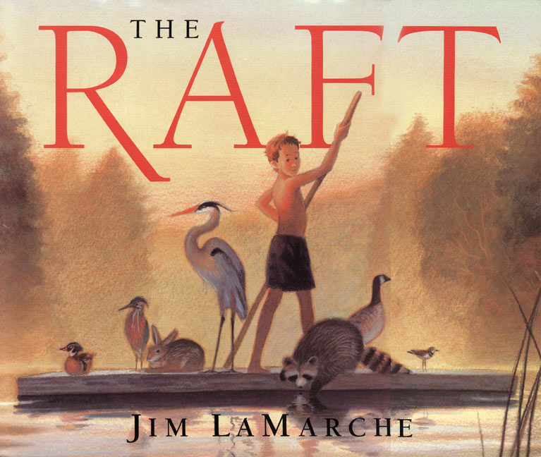

Slide 14
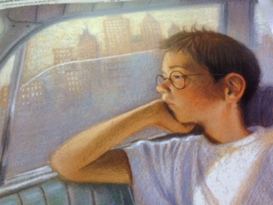
Identify the Point of View:
Who is the speaker? Is it a character in the story or is it a narrator? How do you know?
“There’s nobody to play with,” I complained. “She doesn’t even have a TV.” Dad grinned. “Well, she’s not your normal kind of grandma, I guess,” he said. “Calls herself a river rat.” He chuckled. I felt tears starting again, but I blinked hard and looked out the window.
Notes:
Remember the goal of our lesson is to determine point of view.
Let’s think about the story.
Read this text with me…
When identifying the point of view, we have to decide WHO is the speaker.
Who is the speaker in this text?
(Students need to see the word “I” as being Nikky; the story is told from the point of view of Nikky; )
Nikky is telling the story from a 1st person point of view, which means it is from his perspective.

Slide 15
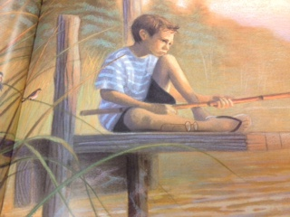
How does this shape the story?
What words does the narrator use to let you know his perspective ?
“ Down at the dock, I looked things over. The lily pads were too close to shore. There couldn’t be fish there. I walked to the end of the dock and threw my line out as far as I could. Then I sat down to wait. And wait. And wait. My bobber never moved. “There’s no fish in this stupid river,” I said out loud, disgusted.”
Notes:
After reading the slide, be sure to ask students:
Identify words that tell how he is feeling: wait wait, stupid river, disgusted; that is helping shaping
How do you know that it is still Nikky telling the story?
We want to make sure to go back to the goal of the lesson.
How does knowing the point of view shape the story? We get to be in Nikky’s head and know how he is feeling
The story is not told from the fish in the water, thinking, “wow! Look at bobber way over there. We are just hanging out swimming around, hoping not to get caught” NO! We are getting to know who Nikky is, and what he is feeling.

Slide 16
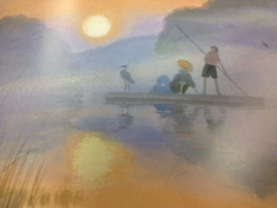
After supper, I showed Grandma my drawing of the fawn and told her my story.
“It’s perfect,” she said, “but we need to do one more thing.” She hurried up to the cottage. When she came back, she had tubes of oil paint and two brushes.
Grandma helped me trace my drawing with the oil paint, which soaked deep into the wood. “That’ll keep it,” she said. “Now you’ll always be part of the river.”
“Just like you, Grandma,” I told her. “A river rat.”
“Grandma laughed. “Just like me,” she agreed.
Identify the point of view (Nikky)
How did it shape the story? (we see how Nikky feels)
Why did the author make this choice?
Notes:
Let’s look at the end of the story. Listen to me read this section of text…
This is what we have done so far:
Identified the point of view
Discussed how it shapes the story
Now,
Why did the author make this choice? Why did he have the point of view be from Nikky? We needed to see how Nikky changed through the story. His perspective changed; but the point of view of the story did not change. At the beginning of the story, he didn’t want to be with his Grandma; at the end of the story, he didn’t want to leave. Nikky is still the one sharing the story; that didn’t change; but his perspective or the way he sees the river and his grandma DID change.

Slide 17
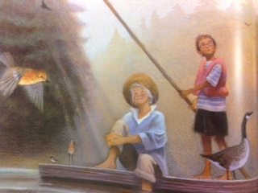
Think about it…
How would the story have been different if it was told from the grandma’s point of view?
Notes:
This is the application piece of the lesson. Depending upon your students, you may want them to write this in their notebooks and then bring them back to share their thoughts.
Students can either do this in their interactive notebooks, or you can use the handout that goes with this slide.
A character’s perspective changes, but the point of view of the story does not change.
Grandma: you would only see how the grandma feels; not Nikki’s
Go try to write about how Grandma’s point of view would be; come back and share.

Slide 18
Looking back at our goal for this lesson...
I can determine point of view
Score yourself on our learning goal.
Notes:
The purpose of this lesson was to see if you could determine point of view from the story, The Raft.

