Slide 1
Comparing
Octopuses & Squids
3rd Grade Unit 2

Slide 2
Goal:
I can use information from a text to compare.

Slide 3
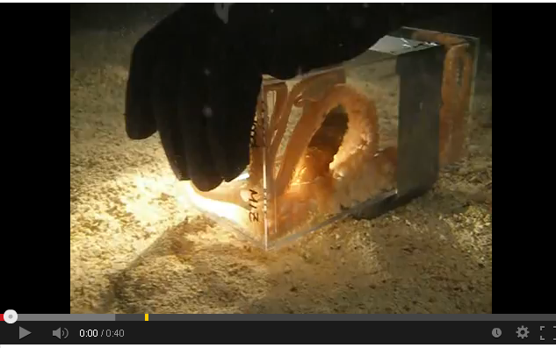

Watch…
What just happened?
Notes:
Access Student’s Prior Knowledge
Turn and Talk- “What just happened?”

Slide 4
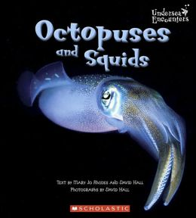
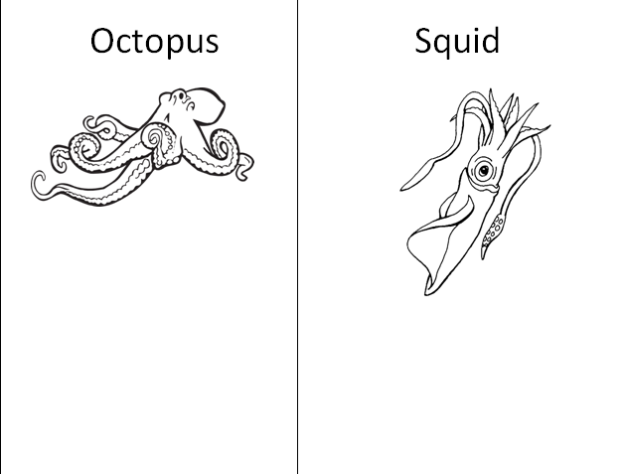
Notes:
New Information
Read and Take Notes

Slide 5
Steps for Comparing
I find the items to compare
I choose the features to compare the items
I tell how the items are the same or different
Notes:
New Information-
Introduce the steps for comparing

Slide 6
Steps for Comparing
I find the items to compare
I choose the features to compare the items
I tell how the items are the same or different
Notes:
Application
Step 1

Slide 7
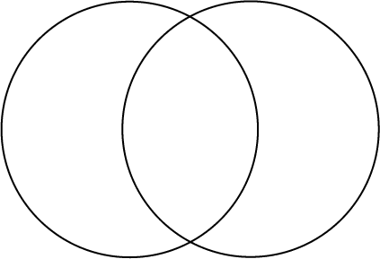
Steps for Comparing
I find the items to compare
I choose the features to compare the items
I tell how the items are the same or different
Habitat
Diet
Body shape
Arms
Camouflage
Notes:
Application
Step 2

Slide 8
Steps for Comparing
I find the items to compare
I choose the features to compare the items
I tell how the items are the same or different
Write a sentence explaining one way they are the same and a sentence explaining one way they are different.
Notes:
Application
Step 3

Slide 9
Goal:
I can use information from a text to compare.

