Slide 1
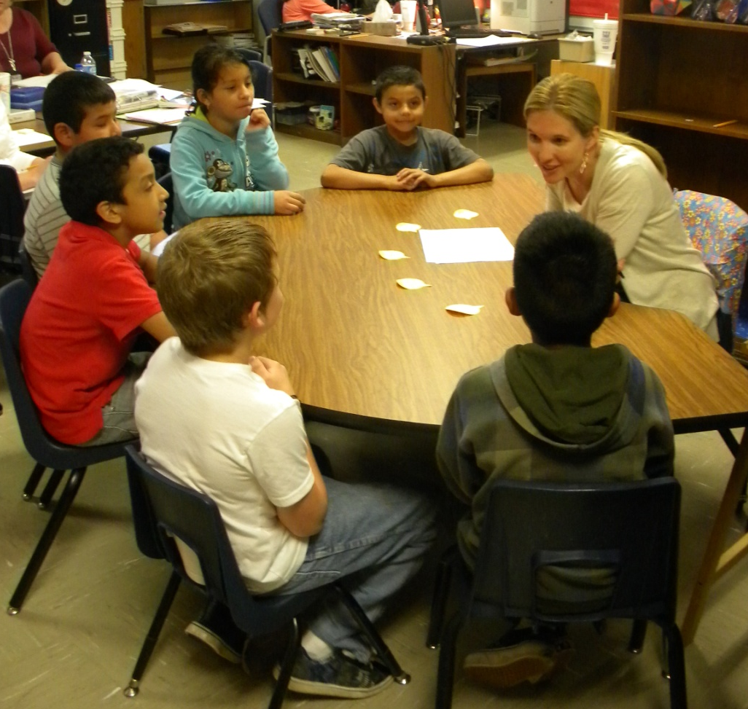
Third Grade
Small Group Instruction
with Gretchen Childs
Grace Hill Elementary
Rogers Public Schools
April 27, 2011
S.Hensley

Slide 2
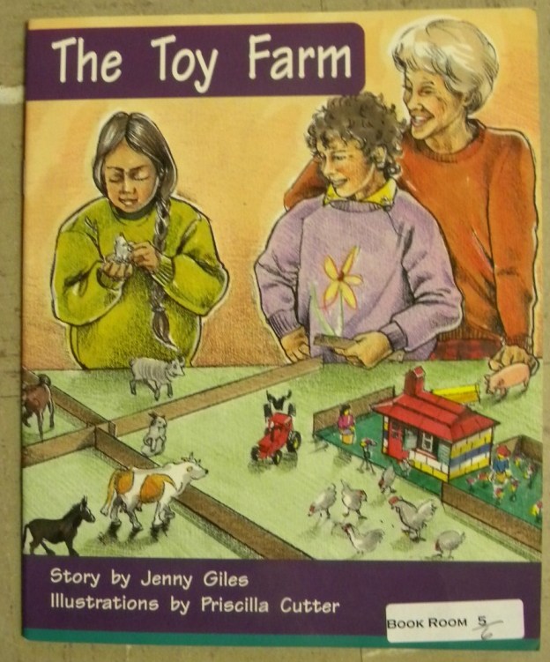
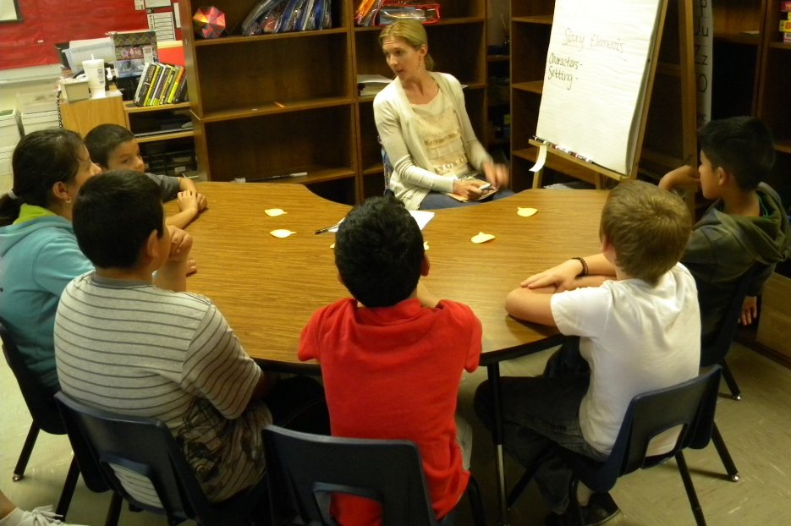
Group: Third Grade (Grace Hill Elementary)
Focus/Goal: Plot Structure; Identify Characters, Setting, Problem and Solution
Title: The Toy Farm by Jenny Giles
Level: 16

Slide 3

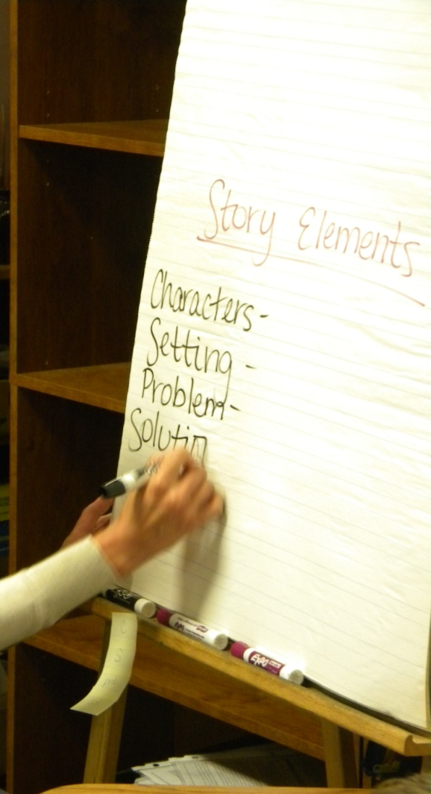
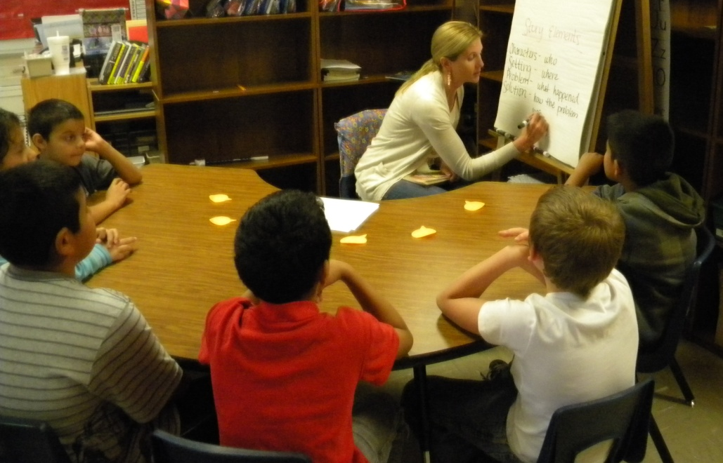
Before Reading
Access Prior Knowledge:
“What do know about story elements?”
With prompting from Gretchen, the students generated:
Characters
Setting
Problem
Solution
An anchor chart was created.

Slide 4
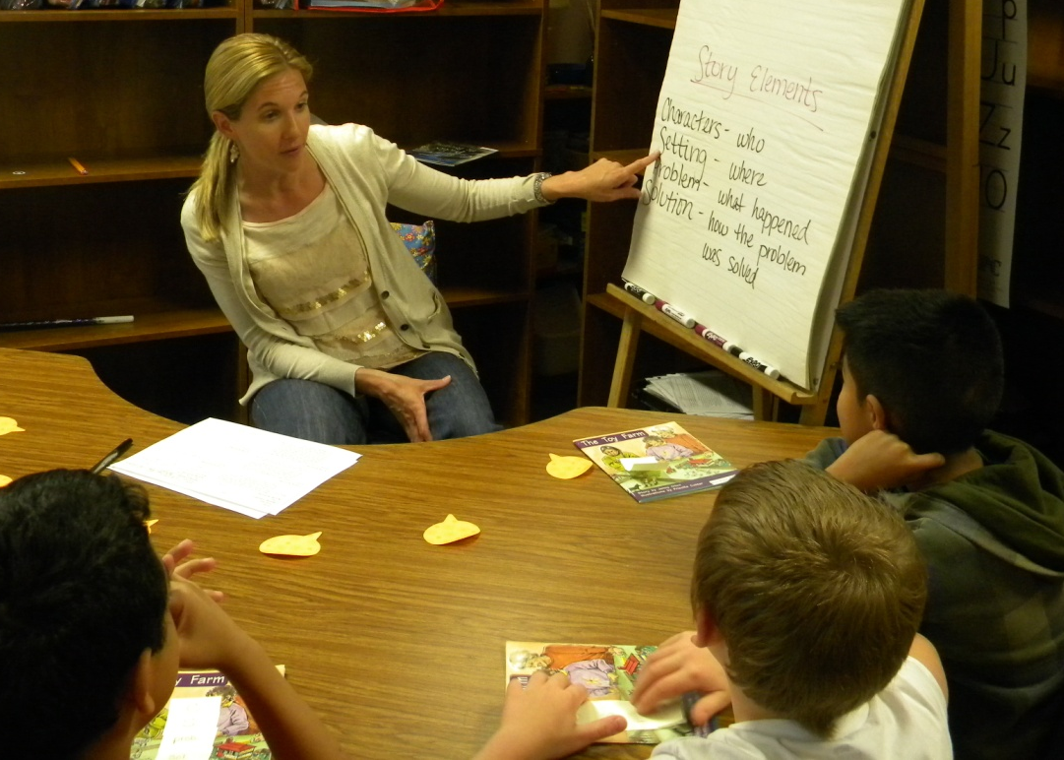
Before Reading
New Information:
“It is important to pay attention to the story elements because they help you understand the story.”
Story Elements
Characters- who
Setting- where
Problem- what happened
Solution- how the problem
was solved

Slide 5
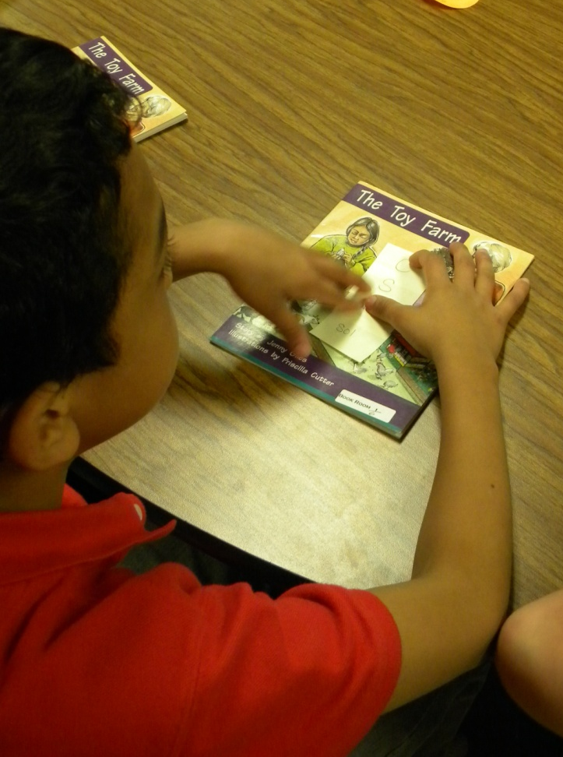
Before Reading
The students were given four sticky notes.
One for each of the story elements.
C
S
Prob.
Sol.

Slide 6
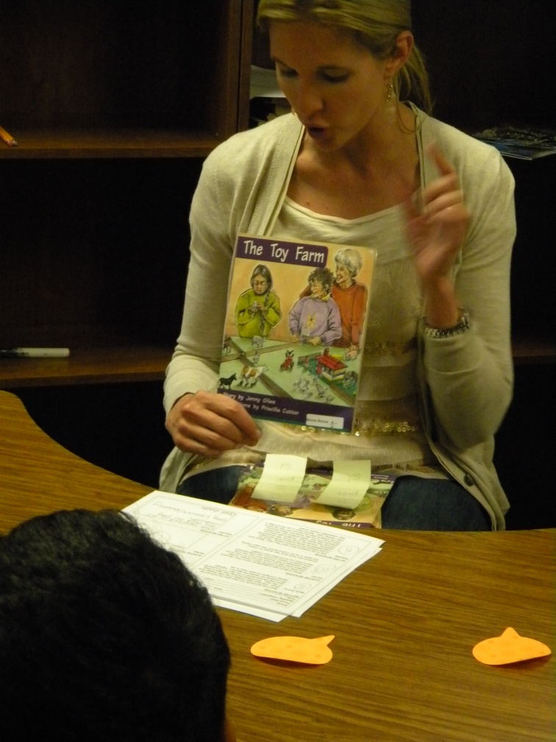
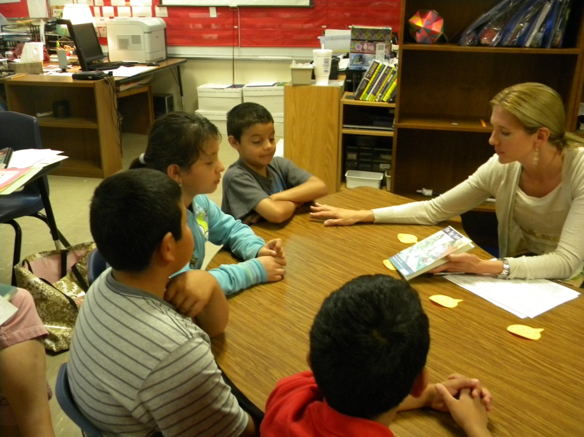
Before Reading
Book Introduction (APK)
Read the title
The Toy Farm
“Sarah and Kiran built a toy farm in Mrs. Webb ‘s class. Something happens to her farm.”

Slide 7
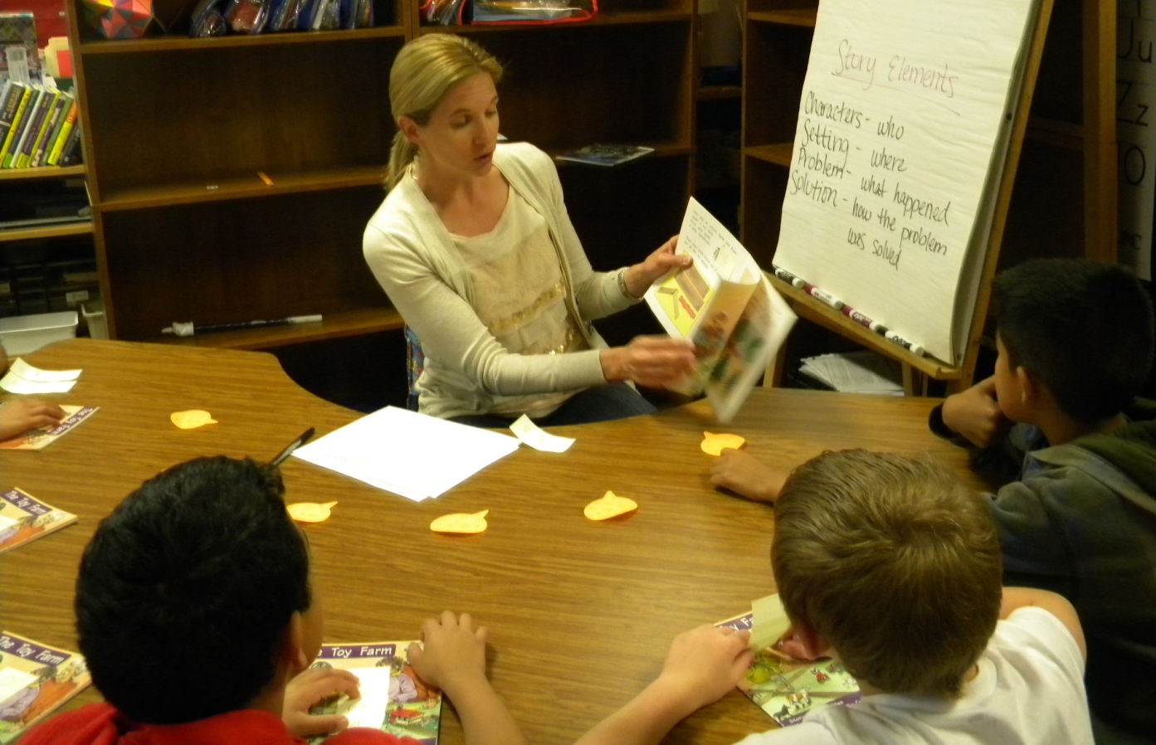
Before Reading
Goals:
Read to find out what happened to the toy farm
Pay attention to the story elements to help you understand the story
Mark the text when you find a story element
Gretchen modeled using a sticky note to mark the portion of the text where the characters were introduced.

Slide 8
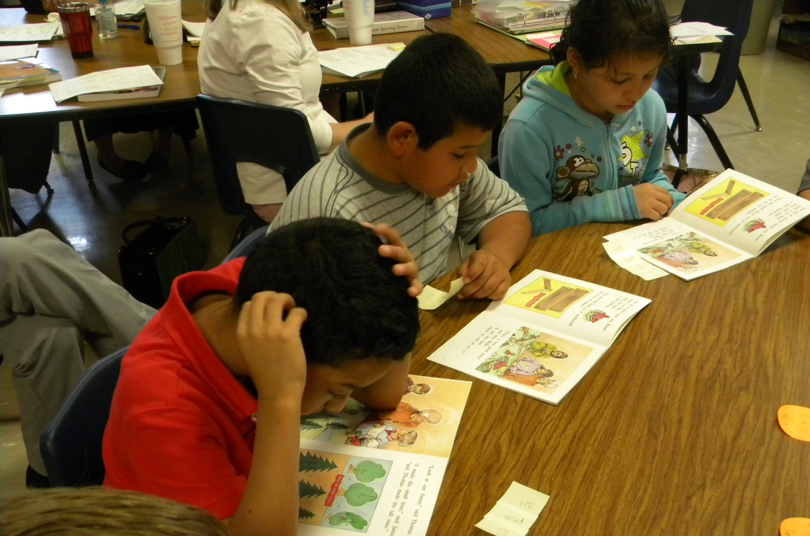
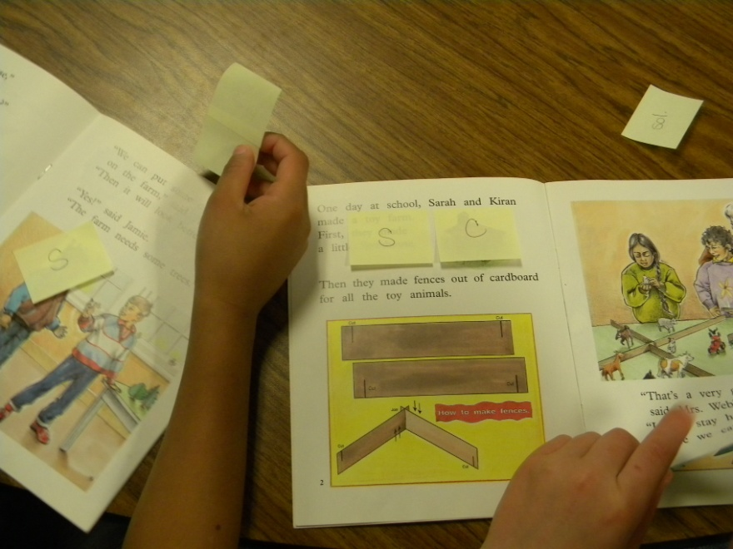
During Reading
The students:
read silently or in whisper voices
used sticky notes to mark the story elements in the book

Slide 9
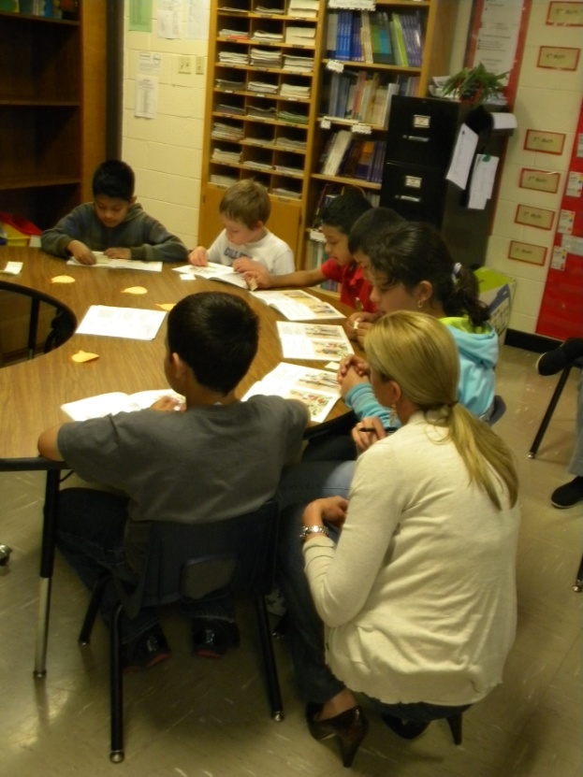
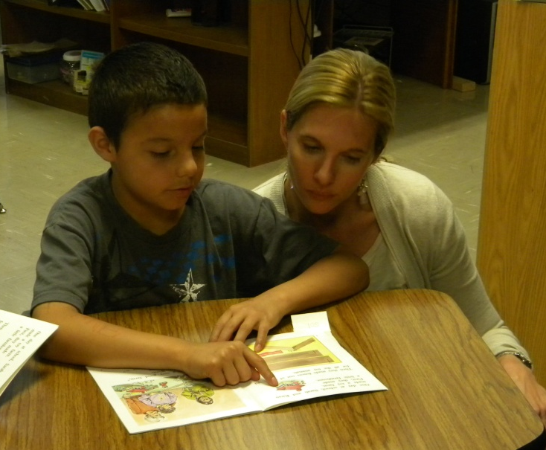
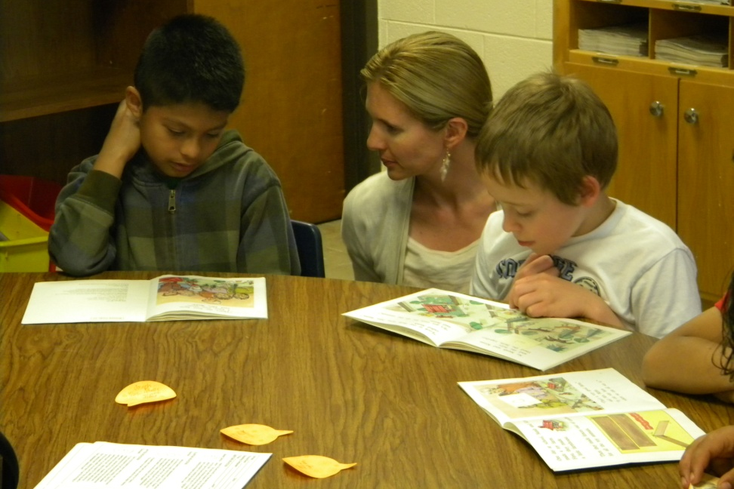
During Reading
Gretchen (the teacher):
listened to students read a portion of
the text
prompted to the goals when necessary
jotted anecdotal notes about the
students

Slide 10
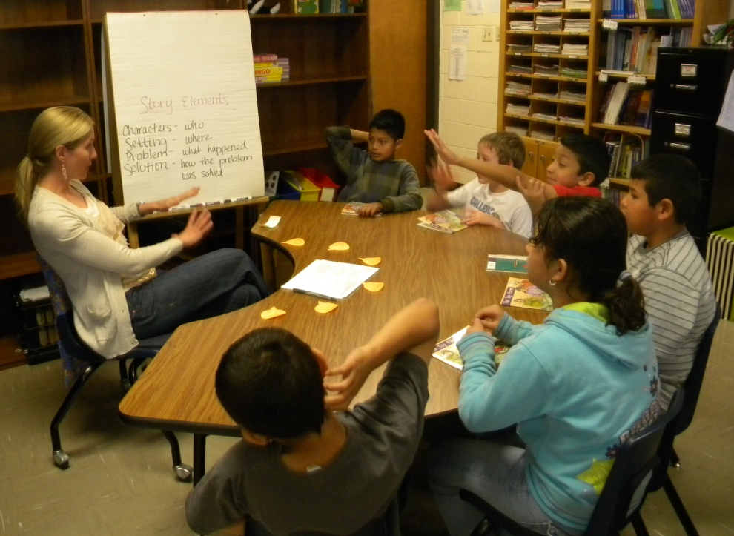
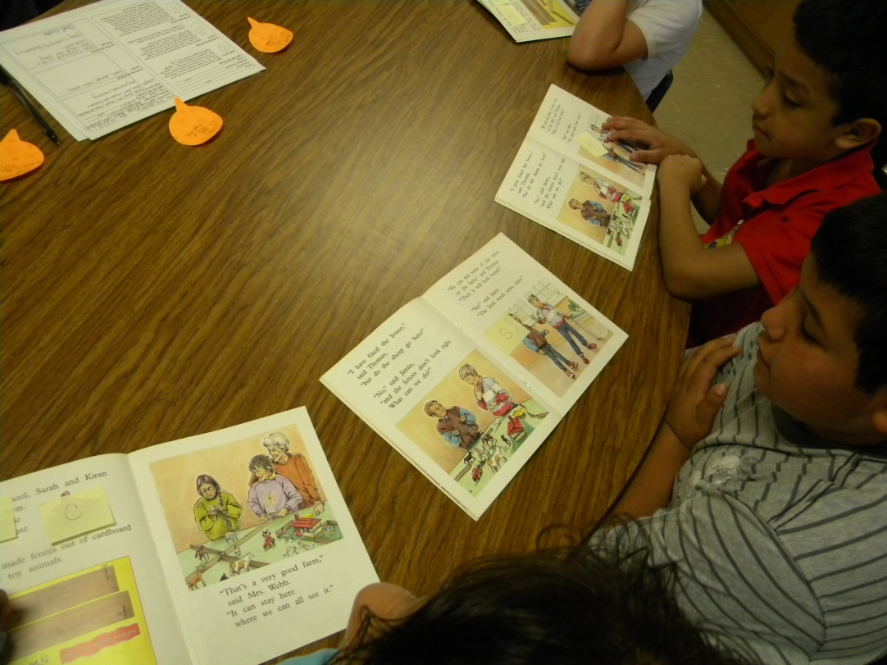
After Reading
Revisit the Goals:
The group discussed what happened to the toy farm
Students shared where they placed their sticky tabs and identified the story elements

Slide 11
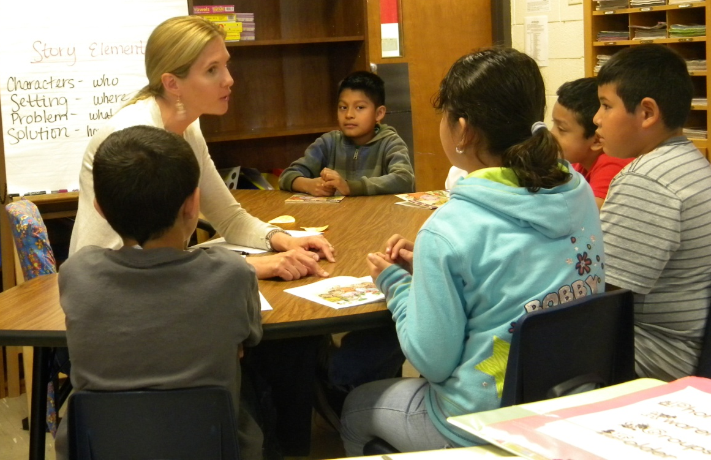
After Reading
Feedback from the students:
Gretchen asked the group, “Was finding the story elements easy, tricky or hard?”
The group used thumbs up, sideways or down to respond.

Slide 12
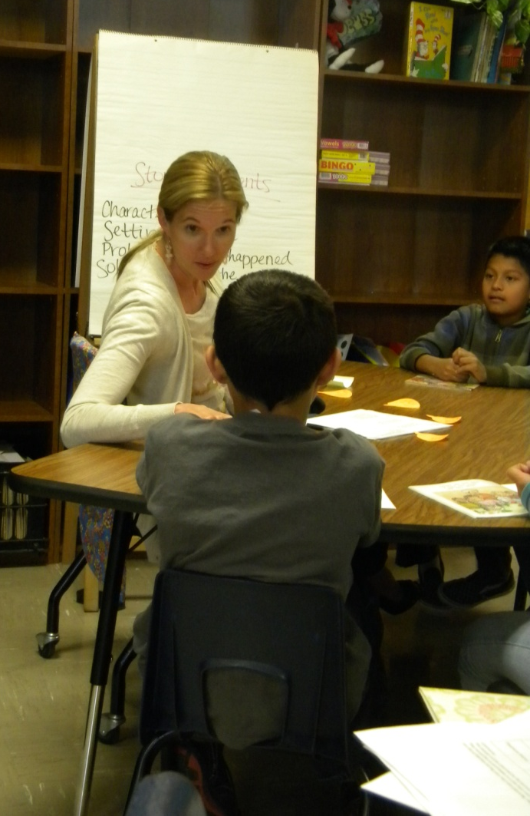
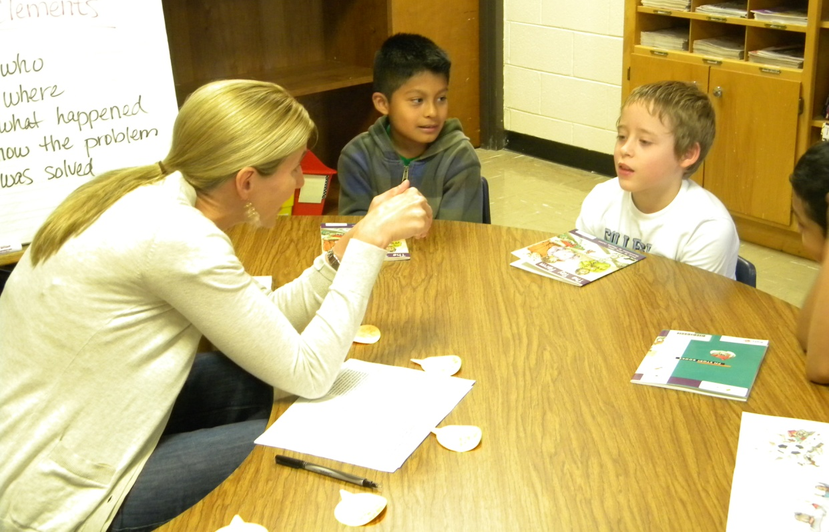
After Reading
Individual Feedback:
Gretchen gave each student individual feedback that was specific to the goals of the lesson.

Slide 13
Big Ideas from the debriefing session after the lesson:
Teach a skill or strategy, not the book.
Use activities and procedures that are specific to the focus of the lesson.
Allow plenty of wait time.
Giving students a job while reading helps them slow down and pay attention to comprehending the story.

Slide 14
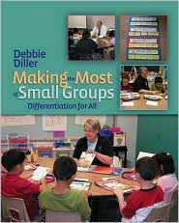
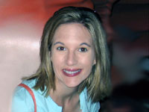
Diller, Debbie (2007). Making the Most of Small Groups; Differentiation for All. Portland, Maine: Stenhouse Publishers.
Gretchen Childs has been an educator for over 15 years. She has taught kindergarten and 2nd grade, as well as Special Education in Pre-K, 5th and 6th grades. She has been a District Literacy Coach, District Math Coach, and Reading Specialist. Gretchen has presented numerous workshops on literacy topics, and has traveled the country as a consultant for Debbie Diller & Associates since 2005.
Gretchen earned her degree from Southwest Texas State University, with specializations in both Special Education and Reading. She also carries an Early Childhood Education endorsement.
She resides in Pearland, Texas with her husband, Michael, and their three daughters.

