Slide 1

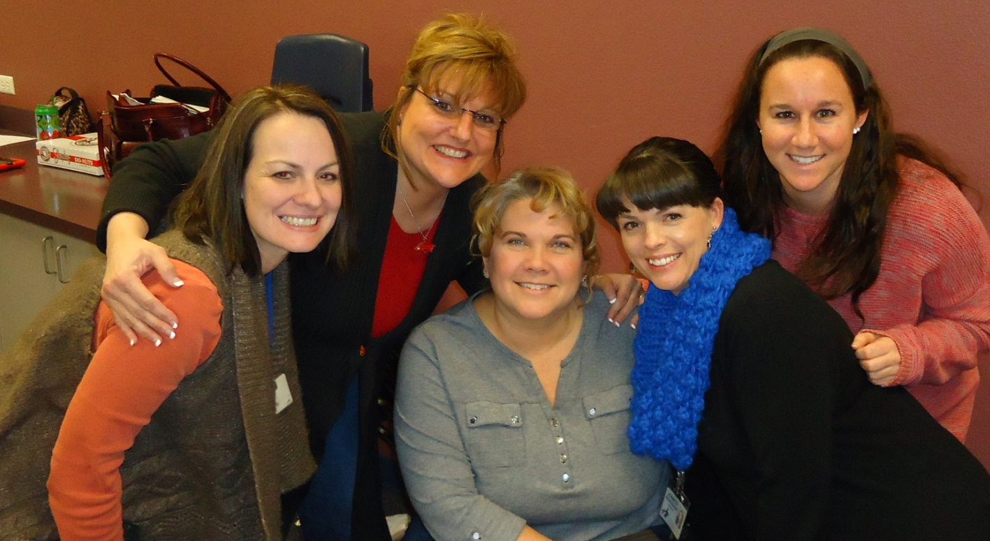

Hand-Me-Down Tales from Around the World
Second Grade Unit 5
Planning Team
Susan Hill
Susan Huntington
Sukey Dake
Jennifer Bradshaw
Megan Dougherty

Slide 2
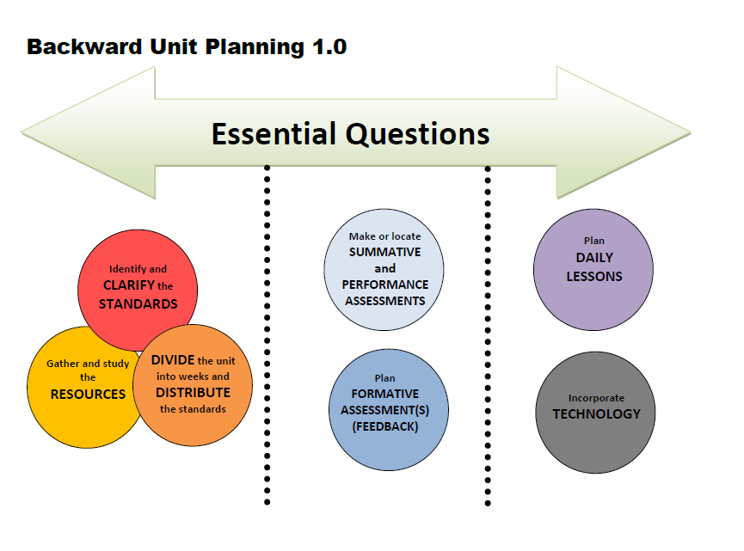

Slide 3

Hand-Me-Down Tales From Around the World
Essential Question
How do texts and images reveal culture?

Slide 4
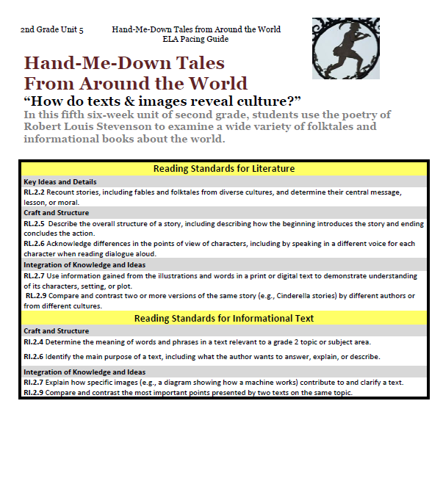
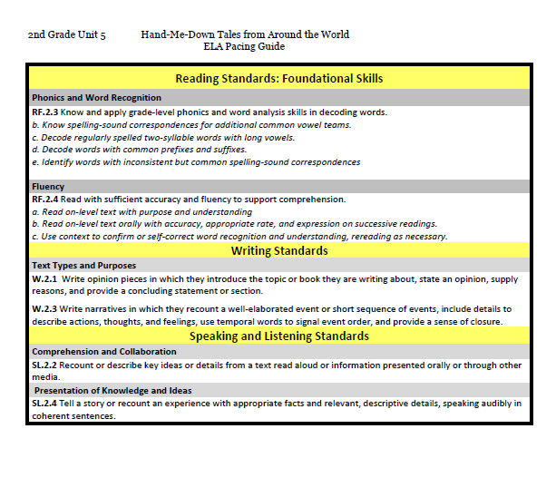

Slide 5


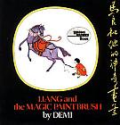

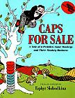
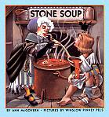
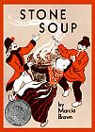
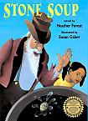
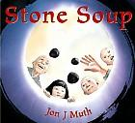
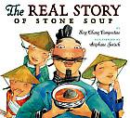

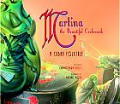



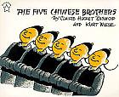
Literature
Stories
Stories
14 copies
Read Aloud
Notes:
Tina

Slide 6
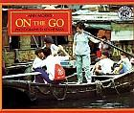

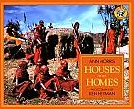
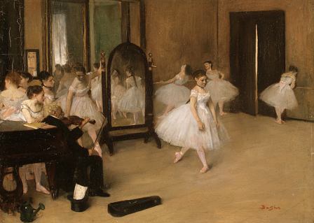
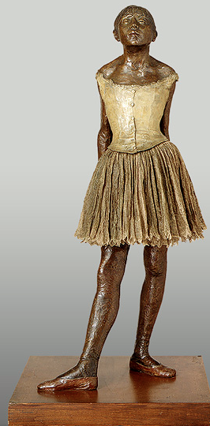


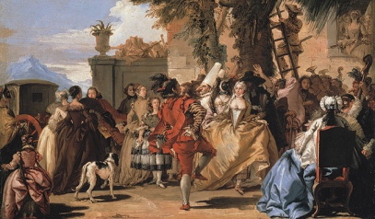
2nd Grade
Print Resources
Unit 5
Informational Text
narrative
Read Aloud
Art
Poems
Music
Sergei Prokofiev, “Peter and the Wolf”
“The Land of Counterpane” Robert Louis Stevenson
“Foreign Lands” Robert Louis Stevenson
“The Land of Story Books” Robert Louis Stevenson
“At the Seaside” Robert Louis Stevenson
“Where Go the Boats?” Robert Louis Stevenson
“My Bed is a Boat” Robert Louis Stevenson
Poems
(Read Aloud)
“The Pied Piper of Hamlin” Robert Browning

Slide 7
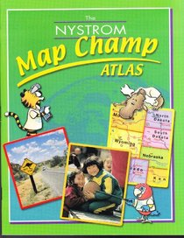

Week | Standards | Texts
1 Geography | Lessons for Geography (4th quarter S.S. standards) G.1.2.1 Define location G.1.2.2 Locate the county in which the student lives on an Arkansas map G.1.2.3 Locate the capital of Arkansas G.1.2.4 Identify and locate countries bordering the United States G.1.2.5 Locate and define the North and South Poles and the Equator on a map or globe G.1.2.6 Locate the seven continents using a map or globe G.1.2.7 Name and locate the four major oceans G.1.2.10 Understand the purpose of map components: *compass rose *map scale *key/legend *inset map *title G.1.2.11 Describe the relative locations of places using cardinal directions (e.g., Arkansas is south of Missouri) G.1.2.12 Identify and locate physical features on maps and globes: *rivers *lakes *oceans *mountains *islands *desert *coast G.1.2.13 Construct maps of a familiar place (e.g., classroom, bedroom, fictional place) that includes the following: *title *compass rose *legend/key L.2.2a Capitalize holidays, product names, and geographic names. Supporting Standard RI.2.1 Ask and answer such questions as who, what, where, when, why, and how to demonstrate understanding of key details in a text.
Social Studies Texts
Notes:
Story kit tutorial
https://www.youtube.com/watch?v=RSWQkUS4kXk

Slide 8
Week | Standards | Texts
2 Culture | Lessons for Culture (3rd quarter S.S. standards) G.2.2.1 Compare customs of another culture to one’s own. G.2.2.2 Compare the lifestyle, dress, and occupations of Arkansas to those of people in other parts of the world. RI.2.6 Identify the main purpose of a text, including what the author wants to answer, explain, or describe. RI.2.7 Explain how specific images (e.g., a diagram showing how a machine works) contribute to and clarify a text. L.2.2a Capitalize holidays, product names, and geographic names. L.2.1b Form and use frequently occurring irregular plural nouns (e.g., feet, children, teeth, mice, fish)
Additional Link
Reading Rainbow link to Bread is for Eating

Slide 9
3 Folk Tale | Focus Standards RL.2.2 Recount stories, including fables and folktales from diverse cultures, and determine heir central message, lesson, or moral. RL.2.5 Describe the overall structure of a story, including describing how the beginning introduces the story and ending concludes the action. RL.2.6 Acknowledge differences in the points of view of characters, including by speaking in a different voice for each character when reading dialogue aloud. RL.2.7 Use information gained from the illustrations and words in a print or digital text to demonstrate understanding of its characters, setting, or plot. RL.2.9 Compare and contrast two or more versions of the same story (e.g., Cinderella stories) by different authors or from different cultures. L.2.6 Use words and phrases acquired through conversations, reading and being read to, and responding to texts, including using adjectives and adverbs to describe (e.g., When other kids are happy that makes me happy). L.2.1.f Demonstrate command of the conventions of standard English grammar and usage when writing or speaking. f. Produce, expand, and rearrange complete simple and compound sentences (e.g. The boy watched the movie; The little boy watched the movie.; The action movie was watched by the little boy.) W.2.1 Write opinion pieces in which they introduce the topic or book they are writing about, state an opinion, supply reasons, and provide a concluding statement or section. Supporting Standards RL.2.1 Ask and answer such questions as who, what, where, when, why, and how to demonstrate understanding of key details in a text. RL.2.3 Describe how characters in a story respond to major events and challenges. SL.2.2 Recount or describe key ideas or details from a text read aloud or information presented orally or through other media. SL.2.4Tell a story or recount an experience with appropriate facts and relevant, descriptive details, speaking audibly in coherent sentences.
ART

Slide 10
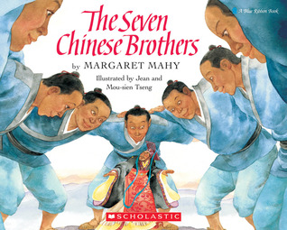
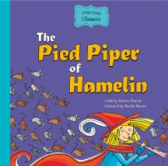
4 Folk Tales | Focus Standards RL.2.6 Acknowledge differences in the points of view of characters, including by speaking in a different voice for each character when reading dialogue aloud. RL.2.9 Compare and contrast two or more versions of the same story (e.g., Cinderella stories) by different authors or from different cultures. Supporting Standards RL.2.1 Ask and answer such questions as who, what, where, when, why, and how to demonstrate understanding of key details in a text. Rl.2.2 Recount stories, including fables and folktales from diverse cultures, and determine their central message, lesson, or moral. RL.2.3 Describe how characters in a story respond to major events and challenges.
Additional resource
(This text is not in your unit text set.
You will have to find this elsewhere if
you choose to use it.)

Slide 11
Focus Standards
5 Compare and Contrast | RL.2.2 Recount stories, including fables and folktales from diverse cultures, and determine their central message, lesson, or moral. RL.2.9 Compare and contrast two or more versions of the same story (e.g., Cinderella stories) by different authors or from different cultures. SL.2.2 Recount or describe key ideas or details from a text read aloud or information presented orally or through other media. SL.2.4 Tell a story or recount an experience with appropriate facts and relevant, descriptive details, speaking audibly in coherent sentences. Supporting Standard RL.2.1 Ask and answer such questions as who, what, where, when, why, and how to demonstrate understanding of key details in a text.
Choose the original Stone Soup by Marcia Brown and three others to compare and contrast.

Slide 12
Writing:
Narrative Summative Assessment
6 Sum it Up | RL.2.6 Acknowledge differences in the points of view of characters, including by speaking in a different voice for each character when reading dialogue aloud. W.2.3 Write narratives in which they recount a well-elaborated event or short sequence of events, include details to describe actions, thoughts, and feelings, use temporal words to signal event order, and provide a sense of closure. L.2.1.f Demonstrate command of the conventions of standard English grammar and usage when writing or speaking. Produce, expand, and rearrange complete simple and compound sentences (e.g., The boy watched the movie; The little boy watched the movie; The action movie was watched by the little boy). SL.2.2 Recount or describe key ideas or details from a text read aloud or information presented orally or through other media. RL.2.9 Compare and contrast two or more versions of the same story by different authors or from different cultures.
Poems
“The Land of Counterpane” Robert Louis Stevenson
“Foreign Lands” Robert Louis Stevenson
“The Land of Story Books” Robert Louis Stevenson
“At the Seaside” Robert Louis Stevenson
“Where Go the Boats?” Robert Louis Stevenson
“My Bed is a Boat” Robert Louis Stevenson
Science/STEM Activity

Slide 13
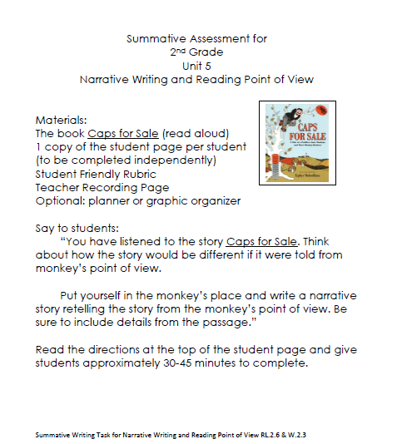
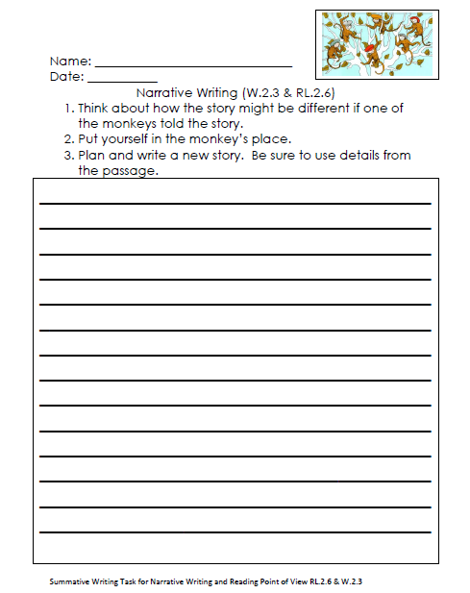
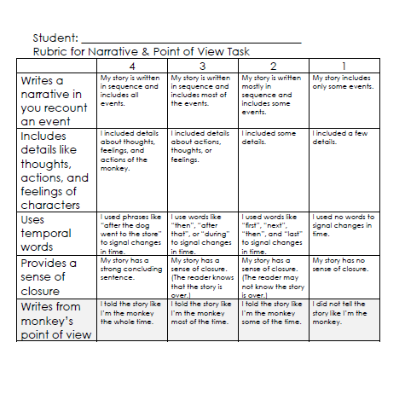

Slide 14
Optional Lessons
All Language Standards are still on-going throughout the unit. The main focus standard is:
L.2.6 Use words and phrases acquired through conversations, reading and being read to, and responding to texts, including using adjectives and adverbs to describe (e.g., When other kids are happy that makes me happy).
Adverb Activity link using Martina the Beautiful Cockroach
L.2.1.f Produce, expand, and rearrange complete simple and compound sentences (e.g. The boy watched the movie; The little boy watched the movie.; The action movie was watched by the little boy.)
Use Enormous Turnip or Caps for Sale
RL.2.4 Describe how words and phrases (e.g., regular beats, alliteration, rhymes, repeated lines) supply rhythm and meaning in a story, poem, or song.
Instead of using the poems only in week 6, you could choose one poem weekly to focus on describing how words and phrases supply rhythm and meaning in a story, poem, or song.

Slide 15

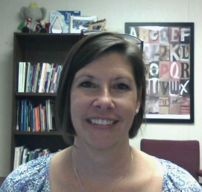

RESOURCES
Susan Hensley
Elementary Curriculum Specialist
shensley@rps.k12.ar.us

