Slide 1


Slide 2
Possession
Hoist
Claim

Slide 3
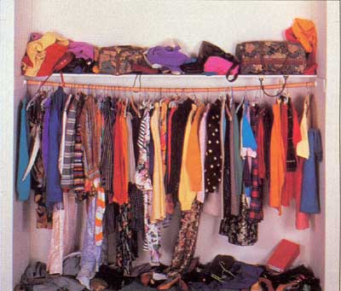

“The bridge was my most prized possession.”
Possession – a thing that a person owns or possesses
“I have many books in my possession!”

Slide 4
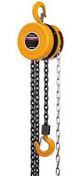


“Daddy worked on that bridge, hoisting cables.”
Hoist – to raise or lift; or a piece of equipment that lifts heavy objects
“My friend and I hoisted my couch into the moving van.”

Slide 5
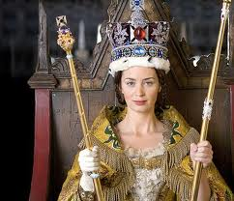
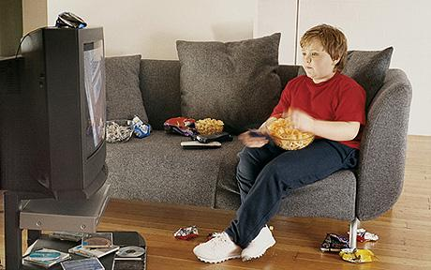
“Now I have claimed it.”
Claim – to demand something as one’s own
“I claimed the couch and television before my brother could get to it!”

Slide 6
Possession
Hoist
Claim

