Slide 1


Slide 2
Stationed
Blushed
Trembled

Slide 3
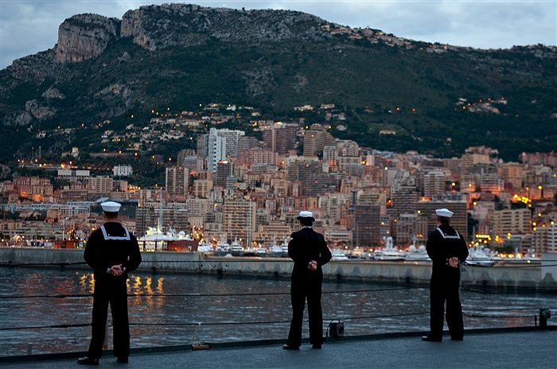
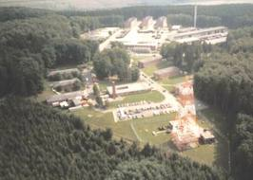
“His ship was stationed in Yokohama.”
Stationed – assigned to a particular place
“My roommate’s father was stationed in Germany when she was a child.”

Slide 4

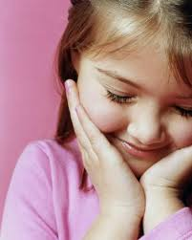

“My mother blushed.”
Blushed - to become red in the face when you are embarrassed
“The student could not help but to blush after reading his paper to his classmates.”

Slide 5
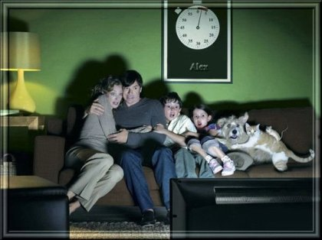

“My mother’s hand trembled. The soup spilled onto the white cloth.”
Trembled – to by shaky
“The musician was so nervous that her hands trembled on stage. It was hard to play the guitar that way.”

Slide 6
Stationed
Blushed
Trembled

