Slide 1
Day 1

Slide 2
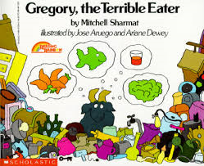
Gregory, the Terrible Eater

Slide 3
I can determine the meaning of unknown words.
Notes:
Goal- Students need to engage with the goal- read it, repeat it, write it, etc.

Slide 4
revolting
“”It’s revolting,” said Father Goat.”
Notes:
New Information-
Contextualize the word- Find it in the text
“She took raisins, candies, and nuts and gave him two bright eyes, a laughing mouth, and a cowboy vest with fringe.”
Say the word together

Slide 5
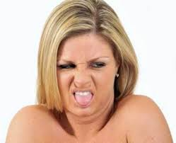
revolting
To affect with disgust
Synonym: gross
Notes:
Give student friendly definition
Use the word in other contexts

Slide 6

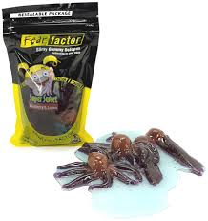
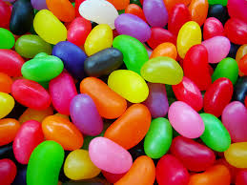
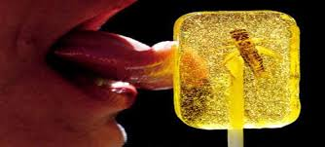
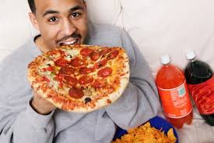
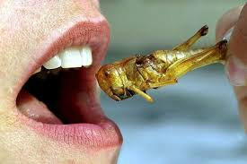
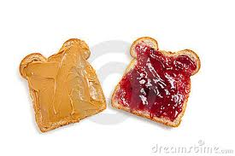
Thumbs up, Thumbs down
Notes:
Engage the students with the word
Thumbs up if this item might have fringe. Thumbs down if not likely.

Slide 7
munching
“Dr. Ram was munching on a few pieces of cardboard. ”
Notes:
Contextualize the word- Find it in the text
… “until he met some hungry cowboys riding the range. The cowboys yelled, ‘Stampede!’ They wanted gingerbread too. “
Say the word together

Slide 8
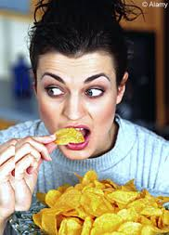
munching
To steadily chew, sometimes you can hear it
Synonym: crunch
Notes:
Give student friendly definition
Use the word in other contexts

Slide 9
Analogy:
Drink is to slurp as eat is to __________
Simile:
You are munching on those chips like a goat!

Slide 10
moaned
“All night Gregory tossed and twisted and moaned and groaned.”
Notes:
Contextualize the word- Find it in the text
“He turned down a canyon and raced away as fast as his boots could carry him.”
Say the word together

Slide 11
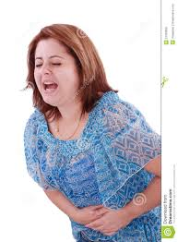
moaned
a long sound made from suffering
Notes:
Give student friendly definition
Use the word in other contexts

Slide 12
Turn and tell your partner the words and what they mean.
revolting
munching
moaned
Notes:
Read all three words and see if you can use them in one sentence.

Slide 13

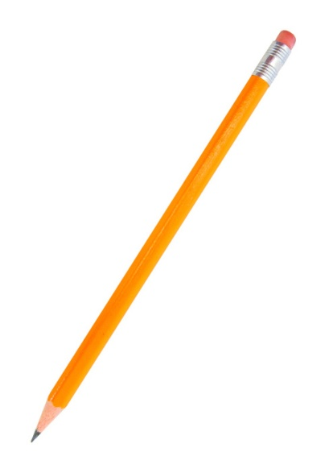
Draw a picture or write a sentence to show you know what these words mean.
revolting
munching
moaned
Notes:
Application-
Students need an opportunity to use the words they just learned from the text.

Slide 14
I can determine the meaning of unknown words.
Notes:
Goal-
Revisit the Goal

Slide 15
Day 2

Slide 16
I can determine the meaning of unknown words.
Notes:
Goal- Students need to engage with the goal- read it, repeat it, write it, etc.

Slide 17
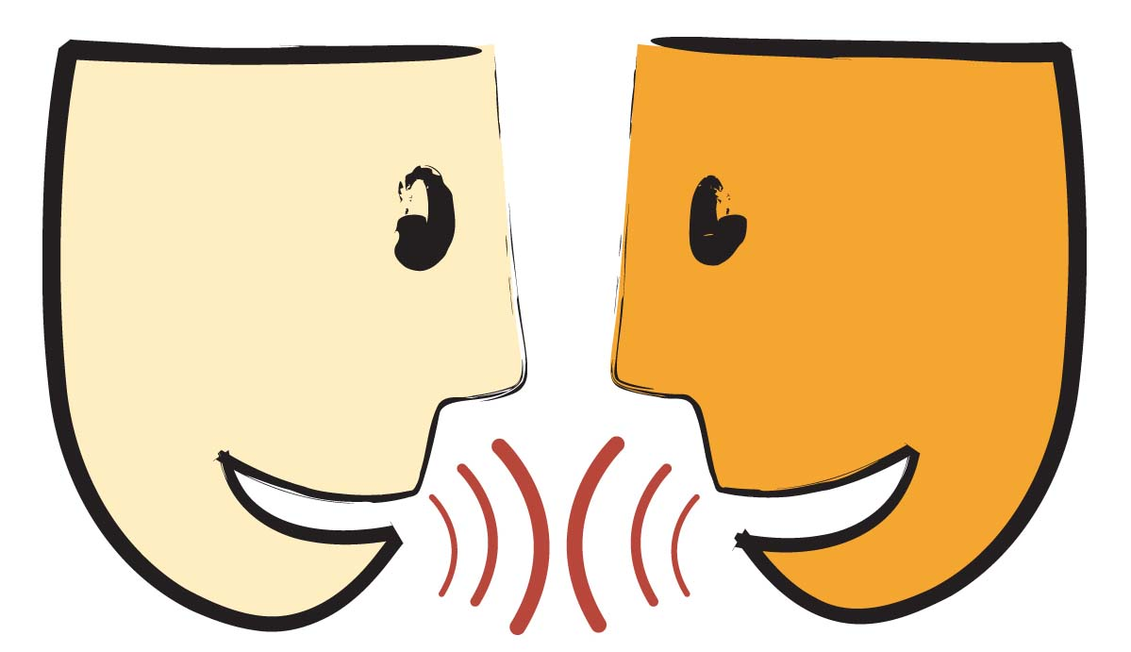
Tell your partner about a new word you learned yesterday.
Notes:
Access Prior Knowledge- (APK)
Turn and Talk
Review 3 words and definitions

Slide 18
Word Association
Which word goes with making sounds?
Which word is a synonym for gross?
Which word means to steadily chew?
revolting
munching
moaned
Notes:
Application
Word Association
Have students explain their thinking

Slide 19
I can determine the meaning of unknown words.
Notes:
Goal- Students need to engage with the goal- read it, repeat it, write it, etc.

Slide 20
Day 3

Slide 21
I can determine the meaning of unknown words.
Notes:
Goal- Students need to engage with the goal- read it, repeat it, write it, etc.

Slide 22
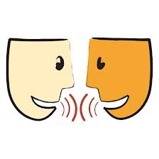
Describe a time when…
you munched on something
You ate or saw something revolting
you moaned or heard someone moan

Slide 23
I can determine the meaning of unknown words.
Notes:
Goal- Students need to engage with the goal- read it, repeat it, write it, etc.

Slide 24
Day 4

Slide 25
I can determine the meaning of unknown words.
Notes:
Goal- Students need to engage with the goal- read it, repeat it, write it, etc.

Slide 26
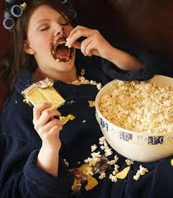
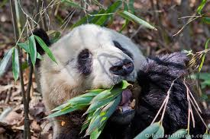
Tell your partner what all of these pictures have in common.
Notes:
Access Prior Knowledge- (APK)
Turn and Talk
Review 3 words and definitions

Slide 27
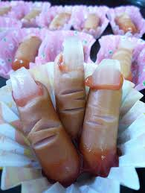
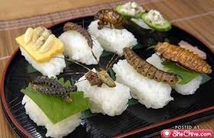
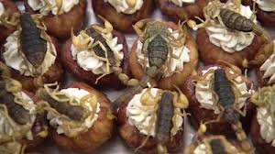
Tell your partner what all of these pictures have in common.

Slide 28
I can determine the meaning of unknown words.
Notes:
Goal- Students need to engage with the goal- read it, repeat it, write it, etc.

