Slide 1

Text Features with
Scaredy Squirrel
Deborah Goff
Old Wire Road
Elementary

Slide 2

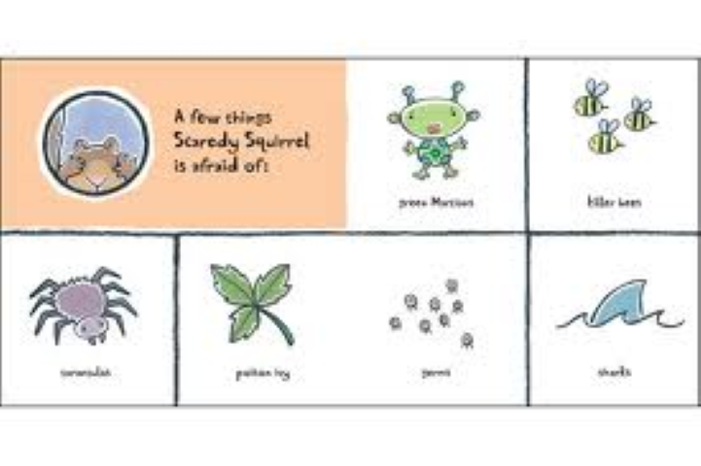
Labels and Captions
Labels and captions give you information about pictures in the text. It is important to read the labels and captions in the text.

Slide 3
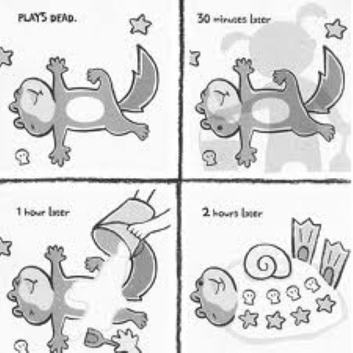
Timelines: Timelines can help you understand when events happened. Sometimes texts have timelines to show how events fit into the story.

Slide 4

Maps and Directions
Maps can show you where events happened.
A map can also show you how to travel from one place to another.

Slide 5
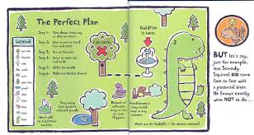
Symbols and steps:
Symbols help you understand pictures or maps. Steps help you know what to do in the correct order.
Steps
Symbols

Slide 6

Bold words:
Bold words are used to help the reader identify important vocabulary or ideas in the text.

Slide 7
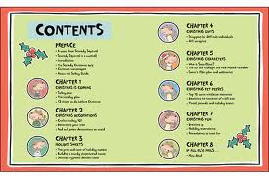
Table of Contents: Tells you about how the book in organized and what the book might be about.

