Slide 1
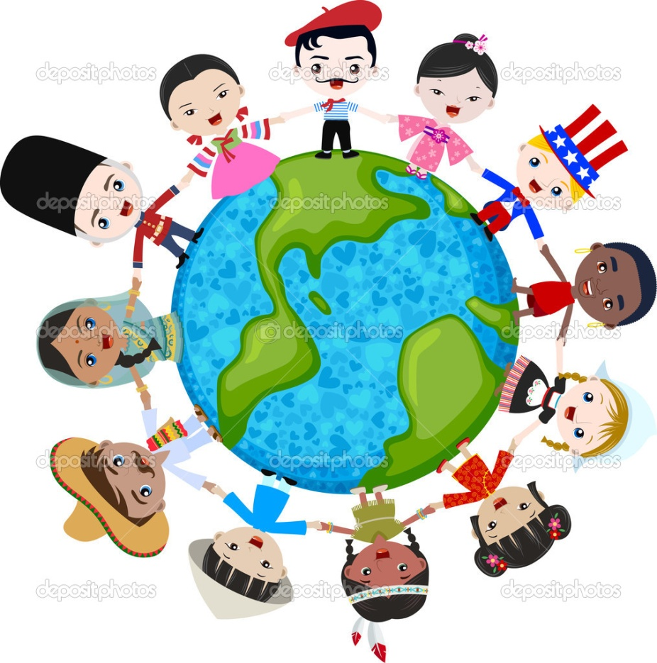
Unit 5:
Hand-Me-Down Tales from Around the World
How do texts and images reveal culture?
Grace Hill
J. Sallis

Slide 2


Score Yourself
I can explain how text and images teach us about culture.
I think this is new for me. I don’t understand all of the words.
I might need help. I know what the words mean, but I can’t put them together.
I can do this by myself. I know I can get all the teacher’s questions right without any help.
I can teach this. My teacher can drink a soda and take a break. I’m taking over the class!

Slide 3

Click the kids to see a Learn360 video about culture, food, and music.
Culture is how someone lives. It includes:
  How their family and friends work together
  How they dress
  How they talk
  What foods they eat
  What kind of art and music they enjoy
  What they believe about God
  What kind of jobs they get
Culture is learned from parents, and sometimes depends on where a person lives or where they were born.

Slide 4

Let’s Review
What is text?
What are images?
Text is the words we read in a book, poem, article, or passage.
Images are pieces of art, photographs, or pictures that go along with text.

Slide 5
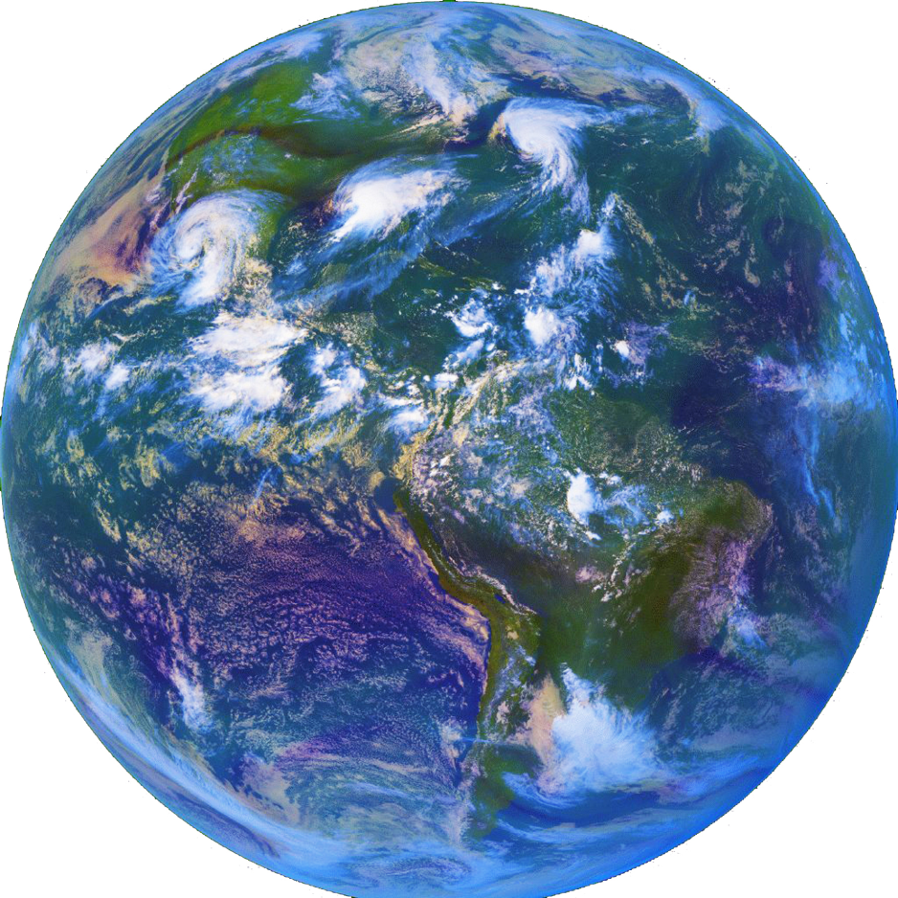

How we will learn about culture
First, we will talk and read about geography. We will look at maps and photographs of different parts of the world.
Click the globe to see a Brainpop, Jr. video about continents and oceans.

Slide 6



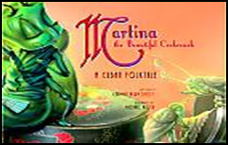
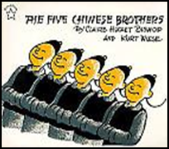

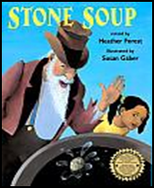
Then, we will read folk tales from different parts of the world. We will analyze their central messages by reading the text.
We will use the central messages and images to discuss differences in culture.

Slide 7

Match these new words with their definitions:
Culture
Geography
Text
Image
A
How someone lives
The words in a book
Pictures or art
Studying maps to find continents, countries, oceans, rivers, and other landforms
D
B
C

Slide 8
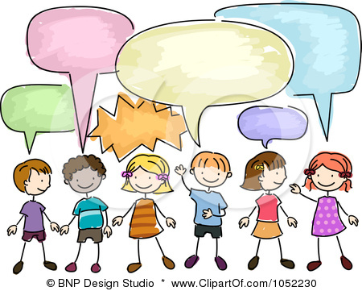
Turn and Talk:
What are 2 things you learned today?

Slide 9
Score Yourself
I can explain how text and images teach us about culture.
I think this is new for me. I don’t understand all of the words.
I might need help. I know what the words mean, but I can’t put them together.
I can do this by myself. I know I can get all the teacher’s questions right without any help.
I can teach this. My teacher can drink a soda and take a break. I’m taking over the class!

