Slide 1

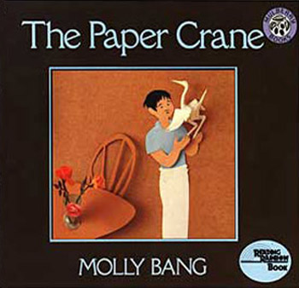
Unit 5
RL.K.9
Comparing & Contrasting the Experiences and Adventures of Characters in Familiar Stories

Slide 2
Note to Teachers
This lesson can only be done using 2 previously read texts that are familiar to students. Students should be successful with RL.K.1(ask & answer questions), RL.K.2 (retelling), and R.L.K.3 (identifying characters) before attempting this lesson.
This lesson is designed to be used at the end of Unit 5, after most of the literary texts have been read and students are familiar with the stories.

Slide 3
Begin with the end in mind-
Assessment Options
Options for assessment for these lessons might be differentiated. It could be:
  scored independently. Students who are able will independently respond by writing the comparing sentence frames at the bottom of the matrix
  scored through observation. Other students will be scored through observation of how students orally respond using the sentence frames.

Slide 4
Day 1
What is an experience?

Slide 5


Goal
I can identify the experience of a character in a story.
Notes:
Goal

Slide 6

APK
Turn and tell a person sitting next to you about something neat you have done.
Notes:
APK

Slide 7
An experience is….
Something you or a character have done before
Something that has happened to you or a character in a story
An adventure
Notes:
New Learning- refer to discussion during APK as experiences

Slide 8

Which pictures are an experience?
Notes:
Application
Hiking up a mountain, being bullied, throwing a ball

Slide 9
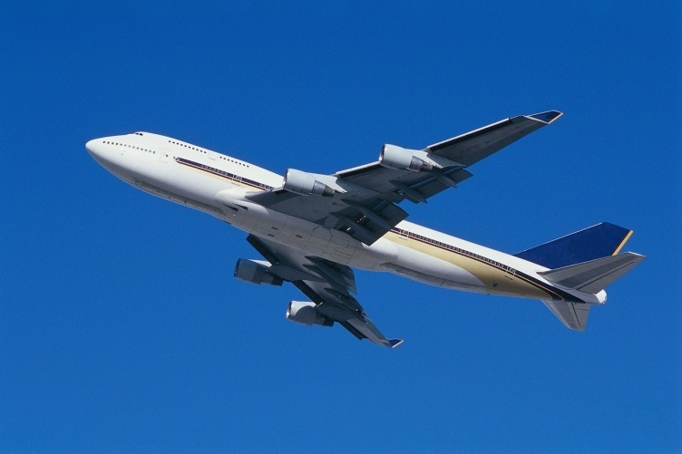
Which pictures are NOT an experience?
Notes:
Riding on an airplane, drinking from a cup, going to the zoo

Slide 10
Thinking about a character’s experience…
To identify the character’s experience, ask these questions.
Who is the main character?
What is the problem?
What does the character do?
What is the solution?
Using all of this information,
Identify the character’s experience?.
Notes:
Use the matrix and steps to compare

Slide 11
Thinking about a character’s experience…
Let’s try together.
Who is the main character?
What is her problem?
What does she do?
What is the solution?
Think about the problem & solution.
What did Koala Lou experience?
Notes:
Guided Application: Use the matrix and steps to compare & record student responses. Answer Key: 1) Koala Lou 2) She is mad because her mom doesn’t pay attention to her anymore 3) She enters a race. She thinks her mom will pay attention to her if she wins. 4) (She loses the race.) She learns that her mom loves her no matter what. 5) She experienced learning a lesson about love.

Slide 12
Revisit the Goal
I can identify the experience of a character in a story.
Notes:
Goal

Slide 13
Day 2
Guided Application

Slide 14
Goal
I can identify the experience of a character in a story.
Notes:
Goal

Slide 15
APK
What was Koala Lou’s experience?

Slide 16
Thinking about a character’s experience…
Let’s try together.
Who is the main character?
What is the problem?
What do they do?
What is the solution?
Think about the problem & solution.
What did they experience?
Notes:
Guided Application: Use the matrix to record student responses. Answer Key: 1)The man and his son 2) No one came to eat at his restaurant 3) accept the paper crane from the stranger 4) The paper crane brought many customers to the restaurant 5) They experienced a stranger’s kindness.

Slide 17
Revisit the Goal
I can identify the experience of a character in a story.
Notes:
Goal

Slide 18
Next steps….
Record student information on Scoring Guide & possibly add notes to anecdotal records. Depending on student success, make plan for the next set of texts.
Continue the lesson format with other familiar texts, such as Ferdinand & One Find Day

