Slide 1

RI.2.1 Ask and answer questions as who, what, where, when, why and how to demonstrate understanding of key details in a text.
RI.2.9 Compare and contrast the most important point presented by two texts on the same topic.
Second Grade
Unit 5

Slide 2
Day 1

Slide 3
Goal:
I can investigate a photograph.
Notes:
RI.2.1 Ask and answer questions such as who, what, where, when, why, and how to demonstrate understanding of key details in a text.

Slide 4
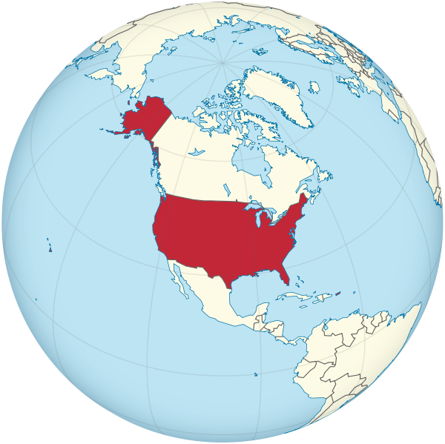
What do you like to eat?
Notes:
APK- What do you like to eat?
Tell your partner 3 things you like to eat.

Slide 5
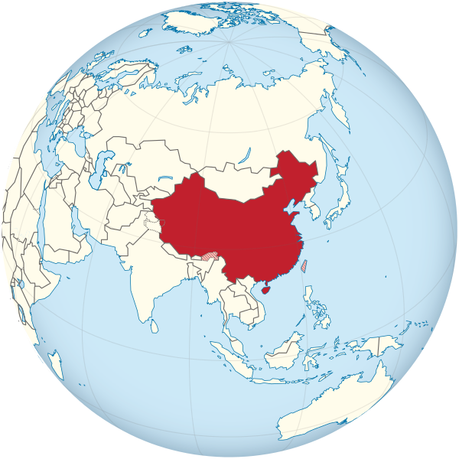

What do you think they like to eat in China?
Notes:
Tell your partner 3 things you think they like to eat in China.

Slide 6
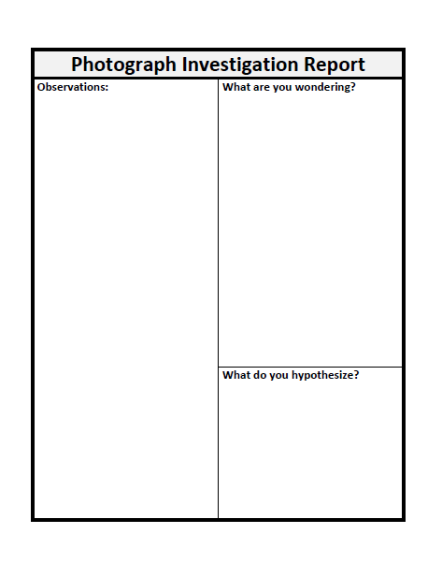
Let’s investigate a photograph.
Notes:
Lets see if we can do some investigating to find out what a family in China likes to eat.

Slide 7
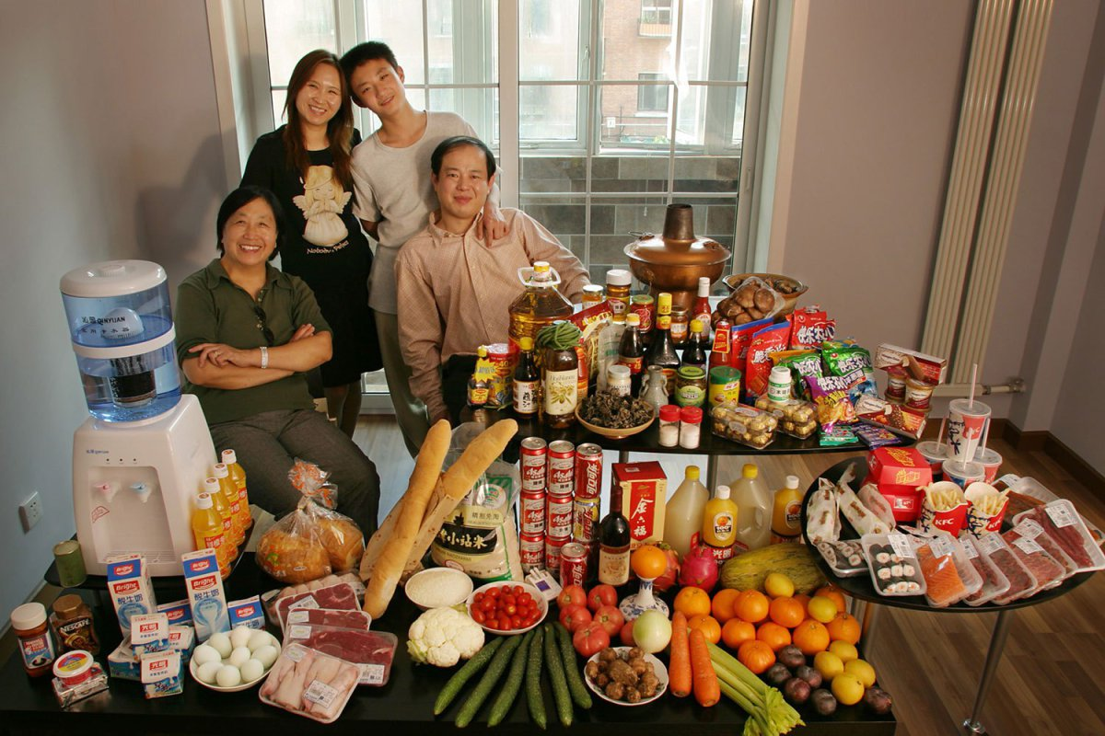
Look closely at the photograph.
What do you notice?
Record your observations here.

Slide 8
Notes:
Lets look at a photograph of a family who lives in China today. What are your observations?

Slide 9
Now that you have made some observations, what are you wondering?
Can you make a hypothesis about what this family in China likes to eat?

Slide 10
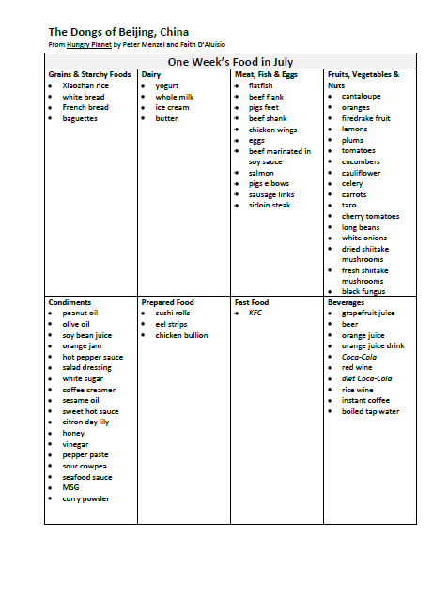
Look at the list of foods that are in the photograph.
Does it answer your questions?
Does it support your hypothesis?

Slide 11
Goal:
I can investigate a photograph.
Notes:
RI.2.1 Ask and answer questions such as who, what, where, when, why, and how to demonstrate understanding of key details in a text.

Slide 12
Day 2

Slide 13
Goal:
I can compare two texts on the same topic.
Notes:
RI.2.1 Ask and answer questions such as who, what, where, when, why, and how to demonstrate understanding of key details in a text.

Slide 14
Would you like to go live with this family for a week, and eat what they eat?
Notes:
APK- Would you like to go live with this family for a week, and eat what they eat?
Tell your partner why.

Slide 15
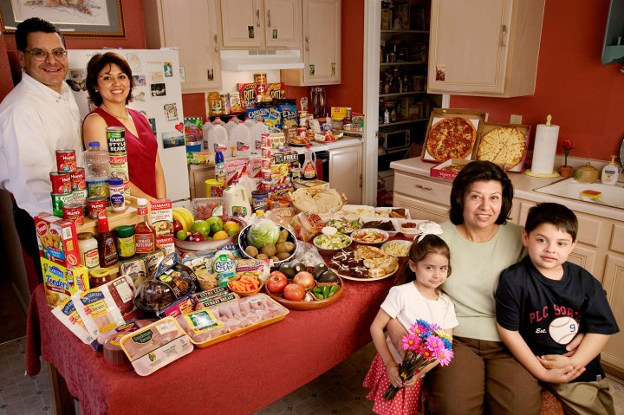
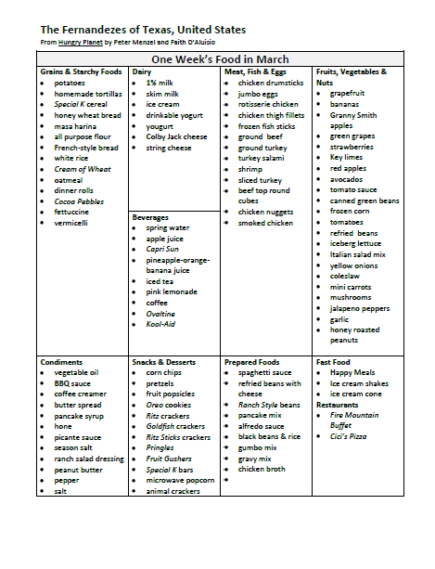
Notes:
This family lives in the united states. Let’s look at what they eat. Informational text can take many forms. Today we are going to use lists as our text. Refer to page 271 and show the students where the lists came from.

Slide 16
Notes:
How are the foods on these lists the same? How are they different?

Slide 17
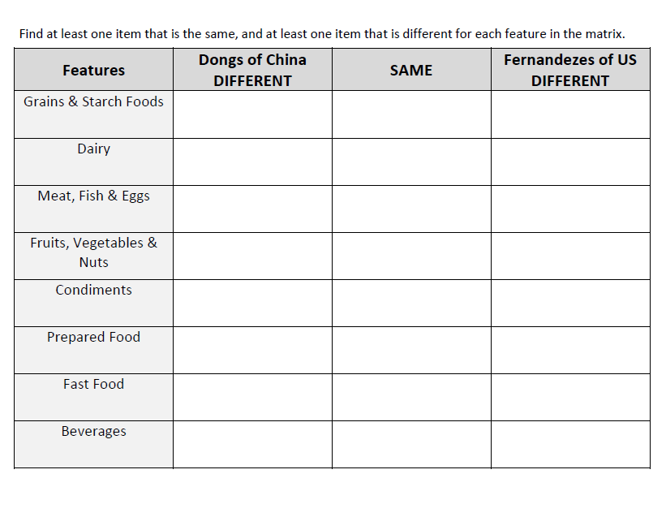

Tell you partner how the foods are the same, and how they are different.
Notes:
Use the lists to complete this comparison matrix.
When everyone is done…have the students tell a partner how the foods are the same and how they are different.

Slide 18
Goal:
I can compare two texts on the same topic.
Notes:
RI.2.1 Ask and answer questions such as who, what, where, when, why, and how to demonstrate understanding of key details in a text.

