Slide 1


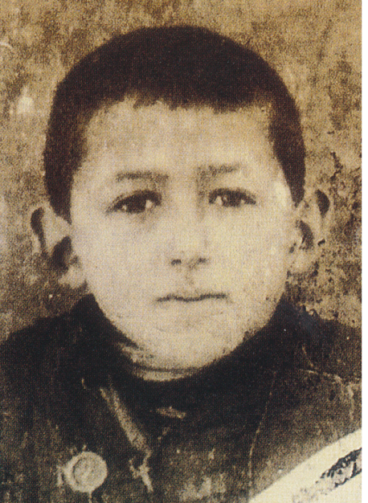

How I Learned Geography
Written by: Uri Shulevitz
Still alive and living in New York

Slide 2
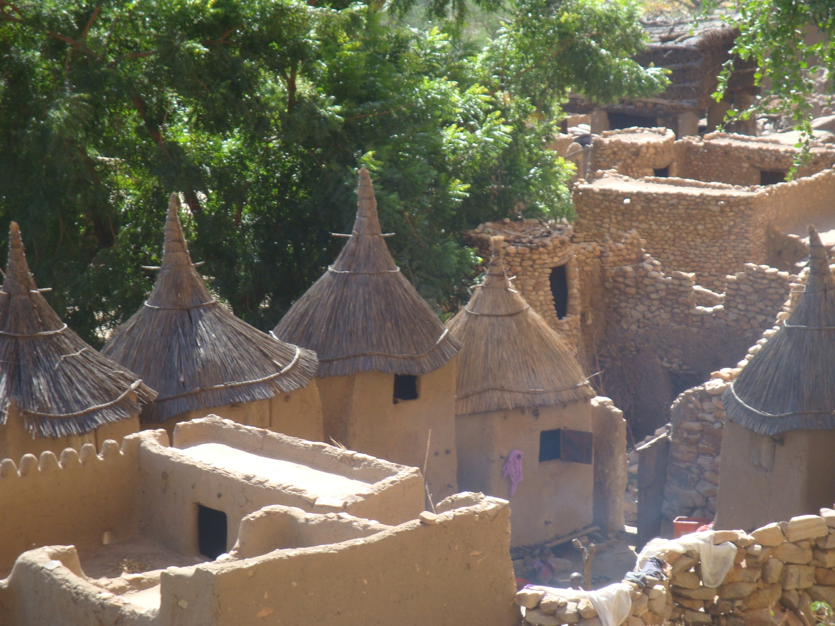
Village of Mud and Straw Homes – Republic of Niger
Notes:
Continent – Africa Book page 4 and 5 Continent

Slide 3
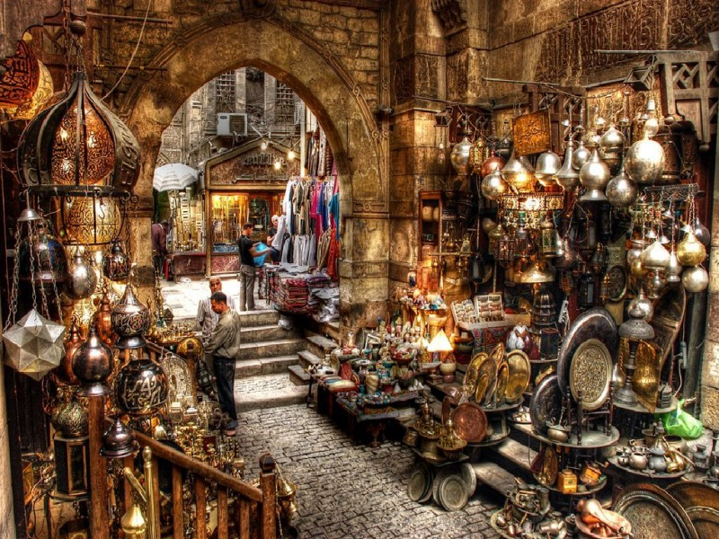
Bazaar
Cairo, Egypt
Notes:
Continent – Africa Book page 7 and 8 Country

Slide 4
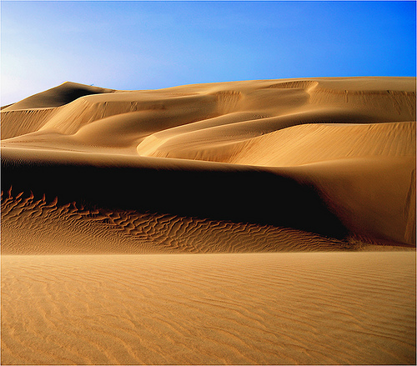
Desert
Venezuela
Notes:
Continent – South America Book page 17 Country

Slide 5

Beach
Caribbean (Bahamas)
Notes:
Continent- North America Book page 18 Country

Slide 6
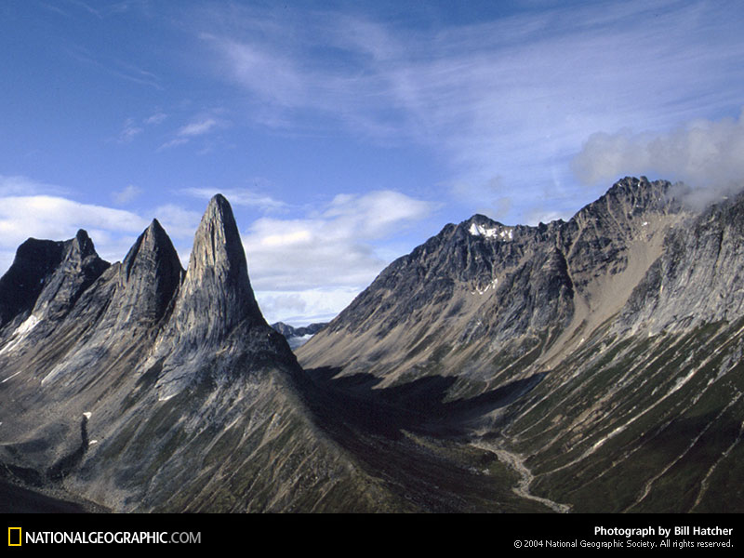
Mountain Range
Alaska
Notes:
Continent – North America Book page 19 and 20 State

Slide 7
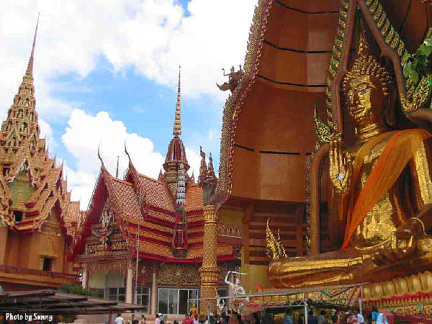
Temple
Thailand
Notes:
Continent – Asia Book page # 21 and 22 Country

Slide 8
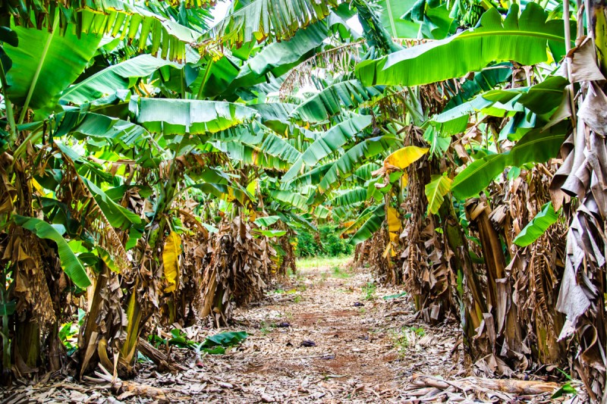
Fruit Groves
Hawaii
Notes:
Continent – North America Book page 23 State

Slide 9
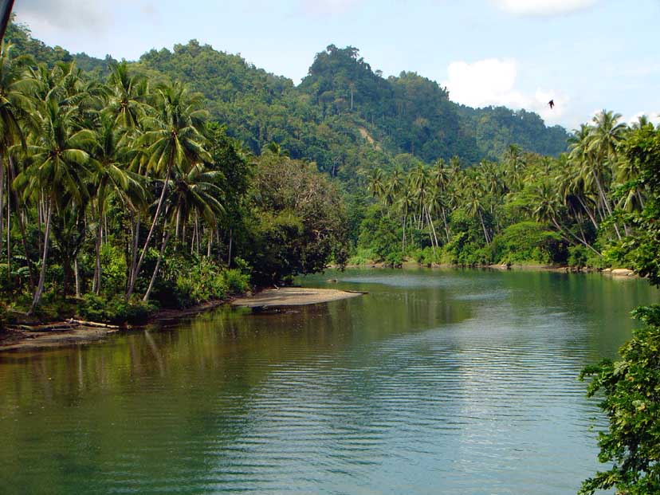
Palm Trees and Fresh Water
Indonesia
Notes:
Continent – Asia Book page 24 Country

Slide 10
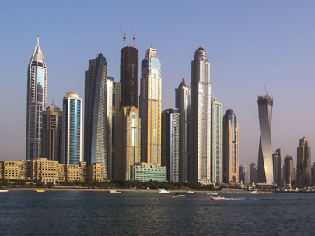
Skyscrapers
Dubai
Notes:
Continent – Asia Book page 25-26 City

Slide 11
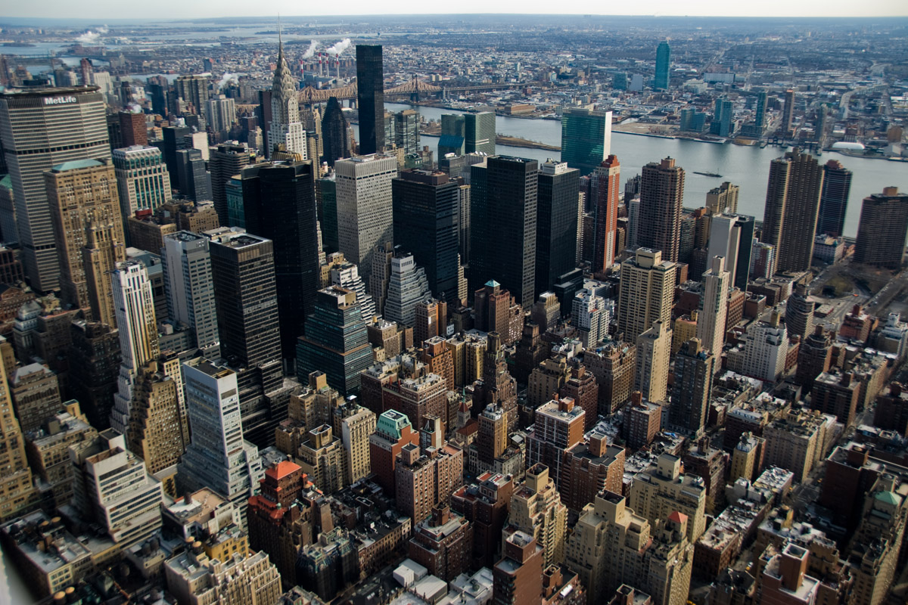
Skyscrapers
New York City
Notes:
Continent – North America Book page 25 and 26 City

Slide 12
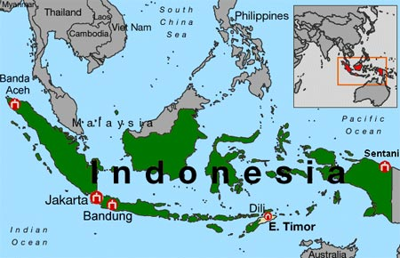
Where, Oh Where is Indonesia?

Slide 13
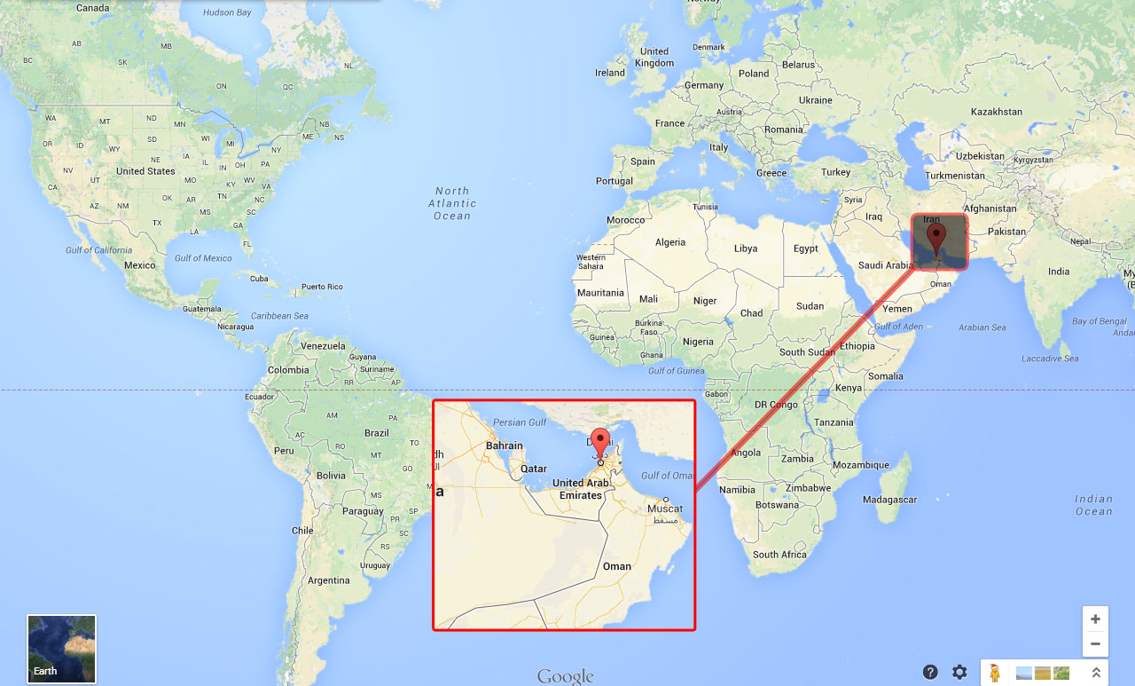
Where exactly is Dubai?

Slide 14
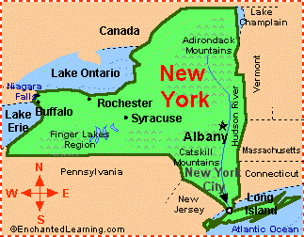
Where is New York City?

Slide 15
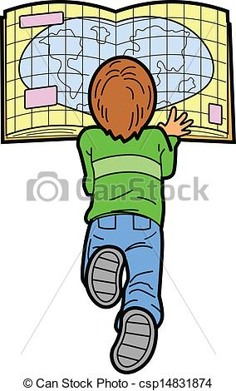
Review
I am going to call out each of the 10 places studied in this lesson and I want you to point to that place on the map.

Slide 16
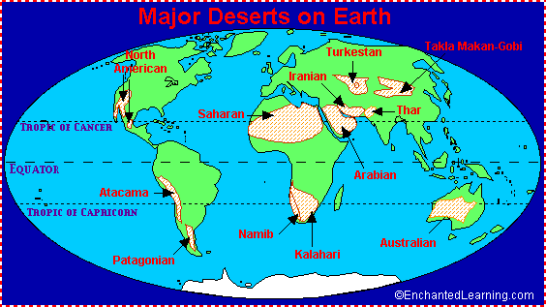

Slide 17
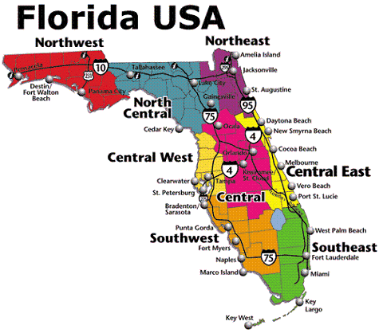

Slide 18
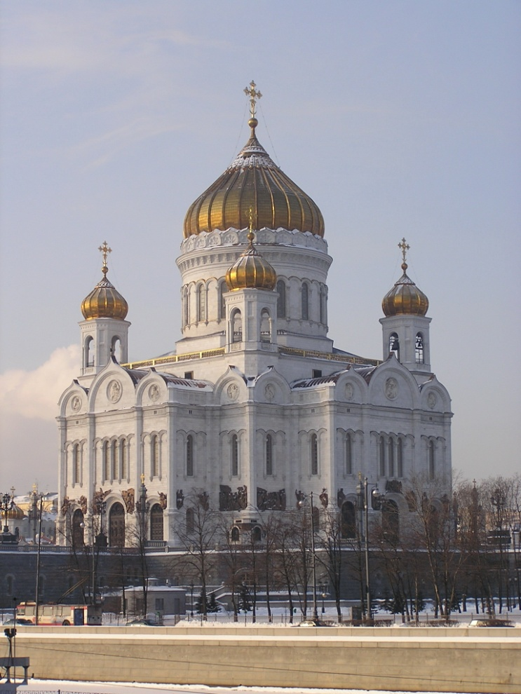
Is there a map to show where temples are located.
http://www.ldschurchtemples.com/maps/unitedstates/

Slide 19

http://www.pinata.com.au/our-farms

