Slide 1
Introducing Opinion Writing
2nd Grade
Coaching Cycle
Jennifer Bradshaw & Gail Undernehr

Slide 2
Day 1/ Part 1
Goal: I can identify and compare an opinion and a fact.
Score yourself
4- Go do your nails, Mrs. Undernehr- I got this!
3- I can can identify and write an opinion, no problem
2- I can do it with some help.
1- What is an opinion?

Slide 3
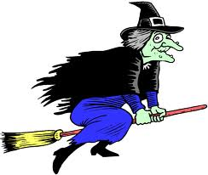
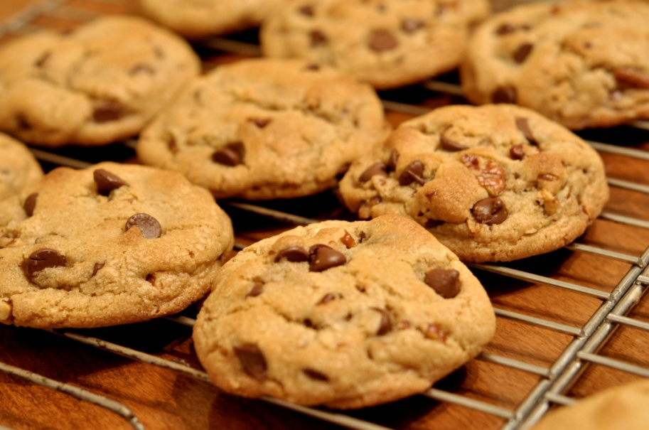
APK
Notes:
What do you think of these pictures? (Show one at a time.)

Slide 4
What is an opinion?
An opinion is _______________________
_____________________________________
*When you make an opinion, you are making a judgement about something.
An opinion is not _______________
A fact is _______________________
Notes:
New Learning- Add to notebooks
An opinion is a way to think about something or a judgement.
An opinion is not a fact.
A fact is a piece of information that can be proven true.

Slide 5
Fact or Opinion?
Sunday is the best day of the week.
This has been a terrible week!
The first day of school is scary.
Your birthday only comes once a year.
Everyone should make Valentine’s Day cards.
Notes:
F-O-O-F-O

Slide 6
You can tell facts AND have an opinion about something, so what’s the difference?
 | Opinion | Fact
What is it?
When do you use it?
Notes:
Guided Application

Slide 7
Reflect on the goal
Goal: I can identify and compare an opinion and a fact.
Score yourself
4- Go do your nails, Mrs. Undernehr- I got this!
3- I can can identify and write an opinion, no problem
2- I can do it with some help.
1- What is an opinion?
Notes:
Turn to a partner and tell your partner your new learning.

Slide 8
Day 1/Part 2
Goal: I can write a fact and opinion about something.
Score yourself
4- Go get some coffee, Mrs. Undernehr- I got this!
3- I can can identify and write an opinion, no problem
2- I can do it with some help.
1- What is an opinion?

Slide 9
APK
Look back in your notes.
What is a fact?
What is an opinion?

Slide 10
Writing a fact
You tell or write a fact to inform or tell someone information about something.
Notes:
New Learning

Slide 11
Writing an opinion
You tell or write an opinion to tell someone how you feel about something.

Slide 12
How do you know if you are writing a fact or an opinion?
fact
Opinion
If you are writing a fact, your purpose is to give or tell true information.
You know you are writing a fact if it can be proven to be true.
If you are writing an opinion, your purpose is to tell how you think about something
You know you are writing an opinion if it cannot be proven.
Notes:
New Learning

Slide 13
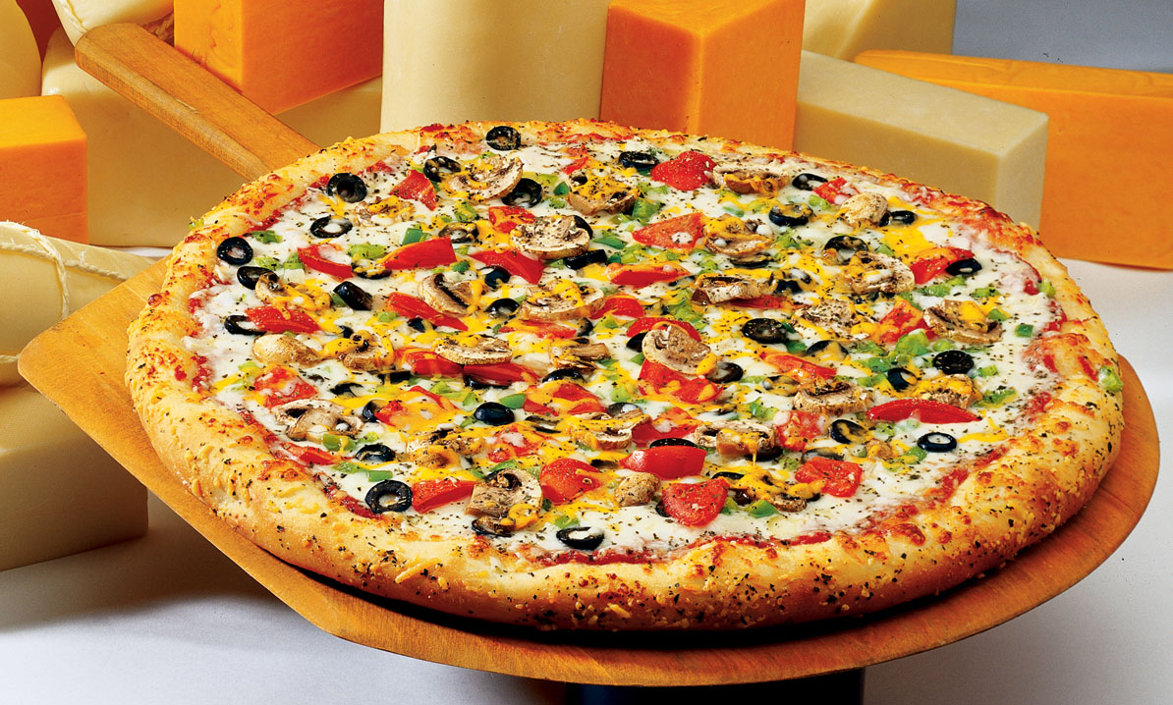
Fact and Opinion
Tell a fact about….
Now tell an opinion.
Notes:
Application- Have students partner up. Share some with group. Decide if it’s a true fact or an opinion by doing thumbs up/down or some other response.

Slide 14
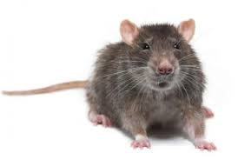
Fact and Opinion
Tell a fact about….
Now tell an opinion.
Notes:
Application- Have students partner up. Share some with group. Decide if it’s a true fact or an opinion by doing thumbs up/down or some other response.

Slide 15

Your turn!
Write a fact about each apple (red, green, yellow).
At the bottom, write your opinion. The best apple is __________________.
Notes:
See handout with 3 pictures… students write a fact, then an opinion about each. Next Lesson is using facts to support opinions.

Slide 16
Day 1/Part 2
Revisit the Goal: I can write a fact and opinion about something.
Score yourself
4- Go get some coffee, Mrs. Undernehr- I got this!
3- I can can identify and write an opinion, no problem
2- I can do it with some help.
1- What is an opinion?
Notes:
Reflect on the goal…

