Slide 1
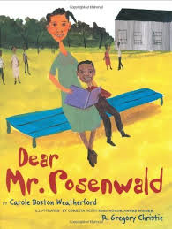
2nd Grade Text Talk
Unit 4

Slide 2
I can make real-life connections to new words.
L.2.5.a
Notes:
Goal-
Students need to engage with the goal- read it, repeat it, write it, etc.

Slide 3
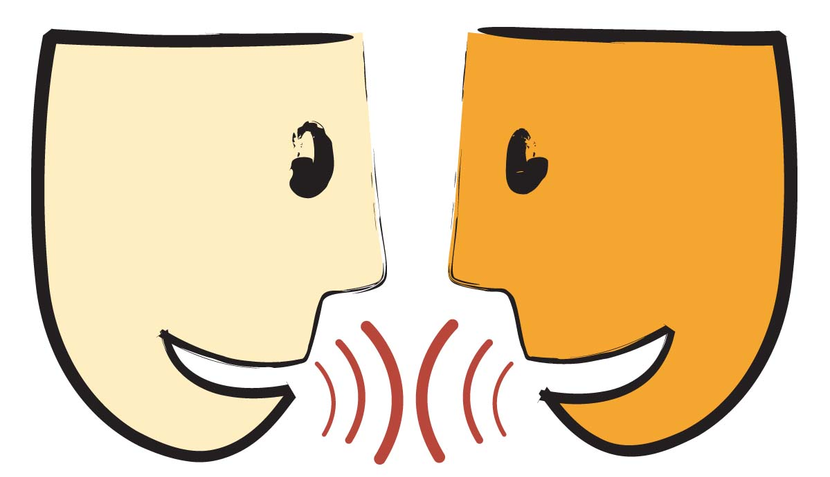
Tell your partner about a new word you learned last week.
Notes:
Access Prior Knowledge- (APK)
Turn and Talk

Slide 4
fretting
Notes:
Contextualize the word- Find it in the text
Say the word together

Slide 5
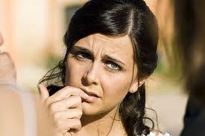
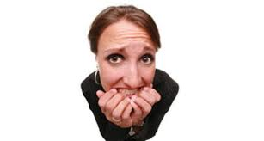
fretting
to worry a little
Notes:
Give student friendly definition
Use the word in other contexts

Slide 6
Describe something that would make you fret.
I would fret if _________ because ___________.
Notes:
Engage the students with the word

Slide 7
hurdle
Notes:
Contextualize the word- Find it in the text
Say the word together

Slide 8
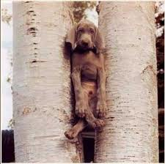
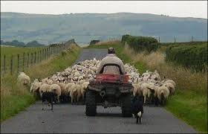
hurdle
an obstacle; something that stands in the way
Notes:
Give student friendly definition
Use the word in other contexts

Slide 9
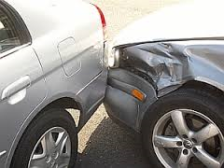
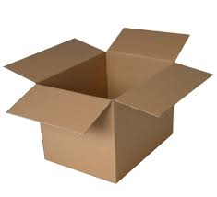

Which could be a hurdle?
Notes:
Engage the students with the word

Slide 10
clammy
Notes:
Contextualize the word- Find it in the text
Say the word together

Slide 11
Use the context clues to figure
out what the word clammy means.
Turn and talk to a friend about what
you think the word clammy means.
Notes:
Contextualize the word- Find it in the text
Say the word together

Slide 12
What helped you figure out what the word clammy means?
Notes:
Engage the students with the word

Slide 13
Who can use all 3 words/phrases in a sentence?
fret
hurdle
clammy
Notes:
Read all three words and see if you can use them in one sentence.

Slide 14
I can make real-life connections to new words.
Notes:
Goal-
Revisit the Goal

