Slide 1
Day 1

Slide 2
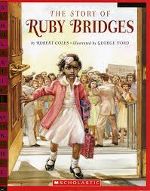
The Story of Ruby Bridges

Slide 3
I can determine the meaning of unknown words.
Notes:
Goal- Students need to engage with the goal- read it, repeat it, write it, etc.

Slide 4
credit
“…Ruby would be a good girl and she’d hold her head up high and be a credit to her own people and a credit to all the American People.”
Notes:
New Information-
Contextualize the word- Find it in the text
“She took raisins, candies, and nuts and gave him two bright eyes, a laughing mouth, and a cowboy vest with fringe.”
Say the word together

Slide 5


credit
A source of pride and honor
Synonym: pride
Notes:
Give student friendly definition
Use the word in other contexts

Slide 6
marshals
“She walked into the Frantz School surrounded by marshals.”
Notes:
Contextualize the word- Find it in the text
… “until he met some hungry cowboys riding the range. The cowboys yelled, ‘Stampede!’ They wanted gingerbread too. “
Say the word together

Slide 7

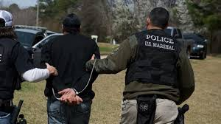
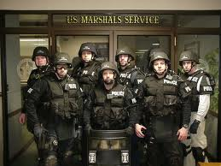
marshals
Officers who have
similar duties to police
Notes:
Give student friendly definition
Use the word in other contexts

Slide 8
irritable
“She didn’t seem nervous or anxious or irritable or scared.”
Notes:
Contextualize the word- Find it in the text
“He turned down a canyon and raced away as fast as his boots could carry him.”
Say the word together

Slide 9
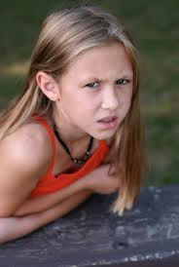
Irritable
Easily annoyed
Synonym: grouchy
Notes:
Give student friendly definition
Use the word in other contexts

Slide 10

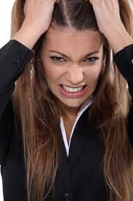
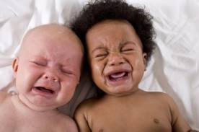
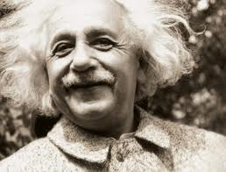
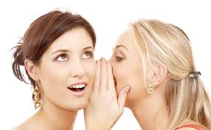
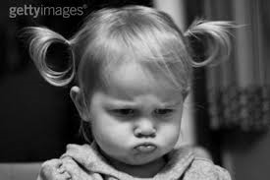
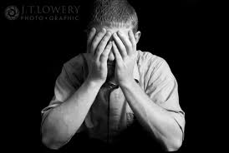
Thumbs up, Thumbs down
Notes:
Engage the students with the word
Thumbs up if this item might have fringe. Thumbs down if not likely.

Slide 11
Turn and tell your partner the words and what they mean.
credit
marshals
irritable
Notes:
Read all three words and see if you can use them in one sentence.

Slide 12


Draw a picture or write a sentence to show you know what these words mean.
credit
marshals
irritable
Notes:
Application-
Students need an opportunity to use the words they just learned from the text.

Slide 13
I can determine the meaning of unknown words.
Notes:
Goal-
Revisit the Goal

Slide 14
Day 2

Slide 15
I can determine the meaning of unknown words.
Notes:
Goal- Students need to engage with the goal- read it, repeat it, write it, etc.

Slide 16
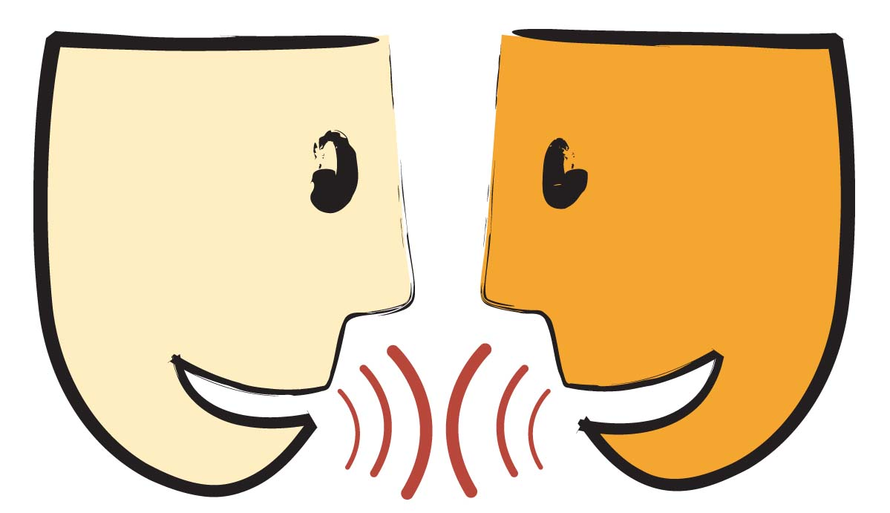
Tell your partner about a new word you learned yesterday.
Notes:
Access Prior Knowledge- (APK)
Turn and Talk
Review 3 words and definitions

Slide 17
Word Association
Which has the same duties as a police officer?
Which word is a synonym for grouchy?
Which word goes with an pride and honor?
Credit
Marshals
irritable
Notes:
Application
Word Association
Have students explain their thinking

Slide 18
I can determine the meaning of unknown words.
Notes:
Goal- Students need to engage with the goal- read it, repeat it, write it, etc.

Slide 19
Day 3

Slide 20
I can determine the meaning of unknown words.
Notes:
Goal- Students need to engage with the goal- read it, repeat it, write it, etc.

Slide 21
Scowl at your partner.
Notes:
Access Prior Knowledge- (APK)
Turn and Talk
Review 3 words and definitions

Slide 22
Describe a time when…
You were irritable
You gave someone credit for doing something
In a book, movie or real life you saw a police officer or a marshal

Slide 23
I can determine the meaning of unknown words.
Notes:
Goal- Students need to engage with the goal- read it, repeat it, write it, etc.

Slide 24
Day 4

Slide 25
I can determine the meaning of unknown words.
Notes:
Goal- Students need to engage with the goal- read it, repeat it, write it, etc.

Slide 26
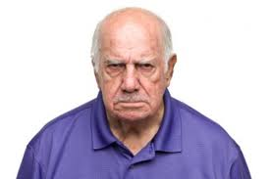
Tell your partner what all of these pictures have in common.
Notes:
Access Prior Knowledge- (APK)
Turn and Talk
Review 3 words and definitions

Slide 27
Turn and Talk
Have you ever given credit to someone when they did something?
When? Where? What were they doing?

Slide 28
I can determine the meaning of unknown words.
Notes:
Goal- Students need to engage with the goal- read it, repeat it, write it, etc.

